Slide 2
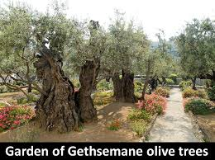
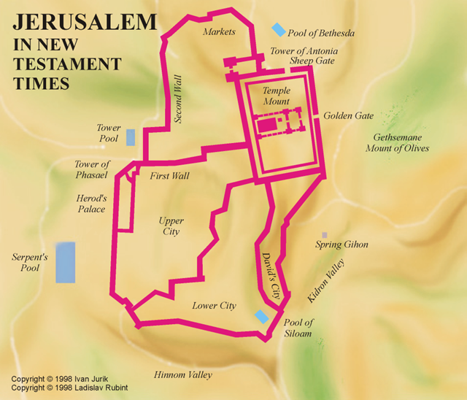
The Garden of Gethsemane
Matthew 25:35-46

Slide 3
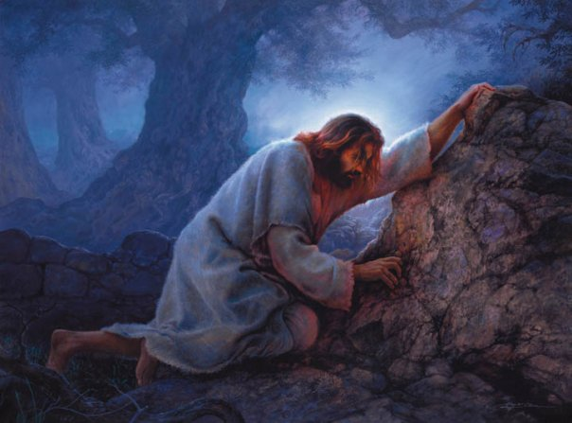
The Garden of Gethsemane
The Garden was a Place of Suffering…
Where Jesus experienced great distress…
Where Jesus endured intense sorrow…
Where Jesus encountered solemn loneliness…
Then He said to them, "My soul is deeply grieved, to the point of death; remain here and keep watch with Me.“ And He went a little beyond them, and fell on His face and prayed, saying, "My Father, if it is possible, let this cup pass from Me; yet not as I will, but as You will."

Slide 4
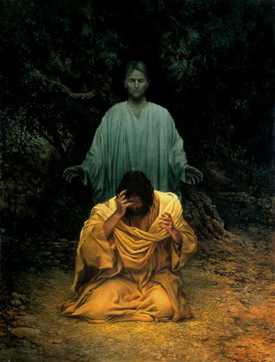
The Garden of Gethsemane
The Garden was a Place of Strength…
When Jesus expressed agonizing prayer…
When Jesus extended complete resignation…
When Jesus enjoyed special comfort…
When Jesus exhibited renewed resolve…
Then an angel appeared to Him from heaven, strengthening Him. (Luke 22:43 NKJV)

Slide 5
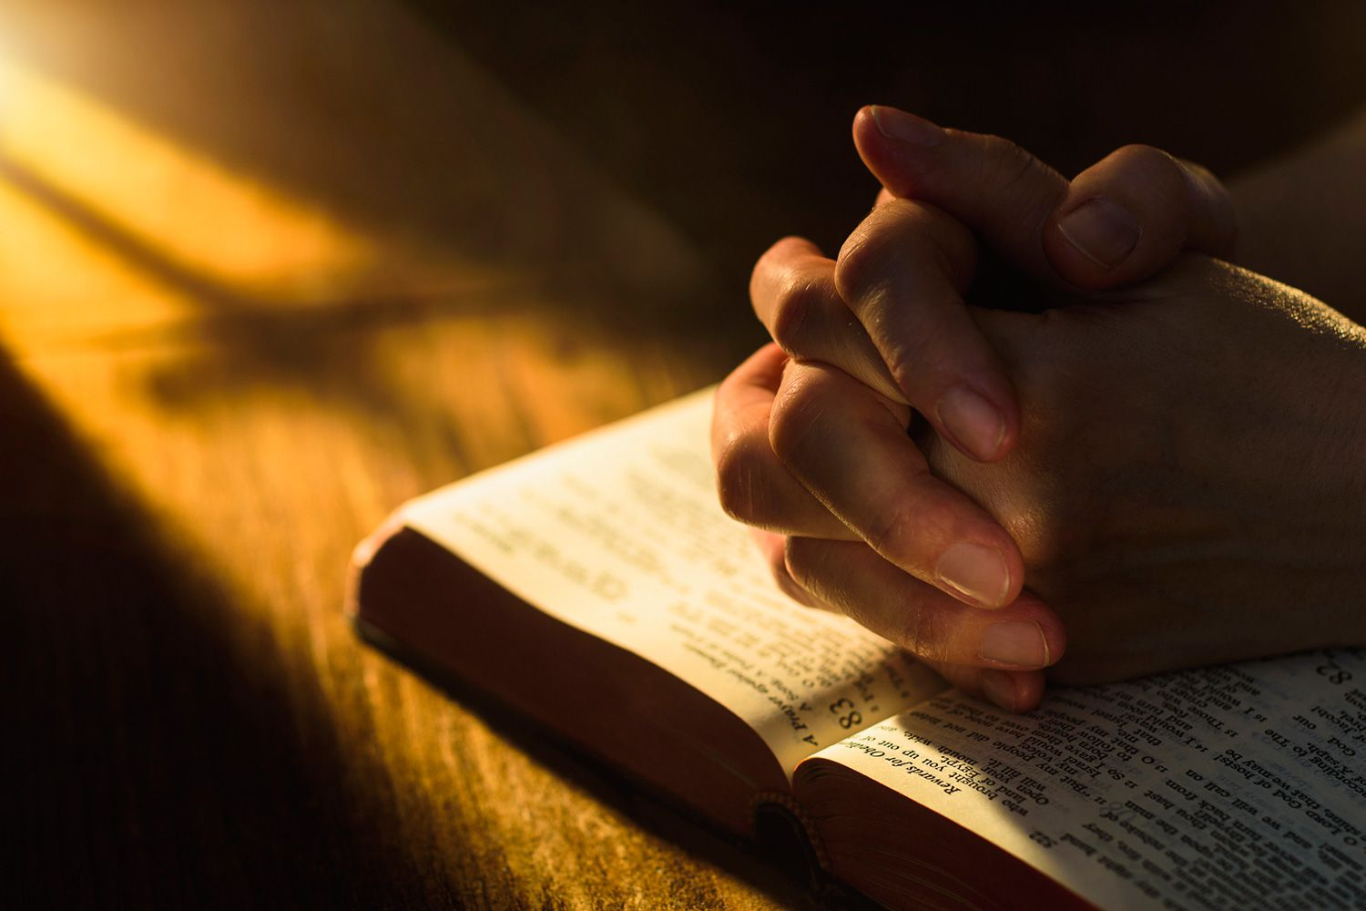
Christians Have A Similar Blessing In Prayer…
Philippians 4:6,7
Be anxious for nothing, but in everything by prayer and supplication with thanksgiving let your requests be made known to God. ⁷ And the peace of God, which surpasses all comprehension, will guard your hearts and your minds in Christ Jesus.

Slide 6
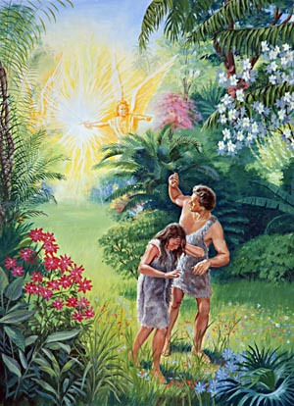
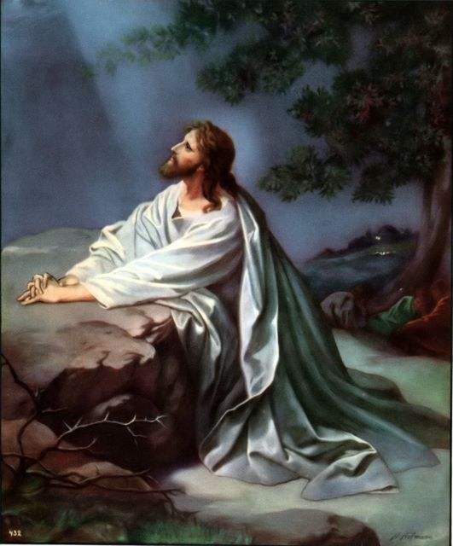
From the Garden of Eden to the Garden of Gethsemane…
Adam and Eve gave into the temptation of Satan at the garden of Eden. They chose to do their own will instead of the will of God.
The “second Adam” chose to give into the Father’s will at the Garden of Gethsemane. He chose to reject the enemy’s temptations.

Slide 7
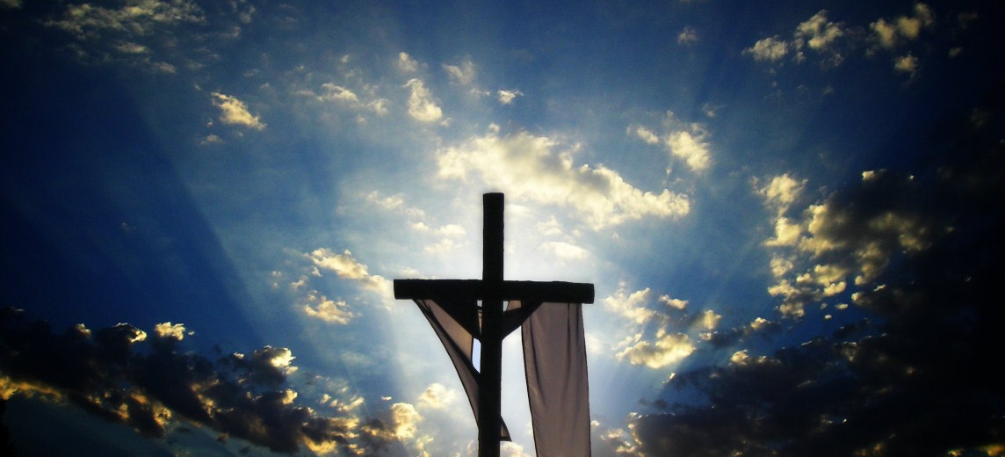
Jesus gained the full victory over evil for us. He did it through prayer and total surrender to God’s will. We have these two tools to help us overcome every temptation today.

Slide 8
Sources
Sermons from Matthew – Outline by Mark A. Copeland
Truth Commentary on Matthew – Kyle Pope
A Commentary on Mathew – Kenneth L. Chumbley

