Slide 2
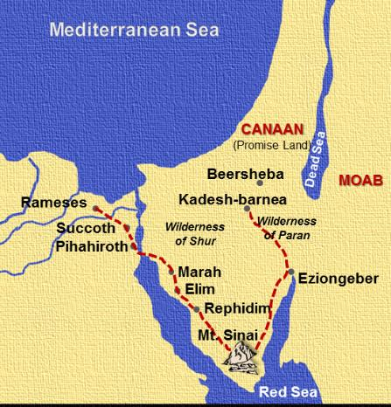
Moses sent 12 men into Canaan to spy out the land.
Numbers 13:1-3, ESV
“¹The Lord spoke to Moses, saying, ²"Send men to spy out the land of Canaan, which I am giving to the people of Israel. From each tribe of their fathers you shall send a man, every one a chief among them." ³So Moses sent them from the wilderness of Paran, according to the command of the Lord, all of them men who were heads of the people of Israel.”

Slide 3
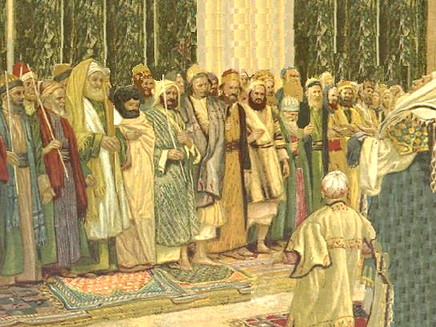
Numbers 13:17-20, ESV
“¹⁷Moses sent them to spy out the land of Canaan and said to them, "Go up into the Negeb and go up into the hill country, ¹⁸and see what the land is, and whether the people who dwell in it are strong or weak, whether they are few or many, ¹⁹and whether the land that they dwell in is good or bad, and whether the cities that they dwell in are camps or strongholds, ²⁰and whether the land is rich or poor, and whether there are trees in it or not. Be of good courage and bring some of the fruit of the land."

Slide 4
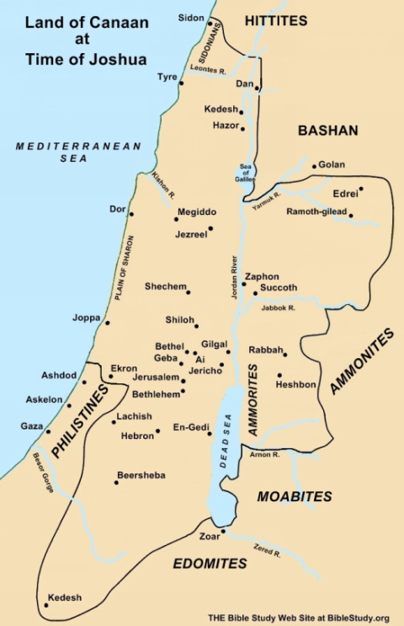
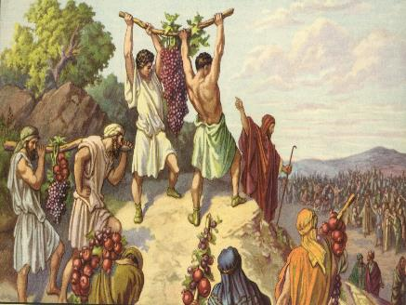
Numbers 13:23-24, ESV
“²³And they came to the Valley of Eshcol and cut down from there a branch with a single cluster of grapes, and they carried it on a pole between two of them; they also brought some pomegranates and figs. ²⁴That place was called the Valley of Eshcol, because of the cluster that the people of Israel cut down from there.

Slide 5
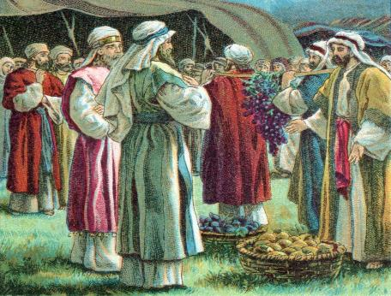
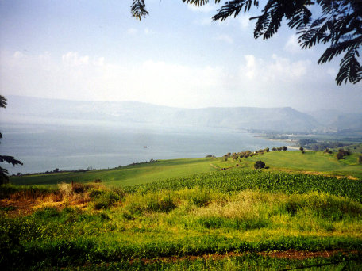
They found the land just as God had promised!
Numbers 13:27, ESV
“²⁷And they told him, "We came to the land to which you sent us. It flows with milk and honey, and this is its fruit.”

Slide 6
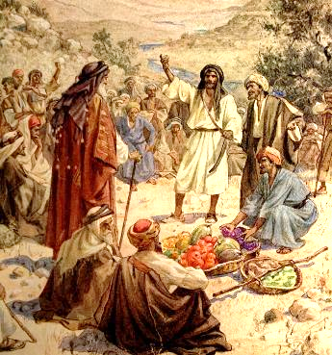
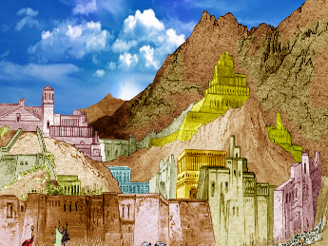
Yet, 10 of the spies went on to give an evil report!
^{“28}However, the people who dwell in the land are strong, and the cities are fortified and very large. And besides, we saw the descendants of Anak there. ²⁹ The Amalekites dwell in the land of the Negeb. The Hittites, the Jebusites, and the Amorites dwell in the hill country. And the Canaanites dwell by the sea, and along the Jordan…" (13:28-29, ESV)

Slide 7
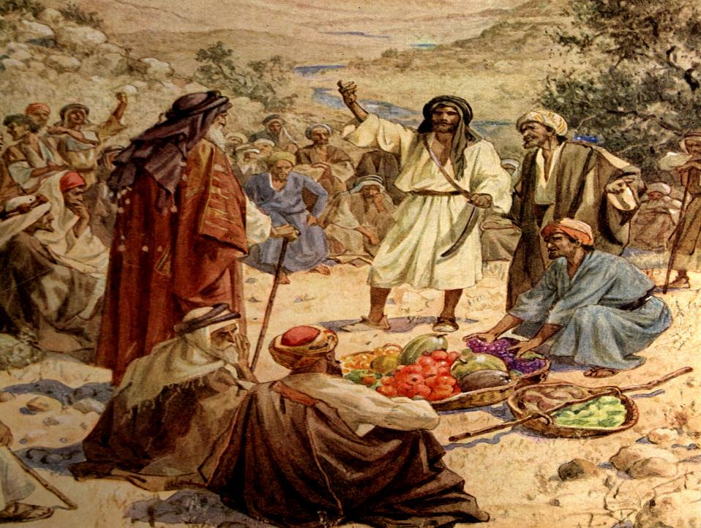
Two men – Joshua and Caleb – provided a different report. They said, “Let us go up at once and occupy it, for we are well able to overcome it.” (13:30)

Slide 8
Yet, 10 of the spies went on to give an evil report!
^{“28}However, the people who dwell in the land are strong, and the cities are fortified and very large. And besides, we saw the descendants of Anak there. ²⁹ The Amalekites dwell in the land of the Negeb. The Hittites, the Jebusites, and the Amorites dwell in the hill country. And the Canaanites dwell by the sea, and along the Jordan…"We are not able to go up against the people, for they are stronger than we are." ³² So they brought to the people of Israel a bad report of the land that they had spied out, saying, "The land, through which we have gone to spy it out, is a land that devours its inhabitants, and all the people that we saw in it are of great height…and we seemed to ourselves like grasshoppers, and so we seemed to them." “ (13:28-29, 31-33ESV)

Slide 9
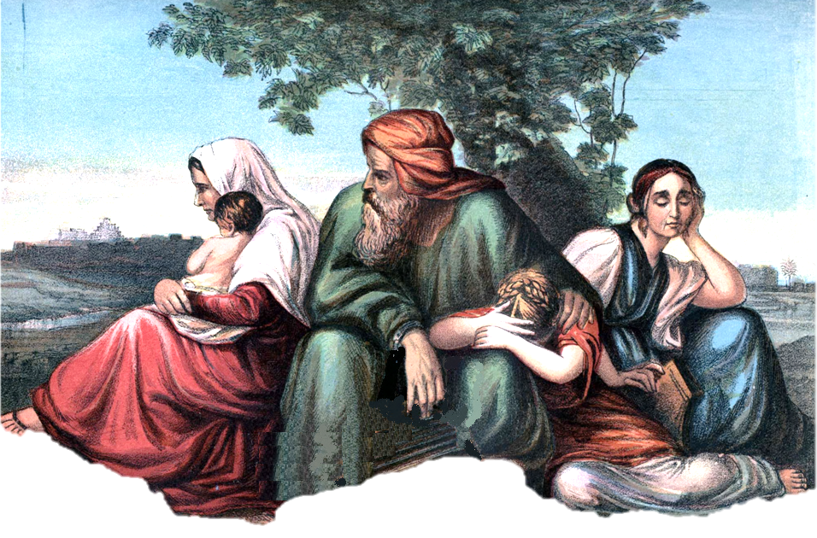
The people though listened to the 10 spies and the bad report – “Then all the congregation raised a loud cry, and the people wept that night.” (14:1, ESV)

Slide 10
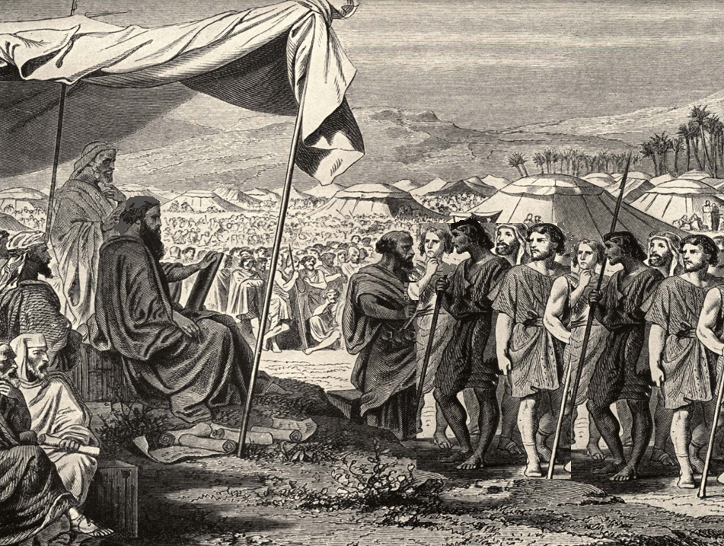
Numbers 14
²And all the people of Israel grumbled against Moses and Aaron. The whole congregation said to them, "Would that we had died in the land of Egypt! Or would that we had died in this wilderness! ³Why is the Lord bringing us into this land, to fall by the sword? Our wives and our little ones will become a prey. Would it not be better for us to go back to Egypt?

Slide 11
Joshua and Caleb continued to plead with – and warn – the people. Yet, the people not only wanted to return to Egypt, but they were ready to stone Joshua and Caleb! What stopped them?
“But the glory of the Lord appeared at the tent of meeting to all the people of Israel.” (13:10)

Slide 12
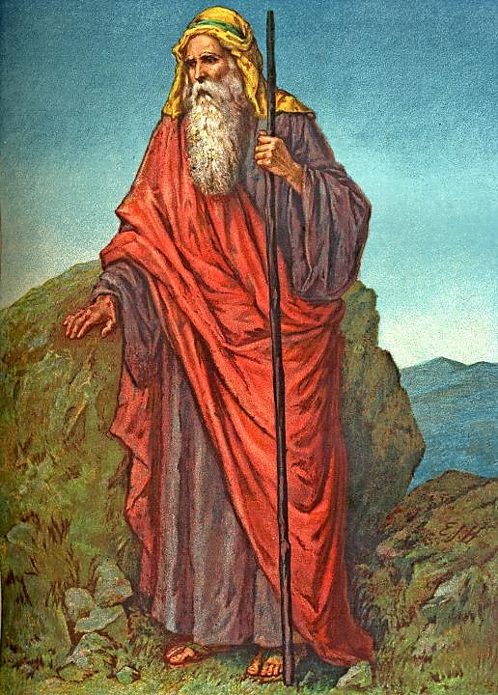
God was ready to destroy this people that would not believe in Him, despite His constant care and provision! Yet, Moses pleaded for the people.
Numbers 14
“¹⁷And now, please let the power of the Lord be great as you have promised, saying, ¹⁸'The Lord is slow to anger and abounding in steadfast love, forgiving iniquity and transgression, but he will by no means clear the guilty, visiting the iniquity of the fathers on the children, to the third and the fourth generation.' ¹⁹Please pardon the iniquity of this people, according to the greatness of your steadfast love, just as you have forgiven this people, from Egypt until now."

Slide 13
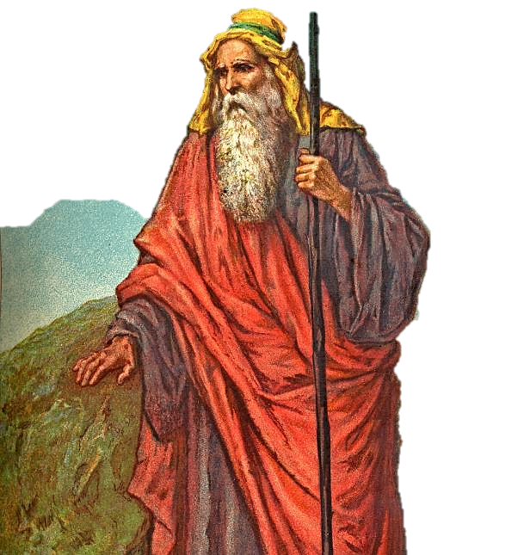
God listened and pardoned in the sense that He did not totally annihilate them. Yet, God did determine that there would have to be consequences for their rebellion and rejection of God’s promises.
“²⁸ Say to them, 'As I live, declares the Lord, what you have said in my hearing I will do to you: ²⁹your dead bodies shall fall in this wilderness, and of all your number, listed in the census from twenty years old and upward, who have grumbled against me, ³⁰not one shall come into the land where I swore that I would make you dwell, except Caleb the son of Jephunneh and Joshua the son of Nun.” (14:28-30)

Slide 14
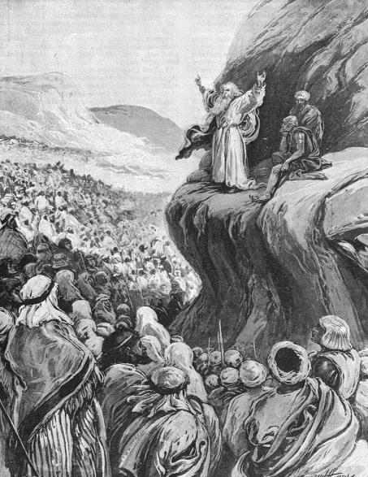
³⁹ When Moses told these words to all the people of Israel, the people mourned greatly.
⁴⁰And they rose early in the morning and went up to the heights of the hill country, saying, "Here we are. We will go up to the place that the Lord has promised, for we have sinned."

Slide 15
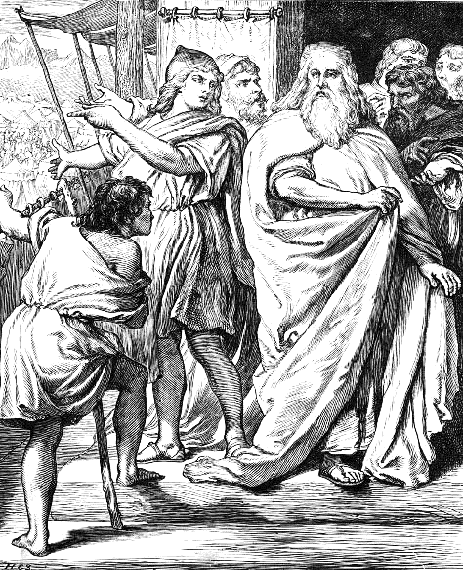
⁴¹ But Moses said, "Why now are you transgressing the command of the Lord, when that will not succeed? ⁴² Do not go up, for the Lord is not among you, lest you be struck down before your enemies. ⁴³ For there the Amalekites and the Canaanites are facing you, and you shall fall by the sword. Because you have turned back from following the Lord, the Lord will not be with you."

Slide 16
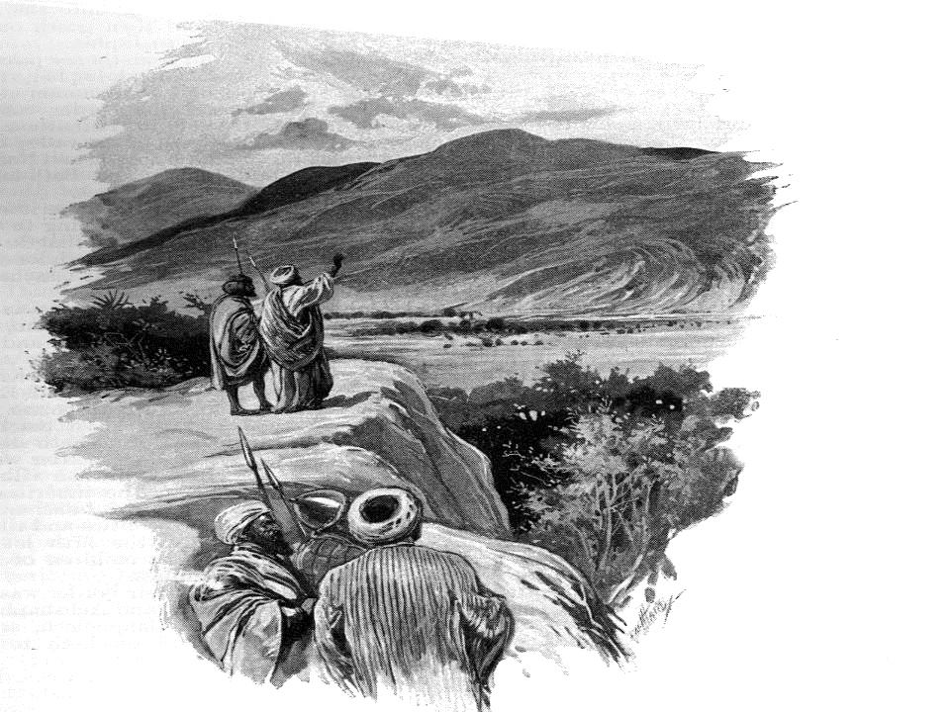
Many of them went despite Moses’ warning. Moses and all those behind watched as they marched to their death.

Slide 17
A Difference in Attitude
Joshua
& Caleb
10 Spies
Doubt
vs.
Faith
Self-Depreciation
vs.
Confidence
Fear
vs.
Courage
Ingratitude
vs.
Thankfulness
Criticism, Unbelief
& Rebellion
vs.
Action

Slide 18
Other Lessons from the Spies
Our actions do have an impact on others!
None of us live in a vacuum.
Everything we do and say can either have a negative or positive impact on those around us.
Be a Moses – think less of self and more of others.
Moses was a very meek man.
This included thinking of the Israelites more than thinking of himself.
God rewards the faithful, even if they are few!
Matthew 7:13-14

