Slide 2
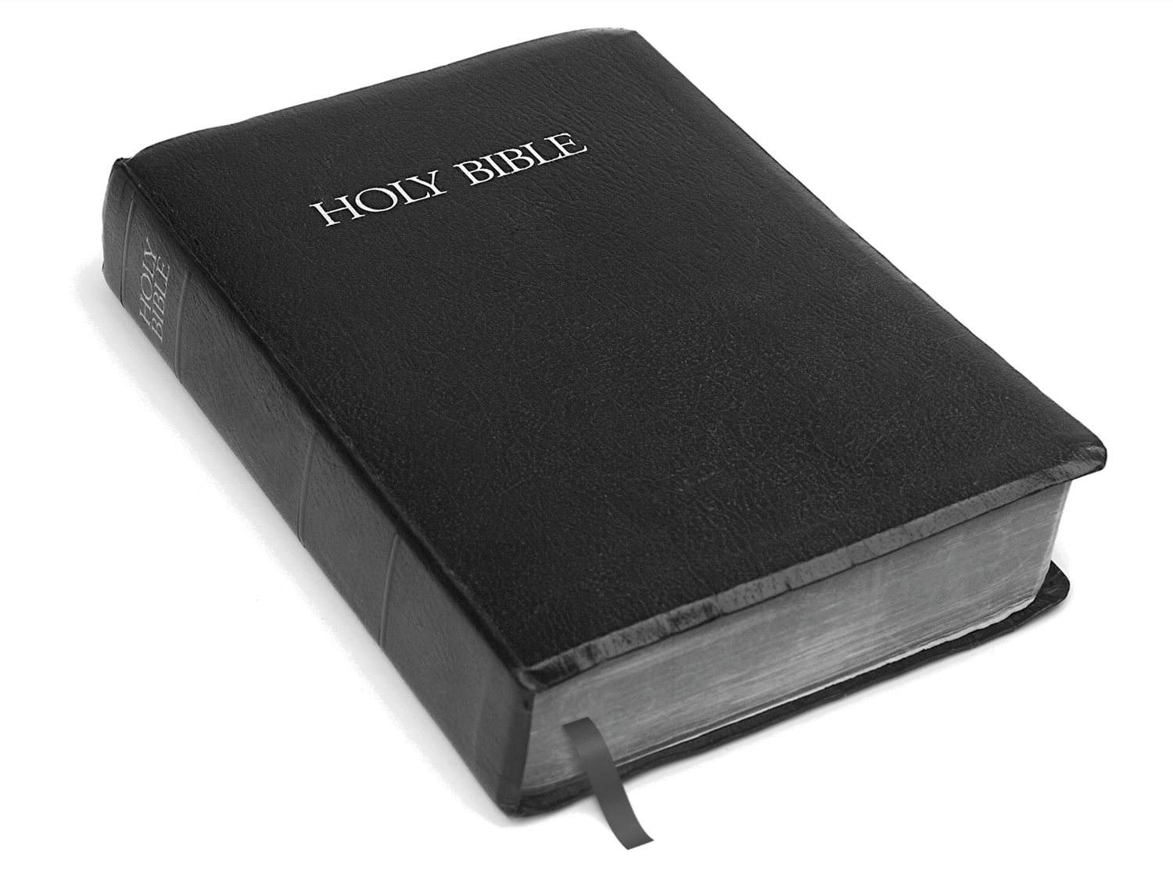
The Word of God
¹¹Let us therefore strive to enter that rest, so that no one may fall by the same sort of disobedience. ¹² For the word of God is living and active, sharper than any two-edged sword, piercing to the division of soul and of spirit, of joints and of marrow, and discerning the thoughts and intentions of the heart. ¹³ And no creature is hidden from his sight, but all are naked and exposed to the eyes of him to whom we must give account.
Hebrews 4:11-13, ESV
Church of Christ at Medina
May 27th, 2018
Notes:
While some deny that obedience is essential to salvation, the Scriptures are clear that obedience is essential. This critical truth must not be compromised to spare the feelings of those who are in doctrinal error!

Slide 3
Exposition of the Passage
^{“11}Let us therefore strive to enter that rest, so that no one may fall by the same sort of disobedience.”
Let’s remember the main emphasis of the book of Hebrews…

Slide 4
Exposition of the Passage
“³²But recall the former days when, after you were enlightened, you endured a hard struggle with sufferings, ³³sometimes being publicly exposed to reproach and affliction, and sometimes being partners with those so treated. ³⁴ For you had compassion on those in prison, and you joyfully accepted the plundering of your property, since you knew that you yourselves had a better possession and an abiding one. ³⁵Therefore do not throw away your confidence, which has a great reward. ³⁶For you have need of endurance, so that when you have done the will of God you may receive what is promised. ³⁷For, "Yet a little while, and the coming one will come and will not delay; ³⁸but my righteous one shall live by faith, and if he shrinks back, my soul has no pleasure in him." ³⁹ But we are not of those who shrink back and are destroyed, but of those who have faith and preserve their souls.”

Slide 5
Context of the Passage
^{“11}Let us therefore strive to enter that rest, so that no one may fall by the same sort of disobedience.”
Let’s remember the main emphasis of the book of Hebrews…to encourage the Christians to maintain their commitment to Christ and not turn back!
He used the Israelites as an example of those who failed to receive God’s promised rest because they did not remain faithful.

Slide 6
Context of the Passage
⁷Therefore, as the Holy Spirit says, "Today, if you hear his voice, ⁸do not harden your hearts as in the rebellion, on the day of testing in the wilderness, ⁹where your fathers put me to the test and saw my works ¹⁰for forty years. Therefore I was provoked with that generation, and said, 'They always go astray in their heart; they have not known my ways.' ¹¹ As I swore in my wrath, 'They shall not enter my rest.' " ¹²Take care, brothers, lest there be in any of you an evil, unbelieving heart, leading you to fall away from the living God. ¹³But exhort one another every day, as long as it is called "today," that none of you may be hardened by the deceitfulness of sin.

Slide 7
Context of the Passage
¹⁴For we share in Christ, if indeed we hold our original confidence firm to the end. ¹⁵As it is said, "Today, if you hear his voice, do not harden your hearts as in the rebellion." ¹⁶For who were those who heard and yet rebelled? Was it not all those who left Egypt led by Moses? ¹⁷And with whom was he provoked for forty years? Was it not with those who sinned, whose bodies fell in the wilderness? ¹⁸And to whom did he swear that they would not enter his rest, but to those who were disobedient? ¹⁹So we see that they were unable to enter because of unbelief.
- Hebrews 3:7-19

Slide 8
Context of the Passage
¹ Therefore, while the promise of entering his rest still stands, let us fear lest any of you should seem to have failed to reach it. ² For good news came to us just as to them, but the message they heard did not benefit them, because they were not united by faith with those who listened.
- Hebrews 4:1-2

Slide 9
Main Passage
¹²For the word of God is living and active, sharper than any two-edged sword, piercing to the division of soul and of spirit, of joints and of marrow, and discerning the thoughts and intentions of the heart.”
- Hebrews 4:1-2
What is the Word of God in this passage?
Hebrews 1:1-2
Hebrews 2:1-4
Hebrews 4:1-2

Slide 10
Main Passage
¹²For the word of God is living and active, sharper than any two-edged sword, piercing to the division of soul and of spirit, of joints and of marrow, and discerning the thoughts and intentions of the heart.”
- Hebrews 4:1-2
What are the characteristics of the Word of God?
Living
It is living because it comes from a living God. (3:12, 10:31)
It is living and is capable of…
…salvation. (Romans 1:16-17)
…condemnation. (John 12:48)

Slide 11
Main Passage
¹²For the word of God is living and active, sharper than any two-edged sword, piercing to the division of soul and of spirit, of joints and of marrow, and discerning the thoughts and intentions of the heart.”
- Hebrews 4:1-2
What are the characteristics of the Word of God?
Living
His living word means that it remains appropriate and applicable to all men. (1 Peter 1:22-23)
His invitation is still open!

Slide 12
Main Passage
¹²For the word of God is living and active, sharper than any two-edged sword, piercing to the division of soul and of spirit, of joints and of marrow, and discerning the thoughts and intentions of the heart.”
- Hebrews 4:1-2
What are the characteristics of the Word of God?
Active
The word emphasizes the effectiveness of God’s word. It accomplishes all that God intends for it to do!
Isaiah 55:8-11

Slide 13
Main Passage
¹²For the word of God is living and active, sharper than any two-edged sword, piercing to the division of soul and of spirit, of joints and of marrow, and discerning the thoughts and intentions of the heart.”
- Hebrews 4:1-2
What are the characteristics of the Word of God?
Dual-edged sword
It cuts with both sides. It is capable of not only salvation, but of defense and destruction. It does so with great precision.
It makes a distinction or division in the hearts of man.
“¹³And no creature is hidden from his sight, but all are naked and exposed to the eyes of him to whom we must give account.”

Slide 14
Application and Conclusion
The message is no different for us than for the Hebrew Christians – stay faithful to God because His Word is living and active. His Word will accomplish all the promises that He gave including His rest.
God’s Word…
…is the good news of Jesus! (1 Corinthians 15:1-4)
…has the power to save! (Romans 1:16)
…is to be shared with others! (Mark 16:16)
…must be treated as complete, accurate and holy. (Galatians 1:6-7)

