Slide 2
Let God’s Word Dwell Richly In You…
Let the word of Christ dwell in you richly, teach and admonish one another in all wisdom, and sing psalms and hymns and spiritual songs with thankfulness in your hearts to God. And whatever you do, in word or deed, do everything in the name of the Lord Jesus, giving thanks to God the Father through him. (Colossians 3:16-17 RSV)
Singing is a command but comes with a promise!
Our singing is more than a warm-up for the sermon or a filler in the service.
Singing stands alongside of preaching as one of two great ways that God has ordained.
Good songs serve as a 3-minute, easily memorizable, deeply biblical summary of important truths from scripture that you can take with you all week!

Slide 3
Without A Song by Edward Eliscu / Billy Rose / Vincent Youmans
Without a song the day would never end
Without a song the road would never bend
When things go wrong a man ain’t got a friend
Without a song
That field of corn would never see a plow
That field of corn would be deserted now
A man is born but he’s no good no how
Without a song
I got my trouble and woe but, sure as I know, the Jordon will roll
And I’ll get along as long as a song, strong in my soul
I’ll never know what makes the rain to fall
I’ll never know what makes the grass so tall
I only know there ain’t no love at all
Without a song!

Slide 4
112 - Teach Me Thy Way - Title

Slide 5
Teach Me Thy Way…
Submission To God At All Times
But he gives more grace; therefore it says, "God opposes the proud, but gives grace to the humble." Submit yourselves therefore to God. Resist the devil and he will flee from you. Draw near to God and he will draw near to you. Cleanse your hands, you sinners, and purify your hearts, you men of double mind. (James 4:6-8 RSV)

Slide 6
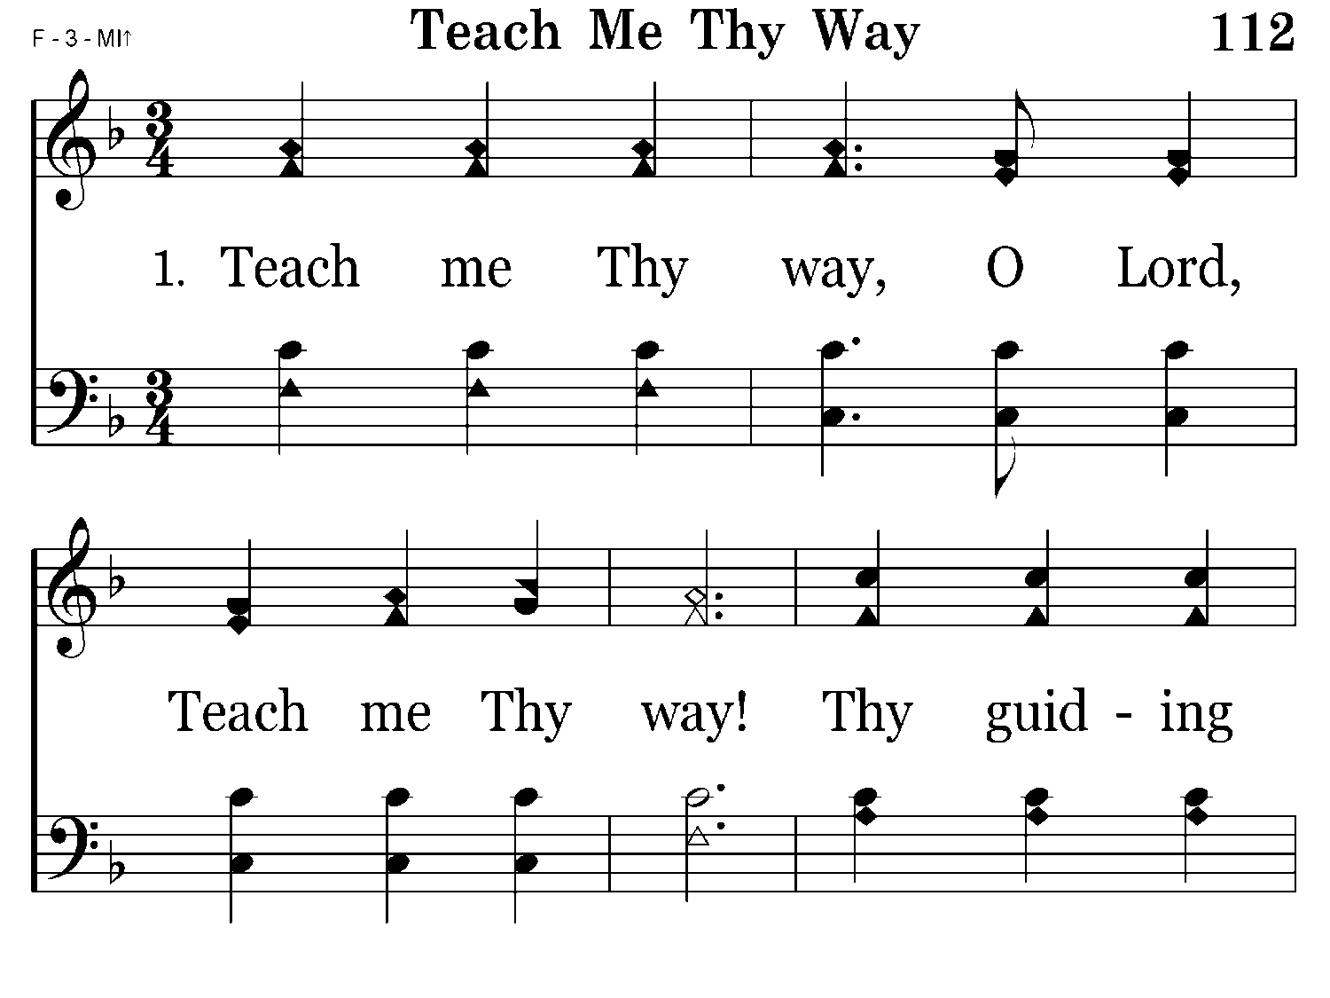
112 - Teach Me Thy Way - 1.1

Slide 7
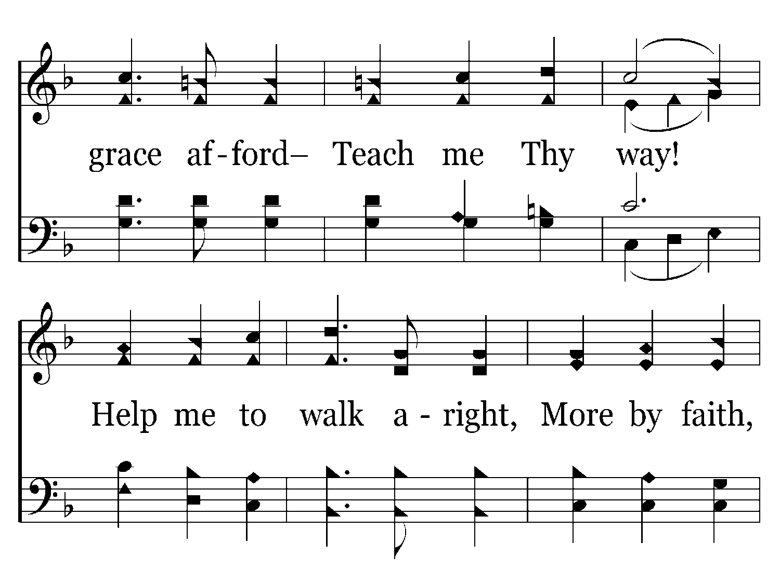
112 - Teach Me Thy Way - 1.2

Slide 8
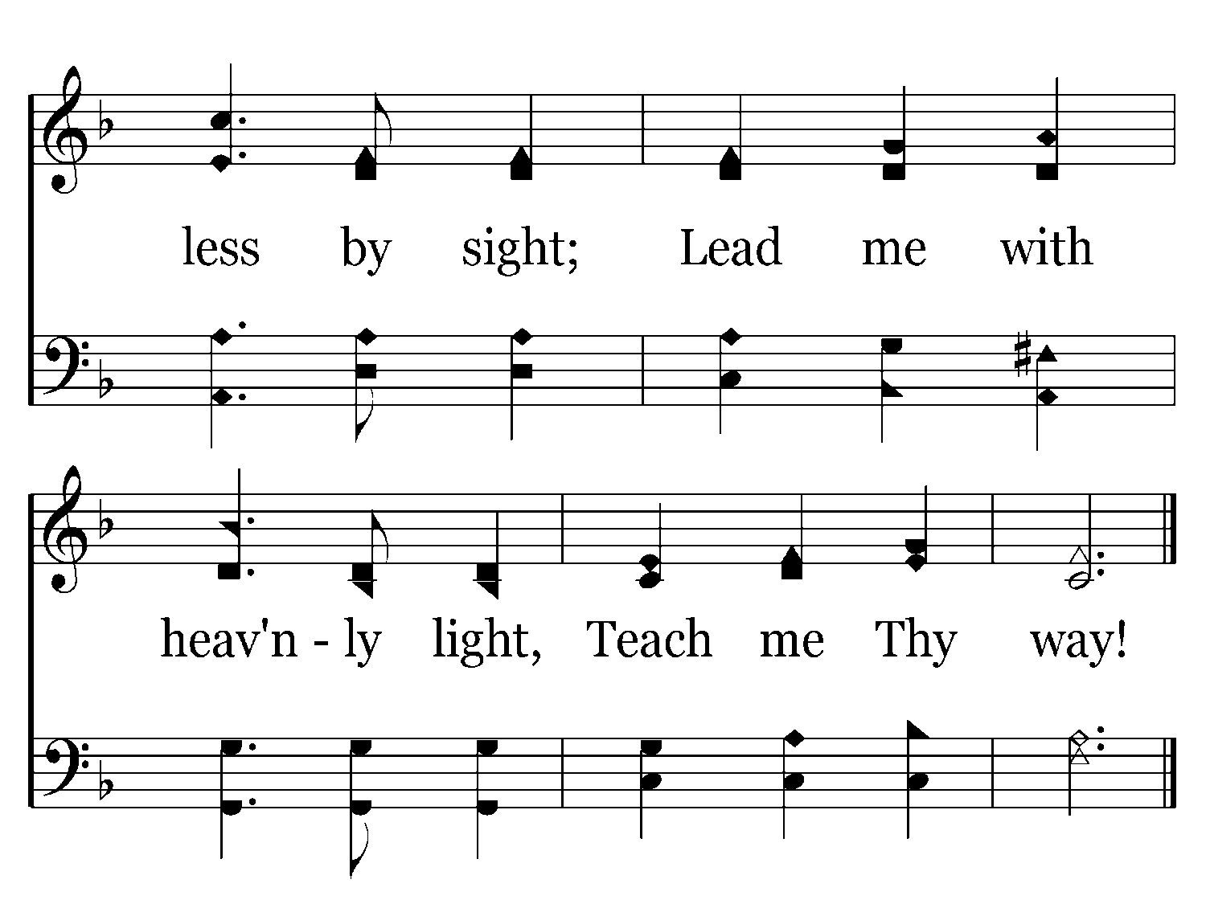
112 - Teach Me Thy Way - 1.3
End of Verse 1

Slide 9
Teach My Thy Way, O Lord!
A Psalm of David. To thee, O LORD, I lift up my soul. O my God, in thee I trust, let me not be put to shame; let not my enemies exult over me. Yea, let none that wait for thee be put to shame; let them be ashamed who are wantonly treacherous. Make me to know thy ways, O LORD; teach me thy paths. Lead me in thy truth, and teach me, for thou art the God of my salvation; for thee I wait all the day long. (Psalms 25:1-5 RSV)

Slide 10
Teach Me Thy Way…
Help Me To Walk More by Faith:
Set your minds on things that are above, not on things that are on earth. (Colossians 3:2 RSV)
For while we are still in this tent, we sigh with anxiety; not that we would be unclothed, but that we would be further clothed, so that what is mortal may be swallowed up by life. He who has prepared us for this very thing is God, who has given us the Spirit as a guarantee. So we are always of good courage; we know that while we are at home in the body we are away from the Lord, for we walk by faith, not by sight. (2 Corinthians 5:4-7 RSV)
for we walk by faith, not by sight. (2 Corinthians 5:7 RSV)

Slide 11
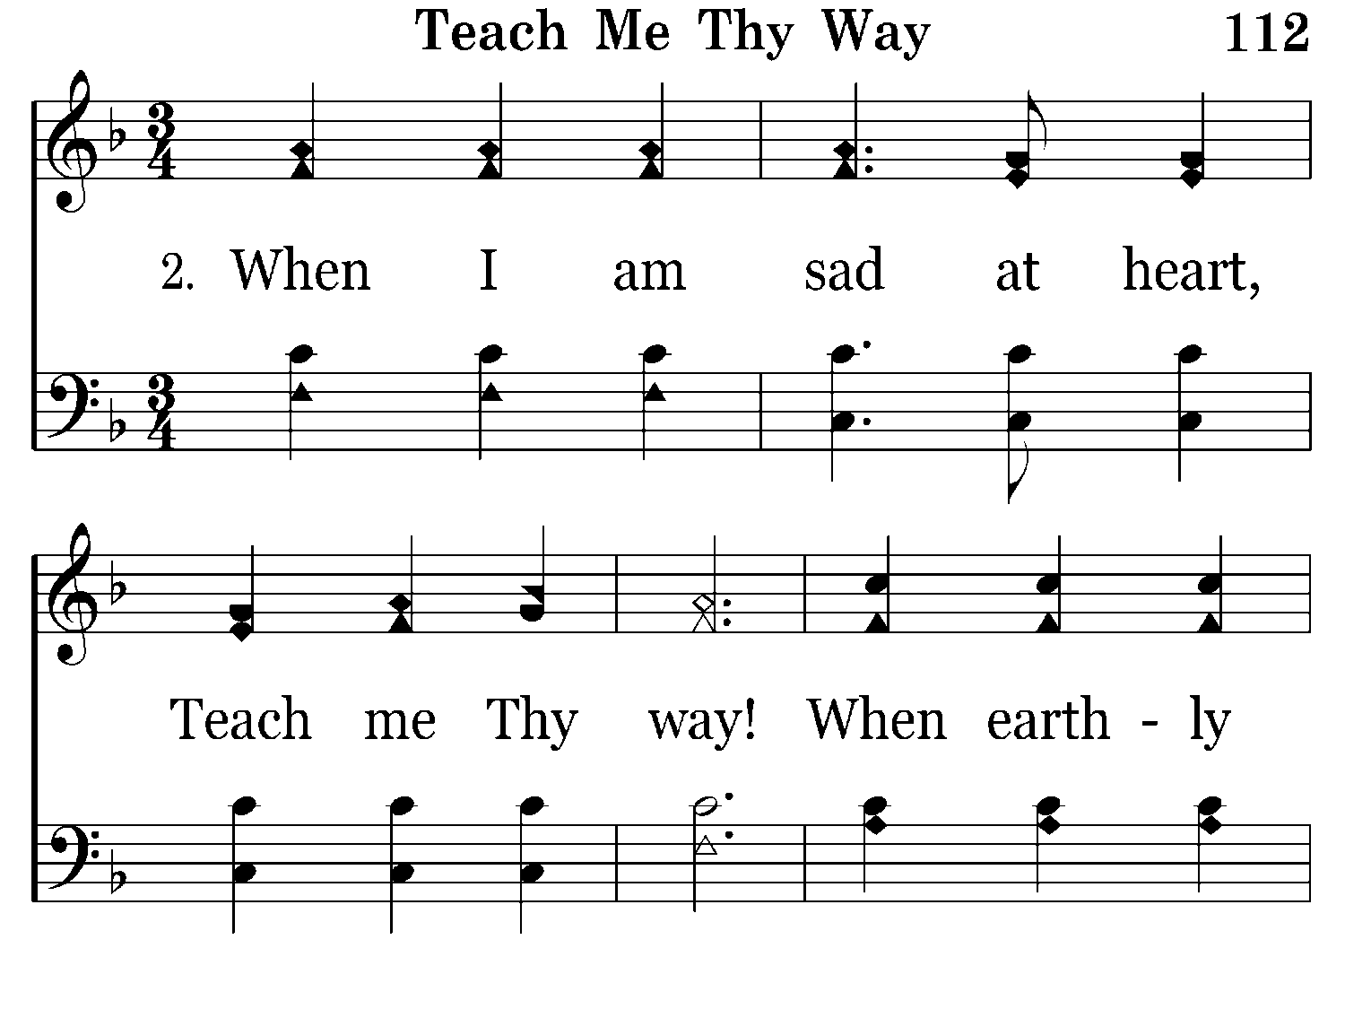
112 - Teach Me Thy Way - 2.1

Slide 12
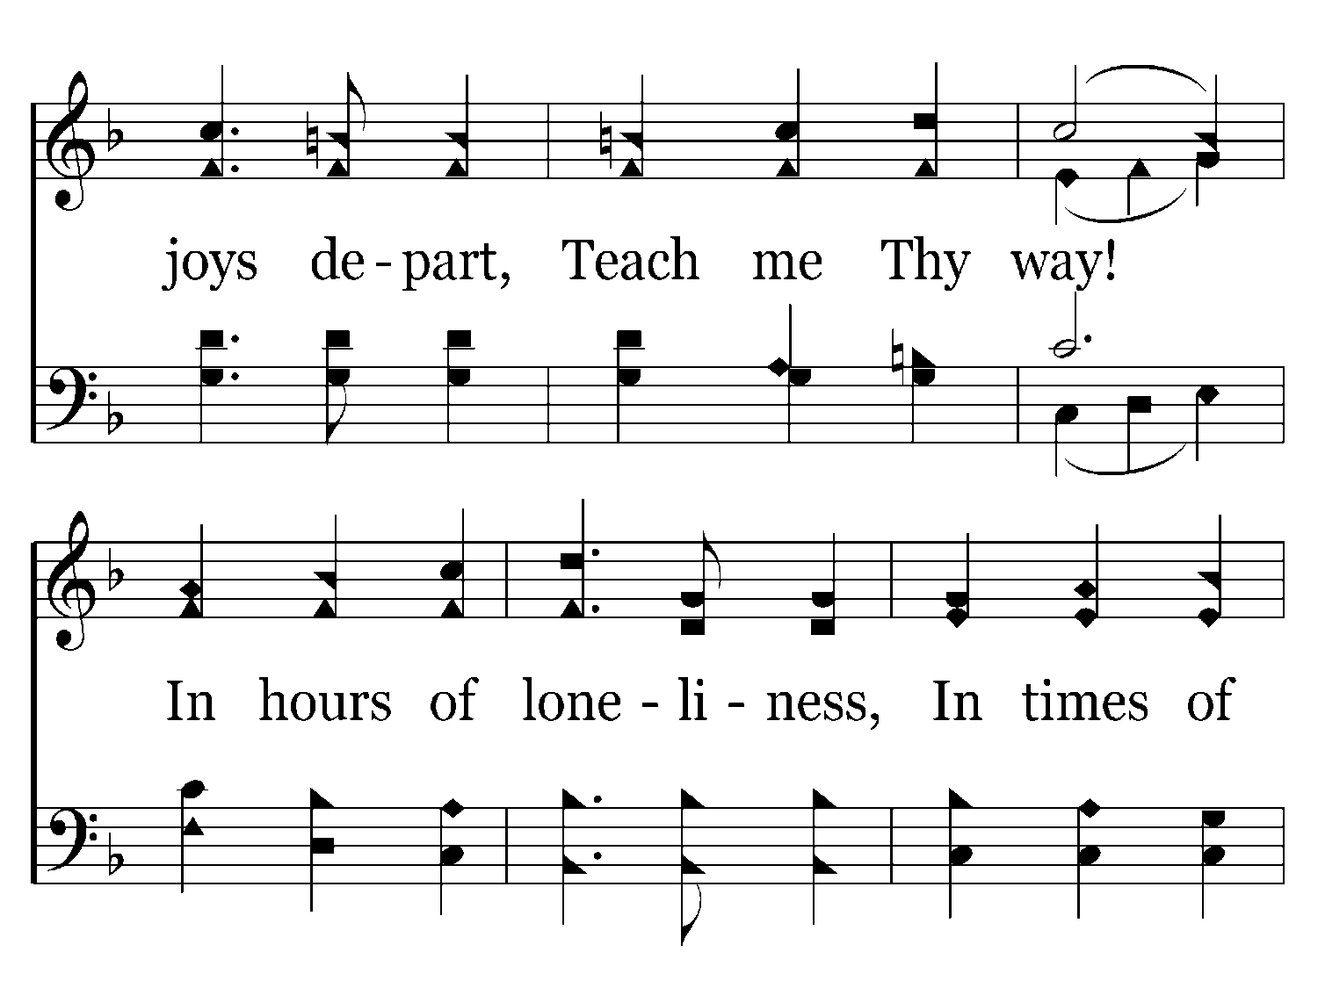
112 - Teach Me Thy Way - 2.2

Slide 13
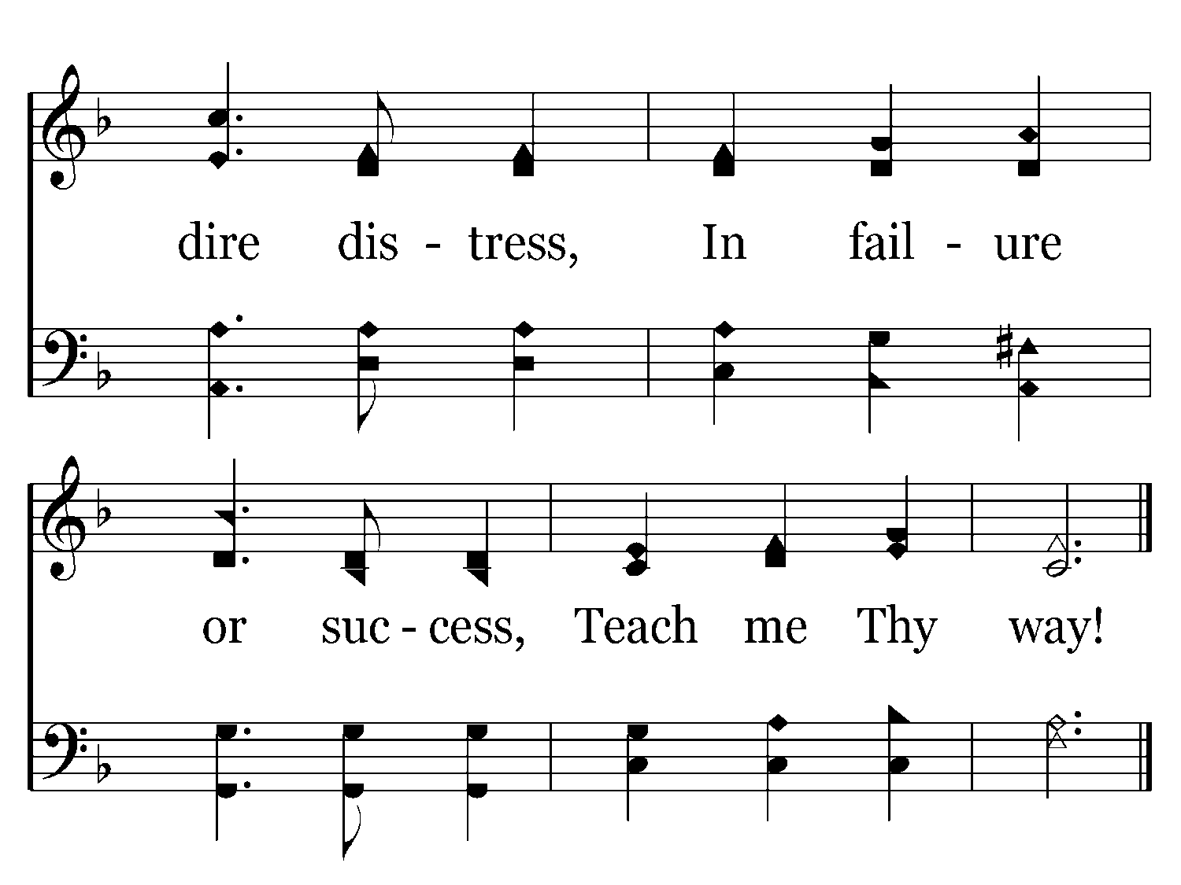
112 - Teach Me Thy Way - 2.3
End of Verse 2

Slide 14
Teach Me Thy Way…
Hear, O LORD, when I cry aloud, be gracious to me and answer me! Thou hast said, "Seek ye my face." My heart says to thee, "Thy face, LORD, do I seek." Hide not thy face from me. Turn not thy servant away in anger, thou who hast been my help. Cast me not off, forsake me not, O God of my salvation! For my father and my mother have forsaken me, but the LORD will take me up. Teach me thy way, O LORD; and lead me on a level path because of my enemies. (Psalms 27:7-11 RSV)

Slide 15
Teach Me Thy Way…
Oh, how I love thy law! It is my meditation all the day. Thy commandment makes me wiser than my enemies, for it is ever with me. I have more understanding than all my teachers, for thy testimonies are my meditation. I understand more than the aged, for I keep thy precepts. I hold back my feet from every evil way, in order to keep thy word. I do not turn aside from thy ordinances, for thou hast taught me. How sweet are thy words to my taste, sweeter than honey to my mouth! Through thy precepts I get understanding; therefore I hate every false way. (Psalms 119:97-104 RSV)

Slide 16
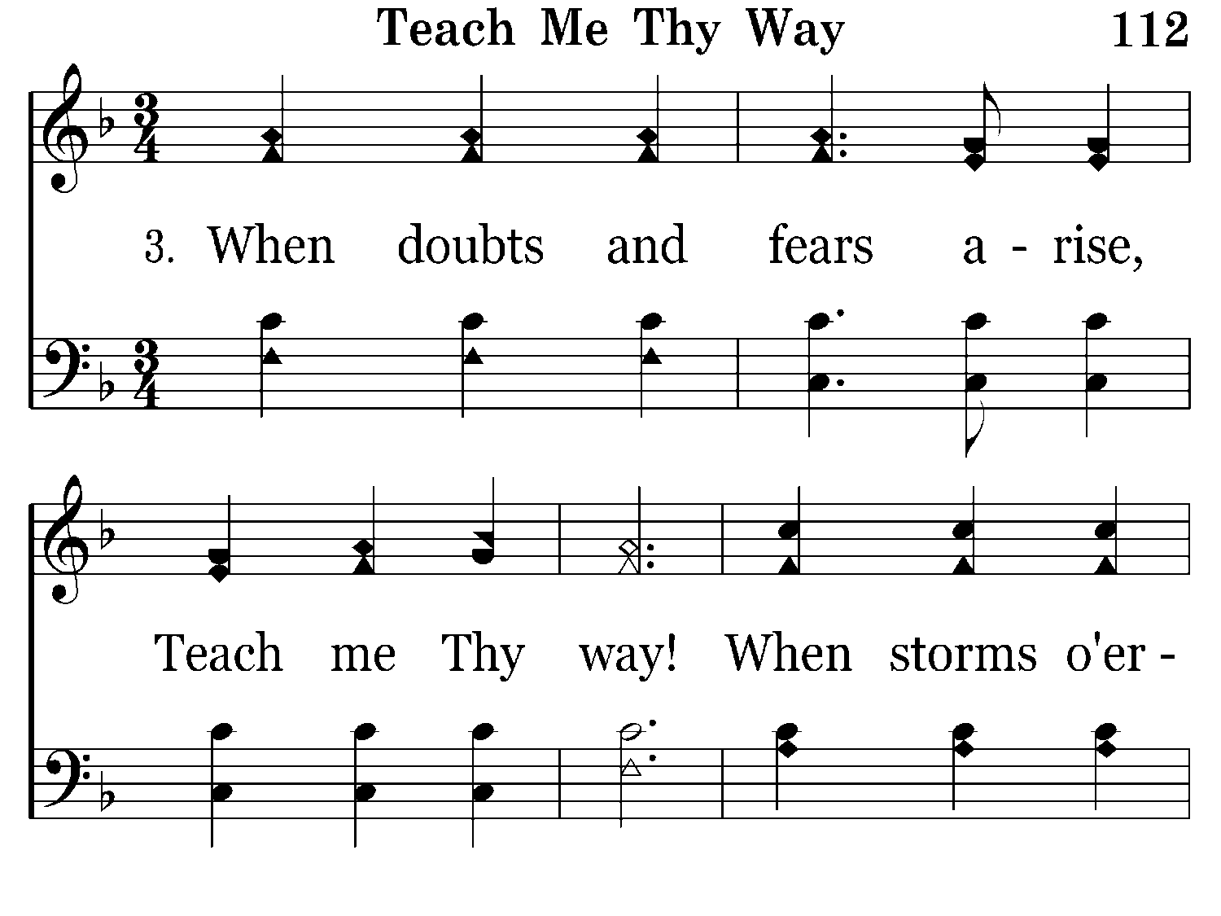
112 - Teach Me Thy Way - 3.1

Slide 17
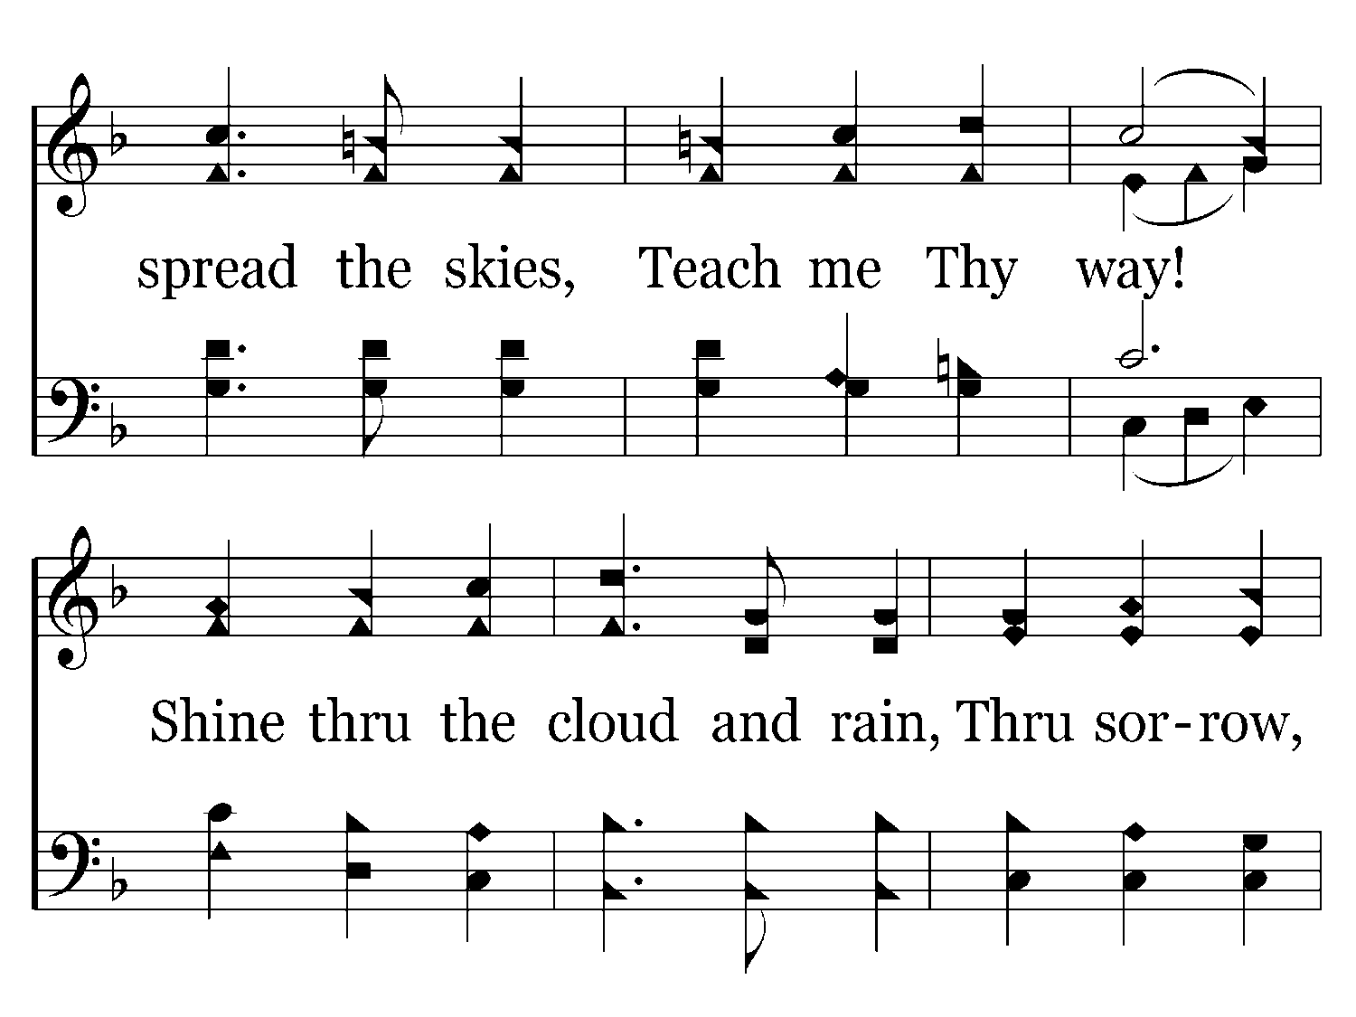
112 - Teach Me Thy Way - 3.2

Slide 18
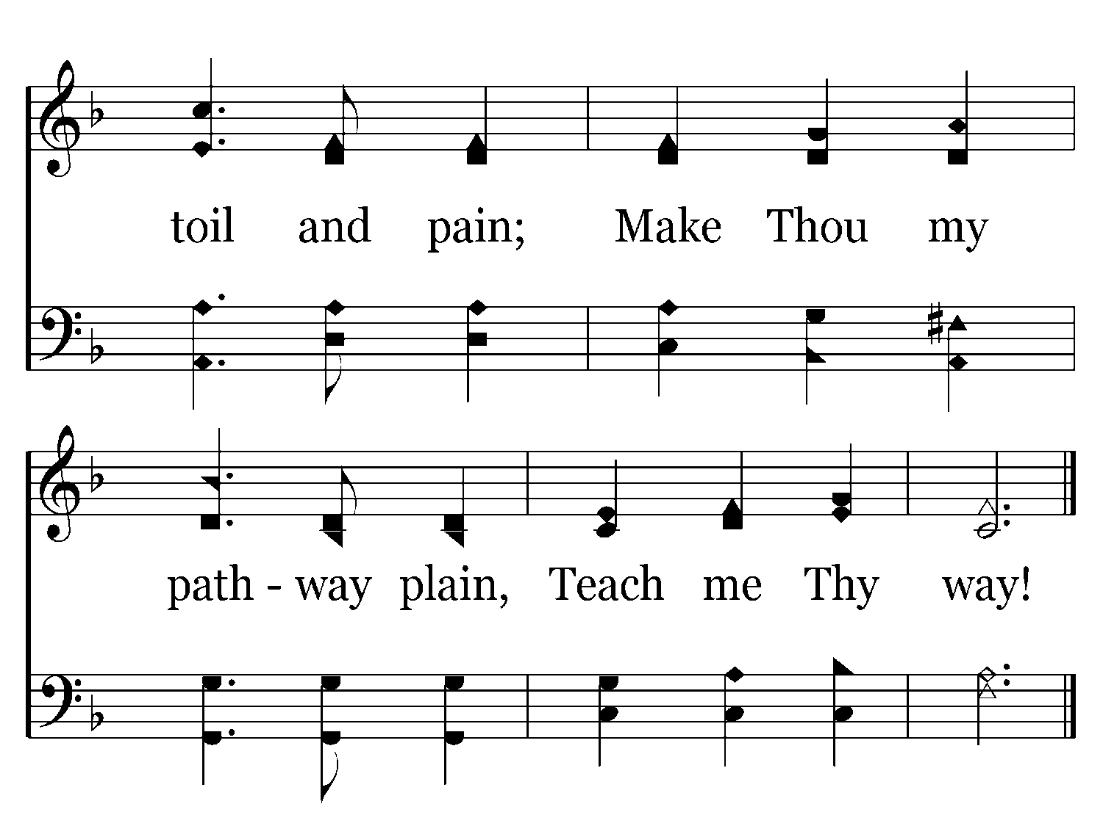
112 - Teach Me Thy Way - 3.3
End of Verse 3

Slide 19
When Doubts And Fears Arise…
He said, "Come." So Peter got out of the boat and walked on the water and came to Jesus; but when he saw the wind, he was afraid, and beginning to sink he cried out, "Lord, save me." Jesus immediately reached out his hand and caught him, saying to him, "O man of little faith, why did you doubt?" And when they got into the boat, the wind ceased. (Matthew 14:29-32 RSV)

Slide 20
When Doubts And Fears Arise…
And seeing a fig tree by the wayside he went to it, and found nothing on it but leaves only. And he said to it, "May no fruit ever come from you again!" And the fig tree withered at once. When the disciples saw it they marveled, saying, "How did the fig tree wither at once?" And Jesus answered them, "Truly, I say to you, if you have faith and never doubt, you will not only do what has been done to the fig tree, but even if you say to this mountain, 'Be taken up and cast into the sea,' it will be done. And whatever you ask in prayer, you will receive, if you have faith." (Matthew 21:19-22 RSV)

Slide 21
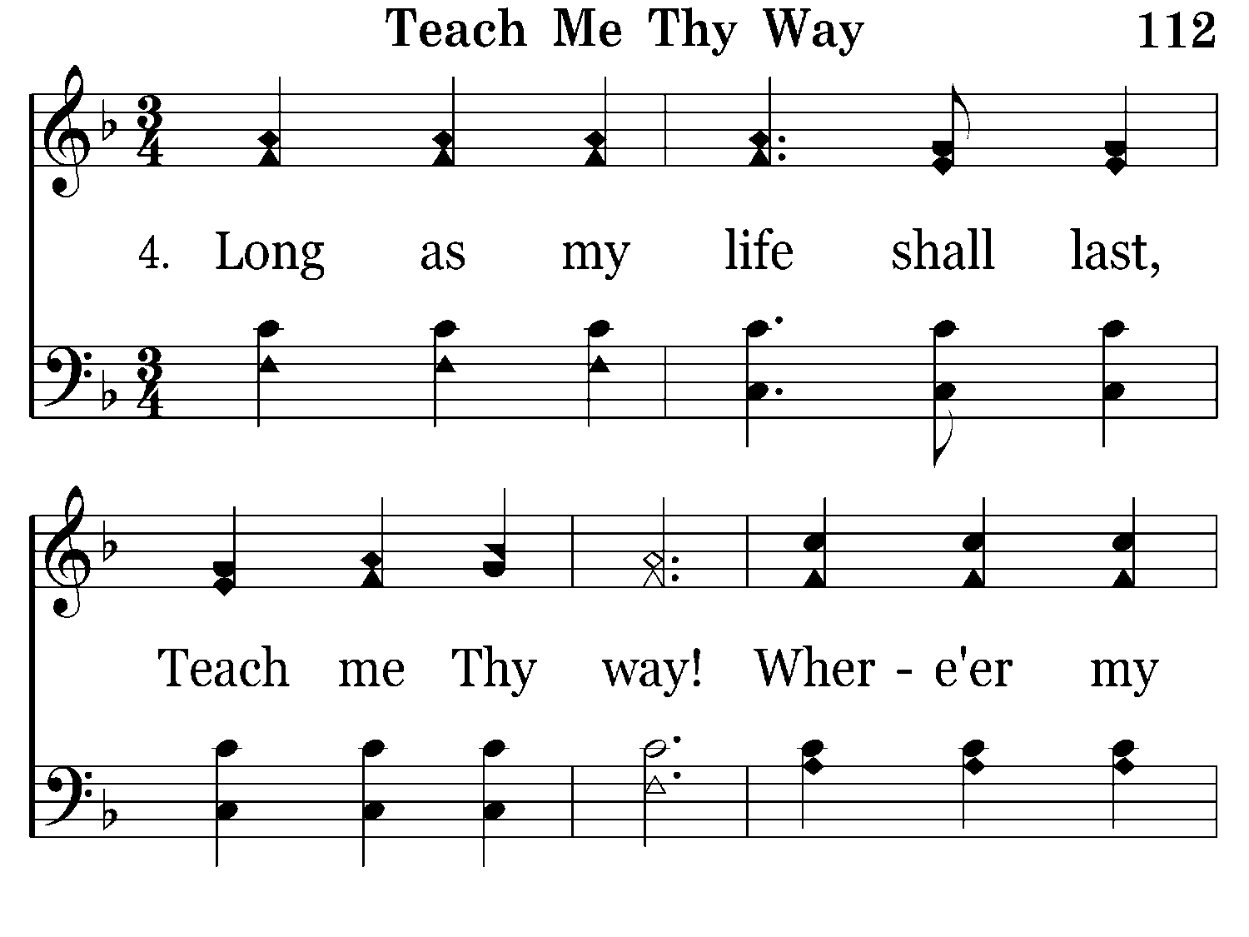
112 - Teach Me Thy Way - 4.1

Slide 22
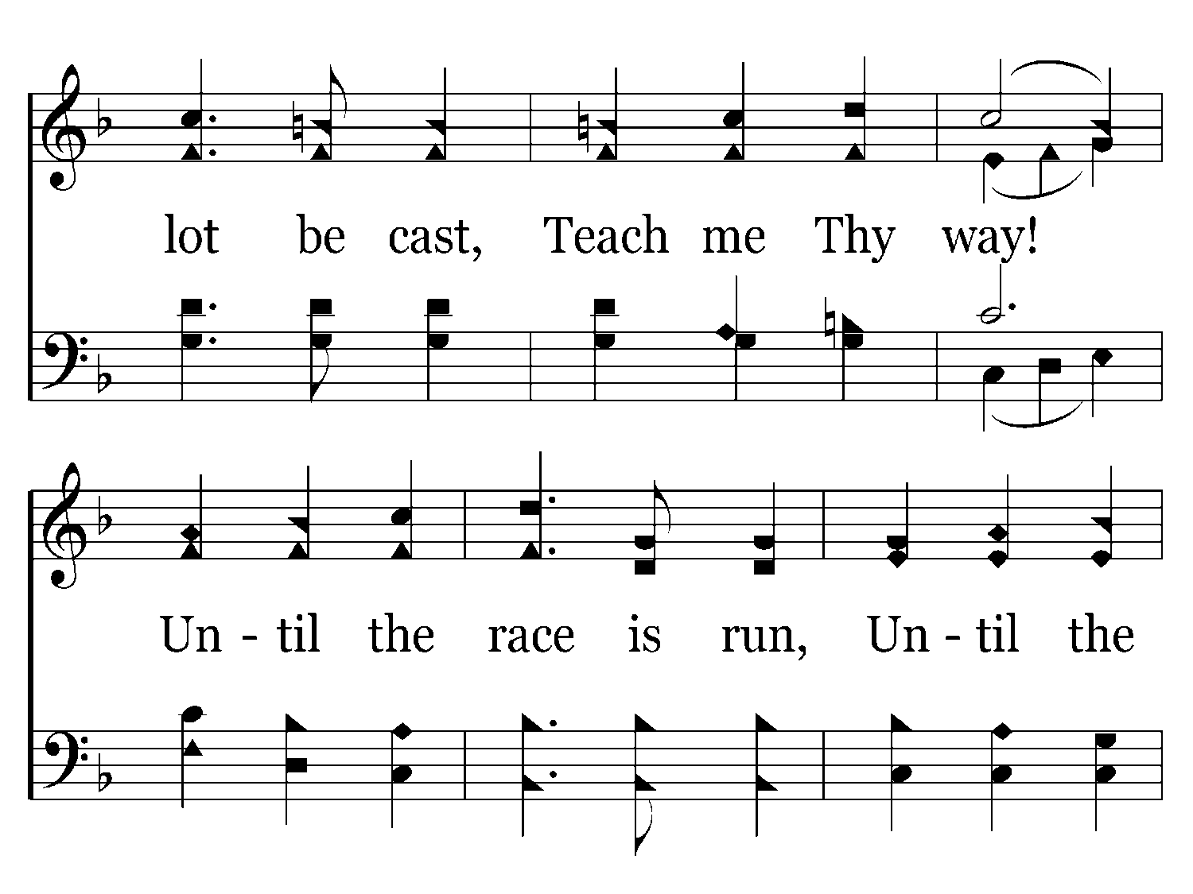
112 - Teach Me Thy Way - 4.2

Slide 23
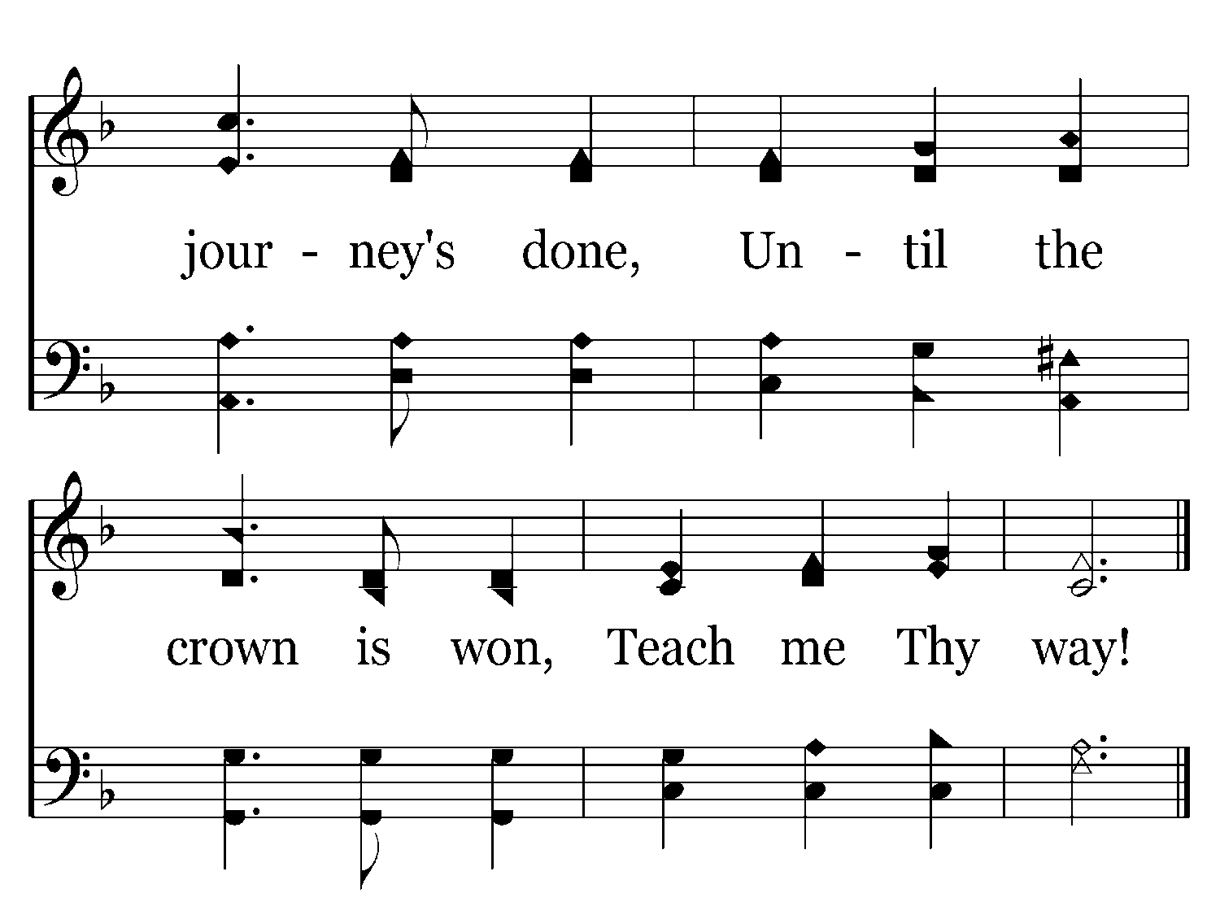
112 - Teach Me Thy Way - 4.3
End of Song

Slide 24
Until The Journey’s Done…
Not that I have already obtained this or am already perfect; but I press on to make it my own, because Christ Jesus has made me his own. Brethren, I do not consider that I have made it my own; but one thing I do, forgetting what lies behind and straining forward to what lies ahead, I press on toward the goal for the prize of the upward call of God in Christ Jesus. Let those of us who are mature be thus minded; and if in anything you are otherwise minded, God will reveal that also to you. Only let us hold true to what we have attained. (Philippians 3:12-16 RSV)

Slide 25
Until The Victory’s Won…
For I am already on the point of being sacrificed; the time of my departure has come. I have fought the good fight, I have finished the race, I have kept the faith. Henceforth there is laid up for me the crown of righteousness, which the Lord, the righteous judge, will award to me on that Day, and not only to me but also to all who have loved his appearing. (2 Timothy 4:6-8 RSV)

Slide 26
Teach My Thy Way, O Lord!
A Psalm of David. To thee, O LORD, I lift up my soul. O my God, in thee I trust, let me not be put to shame; let not my enemies exult over me. Yea, let none that wait for thee be put to shame; let them be ashamed who are wantonly treacherous. Make me to know thy ways, O LORD; teach me thy paths. Lead me in thy truth, and teach me, for thou art the God of my salvation; for thee I wait all the day long. (Psalms 25:1-5 RSV)

