Slide 2
Let God’s Word Dwell Richly In You…
Let the word of Christ dwell in you richly, teach and admonish one another in all wisdom, and sing psalms and hymns and spiritual songs with thankfulness in your hearts to God. And whatever you do, in word or deed, do everything in the name of the Lord Jesus, giving thanks to God the Father through him. (Colossians 3:16-17 RSV)
Singing is a command but comes with a promise!
Our singing is more than a warm-up for the sermon or a filler in the service.
Singing stands alongside of preaching as one of two great ways that God has ordained.
Good songs serve as a 3-minute, easily memorizable, deeply biblical summary of important truths from scripture that you can take with you all week!

Slide 3
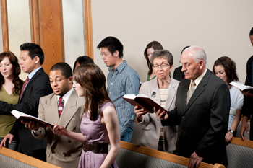
Why Do You Sing?

Slide 4
The Inspired Testimony of the Scriptures:
"Speaking to yourselves in psalms and hymns and spiritual songs, SINGING and making melody in your HEART to the Lord." (Eph. 5:19).
"Let the word of Christ dwell in you richly in all wisdom; teaching and admonishing one another in psalms and hymns and spiritual songs, SINGING with grace in your HEARTS to the Lord." (Col. 3:16).
"What is it then? I will pray with the spirit, and I will pray with the understanding also: I will SING with the spirit, and I will SING with the understanding also." (1 Cor. 14:15).
"Is any among you afflicted? let him pray. Is any merry? let him SING psalms." (Jas. 5:13).

Slide 5
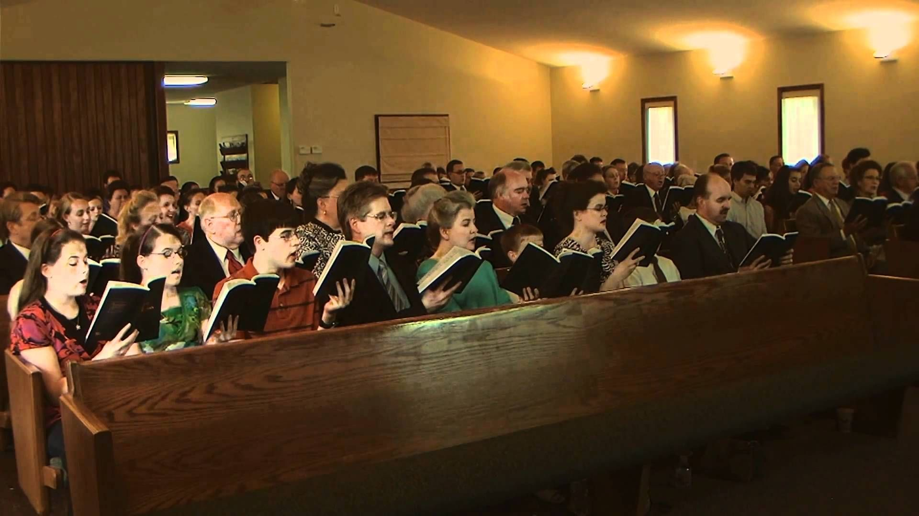
Why Do We Only Sing?
The command within these verses is to SING, and no mention of an instrument can be found. "For I testify unto every man that heareth the words of the prophecy of this book. If any man shall ADD UNTO THESE THINGS, GOD SHALL ADD UNTO HIM THE PLAGUES THAT ARE WRITTEN IN THIS BOOK". (Rev. 22:18).

Slide 6
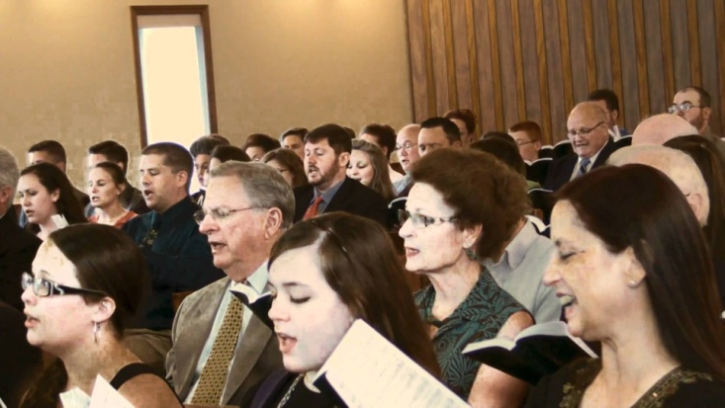
Physical Benefits of Singing
Singing strengthens the immune system
Singing is a workout
Singing improves your posture
Singing helps with sleep
Singing is a natural anti-depressant
Singing lowers stress levels
Singing improves mental alertness
Singing boosts your confidence
Singing broadens communication skills

Slide 7
Paul And Silas Were Singing…
The crowd joined in attacking them; and the magistrates tore the garments off them and gave orders to beat them with rods. And when they had inflicted many blows upon them, they threw them into prison, charging the jailer to keep them safely. Having received this charge, he put them into the inner prison and fastened their feet in the stocks. But about midnight Paul and Silas were praying and singing hymns to God, and the prisoners were listening to them, and suddenly there was a great earthquake, so that the foundations of the prison were shaken; and immediately all the doors were opened and every one's fetters were unfastened. (Acts 16:22-26 RSV)
Why Do You Think Paul and Silas Were Singing?
Confused?
Command?
Show?
Happy?
Love?
Joy?
Why?

Slide 8
Why Do You Sing?

Slide 9
I Sing Because:
There is an empty grave!
There is a power to save!
His grace is real!
But in fact Christ has been raised from the dead, the first fruits of those who have fallen asleep. (1 Corinthians 15:20 RSV)
For I am not ashamed of the gospel: it is the power of God for salvation to every one who has faith, to the Jew first and also to the Greek. (Romans 1:16 RSV)
For by grace you have been saved through faith; and this is not your own doing, it is the gift of God-- (Ephesians 2:8 RSV)

Slide 10
I Sing Because:
I know I’m not alone!
Someday I’m going home where I shall sing for all eternity!
Keep your life free from love of money, and be content with what you have; for he has said, "I will never fail you nor forsake you." Hence we can confidently say, "The Lord is my helper, I will not be afraid; what can man do to me?" (Hebrews 13:5-6 RSV)
then we who are alive, who are left, shall be caught up together with them in the clouds to meet the Lord in the air; and so we shall always be with the Lord. (1 Thessalonians 4:17 RSV)

Slide 11
I Sing Because
I sing because there is an empty grave I sing because there is a power to save I sing because His grace is real to me I sing because I know I’m not alone I sing because someday I’m going home Where I shall sing through all eternity

Slide 12
Sources
Article by David J. Riggs
“I SING BECAUSE” by Squire Parsons
https://takelessons.com/live/singing/health-benefits-of-singing

