Slide 2
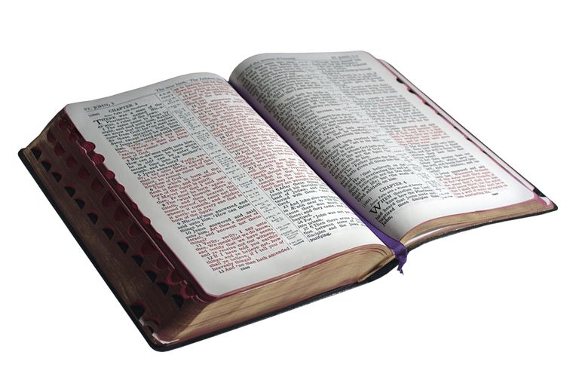
Partakers of the Divine Nature
“His divine power has granted to us all things that pertain to life and godliness, through the knowledge of him who called us to his own glory and excellence, by which he has granted to us his precious and very great promises, so that through them you may become partakers of the divine nature, having escaped from the corruption that is in the world because of sinful desire.”
2 Peter 1:3-4, ESV
*Pictures from the Visualized Old Testament and from Google Images.

Slide 3
Partakers of the Divine Nature
*Pictures from the Visualized Old Testament and from Google Images.

Slide 4
Partakers of the Divine Nature
God has granted…
…all things pertaining to life.
…all things pertaining to godliness.
…precious and very great promises.
Knowing God’s Gifts
Learning Through the Precepts of Christ
Learning Through the Person of Christ
The Purpose of God’s Gifts
God provided these gifts so that we can become partakers of His nature.
Partaker – “share, fellowship, communion”
We cannot be a partaker until we first escape!
When we are partakers, it means we also have fellowship with the life of Christ.
Genesis 1:26
Colossians 1:16-17
Matthew 25:46
2 Corinthians 4:16
Ephesians 4:20-24
1 John 1:7
Philippians 4:8
Hebrews 13:5
Ephesians 3:14-20
Hebrews 1:1-2
John 14:
Luke 6:46
1 John 5:3
James 1:22
Ephesians 5:17
Colossians 1:9-10
Hebrews 4:15
1 Peter 2:21
1 John 3:1
Hebrews 2:11
Colossians 1:13

