Slide 2
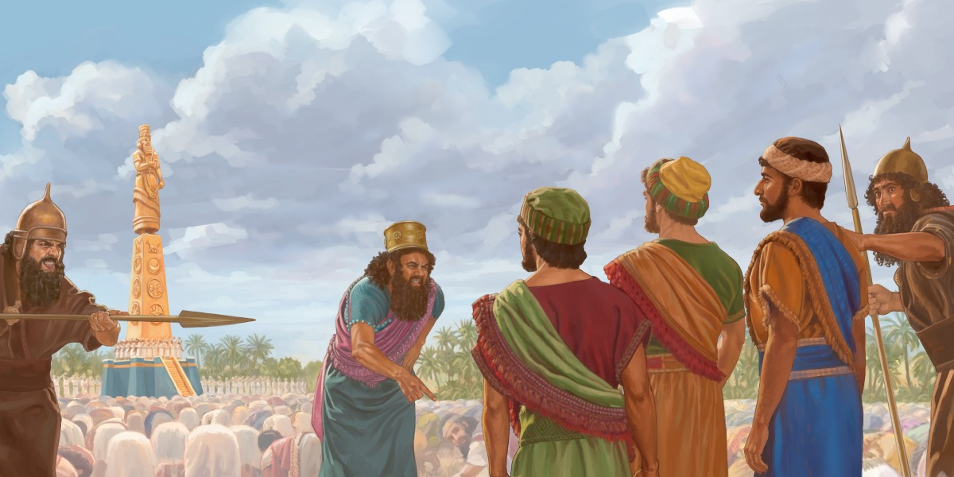
Fireproof Faith
Church of Christ at Medina
November 4th, 2018
Pictures from Google Images.
Reference Sermon by Bubba Garner – “Tested by Fire.”

Slide 3
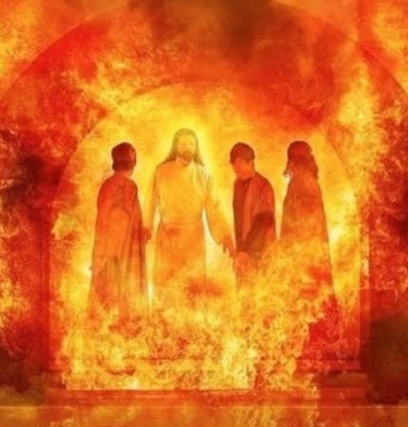
Fireproof faith is a personal faith.
“…our God whom we serve is able to deliver us…”
God has provided multiple ways for us to be encouraged.
Local Congregation
Elders
Evangelists
During the trial of fire, it is our faith in God that will carry us through.
Hebrews 10:24-25, 1 Peter 5:1-4, 2 Timothy 2:1-2, 2 Timothy 4:1-4, Ephesians 4:11-12, Romans 10:17, 2 Timothy 2:15, 2 Peter 3:18, Joshua 24:15, 2 Timothy 1:12

Slide 4
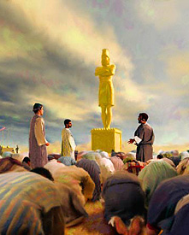
Fireproof faith travels.
In football, defense travels. This means that defense is typically more consistent.
The faith of Shadrach, Meshach and Abednego was consistent.
Their faith did not depend upon location.
God’s law is applicable no matter our location. It is truth everywhere.
Their faith did not depend upon circumstances.
The threat of losing their position did not deter them.
Jude 3, James 1:25, Hebrews 13:7-8

Slide 5
Fireproof faith has no conditions.
“But if not…”
The three faithful men did not doubt God’s ability, and they did not demand that God prove it.
Our faith is not a bargaining chip with God.
The rich young ruler made his faith conditional – as long as he could keep his riches.
Job is an example of a man who did not have conditions.
Matthew 19:22, Job 1:21

Slide 6
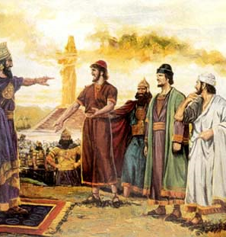
Fireproof faith is tested.
A truly fireproof faith is one that has been tested and has withstood the attack.
The purpose of the trials are to make us stronger.
“Count it all joy, my brothers, when you meet trials of various kinds, for you know that the testing of your faith produces steadfastness. And let steadfastness have its full effect, that you may be perfect and complete, lacking in nothing.”
So, when we are faced with the trials, should we ask for it to be removed – or should we ask God to increase our faith?
1 Peter 4:12, 1 Peter 1:7, James 1:2-4, Luke 17:5

