Slide 2
Parables of Jesus: Laborers in the vineyard
Matthew – 20:1-16

Slide 3
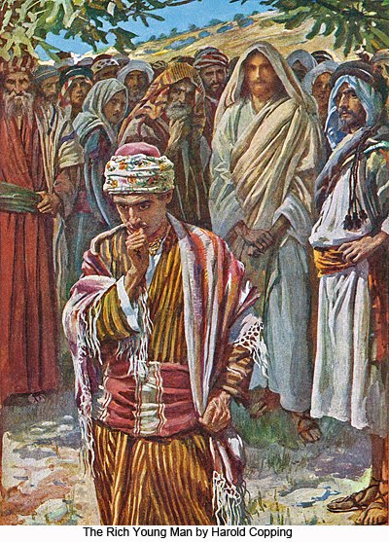
The Setting…
The Conversation with the rich young ruler (19:16-22)
The discussion with the disciples (19:23-26)
The question raised by Peter (19:27-30)
The parable of the laborers in the vineyard (20:1-16)
Then Peter said in reply, "Lo, we have left everything and followed you. What then shall we have?" (Matthew 19:27 RSV)

Slide 4
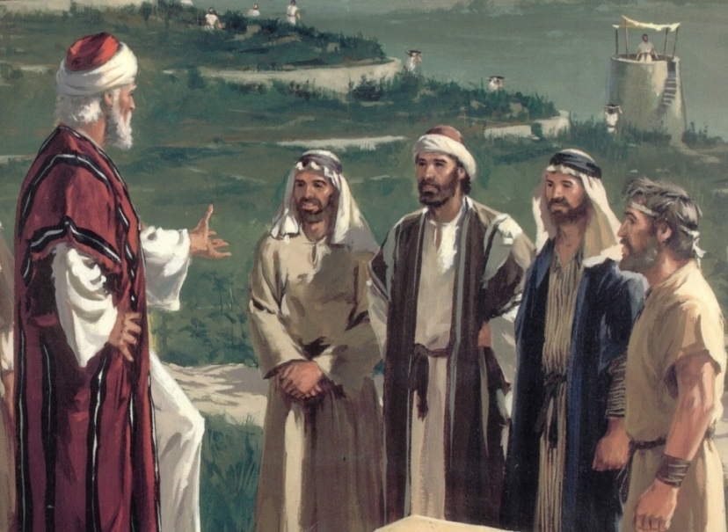
The Parable Itself: Whatever is Right…
"For the kingdom of heaven is like a landowner who went out early in the morning to hire laborers for his vineyard. "Now when he had agreed with the laborers for a denarius a day, he sent them into his vineyard. "And he went out about the third hour and saw others standing idle in the marketplace, "and said to them, 'You also go into the vineyard, and whatever is right I will give you.' So they went. "Again he went out about the sixth and the ninth hour, and did likewise. "And about the eleventh hour he went out and found others standing idle, and said to them, 'Why have you been standing here idle all day?' "They said to him, 'Because no one hired us.' He said to them, 'You also go into the vineyard, and whatever is right you will receive.' (Matthew 20:1-7 NKJV)
The Jewish day is divided into twelve hrs that ~ sunup (6am) to sundown (6pm)
A denarius was the standard daily wage for a common day laborer.
The laborers agreed to the wage.
He hires other workers at 9,12,3 and 5.

Slide 5
The Parable Itself: The Great Reversal
"So when evening had come, the owner of the vineyard said to his steward, 'Call the laborers and give them their wages, beginning with the last to the first.' "And when those came who were hired about the eleventh hour, they each received a denarius. "But when the first came, they supposed that they would receive more; and they likewise received each a denarius. "And when they had received it, they complained against the landowner, "saying, 'These last men have worked only one hour, and you made them equal to us who have borne the burden and the heat of the day.' (Matthew 20:8-12 NKJV)
The workers hired last were paid first.
The workers hired last were paid the same as the first.
Imagine what the first workers must have thought.
Would you have complained?
How much money would you have expected?

Slide 6
The Parable Itself: The Kingdom of Heaven
"But he answered one of them and said, 'Friend, I am doing you no wrong. Did you not agree with me for a denarius? 'Take what is yours and go your way. I wish to give to this last man the same as to you. 'Is it not lawful for me to do what I wish with my own things? Or is your eye evil because I am good?' "So the last will be first, and the first last. For many are called, but few chosen." (Matthew 20:13-16 NKJV)
Was the owner dishonest because he wanted to be generous to the other day-laborers?
Was it right to be envious of the other laborers?
Where was the compassion?

Slide 7
The Message of the Parable
Two Groups:
First Workers: apostles and others like them; proud and self-reliant
Other Workers: those called via the gospel at different times in life; humble and self-emptied.
Main Points:
God dispenses gifts, not wages.
The kingdom of heaven runs on grace, not merit.
What everyone receives will be more than fair.
No one has the right to question the generosity of the Lord.
No one should serve the Lord with a self-centered attitude.
(See Titus 3:5)
So the last will be first, and the first last." (Matthew 20:16 RSV)

Slide 8
What the Parable is not Saying:
That those who purposely put off obeying Christ until the last moment can be saved.
And about the eleventh hour he went out and found others standing; and he said to them, 'Why do you stand here idle all day?' They said to him, 'Because no one has hired us.' He said to them, 'You go into the vineyard too.' (Matthew 20:6-7 RSV)
See Acts 13:46; Rom. 2:4-11
So the last will be first, and the first last." (Matthew 20:16 RSV)

Slide 9
To Whom Is The Parable Directed?
Toward all who like Peter are dreaming of some great reward for some great thing done.
He had to be reminded that even the greatest of sacrifices without love achieves nothing (1 Cor. 13:3).
“It is not how great the labor but how true the heart that makes one “first” in the kingdom of heaven.” (Earnhart)
So the last will be first, and the first last." (Matthew 20:16 RSV)

Slide 10
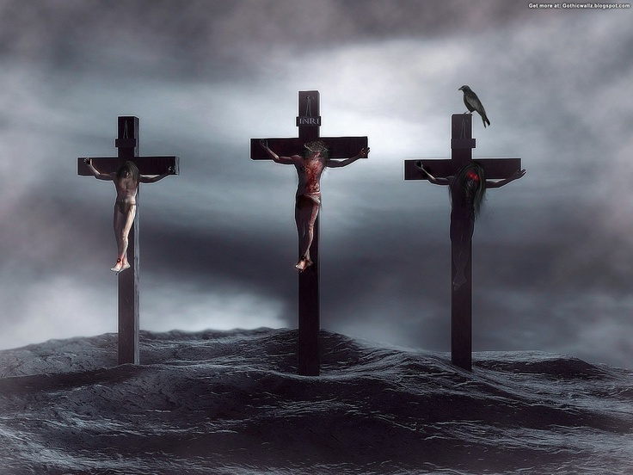
Be Thankful For God Not Giving Us What We Deserve!

Slide 11
Sources
Dehoff’s commentary on Matthew
The Parables of Jesus by Mark Copeland
Commentary on Matthew by Kenneth Chumbley
Glimpses of Eternity by Paul Earnhart

