Slide 1
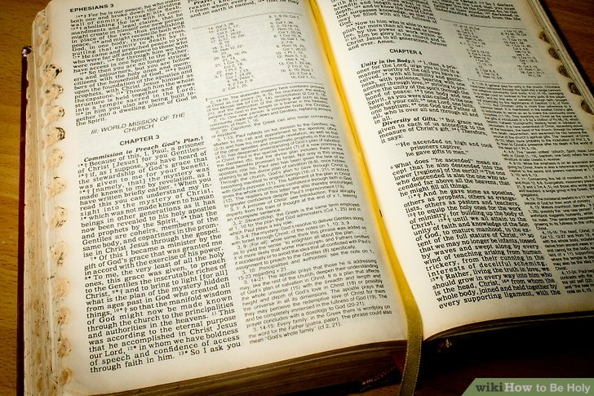
Things All Men Shall Do!
To everything there is a season, A time for every purpose under heaven: A time to be born, And a time to die; A time to plant, And a time to pluck what is planted; (Ecclesiastes 3:1-2 NKJV)
Then God said, "Let Us make man in Our image, according to Our likeness; let them have dominion over the fish of the sea, over the birds of the air, and over the cattle, over all the earth and over every creeping thing that creeps on the earth." So God created man in His own image; in the image of God He created him; male and female He created them. (Genesis 1:26-27 NKJV)

Slide 2
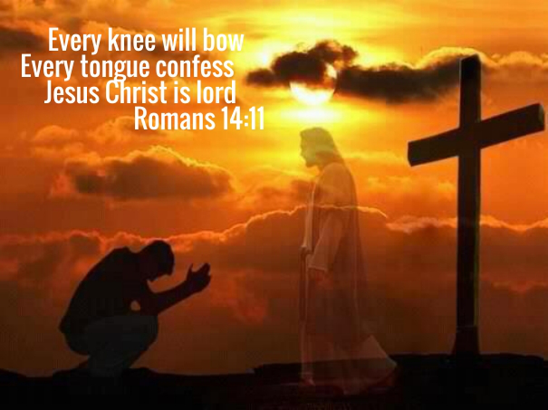
All Men Shall Confess Jesus Christ As Lord!
Philippians 2:5-11
Romans 10:9,10
1 Timothy 6:12
Romans 14:10-12

Slide 3
All Men Shall Be Baptized!
Baptism in Water
Mark 16:15,16; Acts 2:38; 22:16; 1 Peter 3:21
Luke 6:46
Matthew 7:21-23
Baptism in Fire
Matthew 3:11
Revelation 20:15

Slide 4
All Men Shall Be Resurrected!
1 Cor. 15:20-22
John 5:28-29

Slide 5
All Men Shall Be Judged!
Acts 17:30,31
Hebrews 9:27
Revelation 20:12,13
John 12:48

Slide 6
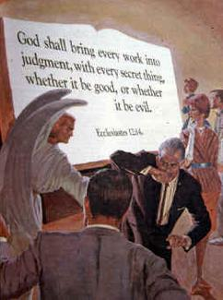
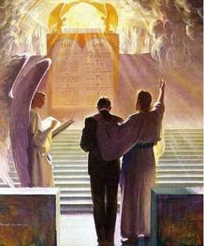

Slide 7
Are You Ready To Meet The Lord?

