Slide 2
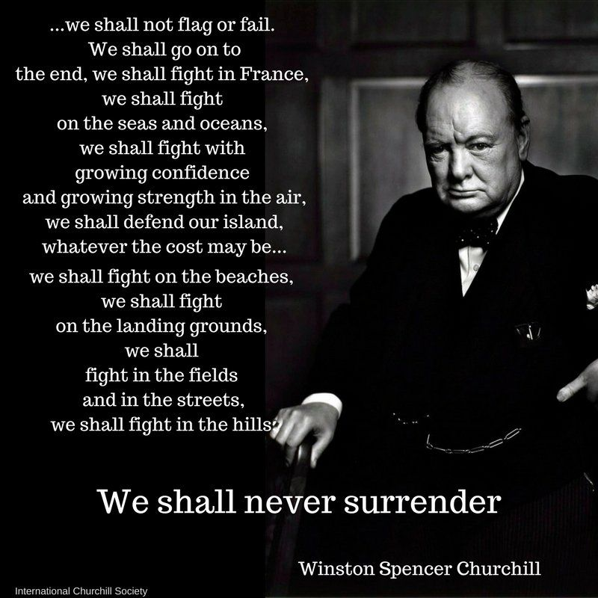
The Power of Words
We shall go on to the end. We shall fight in France, we shall fight on the seas and oceans, we shall fight with growing confidence and growing strength in the air, we shall defend our island, whatever the cost may be. We shall fight on the beaches, we shall fight on the landing grounds, we shall fight in the fields and in the streets, we shall fight in the hills; we shall never surrender…
- Winston Churchill

Slide 3
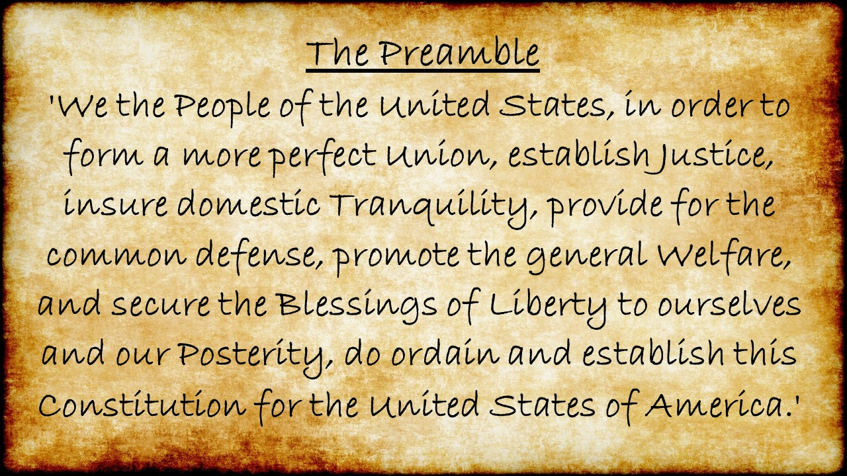
The Power of Words

Slide 4
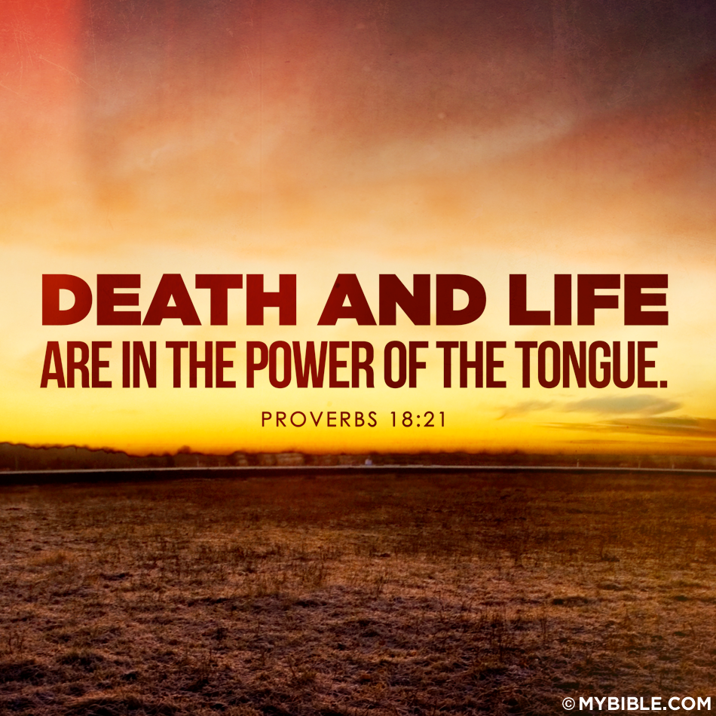
The Power of Words
God has warned us of the great power that lies within the power of the tongue.
“Death and life are in the power of the tongue; And they that love it shall eat the fruit thereof.” (Proverbs 18:21)
Key Verses: Proverbs 18:21

Slide 5
The Power of Words: For Good
“The mouth of the righteous is a fountain of life, but the mouth of the wicked conceals violence.” (Proverbs 10:11)
“The tongue of the righteous is choice silver; the heart of the wicked is of little worth.” (Proverbs 10:20)
“A gentle tongue is a tree of life, but perverseness in it breaks the spirit.” (Proverbs 15:4)
“To make an apt answer is a joy to a man, and a word in season, how good it is.” (Proverbs 15:23)
“Gracious (Pleasant) words are like a honeycomb, sweetness to the soul and health to the body.” (Proverbs 16:24)
“There is gold, and abundance of costly stones, but the lips of knowledge are a precious jewel.” (Proverbs 20:15)
“A word fitly spoken is like apples of gold in a setting of silver.” (Proverbs 25:11)
Key Verses: Proverbs 10:11, 10:20, 15:4, 15:23, 16:24, 20:15, 25:11

Slide 6
The Power of Words: For Evil
“Your tongue plots destruction, like a sharp razor, you worker of deceit. You love evil more than good, and lying more than speaking what is right.” (Psalm 52:2-3)
“They make their tongue sharp as a serpent’s, and under their lips is the venom of asps.” (Psalm 140:3)
“A worthless man plots evil, and his speech is like a scorching fire.” (Proverbs 16:27)
Key Verses: Psalm 52:2-3, Psalm 140:3, Proverbs 16:27

Slide 7
The Power of Words: Affect on Life
“Finally, all of you, have unity of mind, sympathy, brotherly love, a tender heart, and a humble mind. Do not repay evil for evil or reviling for reviling, but on the contrary, bless, for to this you were called, that you may obtain a blessing. For, ‘Whoever desires to love life and see good days, let him keep his tongue from evil and his lips from speaking deceit; let him turn away from evil and do good; let him seek peace and pursue it. For the eyes of the Lord are on the righteous, and his ears are open to their prayer. But the face of the Lord is against those who do evil.’”
- 1 Peter 3:8-12, ESV
Key Verses: Psalms 34:12-16, 1 Peter 3:8-12

Slide 8
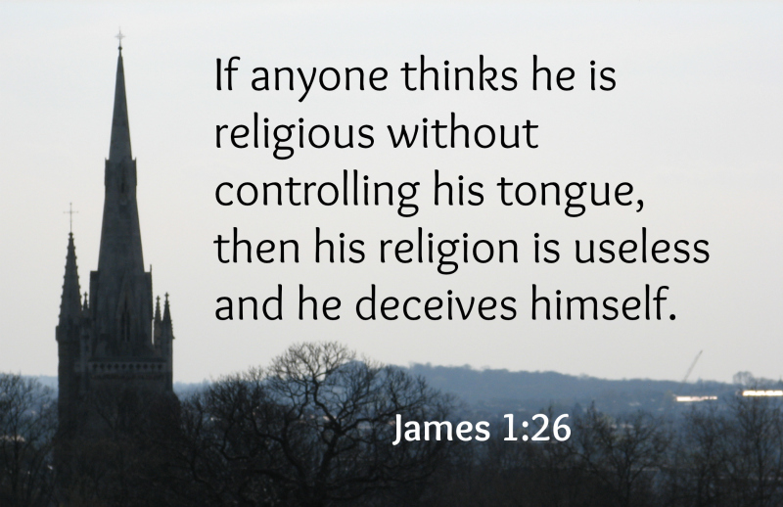
The Power of Words: Controls our Religion
“If anyone thinks he is religious and does not bridle his tongue but deceives his heart, this person’s religion is worthless.”
- James 1:26, ESV
Key Verses: James 1:26

Slide 9
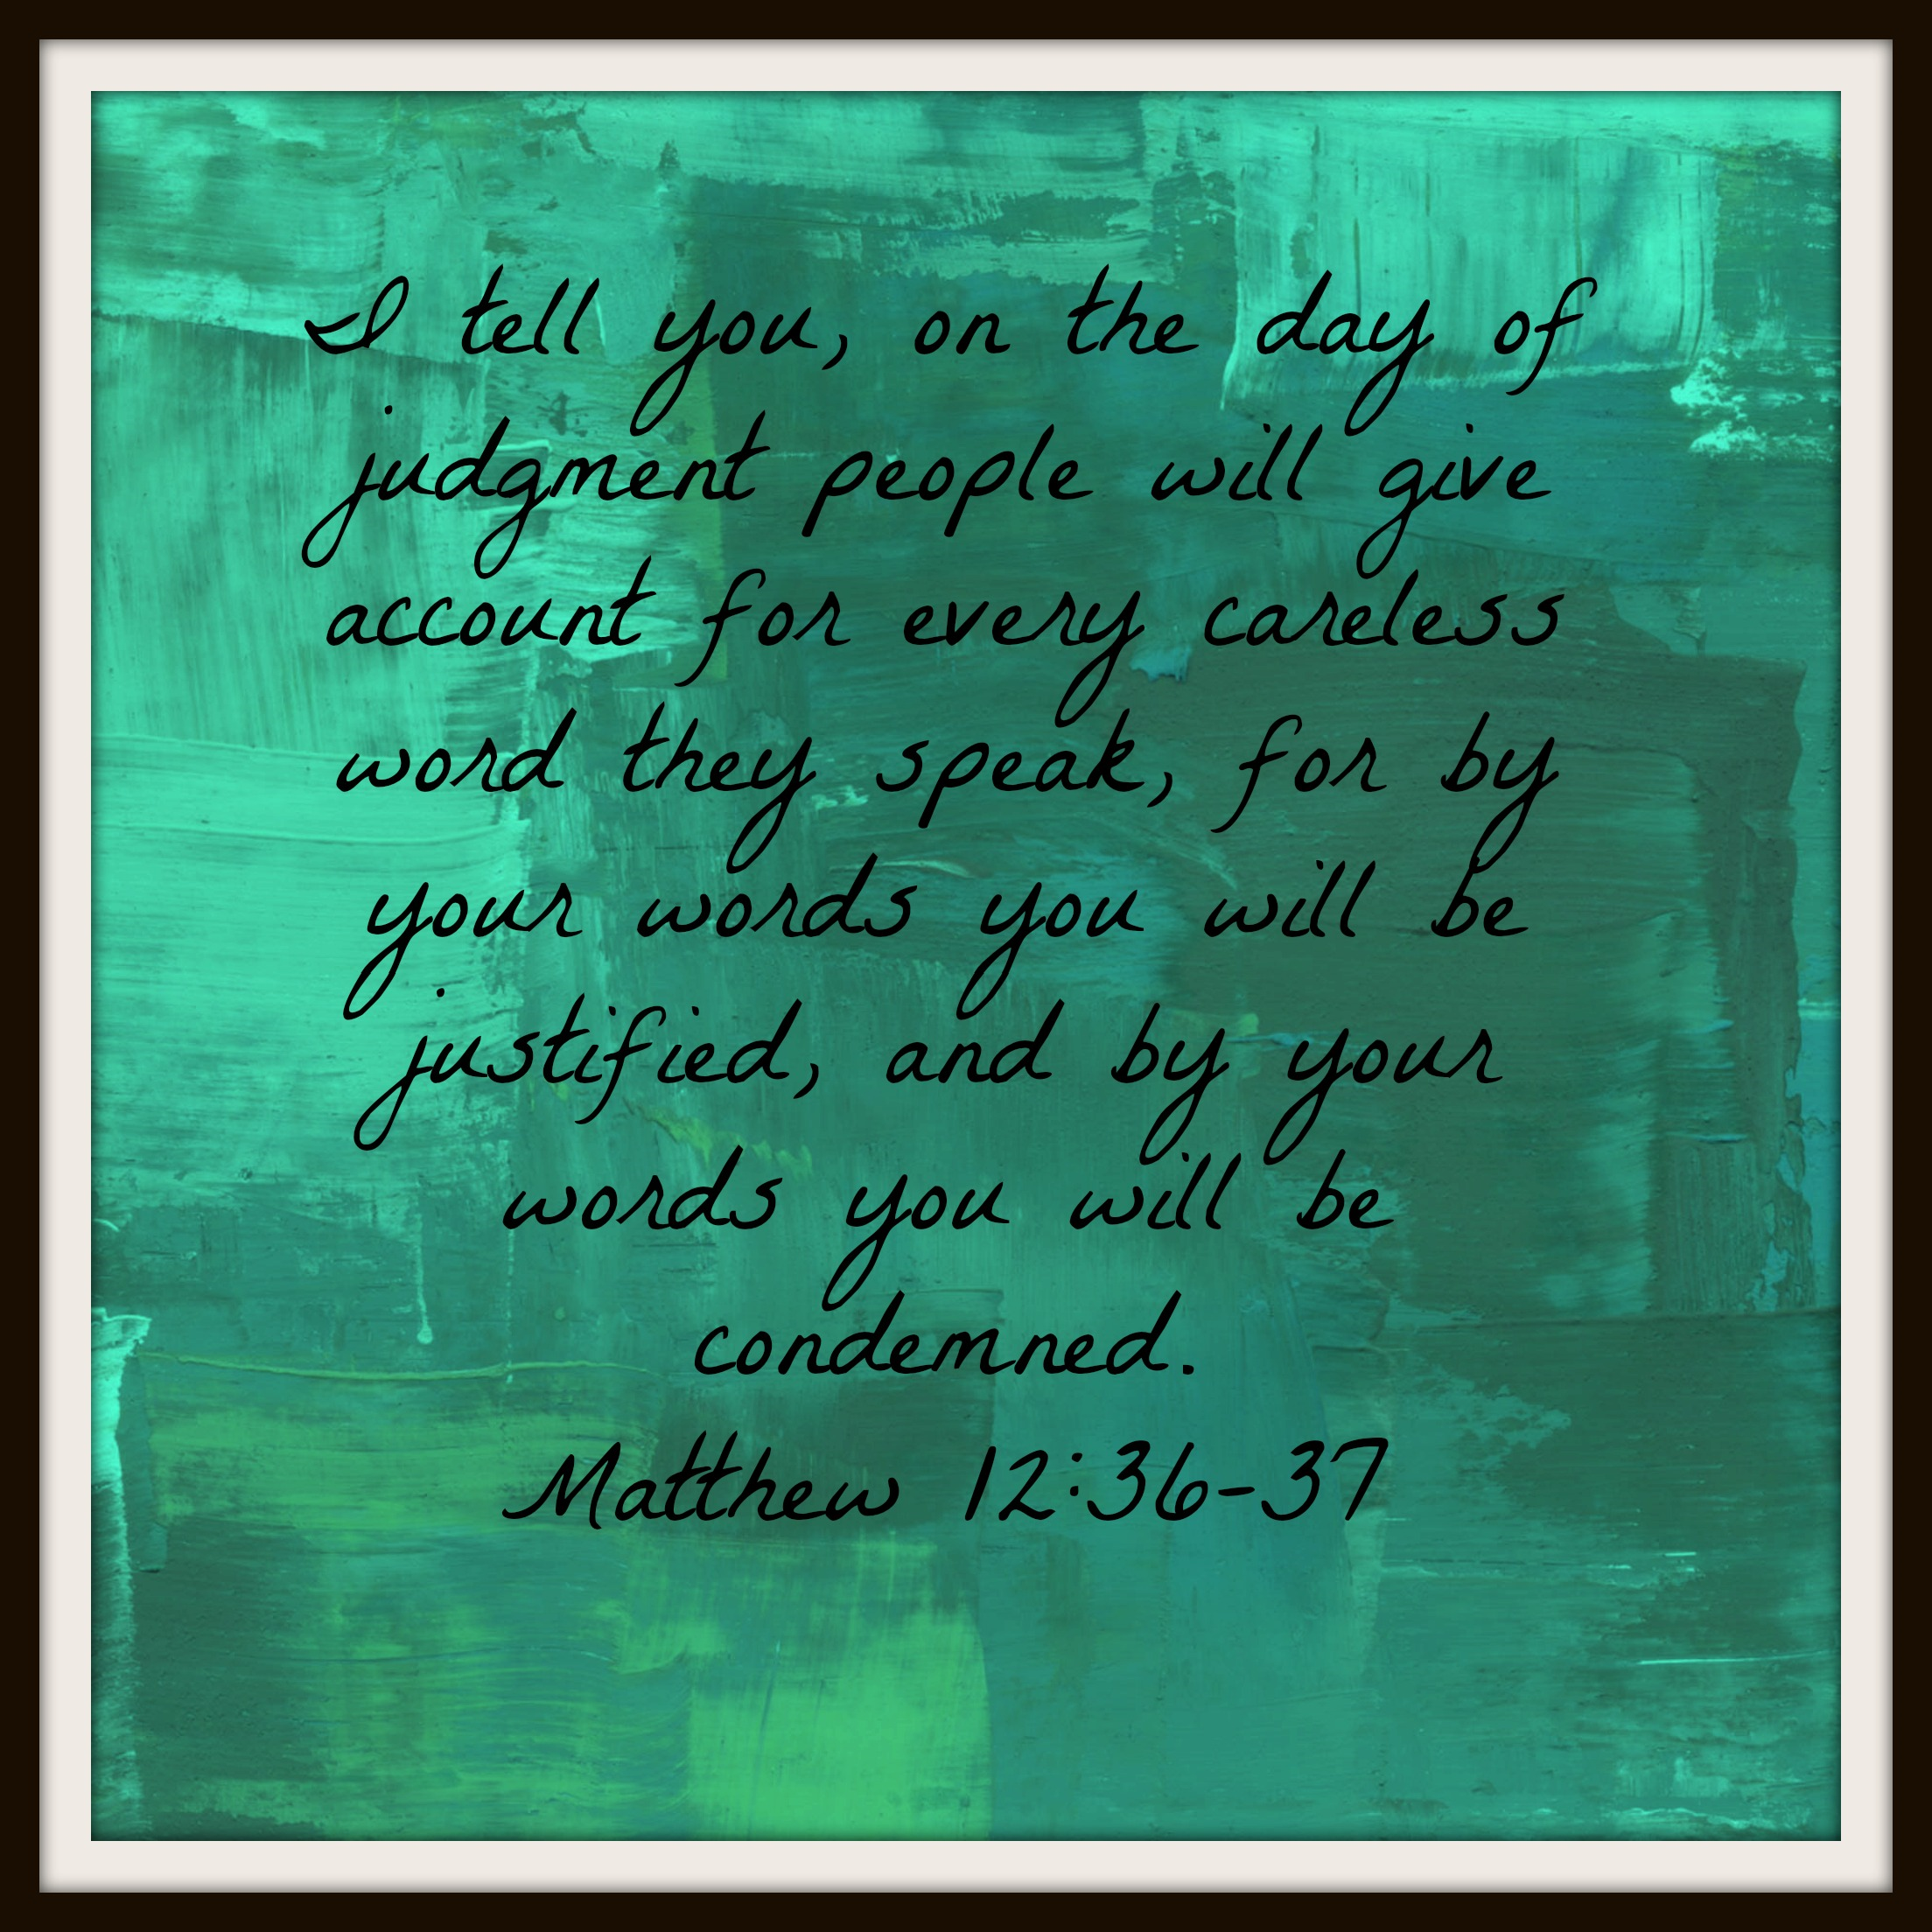
The Power of Words: Affects our Destiny
“O Lord, who shall sojourn in your tent? Who shall dwell in your holy hill? He who walks blamelessly and does what is right and speaks truth in his heart; who does not slander with his tongue and does no evil to his neighbor, not rake up a reproach against his friend…”
- Psalm 15:1-3, ESV
Key Verses: Matthew 12:33-37, Psalm 15:1-3

Slide 10
The Power of the Tongue
Church of Christ at Medina
March 31st, 2019

Slide 11
James 3: The Power of the Tongue
¹Not many of you should become teachers, my brothers, for you know that we who teach will be judged with greater strictness. ²For we all stumble in many ways. And if anyone does not stumble in what he says, he is a perfect man, able also to bridle his whole body. ³If we put bits into the mouths of horses so that they obey us, we guide their whole bodies as well. ⁴Look at the ships also: though they are so large and are driven by strong winds, they are guided by a very small rudder wherever the will of the pilot directs. ⁵So also the tongue is a small member, yet it boasts of great things.
Be careful when teaching.
Every man sins, and the tongue (speech) is one of the most common ways to sin.
Just as large powerful animals and machines are controlled by small items, man is often controlled by a small member of our body – the tongue.
Key Verses: James 3:1-5, Proverbs 10:18, Matthew 28:18-20, 1 Peter 3:15, Hebrews 5:12-6:3, Romans 3:10,23, 1 John 1:8, Ecclesiastes 7:20

Slide 12
James 3: The Power of the Tongue
How great a forest is set ablaze by such a small fire! ⁶And the tongue is a fire, a world of unrighteousness. The tongue is set among our members, staining the whole body, setting on fire the entire course of life, and set on fire by hell. ⁷For every kind of beast and bird, of reptile and sea creature, can be tamed and has been tamed by mankind, ⁸but no human being can tame the tongue. It is a restless evil, full of deadly poison. ⁹With it we bless our Lord and Father, and with it we curse people who are made in the likeness of God. ¹⁰From the same mouth come blessing and cursing. My brothers, these things ought not to be so. ¹¹Does a spring pour forth from the same opening both fresh and salt water? ¹²Can a fig tree, my brothers, bear olives, or a grapevine produce figs? Neither can a salt pond yield fresh water.
The tongue is like a raging fire – it spreads wide and can be uncontrollable.
The tongue can never be tamed, but it can be controlled.
If not controlled, it is full of deadly poison.
Key Verses: James 3:5-12, Proverbs 13:3, 1 Peter 3:10-12, Psalm 39:1, Proverbs 21:23, Romans 3:13

Slide 13
How do we control the tongue?
Recognize the danger of the tongue.
Keep your heart, because it guides the tongue.
Control your temper.
Put a bridle on it!
Let your words be few.
Think before you speak.
Pray.
Don’t tell all you know.
Keep trying.
Key Verses: Proverbs 4:23, Matthew 12:33-35, Matthew 15:18-20, Philippians 4:8, Proverbs 15:1, 17:27-28, 29:11, Psalm 141:3, Psalm 39:1, Proverbs 13:3, 21:23, Proverbs 10:19, James 1:19, Proverbs 10:18, Proverbs 15:28, Ephesians 4:15-29, Colossians 4:6, Proverbs 29:20, Proverbs 11:13, 12:16, Luke 22:32

