Slide 2
The GodHead
What Does The Bible Say?

Slide 3
The Godhead - Definition
Theiotes – divinity or divine nature
Divinity – The quality of being divine
Divine – being a deity
Deity – Supreme being

Slide 4
The Bible teaches that there is a Godhead
(Acts 17:29) “Forasmuch then as we are the offspring of God, we ought not to think that the Godhead is like unto gold, or silver, or stone, graven by art and man's device.”
(Rom 1:20) “For the invisible things of him from the creation of the world are clearly seen, being understood by the things that are made, even his eternal power and Godhead; so that they are without excuse:”
(Col 2:9) “For in him dwelleth all the fulness of the Godhead bodily.”

Slide 5
Biblical Examples of Three Persons:
The Creation
(Gen 1:1) “In the beginning God created the Heaven and the earth.”
God – Hebrew “Elohim” plural form of “Eloha”
Showing that more than one persons was present in the Creation process
(Eph 3:9) “And to make all men see what is the fellowship of the mystery, which from the beginning of the world hath been hid in God, who created all things by Jesus Christ:”

Slide 6
The Creation
(Gen 1:26) “And God said, Let us make man in our image, after our likeness:”
We see the Father, Son, and Holy Spirit united in the creation

Slide 7
Biblical Examples of Three Persons:
The Father, The Son, and The Holy Spirit
When He had been baptized, Jesus came up immediately from the water; and behold, the heavens were opened to Him, and He saw the Spirit of God descending like a dove and alighting upon Him. And suddenly a voice came from heaven, saying, "This is My beloved Son, in whom I am well pleased." (Matthew 3:16-17 NKJV)
"And I will pray the Father, and He will give you another Helper, that He may abide with you forever-- "the Spirit of truth, whom the world cannot receive, because it neither sees Him nor knows Him; but you know Him, for He dwells with you and will be in you. (John 14:16-17 NKJV)
See also 1 Corinthians 13:14, Romans 15:30 and 1 Peter 1:2

Slide 8
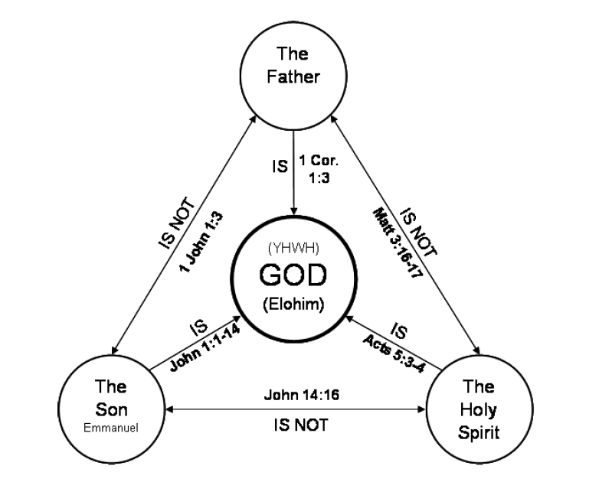

Slide 9
Question
What about passages that teach that there is only one God?

Slide 10
The Bible Teaches Us That There Is One God
(Deut 6:4) “Hear, O Israel: The Lord our God is one Lord:”
(Isa 44:6) “Thus saith the Lord the King of Israel, and his redeemer the Lord of hosts; I am the first, and I am the last; and beside me there is no God.”
(1 Cor 8:4) “As concerning therefore the eating of those things that are offered in sacrifice unto idols, we know that an idol is nothing in the world, and that there is none other God but one.”

Slide 11
These Three are One
(1 John 5:7-8) “For there are three that bear record in heaven, the Father, the Word, and the Holy Ghost: and these three are one. And there are three that bear witness in earth, the spirit, and the water, and the blood: and these three agree in one.”

Slide 12
These Three are One
Jesus says:
(John 10:30) “I and my Father are one.”
The Jews took up stones to stone him. They understood what he was saying.

Slide 13
These Three are One
How can The Father, Christ, and the Holy Spirit be three and one at the same time?
The Bible emphatically proclaims that there’s One God
The Bible also proclaims Three with a Divine nature
The Bible also proclaims that these Three are distinct Individuals

Slide 14
Example: The Marriage – Matt. 19:5,6
The Husband and Wife are separate Persons
God says that they’re “One Flesh”
How is the husband and wife one?
They’re one in purpose, agreement, and life
They are one family
Just like the marriage or family, the Godhead is One in Their plans and purpose

Slide 15
Example: The Church
(John 17:20-23) “Neither pray I for these alone, but for them also which shall believe on me through their word; That they all may be one; as thou, Father, art in me, and I in thee, that they also may be one in us: that the world may believe that thou hast sent me. And the glory which thou gavest me I have given them; that they may be one, even as we are one: I in them, and thou in me, that they may be made perfect in one; and that the world may know that thou hast sent me, and hast loved them, as thou hast loved me.”

Slide 16
The Godhead compared to Humanity
Human Beings
Divine Beings
Humanity
Godhead (Deity)

Slide 17
Divine Division of Labor
These Three make up One God or a United Godhead
Each Person has His work

Slide 18
In Creation
God the Father is the architect of the universe
He planned all things. (Ephesians 3)
The Son is the one that created the things planned by the Father
(John 1:1-3) “In the beginning was the Word, and the Word was with God, and the Word was God. The same was in the beginning with God. All things were made by him; and without him was not any thing made that was made.”
The Holy Spirit is the Lawgiver
(Gen 1:2) “And the earth was without form, and void; and darkness was upon the face of the deep. And the Spirit of God moved upon the face of the waters.”
The Spirit of God – the Holy Spirit gave the natural law

Slide 19
In the Creation of the New Testament Church
The Father planned it.
(Eph 3:10-11) “To the intent that now unto the principalities and powers in heavenly places might be known by the church the manifold wisdom of God, According to the eternal purpose which he purposed in Christ Jesus our Lord:”
The Son Built it (Created it)
(Matt 16:18) “And I say also unto thee, That thou art Peter, and upon this rock I will build my church; and the gates of hell shall not prevail against it.”
The Holy Spirit gave the Law
(John 16:13) “Howbeit when he, the Spirit of truth, is come, he will guide you into all truth: for he shall not speak of himself; but whatsoever he shall hear, that shall he speak: and he will shew you things to come.”

Slide 20
United
(Deut 6:4) “Hear, O Israel: The Lord our God is one Lord:”
One as in United
United in Purpose
United in Plan
Almighty God works through His Son. His Son works through The Holy Spirit. The Holy Spirit Works through the word of God.

Slide 21
Conclusion
There is one true God or Godhead in the sense that there is one humanity
The Godhead is composed of Three persons
Father
Son
Holy Spirit
These Three Work as one – in unity to accomplish the work of Creation and Salvation of our souls.

Slide 22
Sources
Material supplied from Donald McCaslin
Material supplied from Manly Luscombe
Jimmy Tuten, The Holy Spirit & Ferrell Jenkins, The Finger of God
Truth Commentary on Colossians

