Slide 2
A Prayer of Repentance
Psalm 51

Slide 3
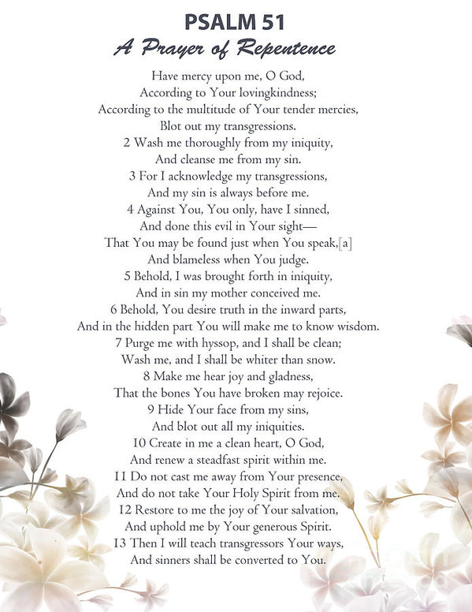

Slide 4
Repentance signifies…
The End of…
Fooling ourselves (1-4)
Blaming others (1-4)
Covering up (5,6)
The beginning of…
Concern for god’s presence (11)
Concern for others (13)
True joy (14)

Slide 5
2 Cor. 7:10 – Godly sorrow brings repentance that leads to salvation and leaves no regret, but worldly sorrow brings death.
Psalm 51:16-17. You do not delight in sacrifice, or I would bring it, you do not take pleasure in burnt offerings. The sacrifices of God are a broken spirit; a broken and contrite heart you, God, will not despise.

Slide 6
Sources
Material by steve Higginbotham
The treasury of david by Charles H. Spurgeon

