Slide 2
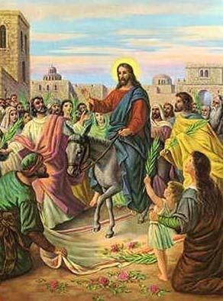
His Last Week
He enters the city of Jerusalem riding on a donkey.
He visits the temple where He drives out the money-changers. (21:12-13)
He heals the blind and lame. (21:14)

Slide 3
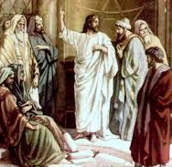
His Last Week
“By what authority are you doing these things, and who gave you this authority?” (21:23)
“I will ask you one question, and if you tell me the answer, then I also will tell you by what authority I do these things.” (21:24)
“The baptism of John, from where did it come? From heaven or from man?” (21:25)

Slide 4
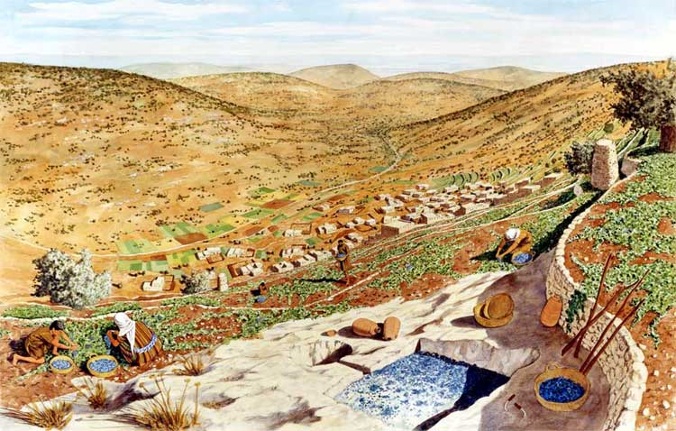
Parables of Judgment
Parable of the Two Sons
Matthew 21:28-32

Slide 5
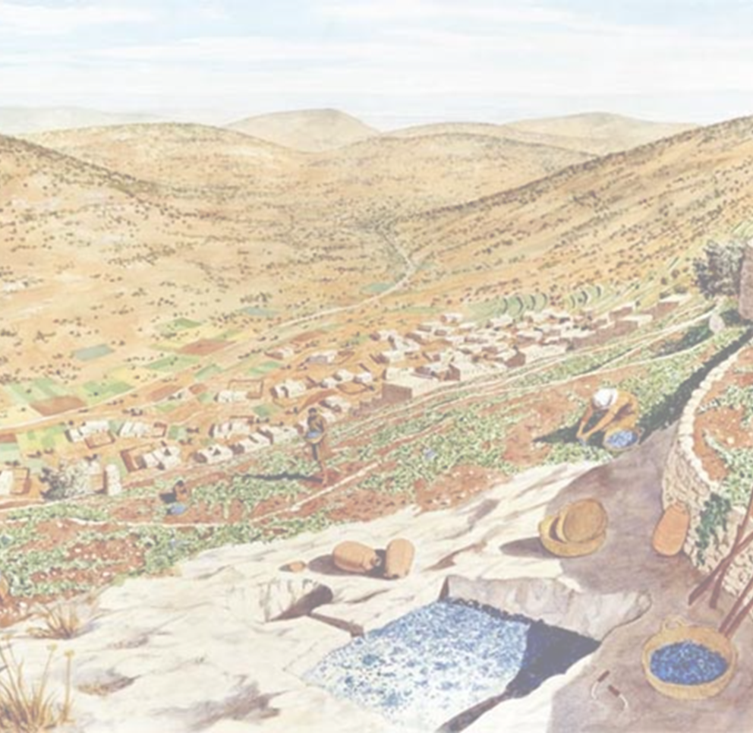
The Parable
“What do you think? A man had two sons. And he went to the first and said, ‘Son, go and work in the vineyard today.’ And he answered, ‘I will not,’ but afterward he changed his mind and went. And he went to the other son and said the same. And he answered, ‘I go, sir,’ but did not go. Which of the two did the will of his father?”
References: Matthew 21:28-31a

Slide 6
Characters
Father: Obviously represents God.
First Son: Those who boldly reject God at some point in life, but later accept and obey. In this instance, they are represented by tax collectors and prostitutes.
Second Son: Those who claim to follow God, but in reality reject Him. Represented by the elders, chief priests and Pharisees.
References: Matthew 21:28-31a

Slide 7
Meaning
It is those who actually obey who are pleasing to the Father.
References: Matthew 21:32

Slide 8
Application
In reality, all men have been the first son at one point in time. We all have rejected God.
For Christians, the question is…have we become the second son? Have we become like the Pharisees?
References: Romans 3:23

Slide 9
What is my attitude?
Pharisees pride themselves on their righteousness as compared to others.
Luke 18:11
Pharisees pride themselves on what they “don’t do”.
Luke 18:11
Pharisees pride themselves on the outward appearance – not inward cleansing.
Matthew 23:5-7, 25-28

Slide 10
God’s Command
God calls each of us individually to obey. (Galatians 6:5, 2 Corinthians 5:10)
God will not force us to obey, but urges us through His sacrificial love. (Hebrews 5:8-9, Acts 2:38-42, Revelation 22:17, Matthew 11:28-30)
All of us have the same command – work and serve Him! (Acts 17:30, Mark 16:15-16)
What is our response - today? (2 Corinthians 6:2, Hebrews 3:15, Matthew 21:28)

