Slide 2
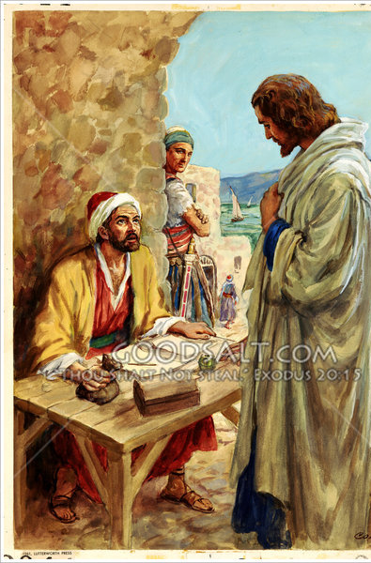
Follow Me
Church of Christ at Medina
November 24th, 2019

Slide 3
Following Jesus
Trusting the Leader
Key Verses
Titus 1:5-9
Hebrews 13:17
Matthew 4:19-20
Luke 5:1-11
John 1:35-42
Acts 2:22-23, 36
John 3:1-2
John 4:40-42
John 9:38
Mark 5:1-20
John 20:30-31

Slide 4
Following Jesus
Trusting the Leader
Desiring the Destination
Key Verses
Matthew 16:13-19
Matthew 22:1-14
Ephesians 4:15-16
Ephesians 5:22-23
Matthew 25:34
2 Peter 1:10-11

Slide 5
Following Jesus
Trusting the Leader
Desiring the Destination
Passable Path
Key Verses
2 Corinthians 5:21
Acts 13:38-39
Romans 3:20
Galatians 3:21
Ephesians 2:1-10
Acts 16:30-33
Acts 2:38
Acts 3:19
Acts 8:36-37
Acts 22:16

