Slide 2
Trying to Avoid Disappointing God
Church of Christ
at Medina
December 22nd, 2019

Slide 3
What is sin?
1 John 3:4
“Everyone who makes a practice of sinning also practices lawlessness; sin is lawlessness.” (1 John 3:4, ESV)
Sin, in our society, has itself become an ‘obsolete idea’.
Moral law, to many people, has become too restrictive and antiquated.
Sin is missing the mark, erring or making a mistake.
Religion implies the idea of “re-binding”, but it also means a system of restraint.
Who defines the mark or the target? God does. He is the creator of all things including us and He has the right to set the boundaries.

Slide 4
How do we sin?
Gen. 2:16-17
Gen. 3:3
Joshua 7
Jonah 1:3
We commit sin.
Essentially, this is doing what God says not to.
We see this type of sin from the very beginning in the Garden of Eden.
God gave specific directions to Adam and Eve.
They understood the commands.
They violated or broke God’s commands.
Other Examples:
Achan
Jonah

Slide 5
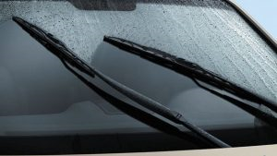
How do we sin?
Matt. 25:41ff
James 4:17
We commit sin.
We sin through omission.
This is not doing what God says to do.
It may be through negligence, carelessness, or disregard – but it’s still sin.
Example: Judgment Scene
“So whoever knows the right thing to do and fails to do it, for him it is sin.”

Slide 6
How do we sin?
Rev. 22:18
2 John 9
Acts 15:28
Gal. 1:9
We commit sin.
We sin through omission.
We sin by adding to God’s Word.
Another way in which we can sin is to add to the commands of God.
Paul and the other apostles had to deal with this problem with regard to the Jews who wanted to add circumcision to the Law of Christ.

Slide 7
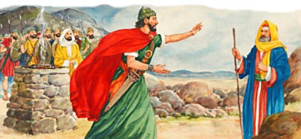
How do we sin?
1 Samuel 15
We commit sin.
We sin through omission.
We sin by adding to God’s Word.
We sin by substituting for God’s commands.
Example: King Saul

Slide 8
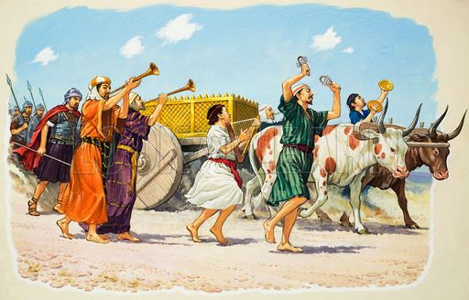
How do we sin?
Psalm 19:13-14
2 Samuel 6
Ex. 25:12-15
Num. 4:15
Deut. 9:7-24
We commit sin.
We sin through omission.
We sin by adding to God’s Word.
We sin by substituting for God’s commands.
We sin through presumption.
Presumption is making assumptions for God, and it is often based on pride.
Example: Uzzah and Israel

Slide 9
Remedy for Sin
Titus 3:4-7
Heb. 10:10
Heb. 9:22
Matt. 26:28
1 Peter 1:22
All men sin.
The remedy is only found in the grace of God!
God’s grace provided the only sacrifice which could provide forgiveness.
To receive God’s perfect gift, we must demonstrate our faithfulness to Him.

