Slide 2
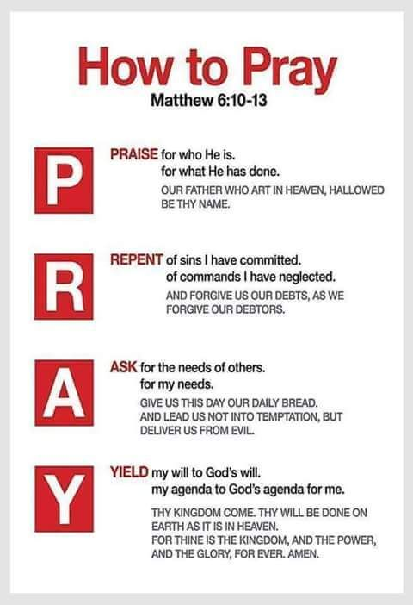
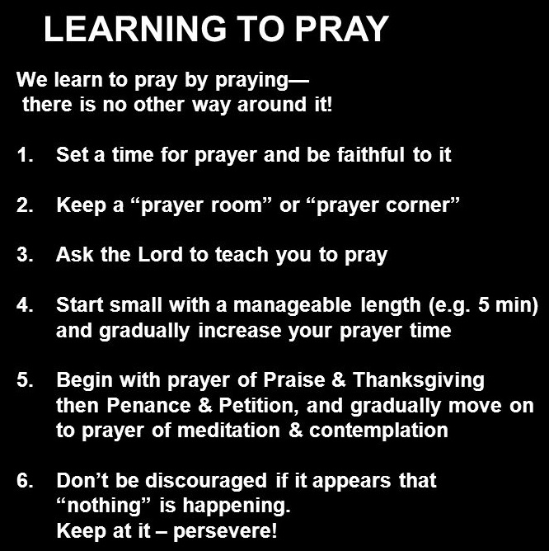

Slide 3

What is Next: Types of Prayer
Praise & Thanksgiving
Confession
Petition
Intercession

Slide 4
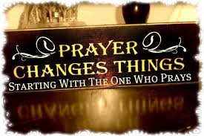
Praise and Thanksgiving
The Value of Praise and Thanksgiving
  Praise is good for us. (Psa 33:1-2)
  To what extent should we be thankful? (1 Thess 5:18)
  Ignoring thanksgiving is the first step to a corrupt heart. (Rom 1:20-21)
  Praise will cause you to know God better. (Rom 8:29)

Slide 5
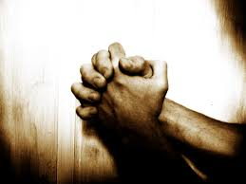
Praise and Thanksgiving
Bible Examples of Praise and Thanksgiving in Prayer
  The prayer of David after deliverance from his enemies. (2 Sam 22:2-4)
  The great prayer of confession led by the Levites in the days of Nehemiah. (Neh 9:5-6)
  A great Psalm of David. (Psa 103:1-2, 19-22)
  Those in the presence of God. (Rev 4:11; 5:9-10, 12-24)

Slide 6
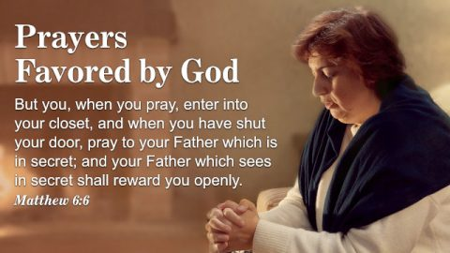
Praise and Thanksgiving
Challenges to a Thankful Heart
  Selfishness. (Jas 4:1-3)
  Bitterness. (1 Peter 3:7; Job 2:9-10)
  Ignorance. (Gal 4:8-9; 1 Peter 2:1-3)
  Indifference. (Heb 11:6)
Have no anxiety about anything, but in everything by prayer and supplication with thanksgiving let your requests be made known to God. And the peace of God, which passes all understanding, will keep your hearts and your minds in Christ Jesus. (Philippians 4:6-7 RSV)

Slide 8
Sources
Be Wise Small – Dee Bowman
The Gospel of Matthew – Kenneth L. Chumbley
The Truth About Prayer – WVBS.org
Outline From Matthew – Mark Copeland
Prayer Article by Greg Gwyn

