Slide 2
Job: Struggling through Suffering
Job 3:11-26

Slide 3
Robert Ingersoll, 19th Century Infidel
“In civilized life, there is a great struggle, great competition, and many
fail...Death becomes his only friend. Death promises release from want, from
hunger and pain, so the poor wretch lays down his burden, dashes it from his
shoulders and falls asleep. To me, all this seems so very natural. The
wonder is that so many endure and suffer to the natural end. That so many
nurse the spark of life in huts and prisons, keep it and guard it through years
of misery and want, support it by beggary, by eating the crust found in the
gutter, and to whom it only gives days of weariness and nights of fear and
dread. Why should the man, sitting amid the wreck of all he had, the loved
ones dead, friends lost, seek to lengthen, to preserve his life? What can the
future have for him?...Undoubtedly, there are many cases of perfectly
justifiable suicide. Cases in which not to end life would be a mistake,
sometimes almost a crime.” (New York World, 1894).

Slide 4
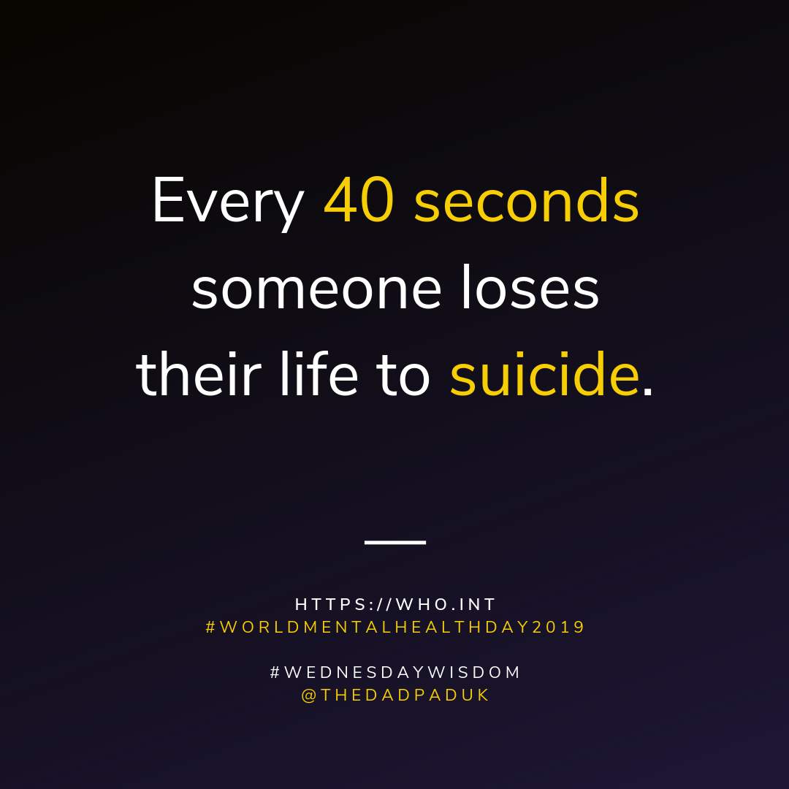
Suicide is the act of intentionally causing one's own death.^{[9]} Mental disorders, including depression, bipolar disorder, schizophrenia, personality disorders, anxiety disorders, and substance abuse—including alcoholism and the use of benzodiazepines—are risk factors.^{[2][4][10]}

Slide 6
Suicide Statistics
The most commonly used method of suicide varies between countries, and is partly related to the availability of effective means.^{[16]} Common methods of suicide include hanging, pesticide poisoning, and firearms.^{[2][3]} Suicides resulted in 828,000 global deaths in 2015, an increase from 712,000 deaths in 1990.^{[17][18]} This makes suicide the 10th leading cause of death worldwide.^{[4][6]}

Slide 7
Some Reasons Why People Attempt Suicide…
Some attempt suicide to fail.
To Escape Problems.
Some Don’t Feel They Belong.
They Have No Hope Or Vision For A Brighter Future.

Slide 8
Identifying Emotions Associated With Suicide…
Depression.
Elijah – 1 Kings 19:1-18
Escape.
Job (Job 3:11-26).
Paul (Philippians 1:21-24).
Pride.
King Saul (1 Samuel 31:3-5).
Ahithophel (2 Samuel 17:23).

Slide 9
What Is The Answer To Suicide?
Jesus is the Answer!
Notice how Jesus addresses the reasons people commit suicide.
Attention - You have God’s attention (John 3:16).
Escape - God will bear your burdens (1 Peter 5:7).
Don’t belong - God will adopt you as a son (Galatians 4:5).
No future - God has an inheritance for you (1 Peter 1:4).
For I know the plans I have for you, says the LORD, plans for welfare and not for evil, to give you a future and a hope. (Jeremiah 29:11 RSV)

Slide 10
Sources
www.cdc.gov
WHO: World Health Organization
Suicide statistics by Wickipedia
Outline by Steve Higginbotham

