Slide 1
Emotional Christians
Church of Christ at Medina
September 27th, 2020

Slide 2
Danger With Using Emotions in Religion
It is very dangerous to use our emotions as our primary guide in religious matters.
It is necessary to use both reason and logic in our religious lives.
The only reasonable explanation to our existence is that someone designed the world and us. That someone – is God!
Therefore, logic would tell us that God has all authority.
God has expressed His commands through His Son and the Holy Spirit.
To obey the commands of God then requires our reasoning, but also our will or determination.
References: 2 Timothy 4:1-5, Judges 2:11-13, Romans 1:18-32, Hebrews 1:1-2, John 15-16

Slide 3
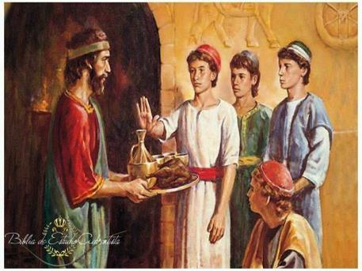
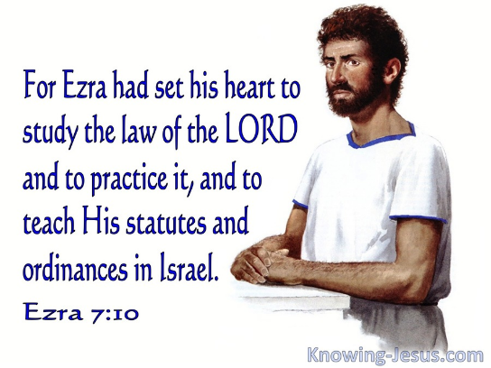
Danger With Using Emotions in Religion
We must be decisive in our commitment to serve God.
However, internal determination will only take us so far.
It is difficult to maintain a committed life if the only things that connect us are reason, logic and will.
References: Daniel 1:8, Ezra 7:10, Luke 14:27

Slide 4
Danger With Removing Emotion From Religion
God has given us a “three-pronged” toolbox to be successful in life.
Intellect: Our ability to think and reason.
Will: Our ability to carry out a purpose.
Emotion: Our ability to feel.
Intellect
Will
Emotion
References: Daniel 1:8, Ezra 7:10, Luke 14:27

Slide 5
Danger With Using Emotions in Religion
The Bible shows the lives of faithful people were filled with emotions.
References: Romans 6:17, The Book of Psalms

Slide 6
Developing Good Emotions
Recognize that our God is real!
How can we become emotionally attached to someone if we don’t think of them as real?
Realize that we are sinners, and we are unworthy of God’s love.
Christians sometimes forget that we need God’s love and mercy.
Simon’s was deceived by his own ‘self-righteousness’. The woman showed great emotion because of her recognition of sin. (Luke 7)
Remember that forgiveness is a wonderful gift from God.
Our hearts will be filled with thankfulness and gratitude – EMOTIONS! – when we know God has forgiven us.
This leads to a greater love for God – a determination to do His will, but also an emotional attachment to our Father!
References: 1 John 4:7-10, Psalm 89:5-8, Deuteronomy 33:26-27, Revelation 2:4, Luke 7, Psalm 40, 1 Timothy 1:12-15, Luke 7:47

Slide 7
Results of Christian Emotions
A Greater Desire to Worship God
A Greater Desire to Serve God
A Greater Desire to Overcome Temptation
References: Psalm 122:1, Psalm 100, 1 Corinthians 15:9-10, 2 Corinthians 5:14-15, Acts 20:24, Psalm 40:8

