Slide 1
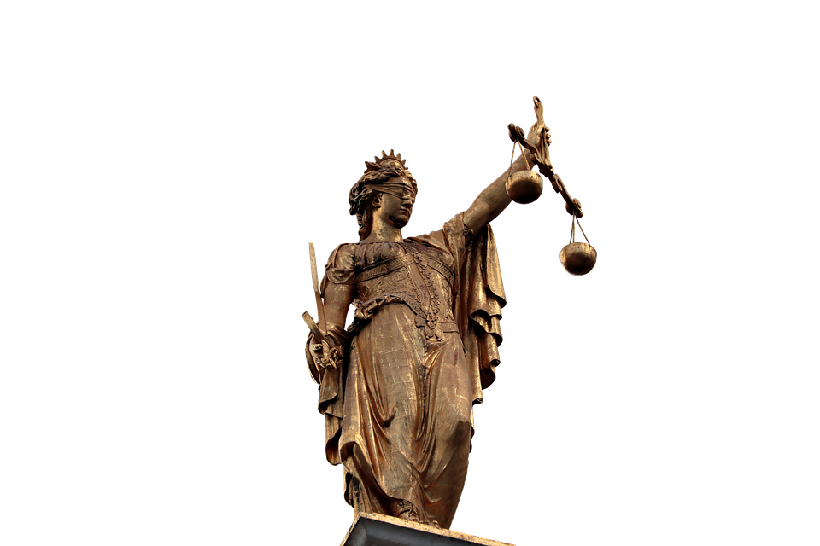
“And Justice For All”
Psalm 9:7-10
Notes:
Ultimately, justice for all can be supplied by God alone. Practically, He expects His people to stand for justice in this world while at the same time trusting Him to judge the world in righteousness.

Slide 2
Justice and the Golden Rule
Justice will elude us until we’ve put ourselves in the other person’s shoes
Matthew 7:12
Romans 13:10
Philippians 2:4

Slide 3
God’s Justice Isn’t Blind
God sees all (Hebrews 4:12-13)
We will give an account for…
Thoughts (Ecclesiastes 12:14)
Words (Matthew 12:36)
Deeds (2 Cor. 5:10; Rom. 2:6-10)
God weighs our hearts (Proverbs 21:2; 24:12)
God’s standard of judgment is perfect (Job 31:6; Romans 2:16; Acts 17:31; John 12:48)
God’s Justice will settle every issue (Isaiah 40:4, 23; Ps. 89:14)

Slide 4
The Lord Expects us to Stand for Justice
Justice should characterize our personal interactions (Zech. 7:9-10; Proverbs 31:9; Psalm 37:30-31; Micah 6:8; Matthew 5:13-14).
We must not allow ourselves to be pressured to approve of injustice (Exo. 23:2; Deut. 16:19).
We must not pervert the purpose and work of the church for a human cause (John 2:13-17; Leviticus 5:7; 1 Corinthians 3:17).

Slide 5
Psalm 9:7-10
“But the LORD sits enthroned forever; He has established his throne for justice,
and He judges the world with righteousness; He judges the peoples with uprightness.
The LORD is a stronghold for the oppressed, a stronghold in times of trouble.
And those who know your name put their trust in you, for you, O LORD, have not forsaken those who seek you.” (ESV)

