Slide 1
“Now the serpent was more crafty than any other beast of the field that the Lord God had made. He said to the woman, ‘Did God actually say, ‘You shall not eat of any tree in the garden?’’ And the woman said to the serpent, ‘We may eat of the fruit of the trees in the garden, but God said, ‘You shall not eat of the fruit of the tree that is in the midst of the garden, neither shall you touch it, lest you die.’’ But the serpent said to the woman, ‘You will not surely die. For God knows that when you eat of it your eyes will be opened, and you will be like God, knowing good and evil.’ So when the woman saw that the tree was good for food, and that it was a delight to the eyes, and that the tree was to be desired to make one wise, she took of its fruit and ate, and she also gave some to her husband who was with her, and he ate. Then the eyes of both were opened, and they knew that they were naked. And they sewed fig leaves together and made themselves loincloths.”
Genesis 3:1-7, ESV

Slide 2
What comes next? A Study of What Comes After This Life
Church of Christ at Medina
November 29th, 2020

Slide 3
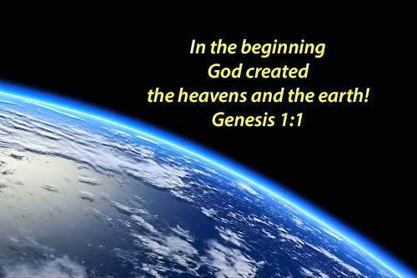
God’s Unique Creation
The world around us shows the power, intelligence and creativity of our God!
Yet, it was God’s creation on the 6th day that was unique, and He called him man. What made this creation so unique?
“And for your lifeblood I will require a reckoning; from every beast I will require it and from man. From his fellow man I will require a reckoning for the life of man. Whoever sheds the blood of man, by man shall his blood be shed, for God made man in His own image.” (Genesis 9:5-6)
“Then God said, ‘Let us make man in our image, after our likeness. And let them have dominion over the fish of the sea and over the birds of the heavens and over the livestock and over all the earth and over every creeping thing that creeps on the earth.’ So God created man in his own image, in the image of God he created him; male and female he created them.”
- Genesis 1:26-27, ESV
References: Genesis 1:26-27, Genesis 9:1,5-6

Slide 4
The Uniqueness of Man
References: 1 Thessalonians 5:23, Genesis 2:7-8, Psalm 103:14, Eccl. 12:7, 2 Cor. 4:16-5:1, 1 Corinthians 15:53
“Now may the God of peace himself sanctify you completely, and may your whole spirit and soul and body be kept blameless at the coming of our Lord Jesus Christ.” (1 Thess. 5:23, ESV)
Man’s Body
When God created man, He used the dust from the ground to form him.
Man’s body is composed of a wondrous system – circulatory, nervous and brain.
It is a temporal home, an earthly body used to clothe the spirit for a time.
Body
Spirit
Soul

Slide 5
The Uniqueness of Man
References: Luke 12:22-23, Matthew 10:5-8, 16-25, 26-28, Luke 12:5, Luke 1:46, Acts 14:22, Matthew 22:37, Acts 4:32, James 1:21, 1 Peter 1:8-9
“Now may the God of peace himself sanctify you completely, and may your whole spirit and soul and body be kept blameless at the coming of our Lord Jesus Christ.” (1 Thess. 5:23, ESV)
Man’s Soul
The words translated soul…
Greek: psuche
Hebrew: nephesh
The words mean breath or breath of life.
However, the words represent a variety of things.
Man’s natural body: Luke 12:22-23
Man’s invisible portion: Matthew 10:26-28
Man’s emotions and feelings: Luke 1:46, Acts 14:22
Man’s will: Matthew 22:37, Acts 4:32
Immortal Part of Man: James 1:21, 1 Peter 1:8-9
Body
Spirit
Soul

Slide 6
The Uniqueness of Man
References: John 4:24, Zechariah 12:1, Hebrews 12:9, Genesis 1:26-27, Genesis 2:7, Ecclesiastes 12:7
“Now may the God of peace himself sanctify you completely, and may your whole spirit and soul and body be kept blameless at the coming of our Lord Jesus Christ.” (1 Thess. 5:23, ESV)
Man’s Spirit
The words translated soul…
Greek: pneuma
Hebrew: rauch
Again, the words mean breath or wind. Like the wind, it is invisible, powerful and immaterial (Vine).
God, Himself, is a spirit. (John 4:24)
God is the Father of our spirits. (Zech. 12:1, Heb.12:9)
Therefore, our spirits are what make us unique and in the image of God. (Gen. 1:26-27, 2:7, Eccl. 12:7)
Body
Spirit
Soul

Slide 7
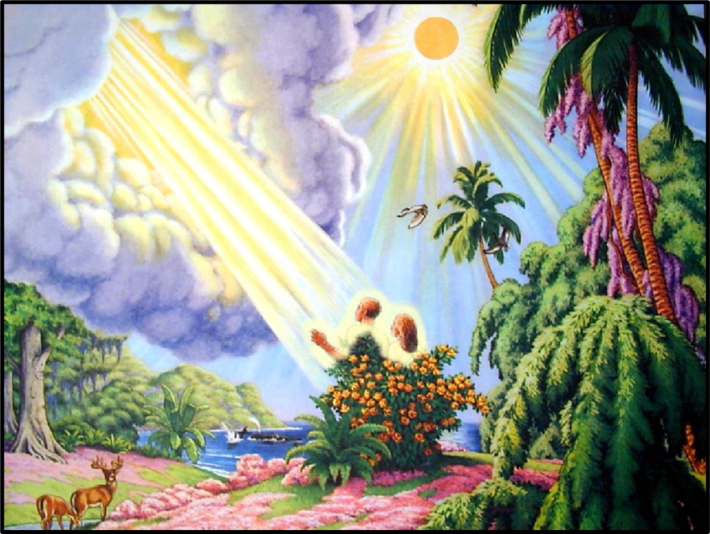
Man’s Tragic Past & Present
In the garden of Eden, man had everything:
He had a relationship with God.
He had access to physical life.
He had a work to do.
He had commands to obey.
However, man disobeyed the commands of God (Genesis 3:1-7), causing consequences:
Spiritual Consequences: Sin is completely against the nature of God and therefore it separated Adam and Eve from God. (Isaiah 59:1-2)
Physical Consequences: God had put physical death as a consequence of disobedience. (Genesis 2:17, 3:19, 3:22-24, 5:1-5)
“So when the woman saw that the tree was good for food, and that it was a delight to the eyes, and that the tree was to be desired to make one wise, she took of its fruit and ate, and she also gave some to her husband who was with her, and he ate.”
- Genesis 3:6, ESV
References: Genesis 3:8, Genesis 2:9, Genesis 3:22, Genesis 2:15-17, Genesis 3:1-7, Isaiah 59:1-2

Slide 8
Man’s Tragic Past & Present
Even today, man still is faced with death.
Spiritual Death
We do not inherit Adam’s sin. However, all accountable men willingly choose to disobey God at some point. This sin leads to spiritual death.
Because of this sin and our inability to obtain forgiveness on our own, God sent His Son. (John 3:16)
Physical Death
Because of the initial sin of Adam and Eve, we all will experience physical death.
“For as in Adam all die, so also in Christ all shall be made alive.”
1 Corinthians 15:22, ESV
“And just as it is appointed for man to die once, and after that comes judgment.”
Hebrews 9:27, ESV
References: Romans 5:12, Romans 6:23, Ephesians 2:1, James 1:15, 1 Corinthians 15:22, Hebrews 9:27

Slide 9
Conclusion
Man is God’s unique creation.
Man has a tragic past and present.
Adam and Eve sinned causing a spiritual separation from God. All accountable men have since followed the same path and sinned.
Adam and Eve’s sin also caused physical death for themselves and all men thereafter.
It is this death – what happens after this life – that we will study in future lessons.
For now, we need to understand that we do not have to experience eternal spiritual separation from God. Salvation can be found through Jesus Christ!
References: Ephesians 2:1-10

