Slide 1
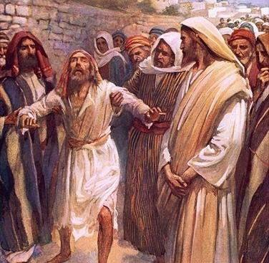
When Jesus Stood Still
Church of Christ at Medina
January 31st, 2021

Slide 2
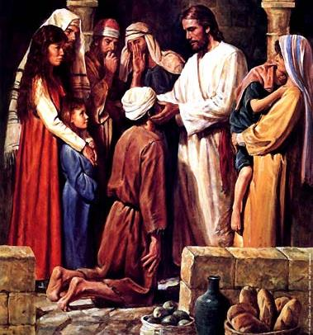
Many Today Are Blind…Spiritually!
Some are blinded by the evils of this world.
The physical pleasures of this life – and the pursuit of them – will often blind people.
These evil works are often compared to darkness, as opposed to the light of righteousness found in Christ.
Some are blinded because they fail to see the light of the gospel.
The devil is constantly trying to shroud or blind people. He will cast doubt and insults on the gospel.
“It is outdated…uneducated…non-inclusive…hateful…”
These are all false narratives that prevent people from seeing the grace of God and His desire for men to live righteously.
Some choose to be blinded by some things.
This is an extremely dangerous condition. We “selectively” see or are “selectively” blind to our condition.
As Christians, we must keep an honest heart and an honest examination of our lives.
References
John 3:19-20, Ephesians 5:11-12, 2 Corinthians 4:1-6, John 9:41, Luke 18:9-14, Revelation 3:14-22, 2 Cor. 13:5

Slide 3
We still need to call out for Jesus.
Bartimaeus was in a dire situation.
He had no medical prospects for healing.
He had no opportunities for provisions but relied on the mercy of others.
His only real hope rested in the man from Nazareth of whom he had undoubtedly heard. So, when he heard that this Jesus was passing by, he cried out for help!
Our situation, spiritually, is like that of the blind man.
We are dead in our trespasses, and we have no prospects for healing on our own. Rather, our only hope is through the sacrifice of Jesus.
What should we do then when we know Jesus is passing by? Cry out for His love and mercy!
When does Jesus pass us by?
References
Mark 6:53-56, 1:40-45, 2:1-12, 3:10, 5:21-43, 7:31-37, 8:22-26
Ephesians 2:1, 1 Peter 1:19

Slide 4
We still need to call out for Jesus.
Jesus passes us by…
…with every sunrise.
…with every Lord’s Day.
…with every moment in His Word.
…with every sermon.
…with every opportunity to sing and partake of the Lord’s Supper.
…with every door to teach others.
…with every period of distress, trial and sadness.
But our Lord is passing by. He will not always stand at the door and wait. We must no longer reject or ignore Him!
References
Mark 6:53-56, 1:40-45, 2:1-12, 3:10, 5:21-43, 7:31-37, 8:22-26
Ephesians 2:1, 1 Peter 1:19

Slide 5
Jesus stood still.
Consider…
Jesus is on His way to Jerusalem, determined that He should fulfill the will of God.
Great crowds are traveling with Him because of the great feast, Passover, and because of His wondrous works.
He is busy, preoccupied and determined. Yet, when He hears the urgent plea of Bartimaeus…”So Jesus stood still.”
Jesus placed great emphasis on the saving of souls, all souls, one soul.
What about me? Do I see the value in the salvation of just one person?
References
Mark 10:32-34, Luke 15:1-10, Luke 15:31-32

Slide 6
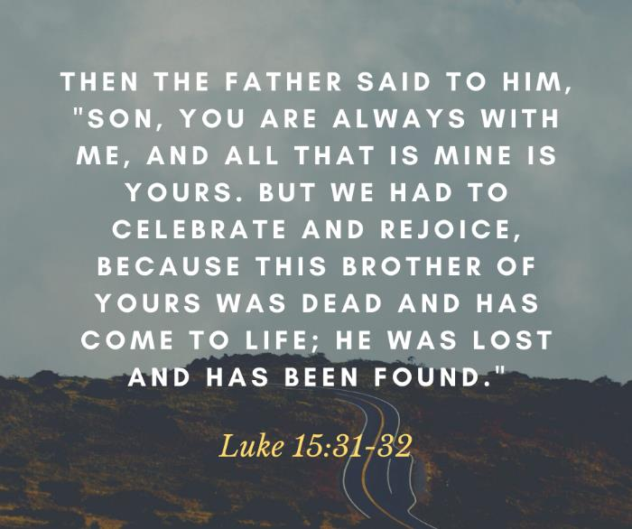
Jesus stood still.
References
Mark 10:32-34, Luke 15:1-10, Luke 15:31-32

Slide 7
Jesus calls for Bartimaeus.
After Jesus stopped, He then called for Bartimaeus to come to Him.
Jesus still calls us today through the gospel!
“For I am not ashamed of the gospel of Christ, for it is the power of God for salvation to everyone who believes, to the Jew first and also to the Greek. For in it the righteousness of God is revealed from faith for faith, as it is written, ‘The righteous shall live by faith.’”
How is the gospel carried to others? Through the words and actions of Christians!
“So faith comes from hearing, and hearing through the word of Christ.”
“Now those who were scattered went about preaching the word.”
“In the same way, let your light shine before others, so that they may see your good works and give glory to your Father who is in heaven.”
References
Romans 1:16, Romans 10:13-14, 17, Acts 8:4, Matthew 5:16, Hebrews 12:1-2, Acts 8:39

Slide 8
“Your faith has made you well.”
Who or what was responsible for Bartimaeus being able to see? Jesus said, “Go your way; your faith has made you well.”
We all understand that it was Jesus who gave Bartimaeus his sight. However, it was given to Bartimaeus based on faith – a belief in the power of Jesus and the willingness to act on that belief.
Our spiritual sight today is exactly the same. It is Jesus who provides the sight, but our faith plays a major role.
“And without faith it is impossible to please him, for whoever would draw near to God must believe that He exists and that He rewards those who seek Him.”
“Come to me, all who labor and are heavy laden, and I will give you rest. Take my yoke upon you, and learn from me, for I am gentle and lowly in heart, and you will find rest for your souls. For my yoke is easy, and my burden is light.”
References
Hebrews 11:6, Matthew 11:28-30

