Slide 1
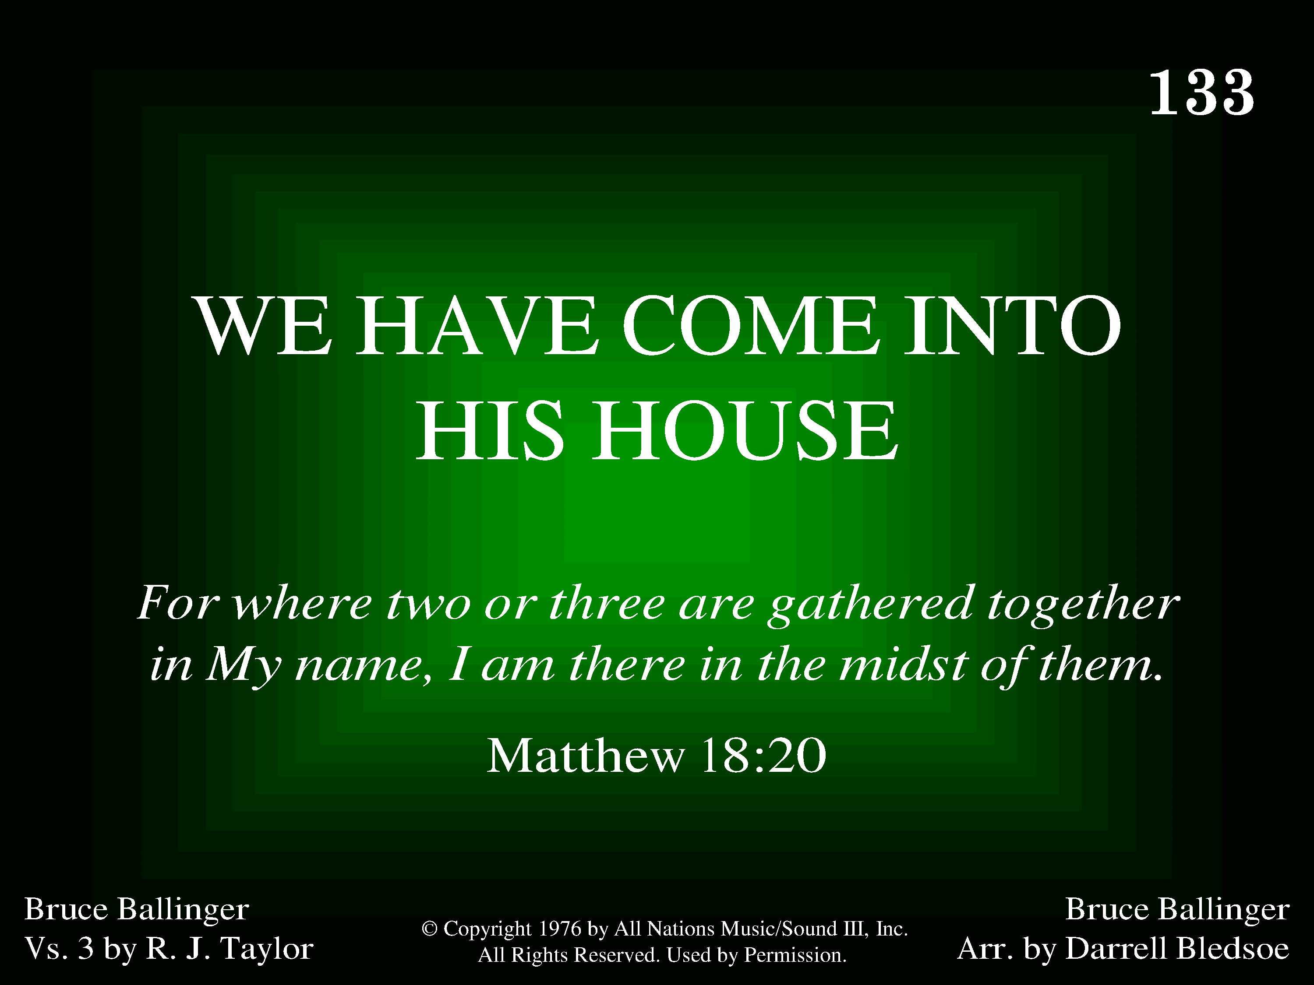
1133 - We Have Come Into His House - Title

Slide 2
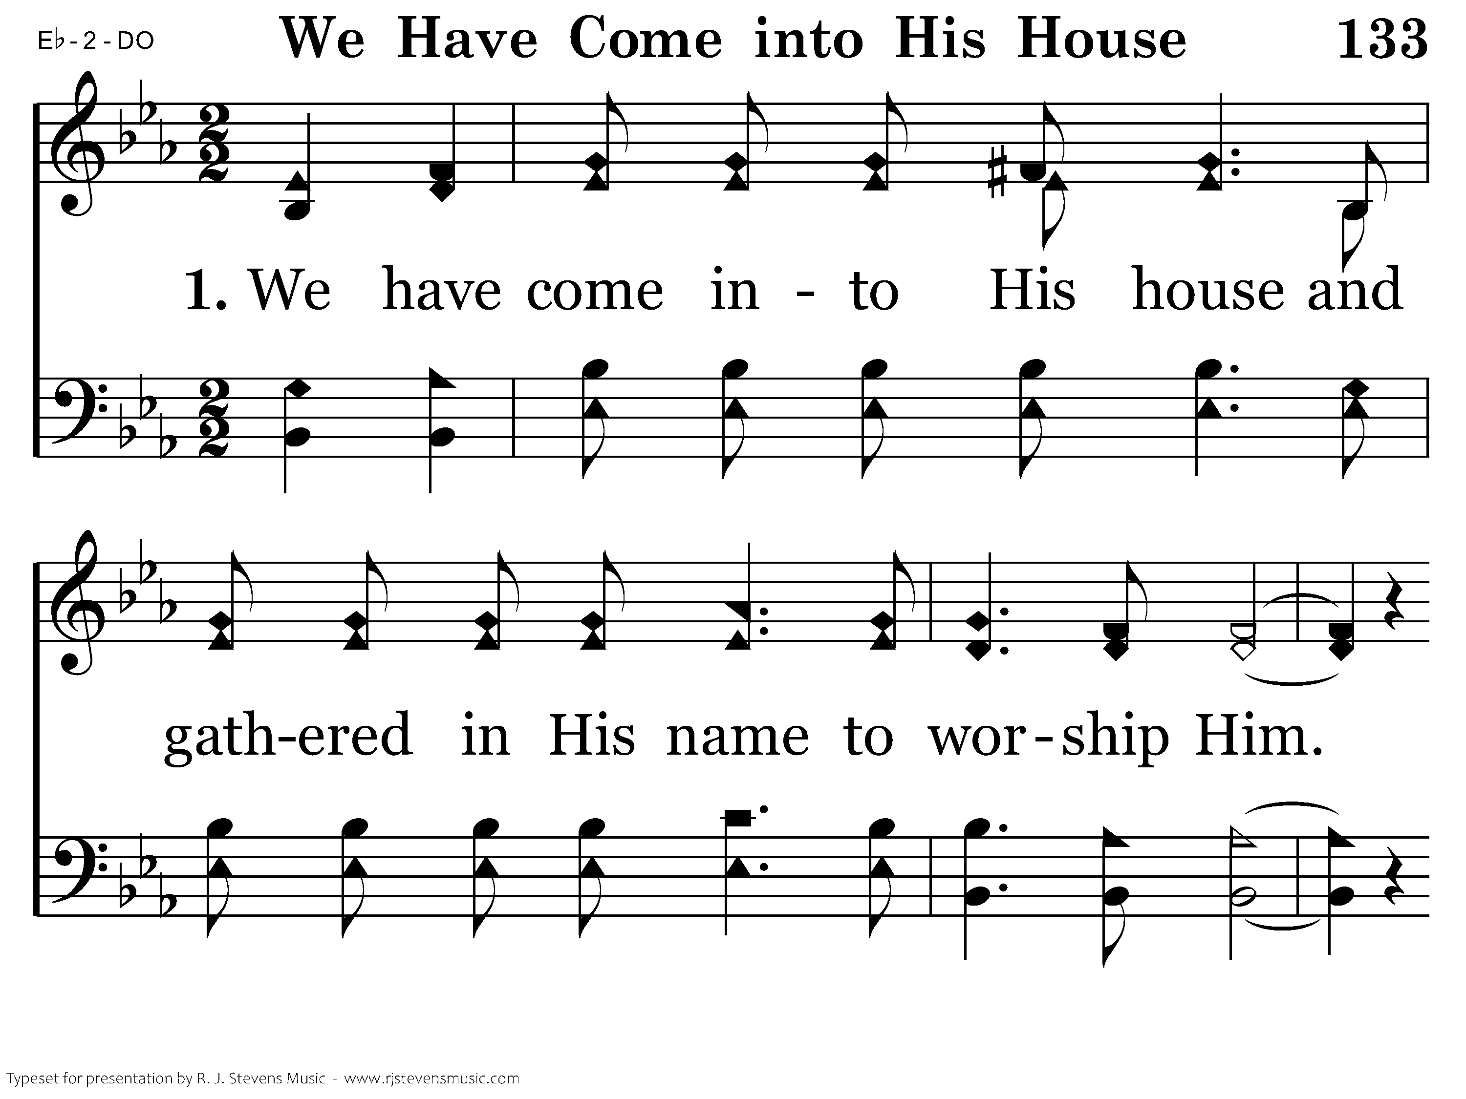
1133 - We Have Come Into His House - 1.1

Slide 3
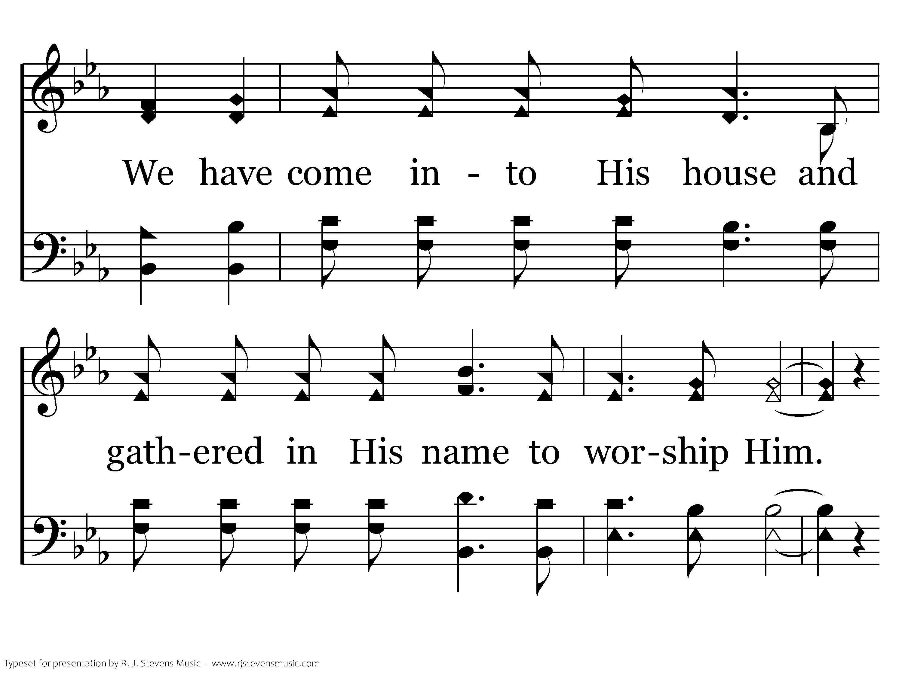
1133 - We Have Come Into His House - 1.2

Slide 4
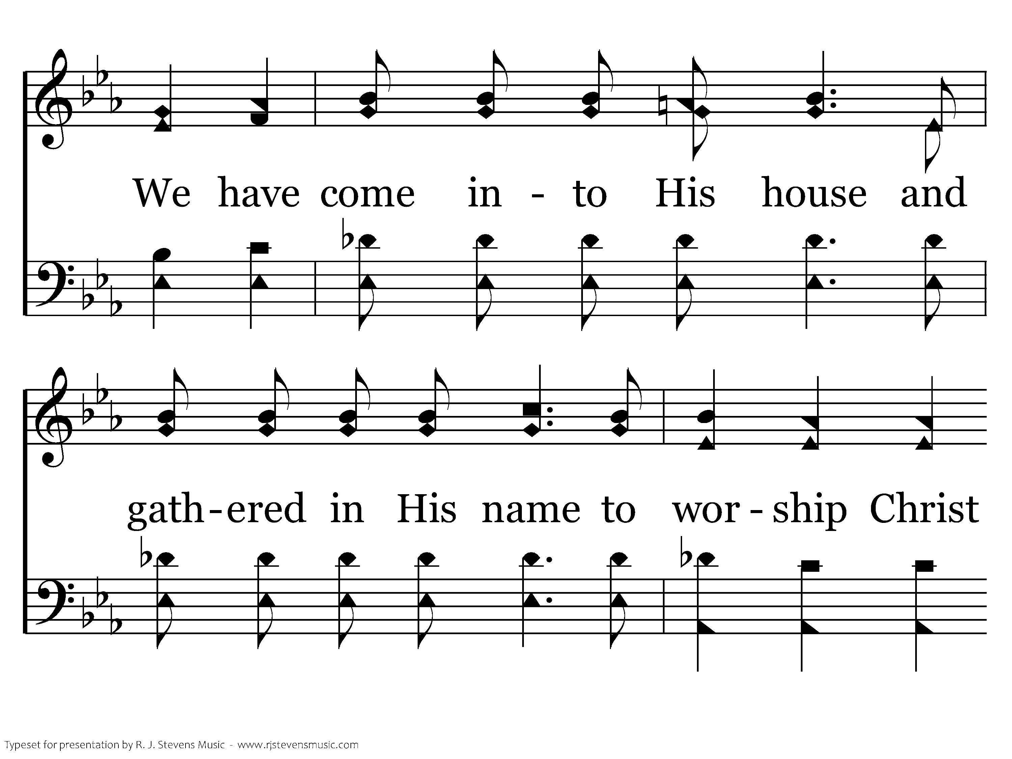
1133 - We Have Come Into His House - 1.3

Slide 5
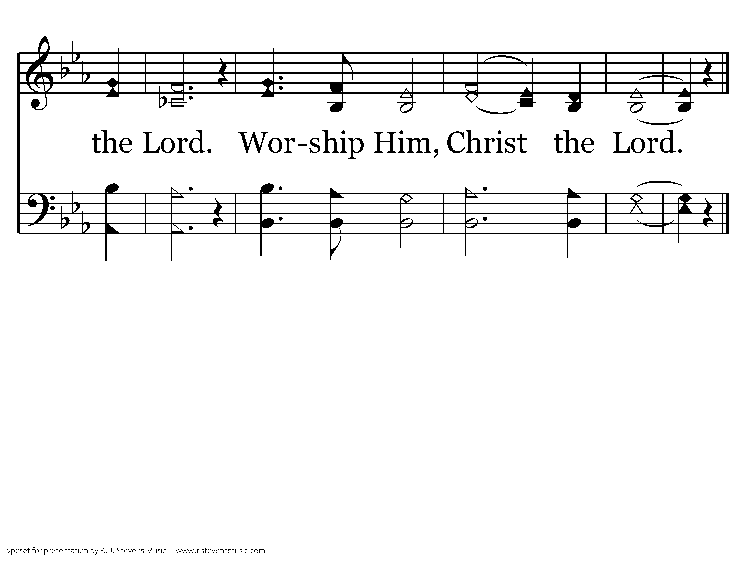
1133 - We Have Come Into His House - 1.4
End of Verse 1

Slide 6
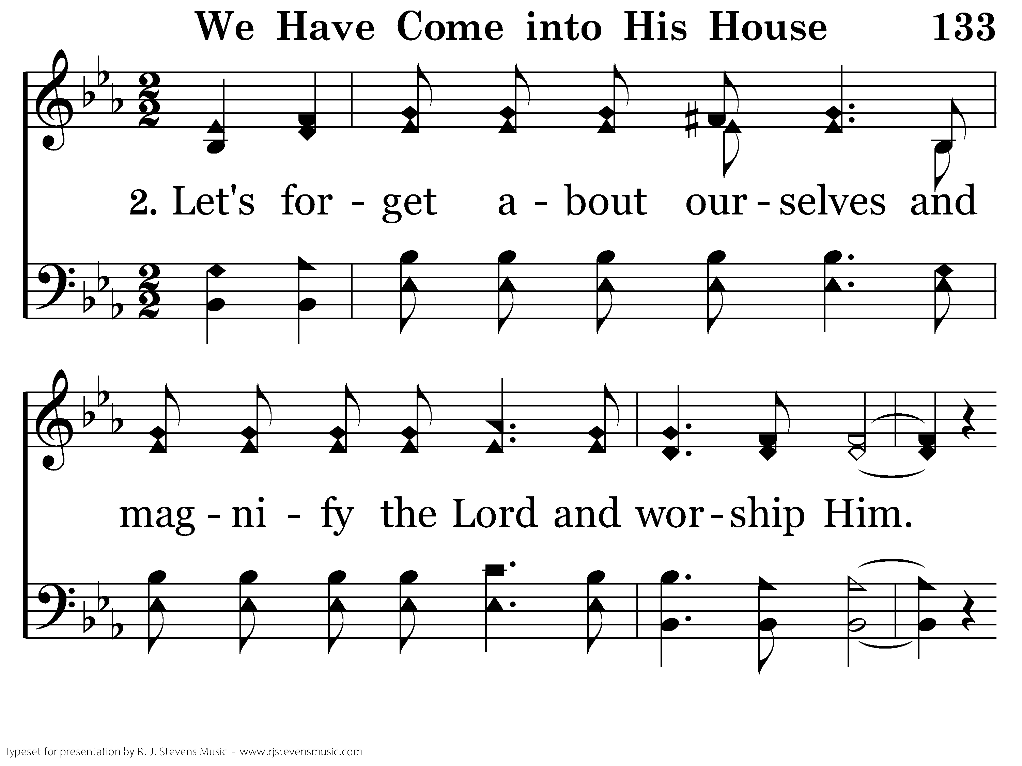
1133 - We Have Come Into His House - 2.1

Slide 7
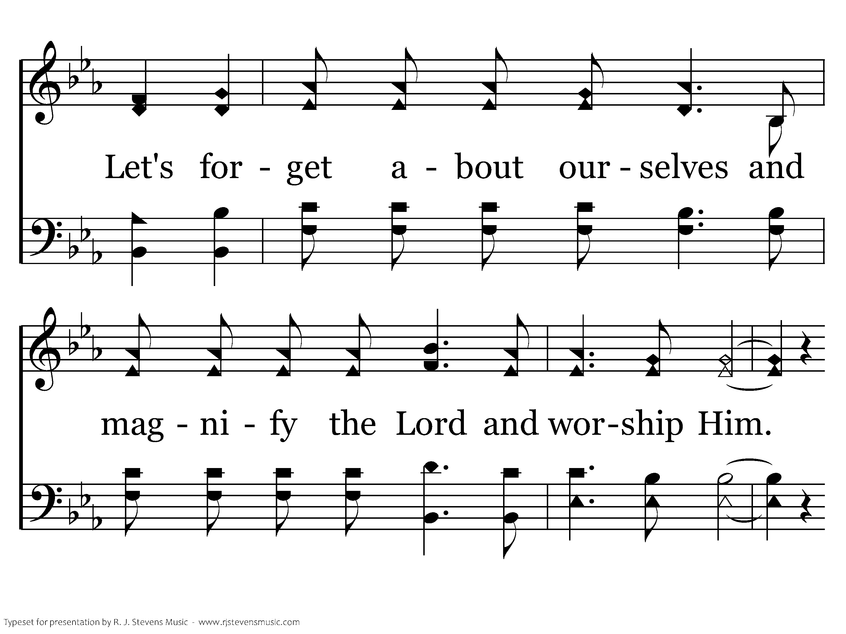
1133 - We Have Come Into His House - 2.2

Slide 8
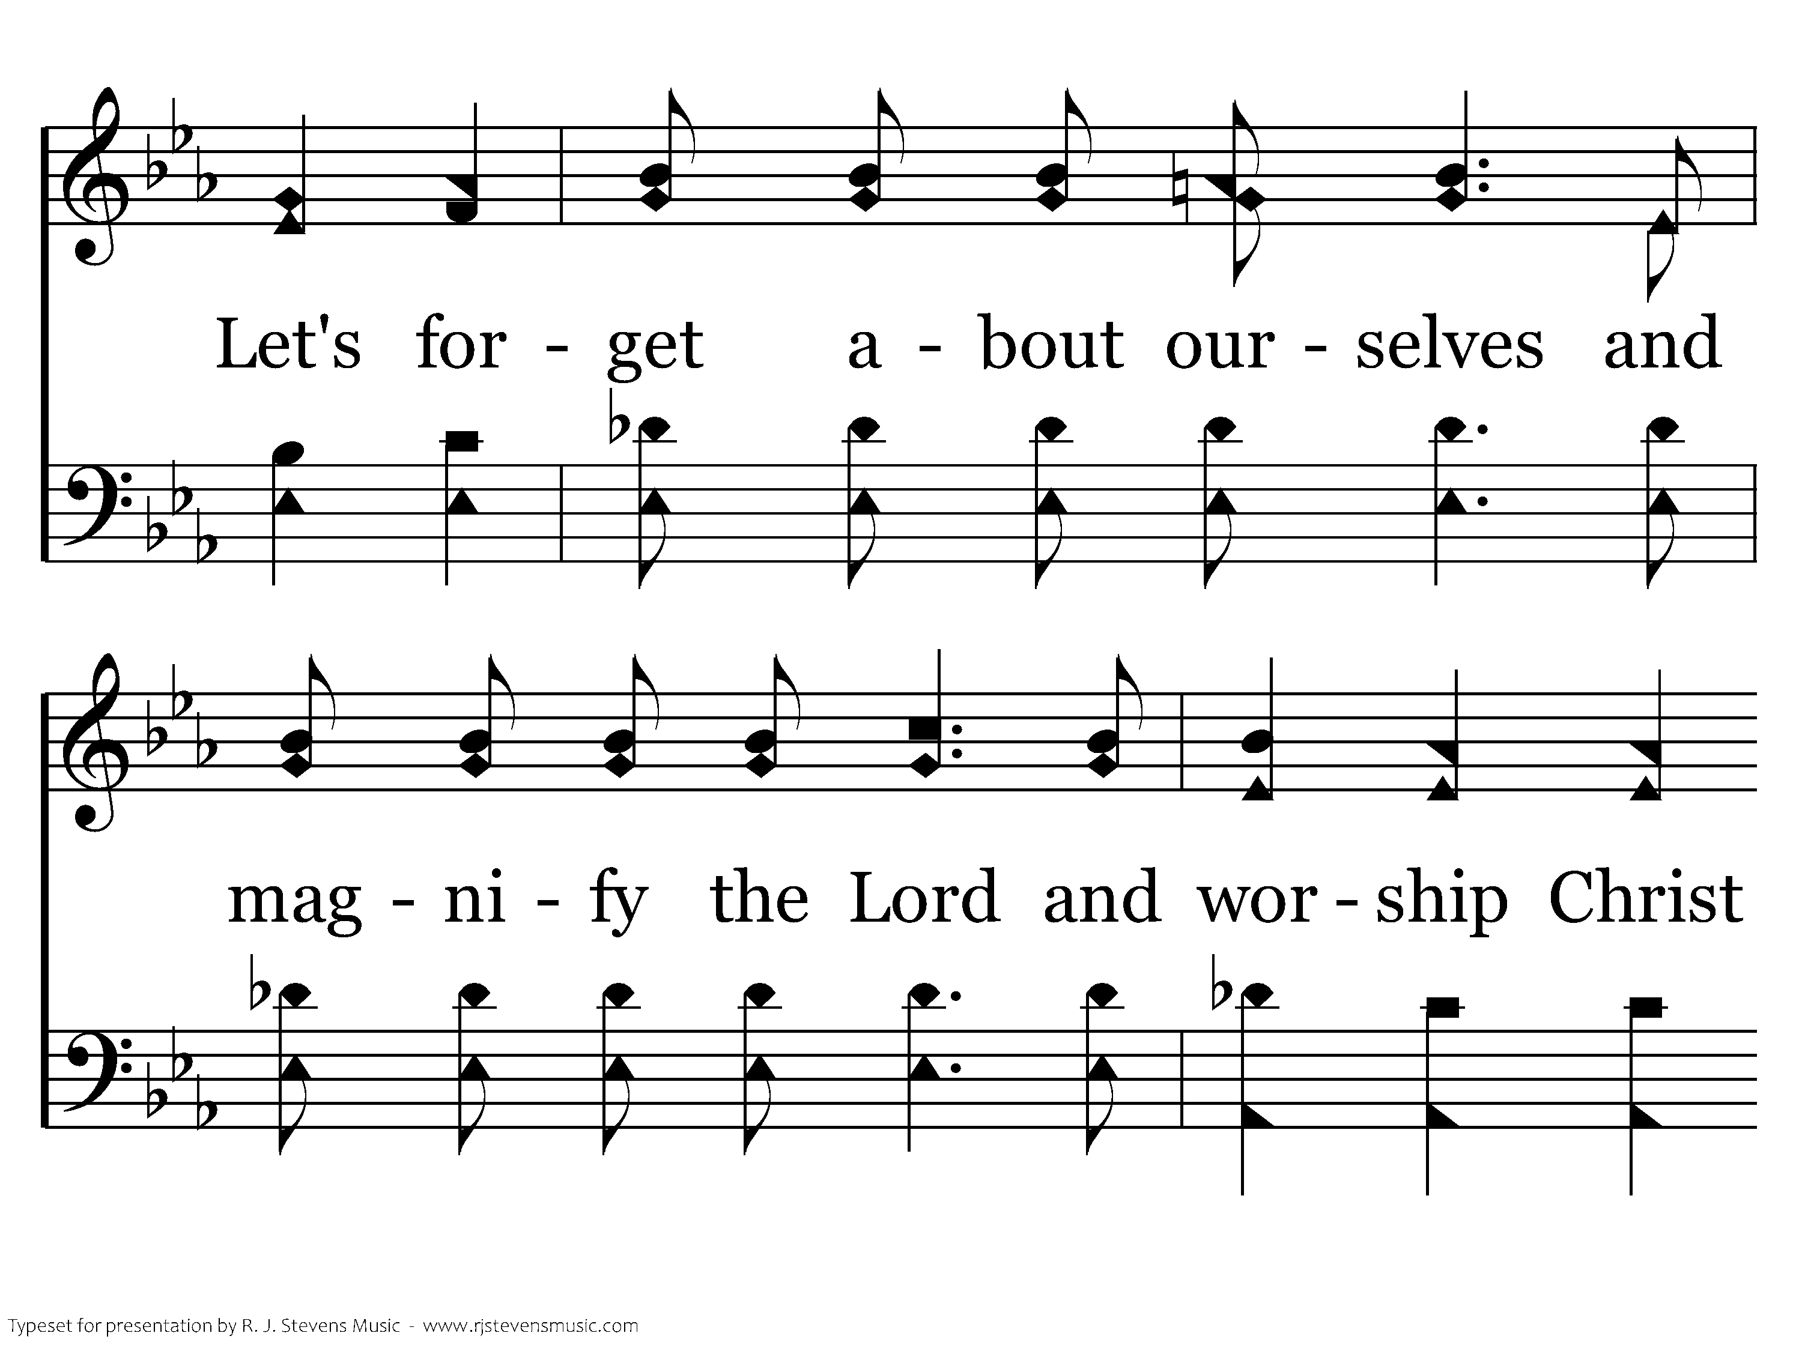
1133 - We Have Come Into His House - 2.3

Slide 9
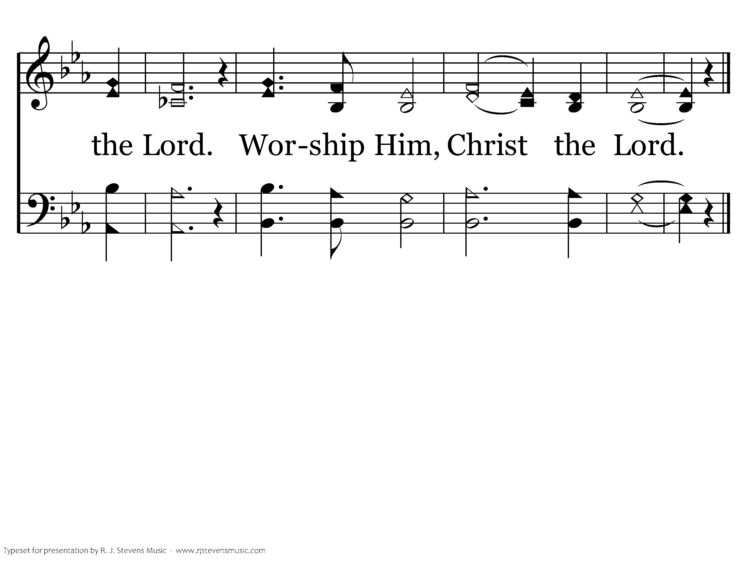
1133 - We Have Come Into His House - 2.4
End of Verse 2

Slide 10
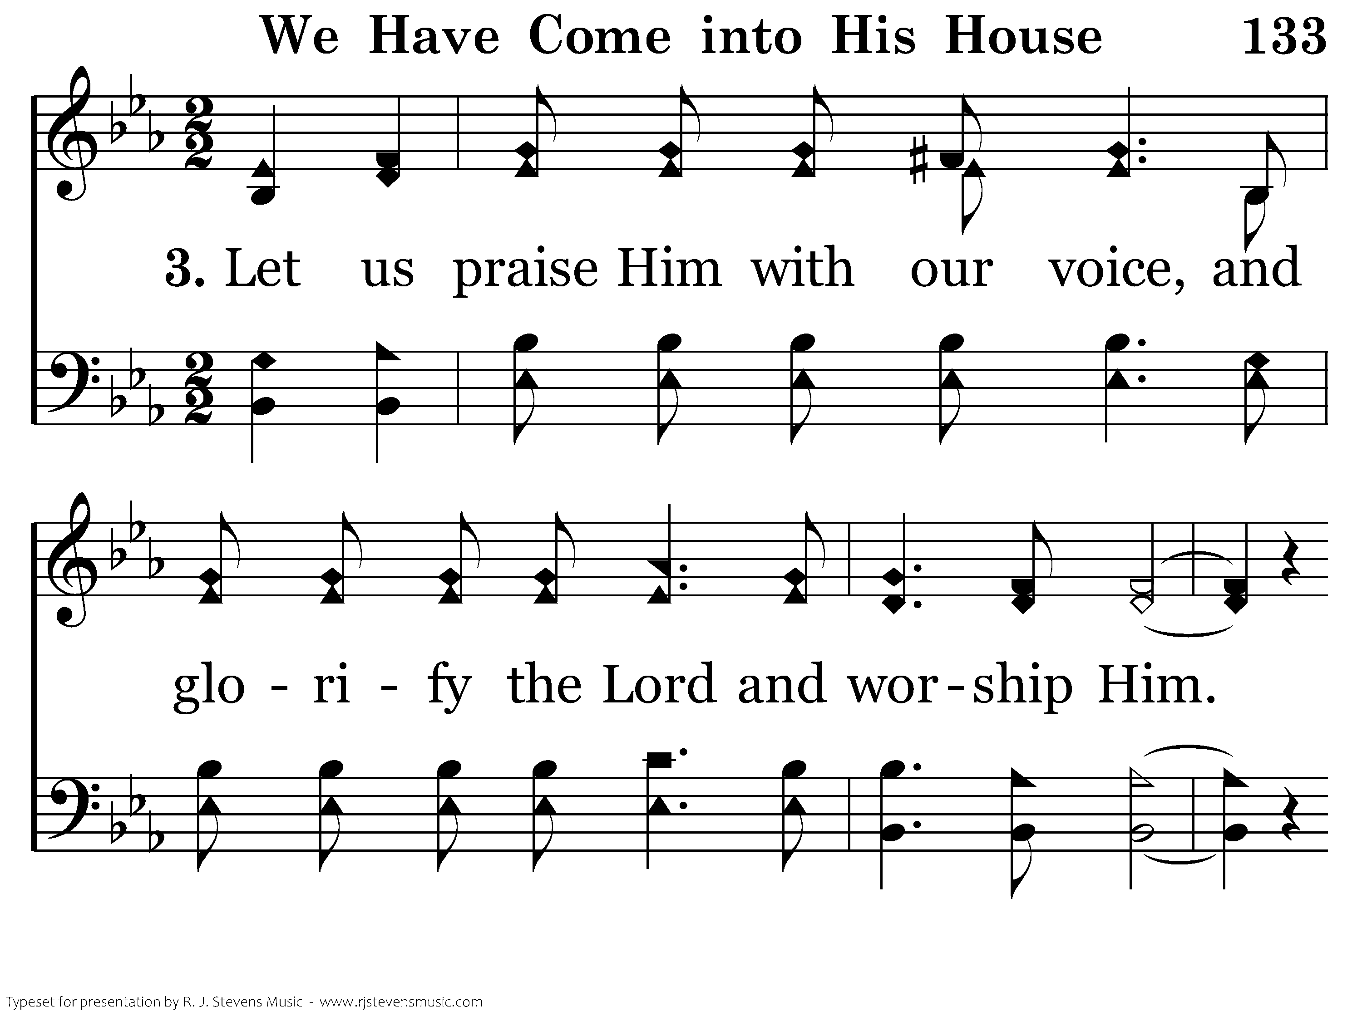
1133 - We Have Come Into His House - 3.1

Slide 11
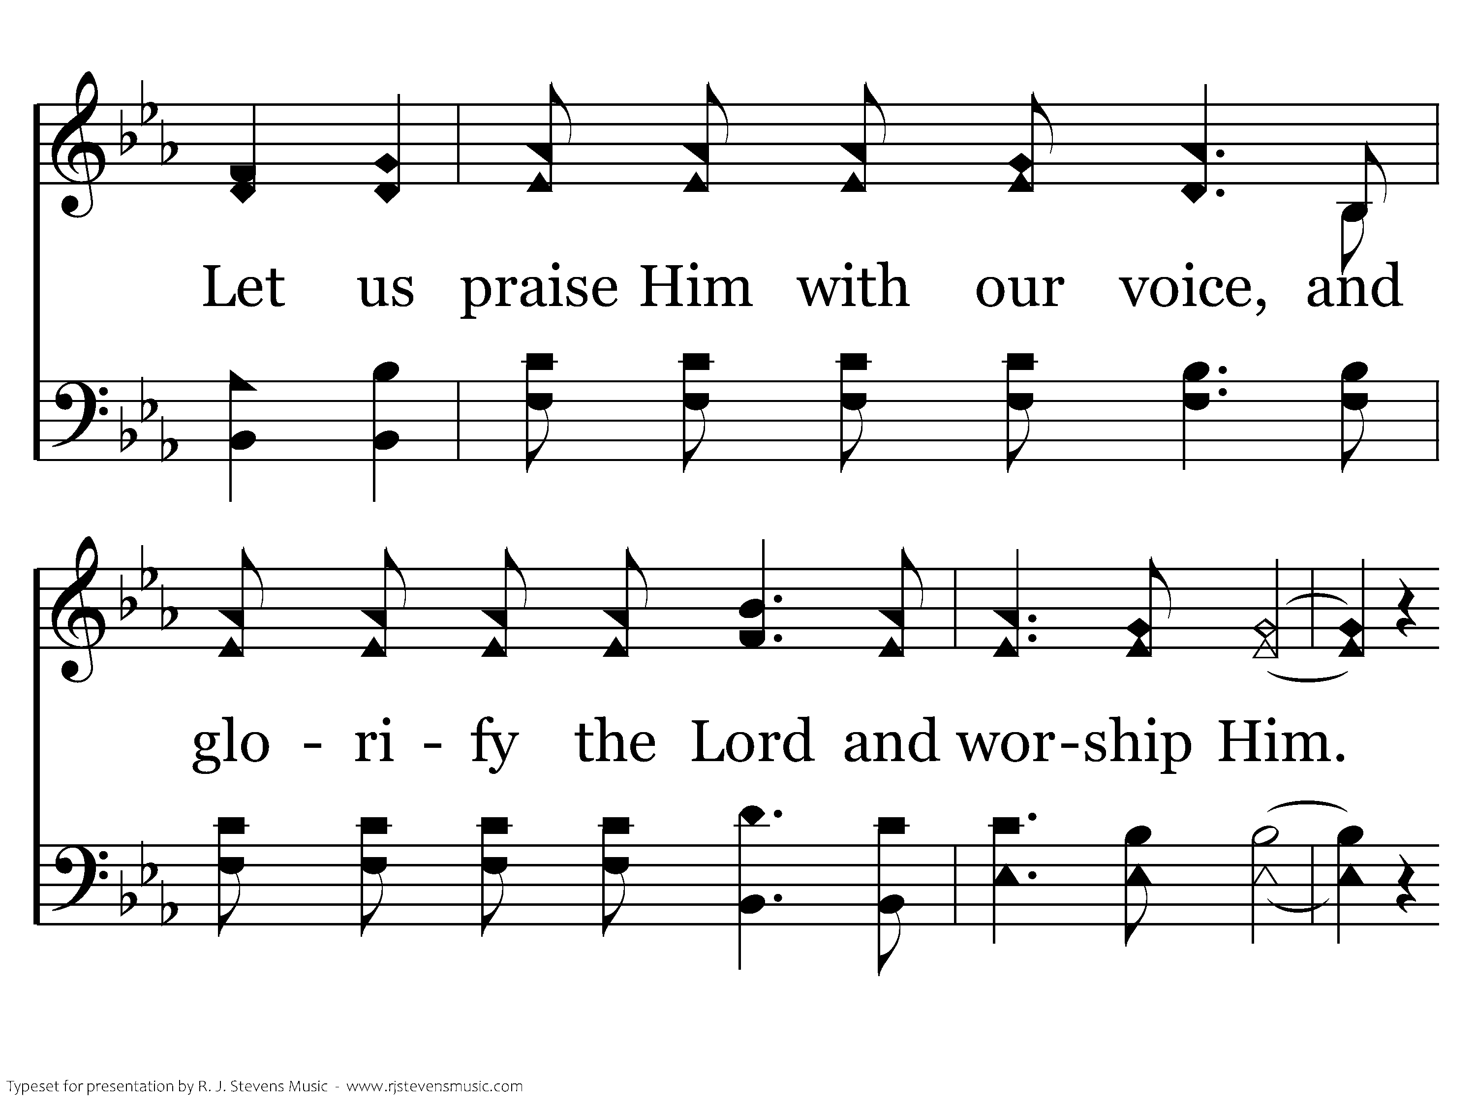
1133 - We Have Come Into His House - 3.2

Slide 12
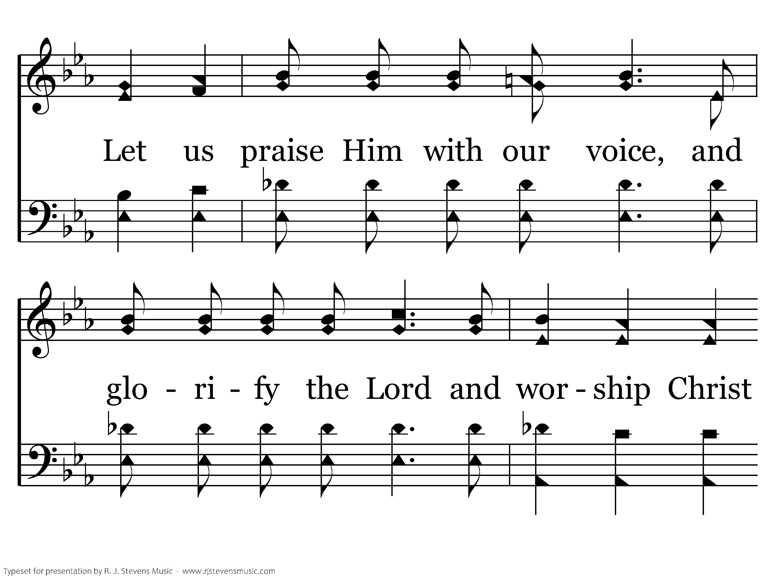
1133 - We Have Come Into His House - 3.3

Slide 13

1133 - We Have Come Into His House - 3.4
End of Song

Slide 14

047 - God Is So Good - Title

Slide 15
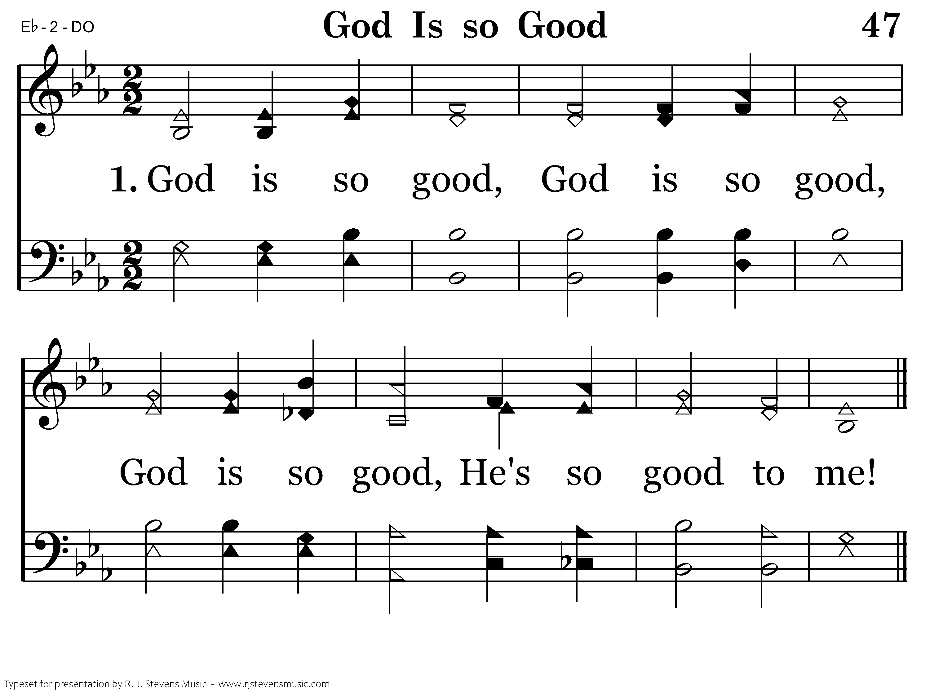
047 - God Is So Good - 1.1
End of Verse 1

Slide 16
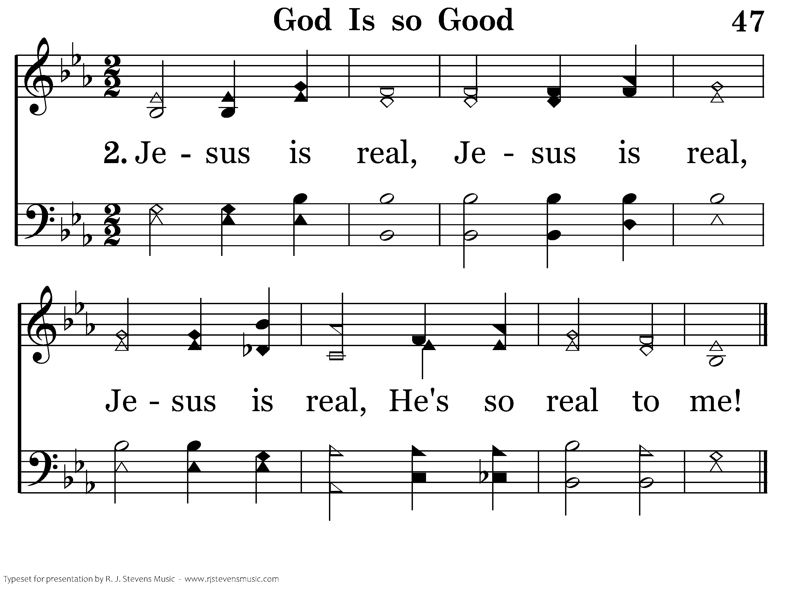
047 - God Is So Good - 2.1
End of Verse 2

Slide 17
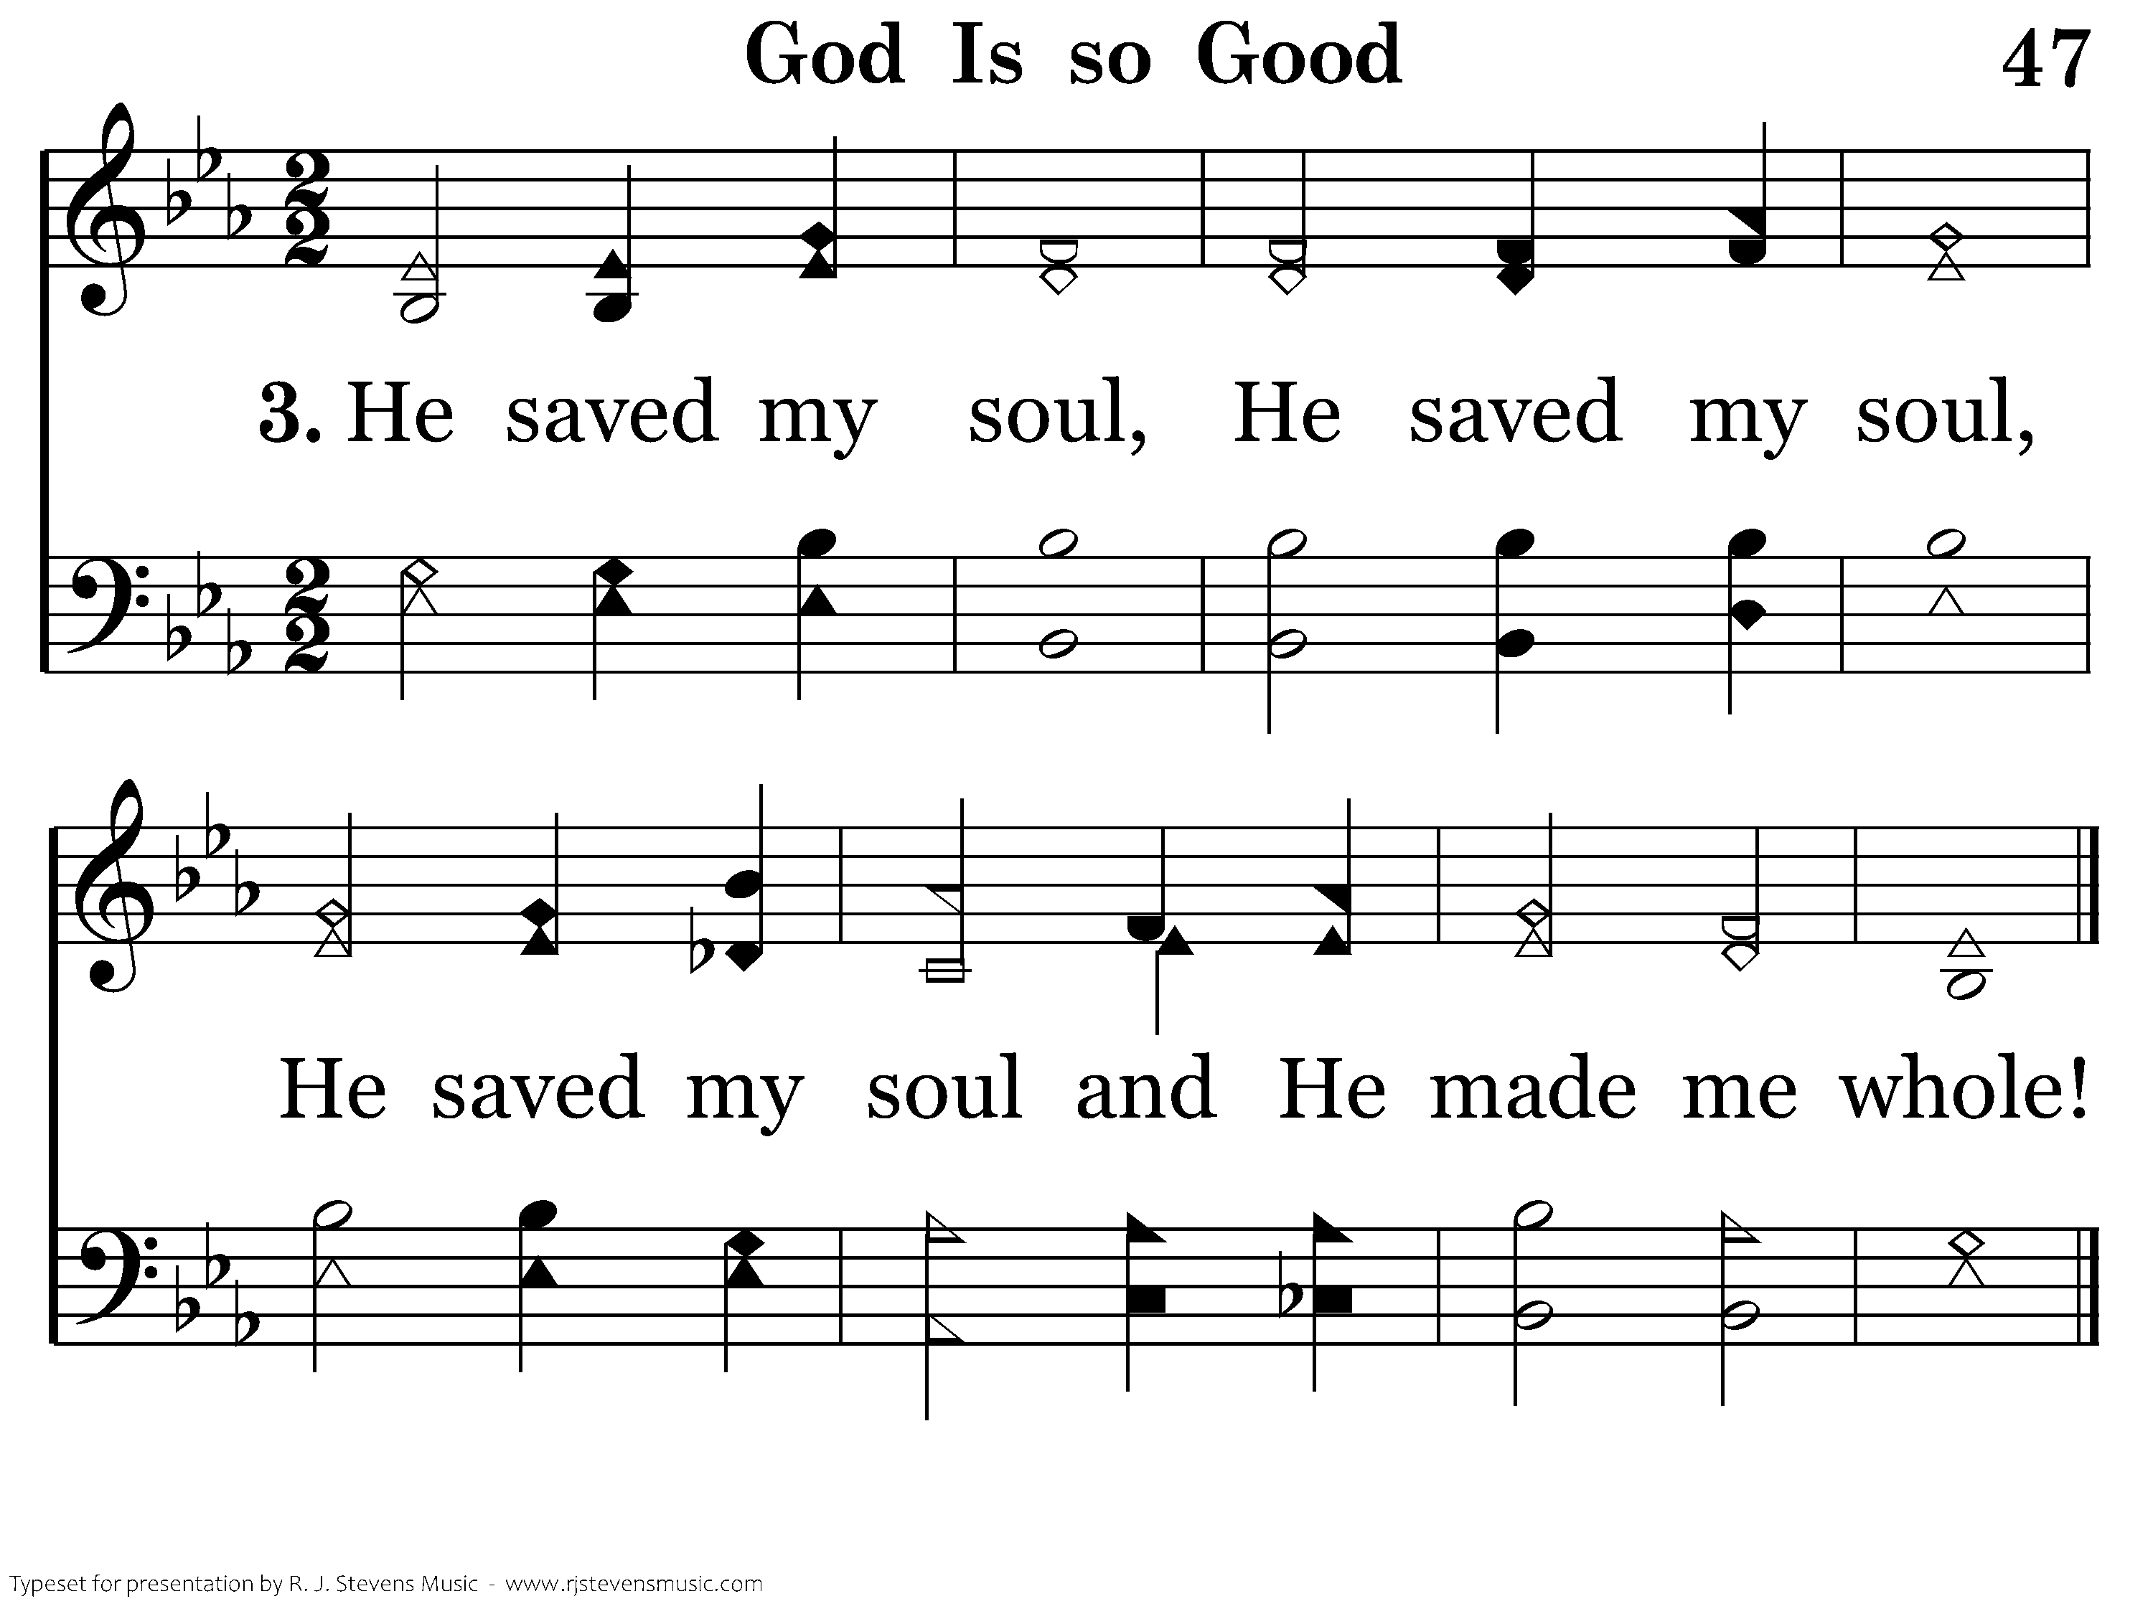
047 - God Is So Good - 3.1
End of Verse 3

Slide 18
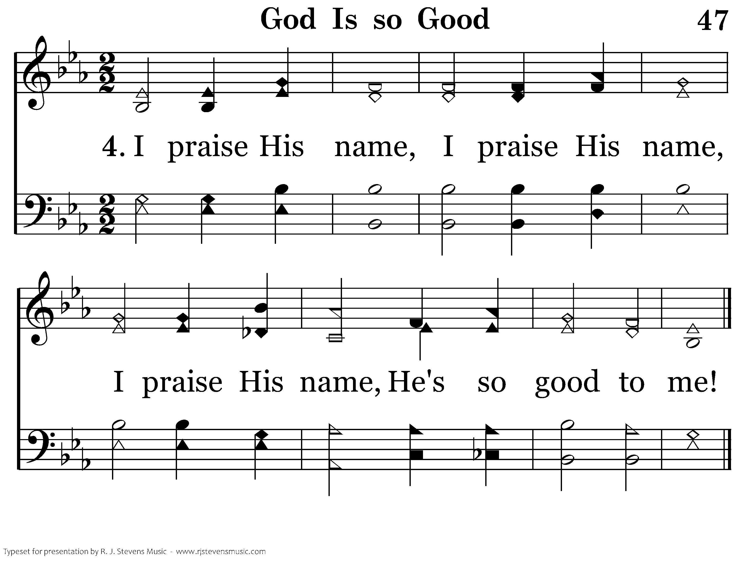
047 - God Is So Good - 4.1
End of Song

Slide 20
Now the multitude of those who believed were of one heart and one soul; neither did anyone say that any of the things he possessed was his own, but they had all things in common. And with great power the apostles gave witness to the resurrection of the Lord Jesus. And great grace was upon them all. Nor was there anyone among them who lacked; for all who were possessors of lands or houses sold them and brought the proceeds of the things that were sold, and laid them at the apostles' feet; and they distributed to each as anyone had need. And Joses, who was also named Barnabas by the apostles (which is translated Son of Encouragement), a Levite of the country of Cyprus, having land, sold it, and brought the money and laid it at the apostles' feet. (Acts 4:32-37 NKJV)

Slide 21
But a certain man named Ananias, with Sapphira his wife, sold a possession. And he kept back part of the proceeds, his wife also being aware of it, and brought a certain part and laid it at the apostles' feet. But Peter said, "Ananias, why has Satan filled your heart to lie to the Holy Spirit and keep back part of the price of the land for yourself? "While it remained, was it not your own? And after it was sold, was it not in your own control? Why have you conceived this thing in your heart? You have not lied to men but to God." Then Ananias, hearing these words, fell down and breathed his last. So great fear came upon all those who heard these things. (Acts 5:1-5 NKJV)

Slide 22
And the young men arose and wrapped him up, carried him out, and buried him. Now it was about three hours later when his wife came in, not knowing what had happened. And Peter answered her, "Tell me whether you sold the land for so much?" She said, "Yes, for so much." Then Peter said to her, "How is it that you have agreed together to test the Spirit of the Lord? Look, the feet of those who have buried your husband are at the door, and they will carry you out." Then immediately she fell down at his feet and breathed her last. And the young men came in and found her dead, and carrying her out, buried her by her husband. So great fear came upon all the church and upon all who heard these things. (Acts 5:6-11 NKJV)

Slide 23
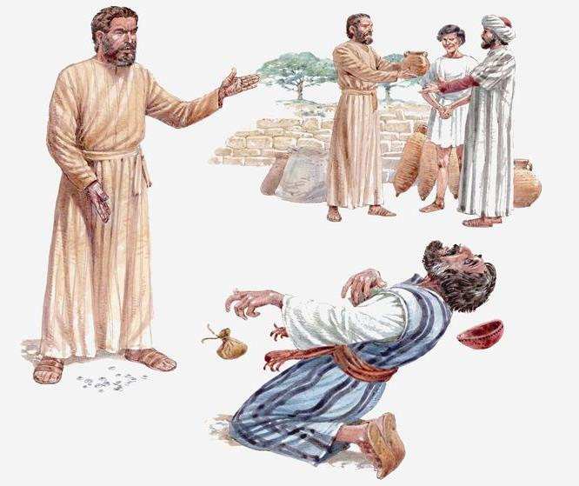
Life Lessons From Ananias & Sapphira
Acts 5:1-11

Slide 24

#1 – Your Spouse Has A Great Influence On You.
Had either of them been a better spouse, the whole thing would not have happened.
One of the blessings of marriage is that you have someone who can be strong when you are weak (Ecclesiastes 4:9-12).
I know of no single factor that has more to do with your faithfulness to God than your spouse.
Husband and wife are to help each other to faithfulness not hinder each other!
Husband and Wife are a Team!

Slide 25
#2 - Do Not Do Good To Try To Impress Men
Ananias and Sapphira wanted people to think they had given all. They were trying to impress men.
  "Take heed that you do not do your charitable deeds before men, to be seen by them. Otherwise you have no reward from your Father in heaven. "Therefore, when you do a charitable deed, do not sound a trumpet before you as the hypocrites do in the synagogues and in the streets, that they may have glory from men. Assuredly, I say to you, they have their reward. "But when you do a charitable deed, do not let your left hand know what your right hand is doing, (Matthew 6:1-3 NKJV)
  Nevertheless even among the rulers many believed in Him, but because of the Pharisees they did not confess Him, lest they should be put out of the synagogue; for they loved the praise of men more than the praise of God. (John 12:42-43 NKJV)
Do you broadcast your good deeds? God knows our hearts!

Slide 26
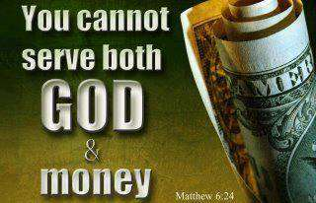
#3 - Something Good Can Be Turned Into Something Bad
What could be wrong with giving money to help those in need?
  For the love of money is a root of all kinds of evil, for which some have strayed from the faith in their greediness and pierced themselves through with many sorrows. (1 Timothy 6:10 NKJV)
  Let your conduct be without covetousness; be content with such things as you have. For He Himself has said, "I will never leave you nor forsake you." (Hebrews 13:5 NKJV)

Slide 27
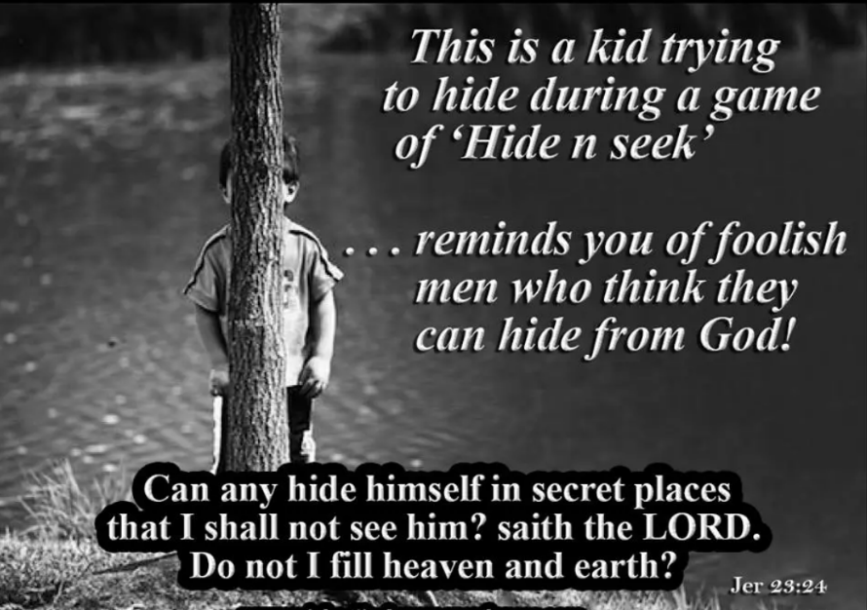
#4 - You Cannot Hide Anything From God
Man can see what you do. God can see why you do it.
  "But if you do not do so, then take note, you have sinned against the LORD; and be sure your sin will find you out. (Numbers 32:23 NKJV)
  And there is no creature hidden from His sight, but all things are naked and open to the eyes of Him to whom we must give account. (Hebrews 4:13 NKJV)

Slide 28

Conclusion
The fact that judgment doesn’t occur immediately as it did with Ananias and Sapphira, doesn’t mean that God doesn’t know and won’t hold us accountable.
Brethren, develop the kind of morals that will allow you to stand before the judgment seat of Christ and say as David did, “Search me, O God, and know my heart: try me, and know my thoughts: And see if there is any wicked way in me, and lead me in the way everlasting” (Psalm 139:23-24).

Slide 29

680 - Anywhere Is "Home" - Title

Slide 30
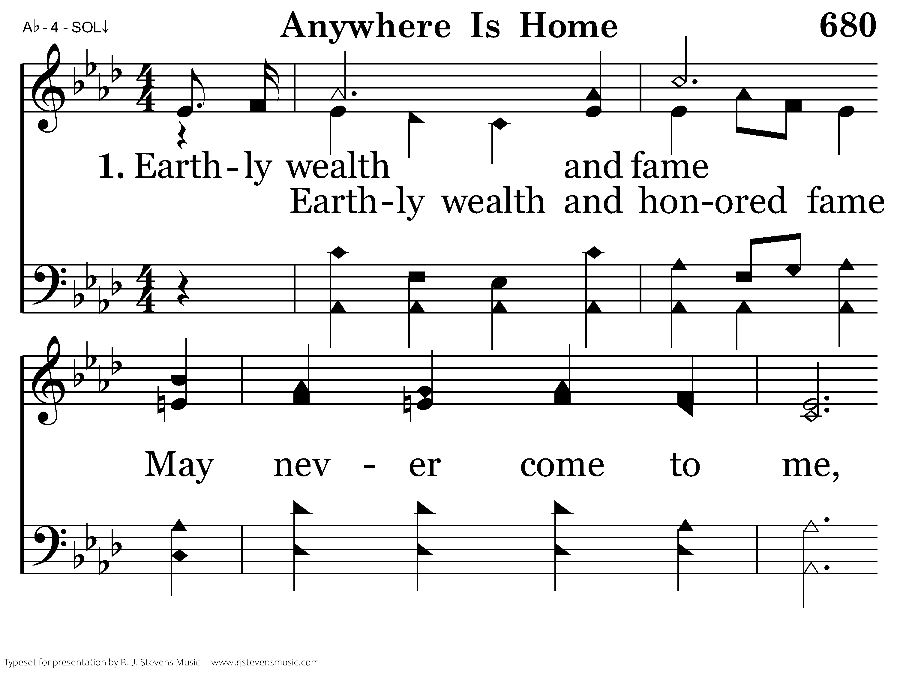
680 - Anywhere Is "Home" - 1.1

Slide 31
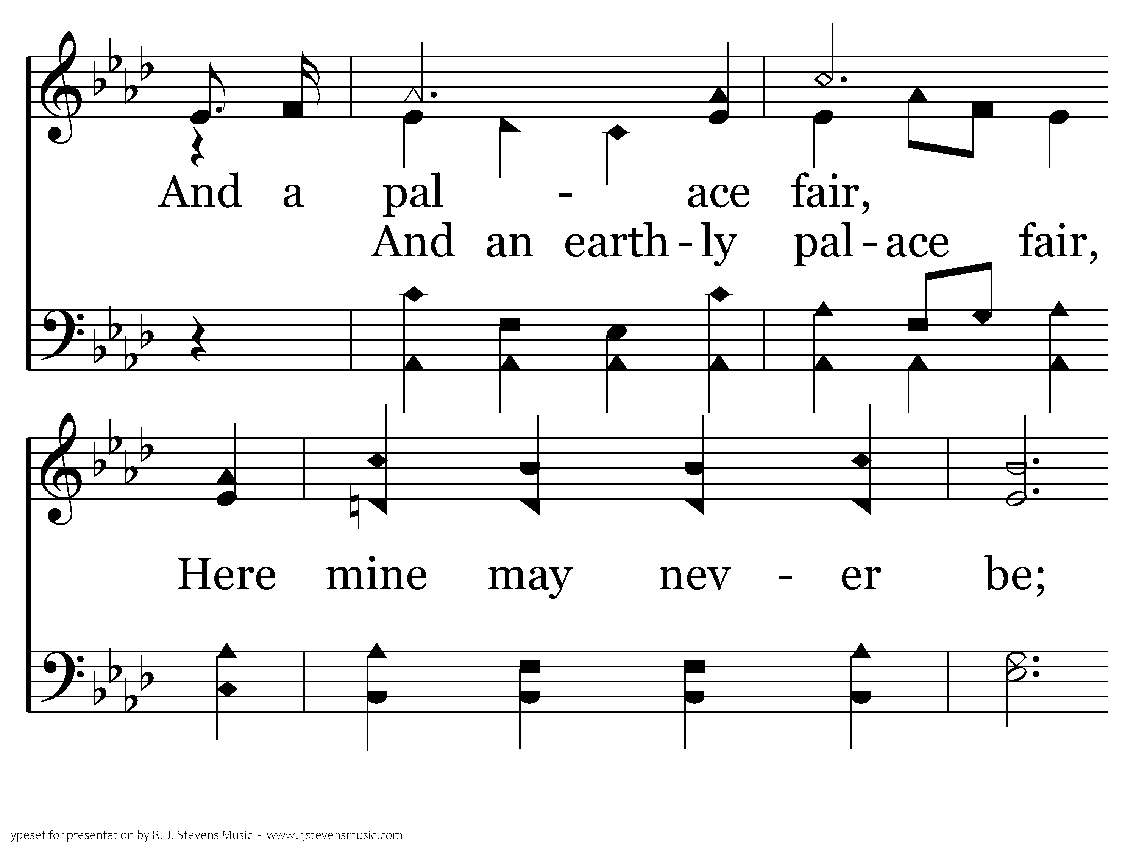
680 - Anywhere Is "Home" - 1.2

Slide 32
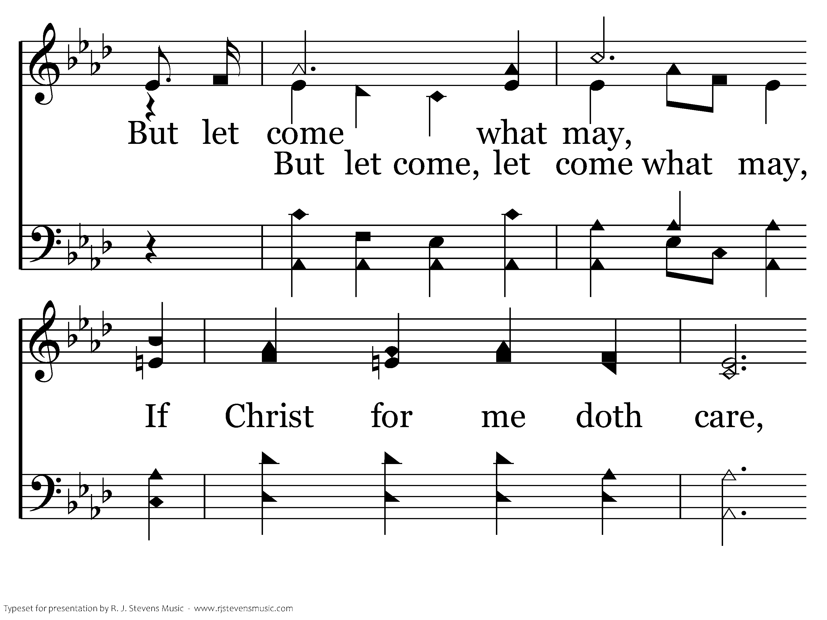
680 - Anywhere Is "Home" - 1.3

Slide 33
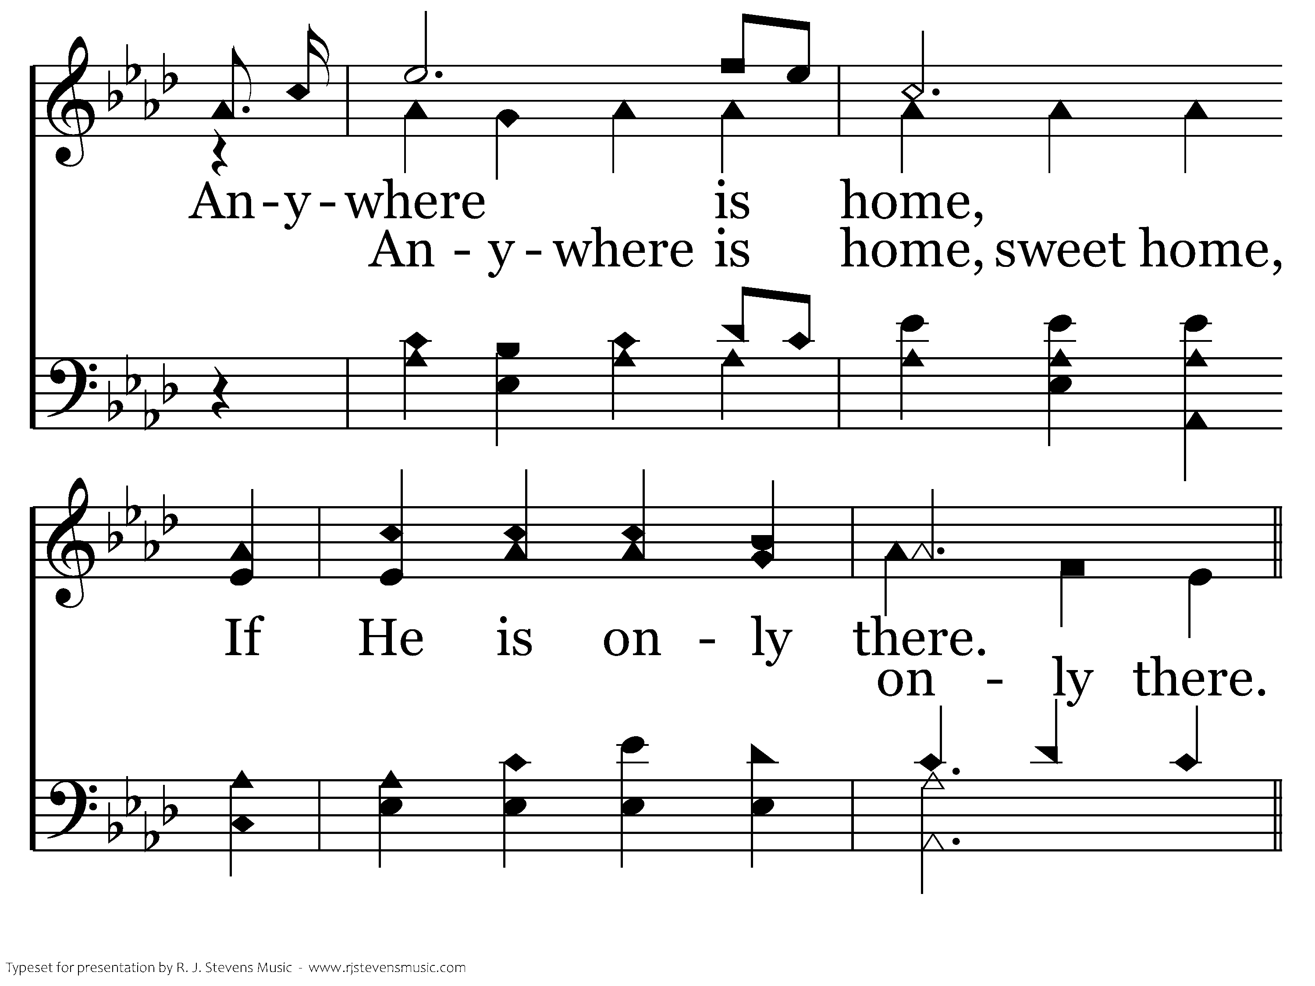
680 - Anywhere Is "Home" - 1.4

Slide 34
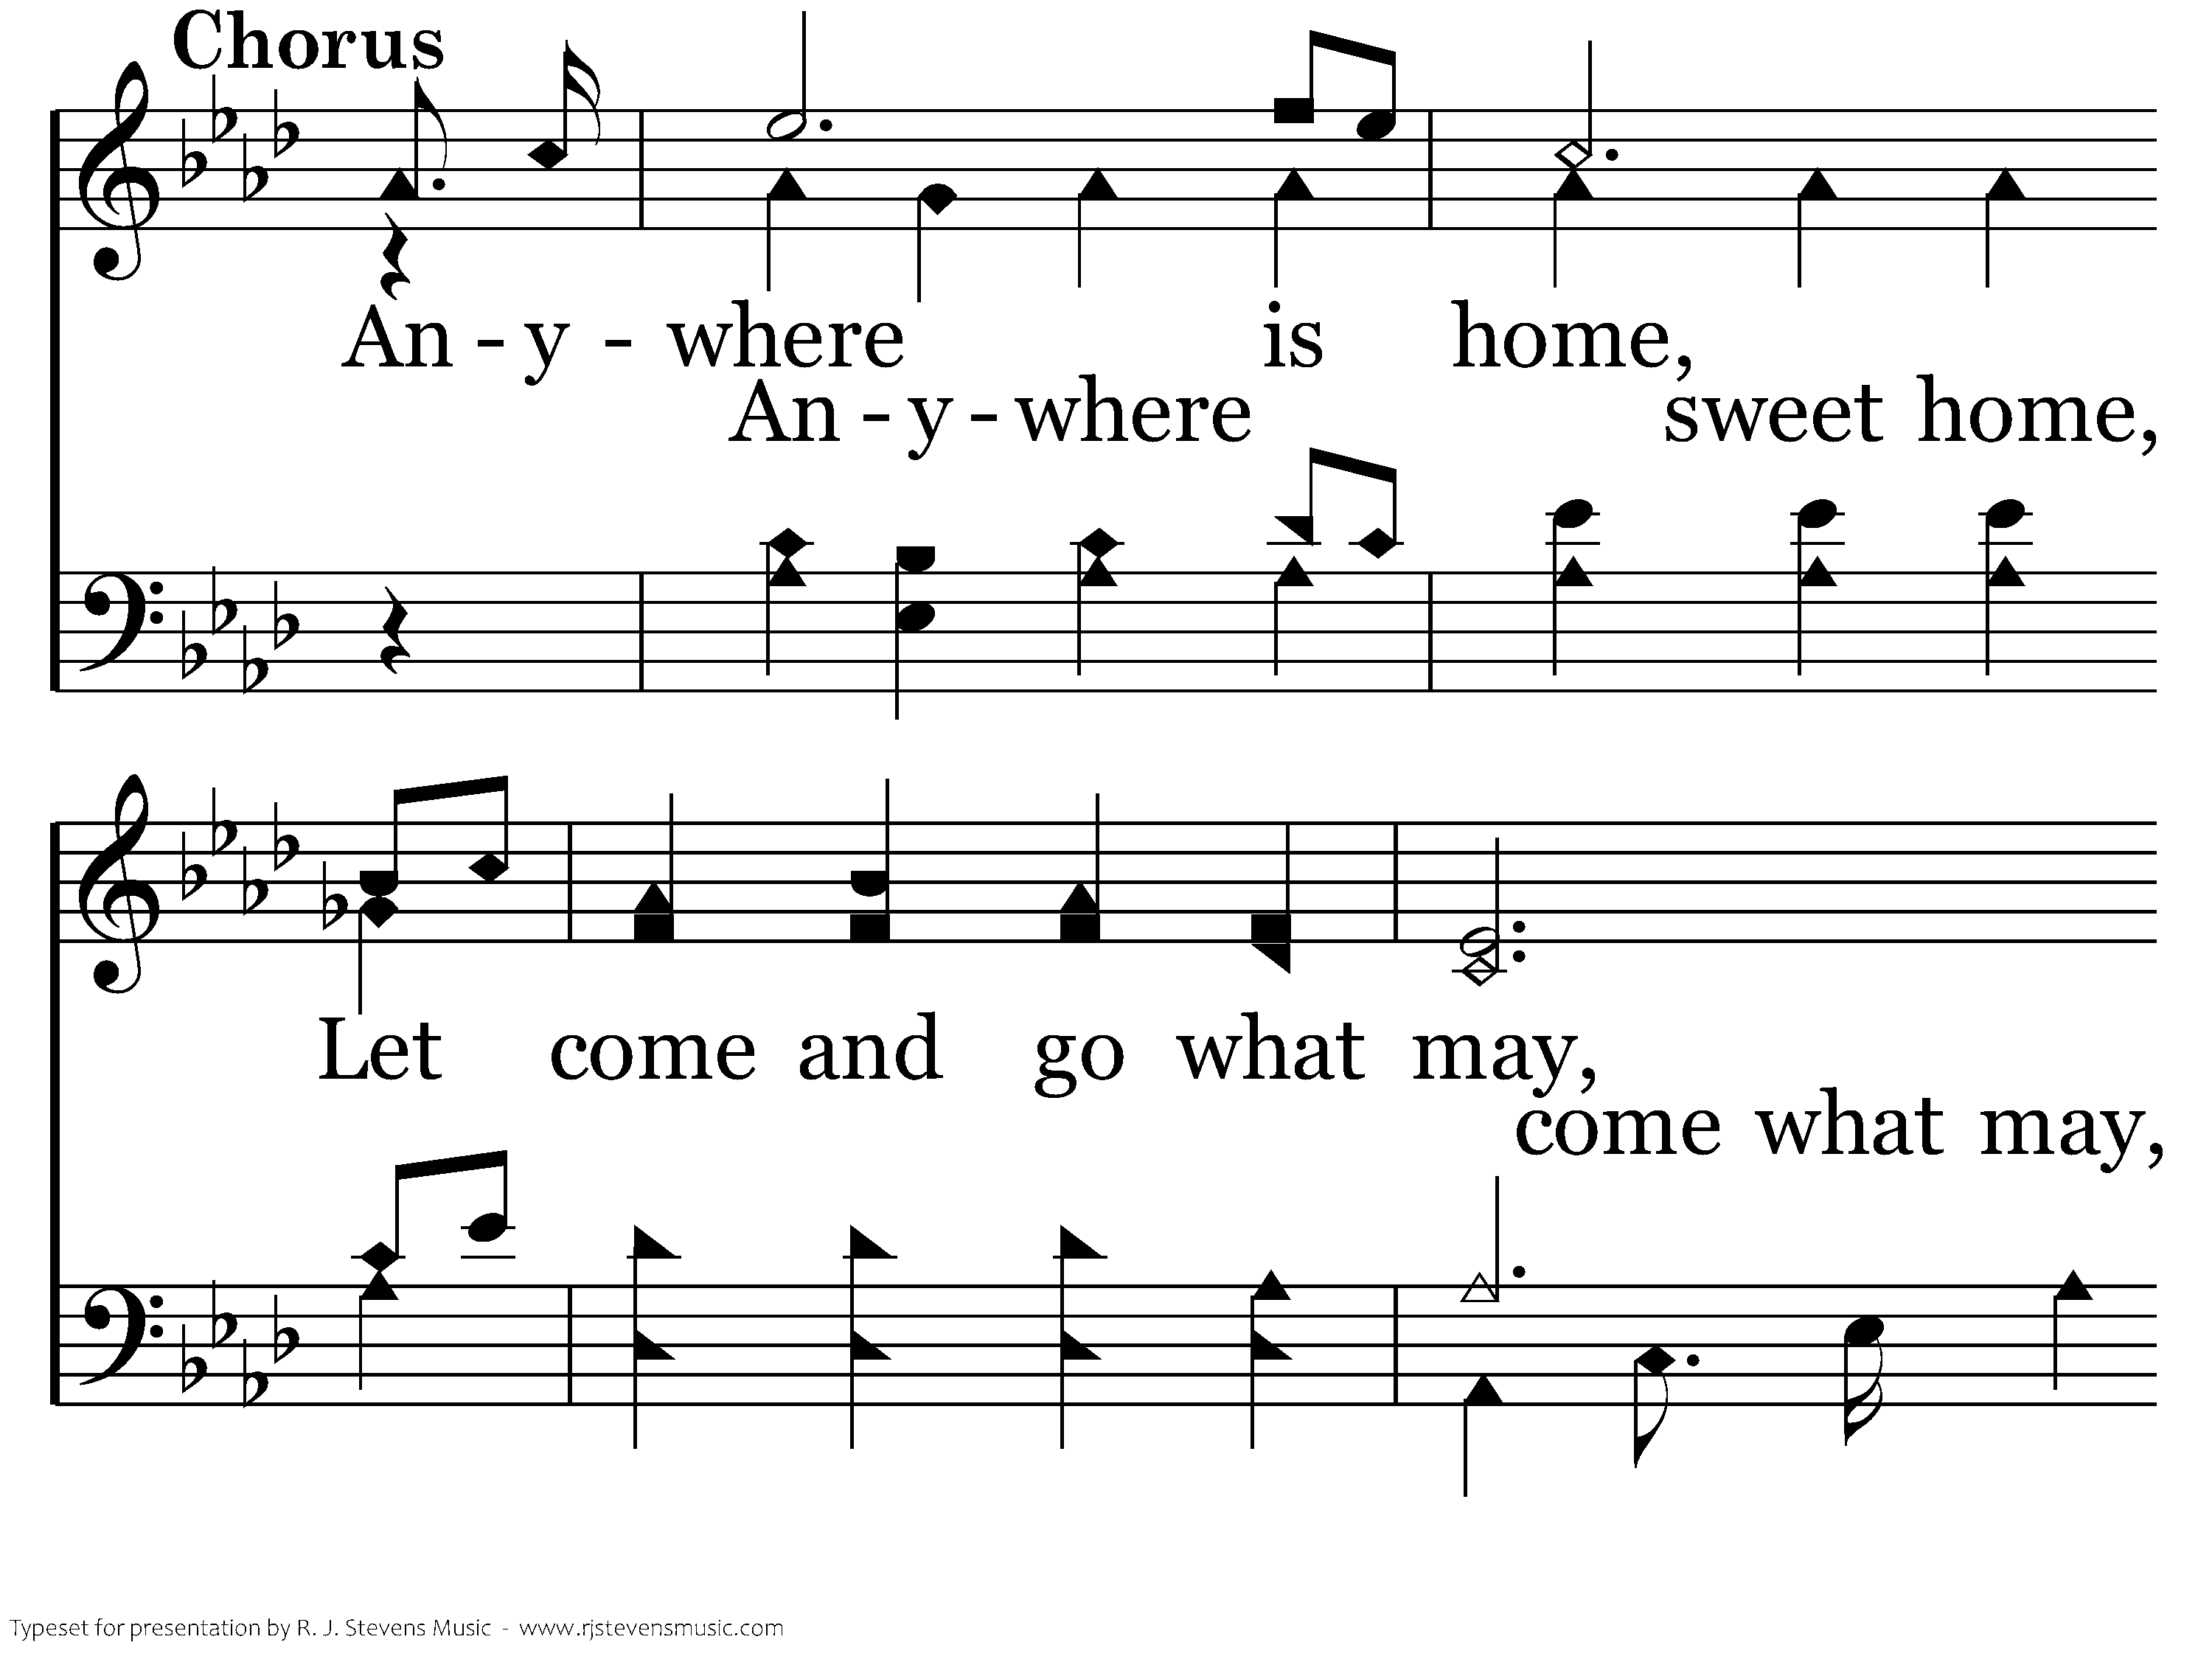
680 - Anywhere Is "Home" - C.1

Slide 35
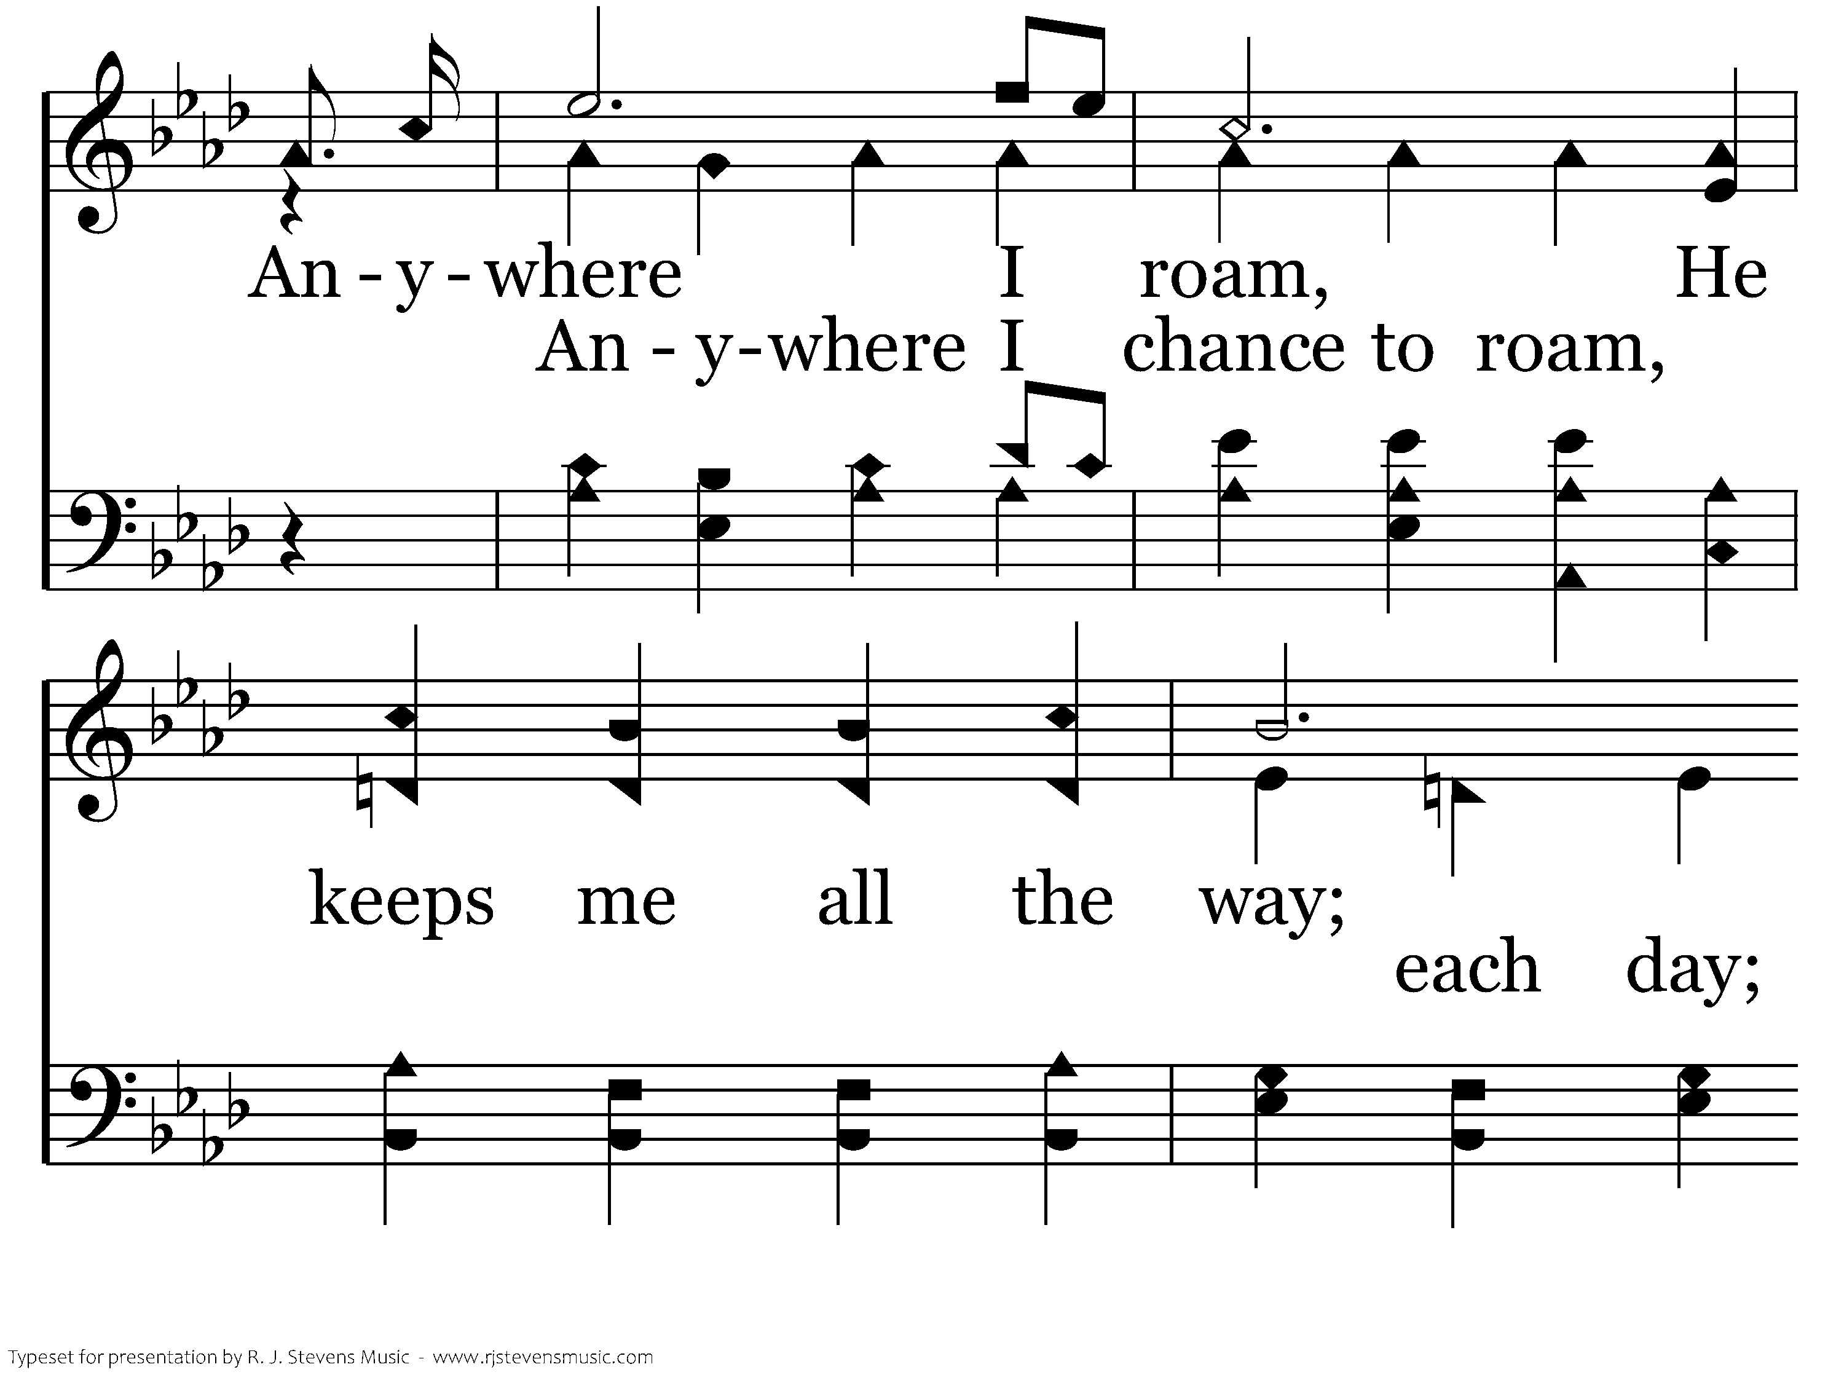
680 - Anywhere Is "Home" - C.2

Slide 36
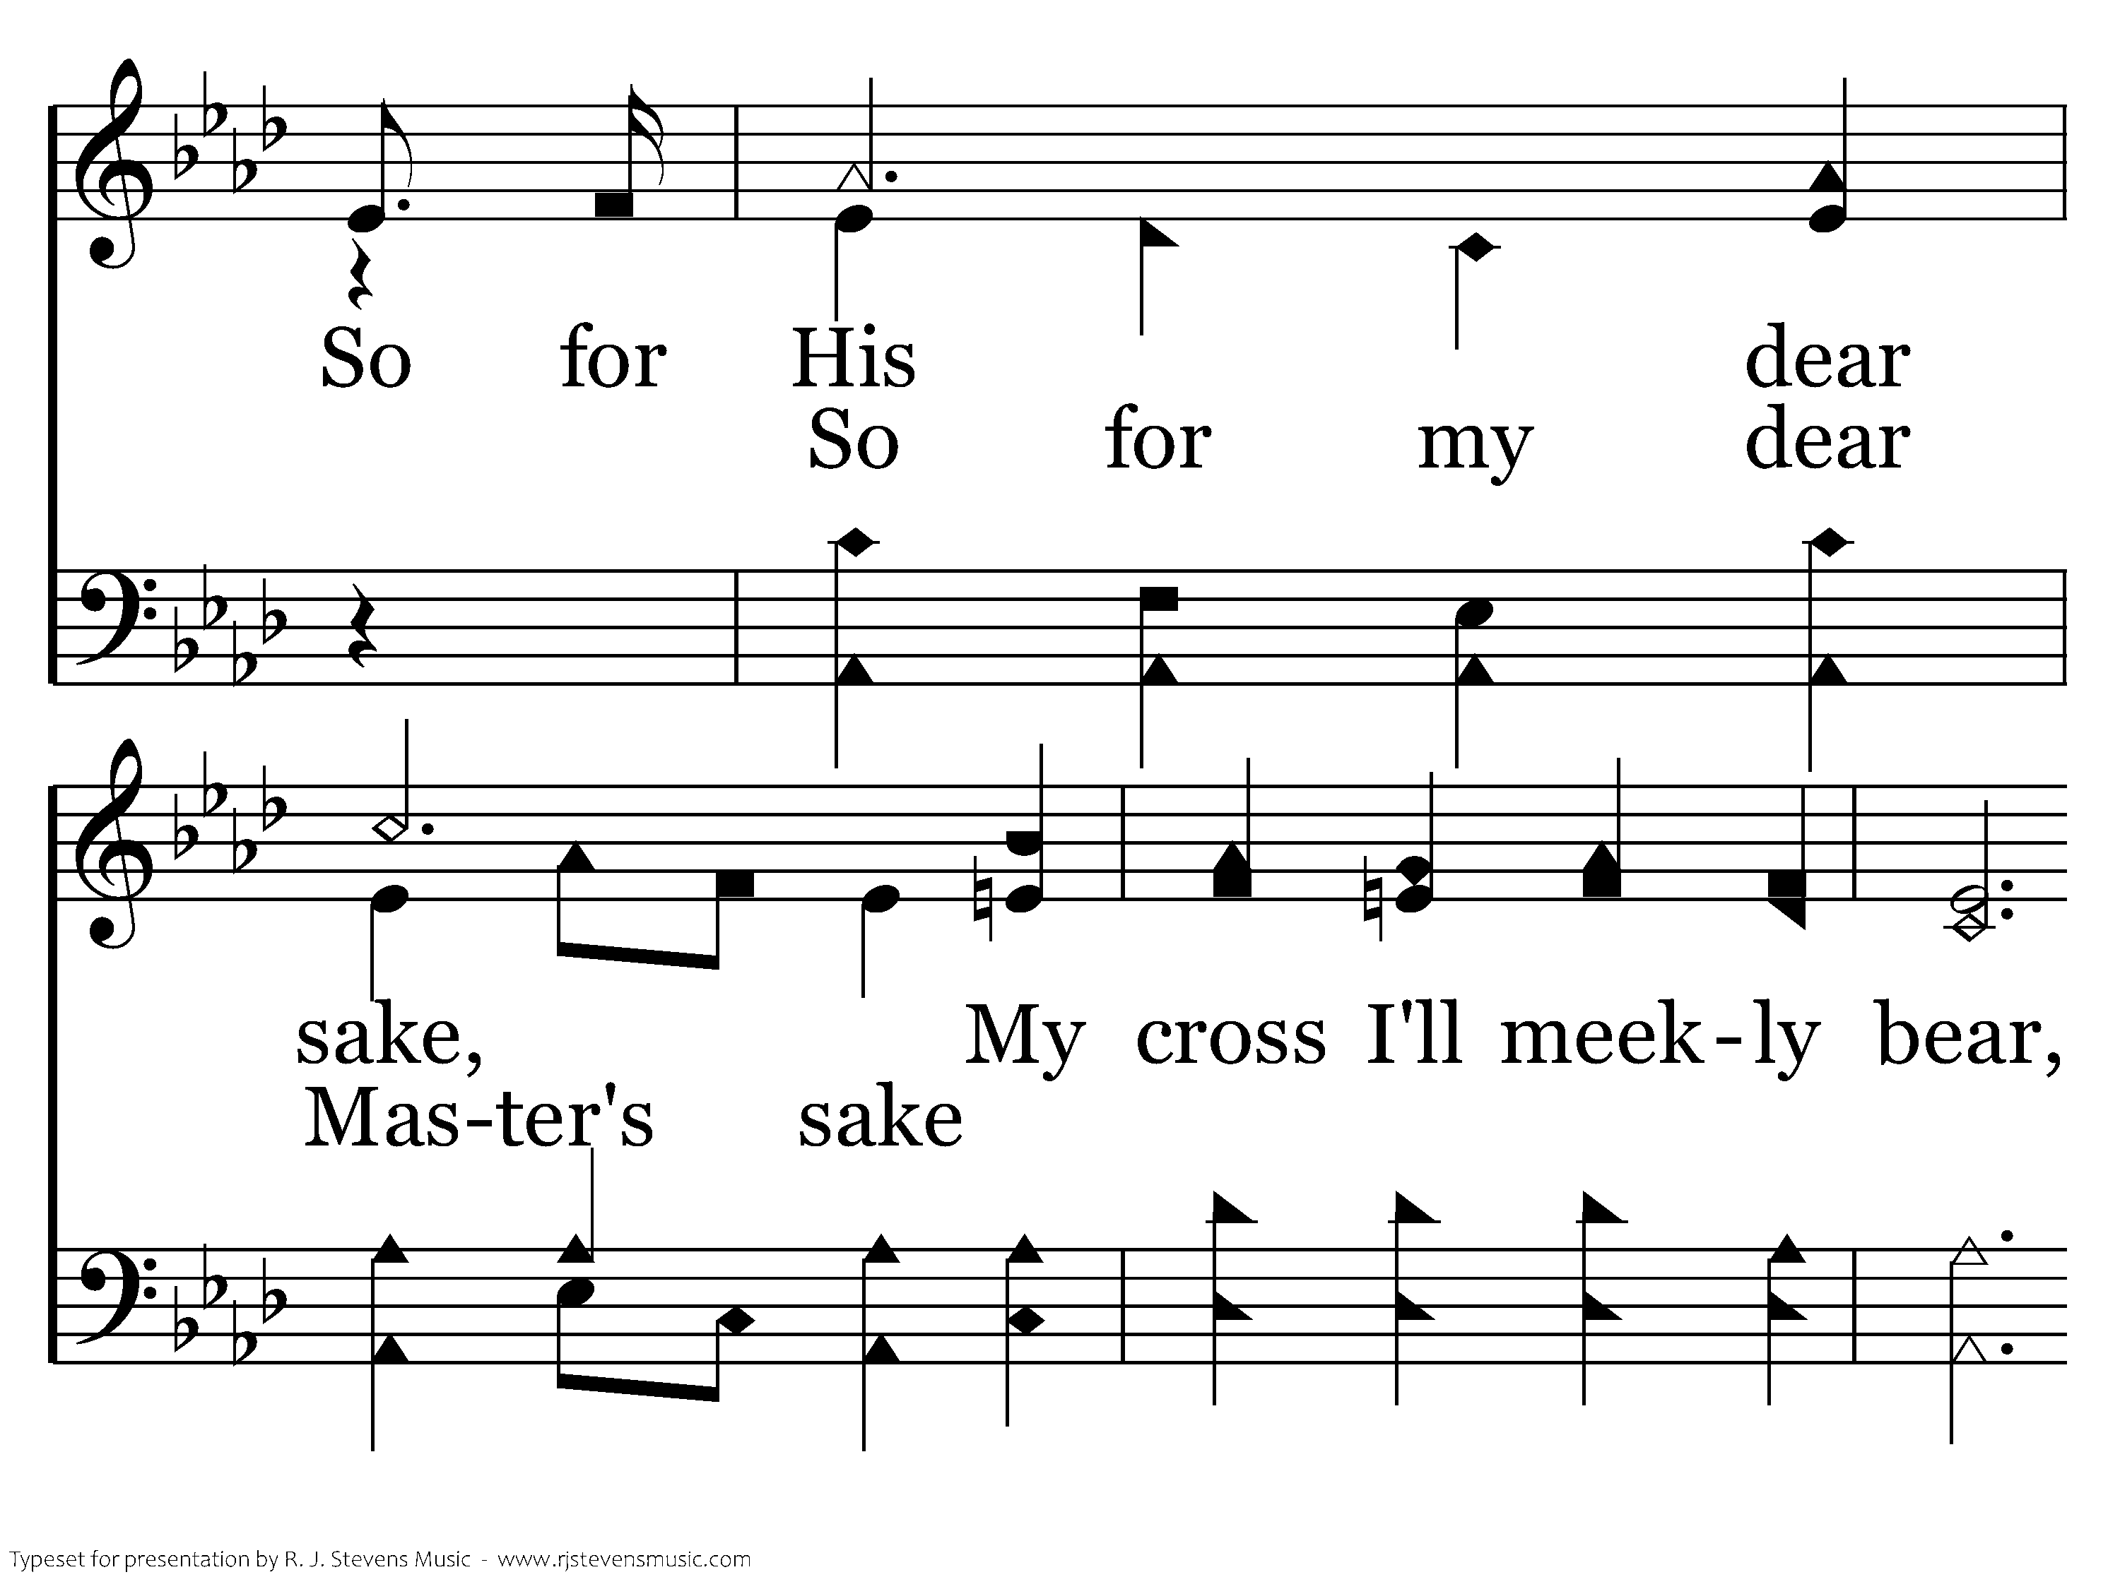
680 - Anywhere Is "Home" - C.3

Slide 37
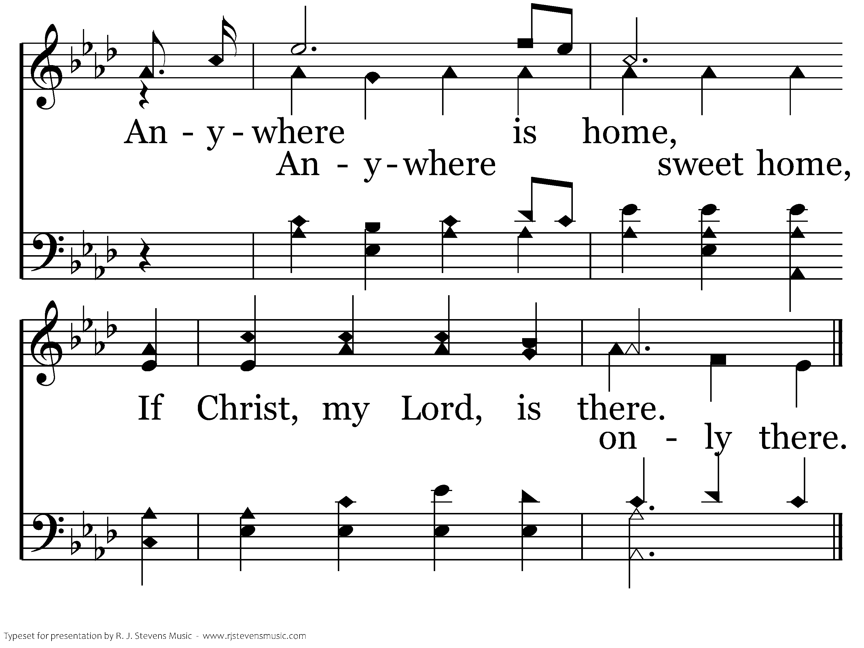
680 - Anywhere Is "Home" - C.4
End of Verse 1

Slide 38
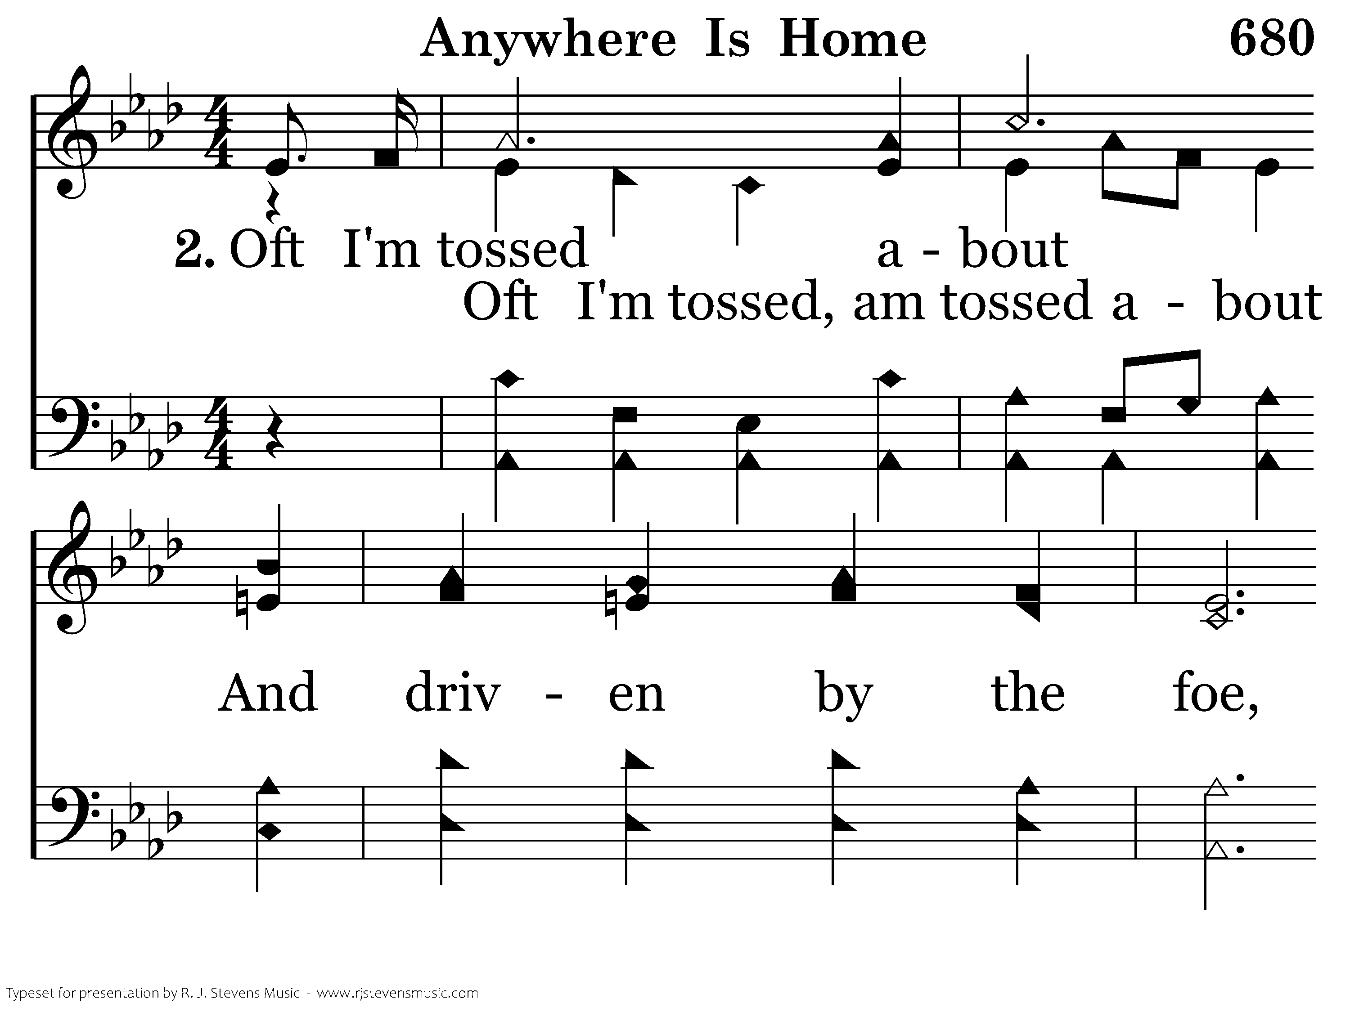
680 - Anywhere Is "Home" - 2.1

Slide 39
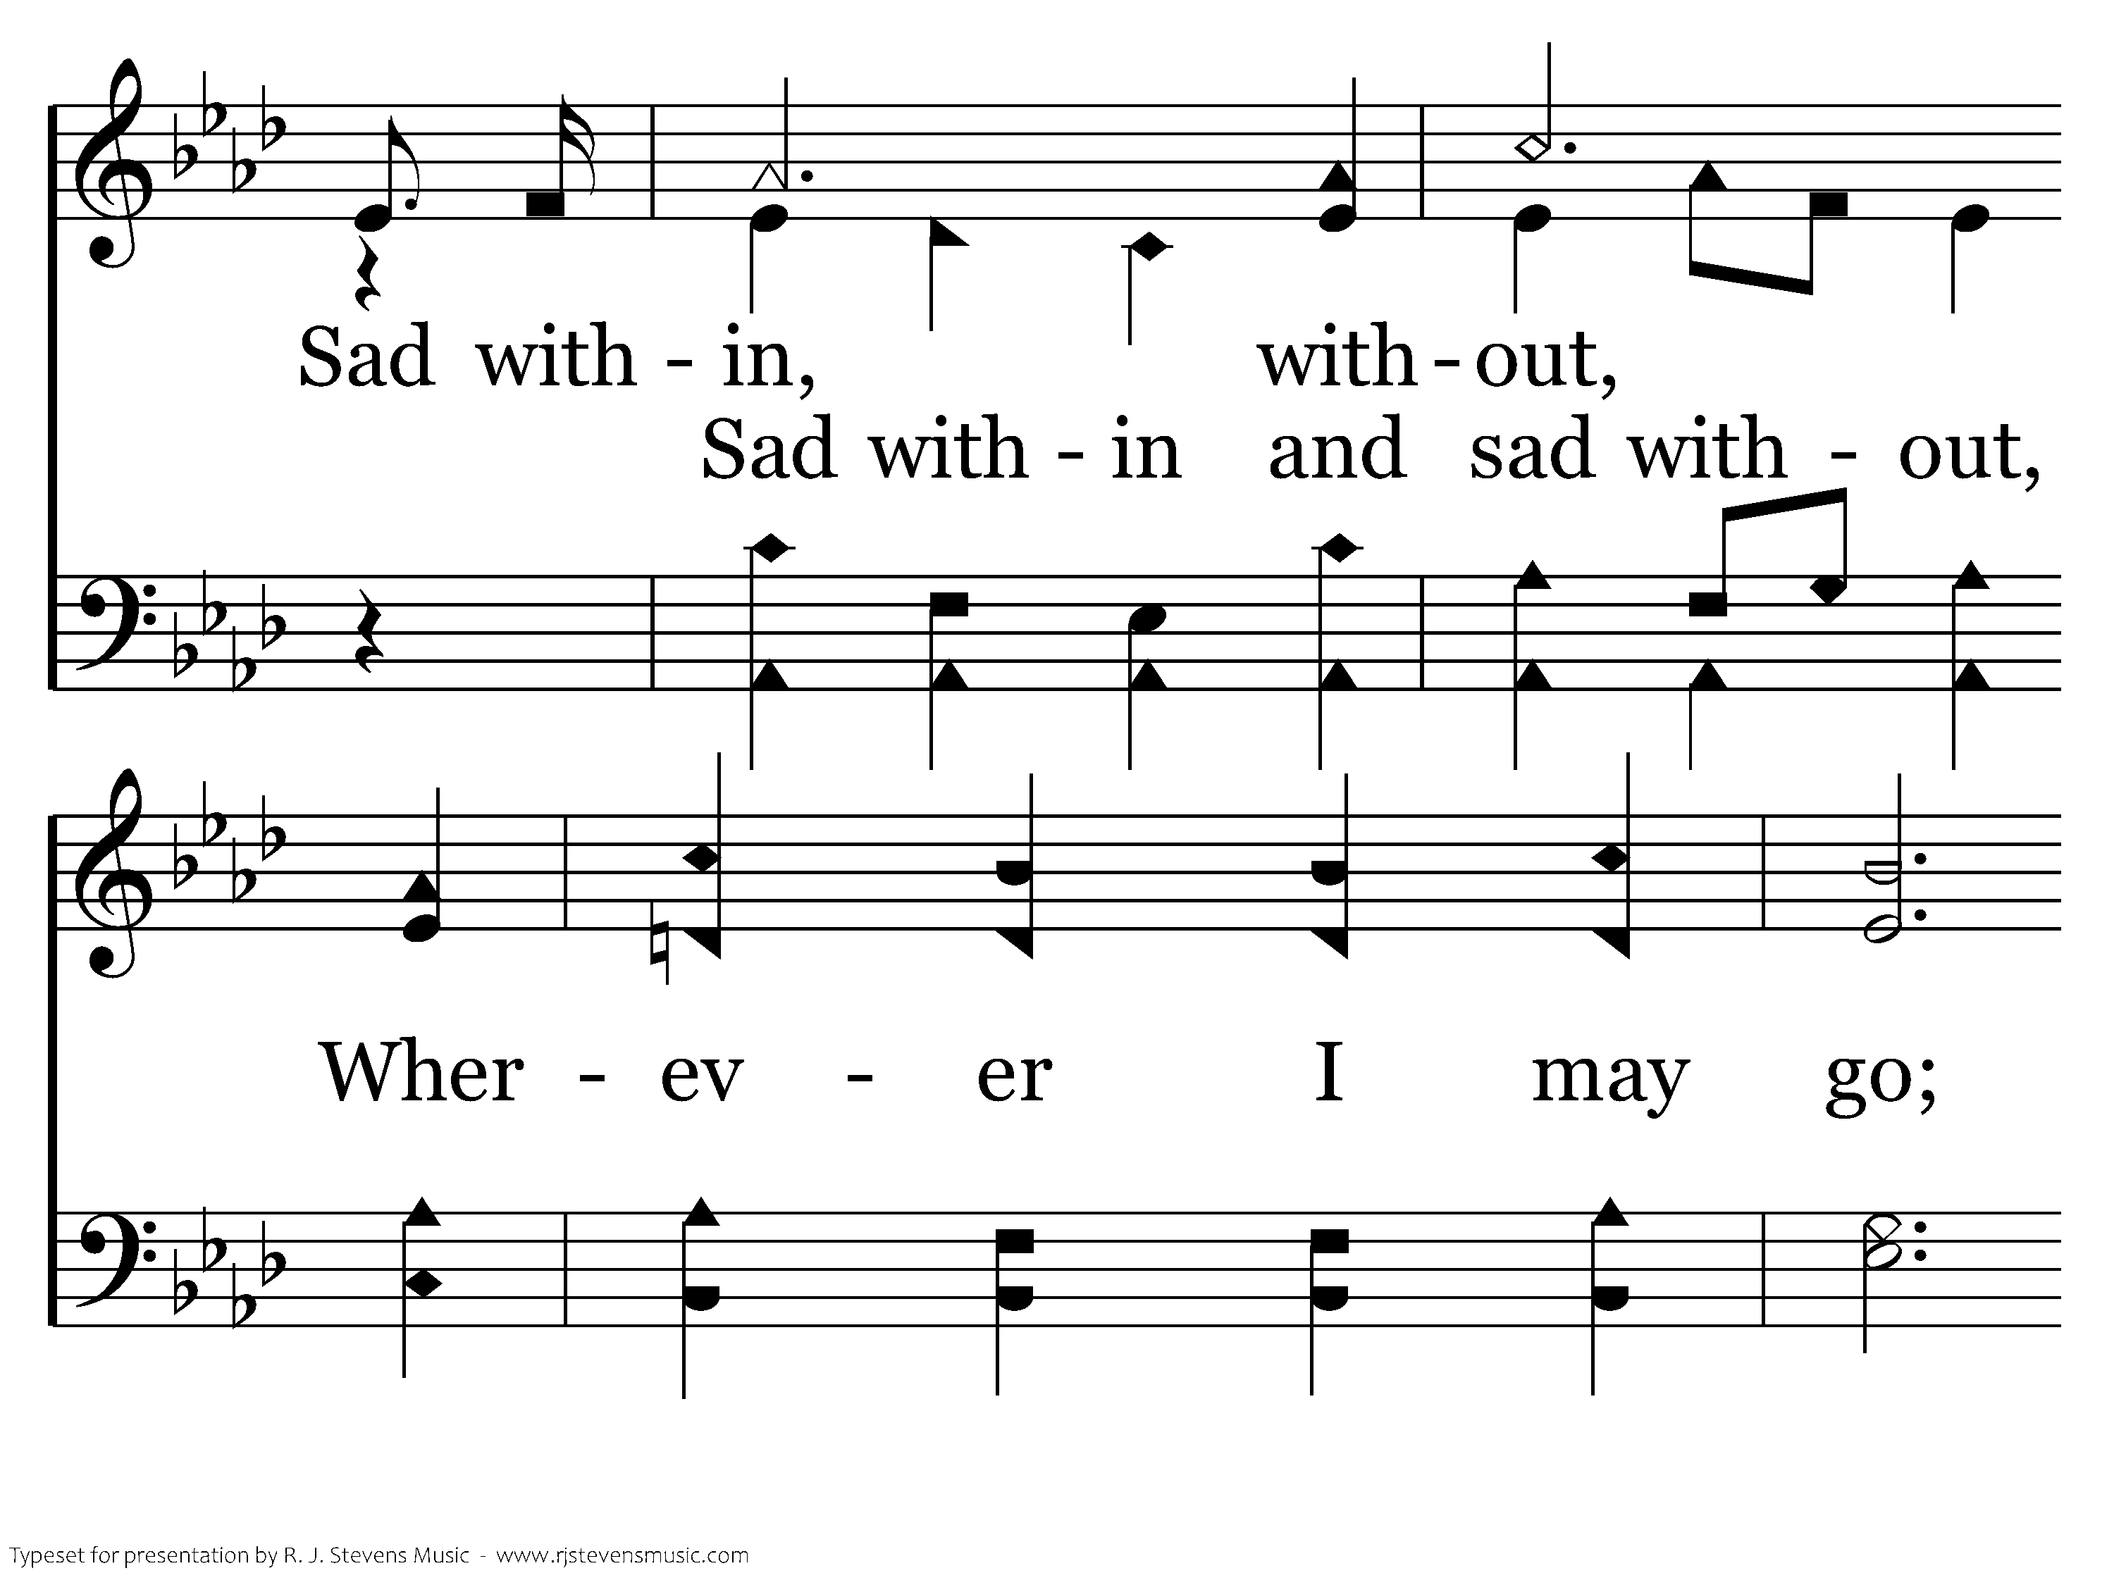
680 - Anywhere Is "Home" - 2.2

Slide 40
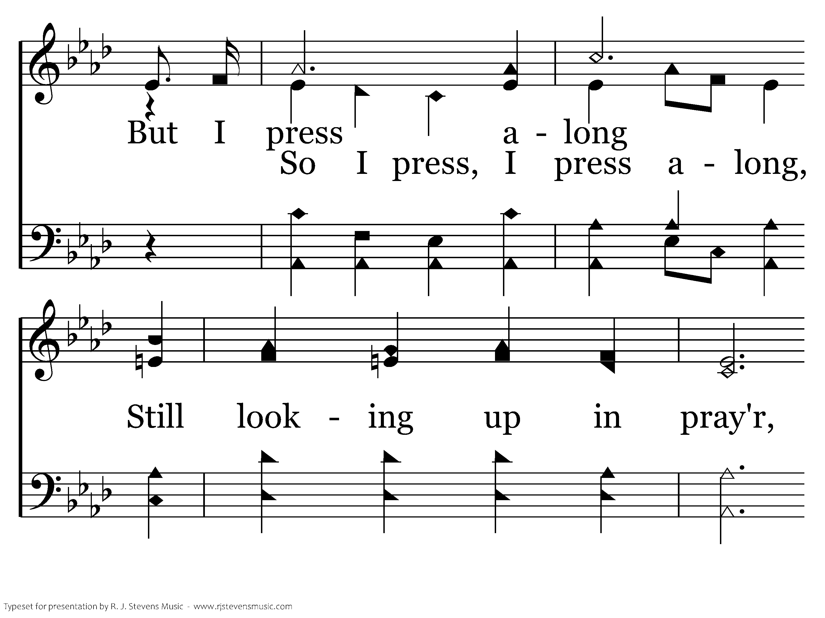
680 - Anywhere Is "Home" - 2.3

Slide 41
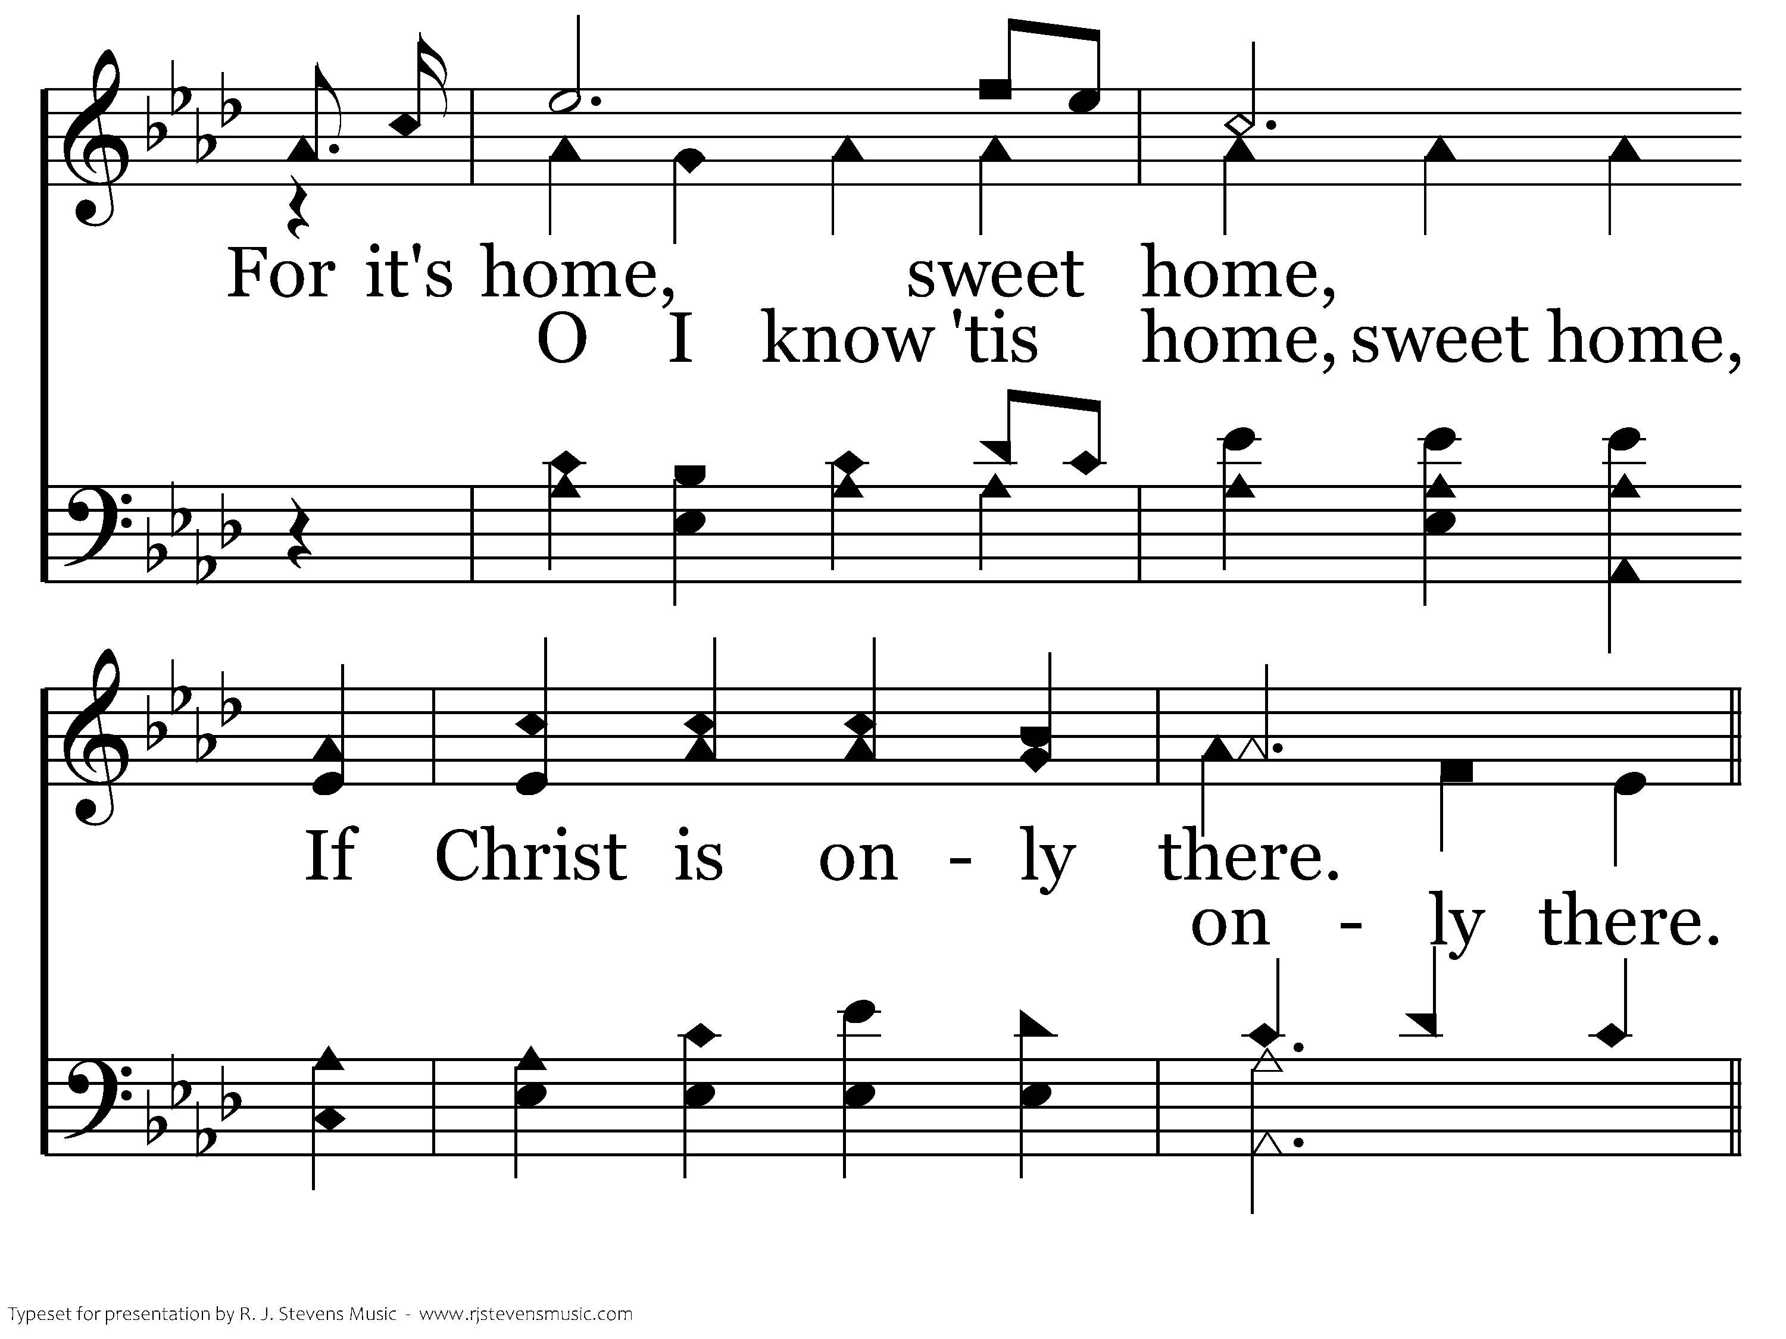
680 - Anywhere Is "Home" - 2.4

Slide 42
680 - Anywhere Is "Home" - C.1

Slide 43
680 - Anywhere Is "Home" - C.2

Slide 44
680 - Anywhere Is "Home" - C.3

Slide 45
680 - Anywhere Is "Home" - C.4
End of Verse 2

Slide 46
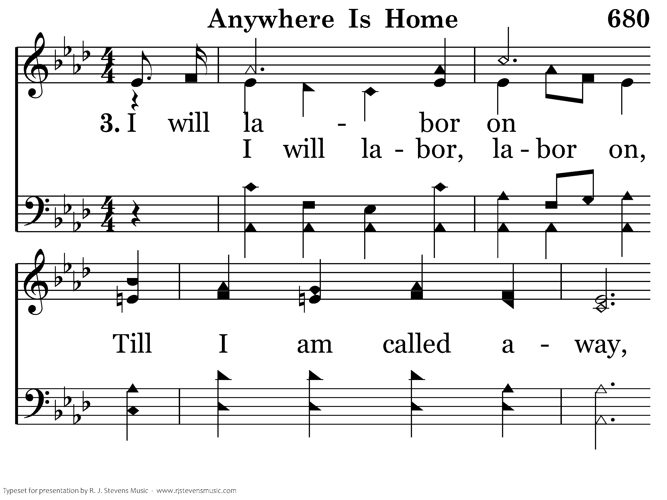
680 - Anywhere Is "Home" - 3.1

Slide 47
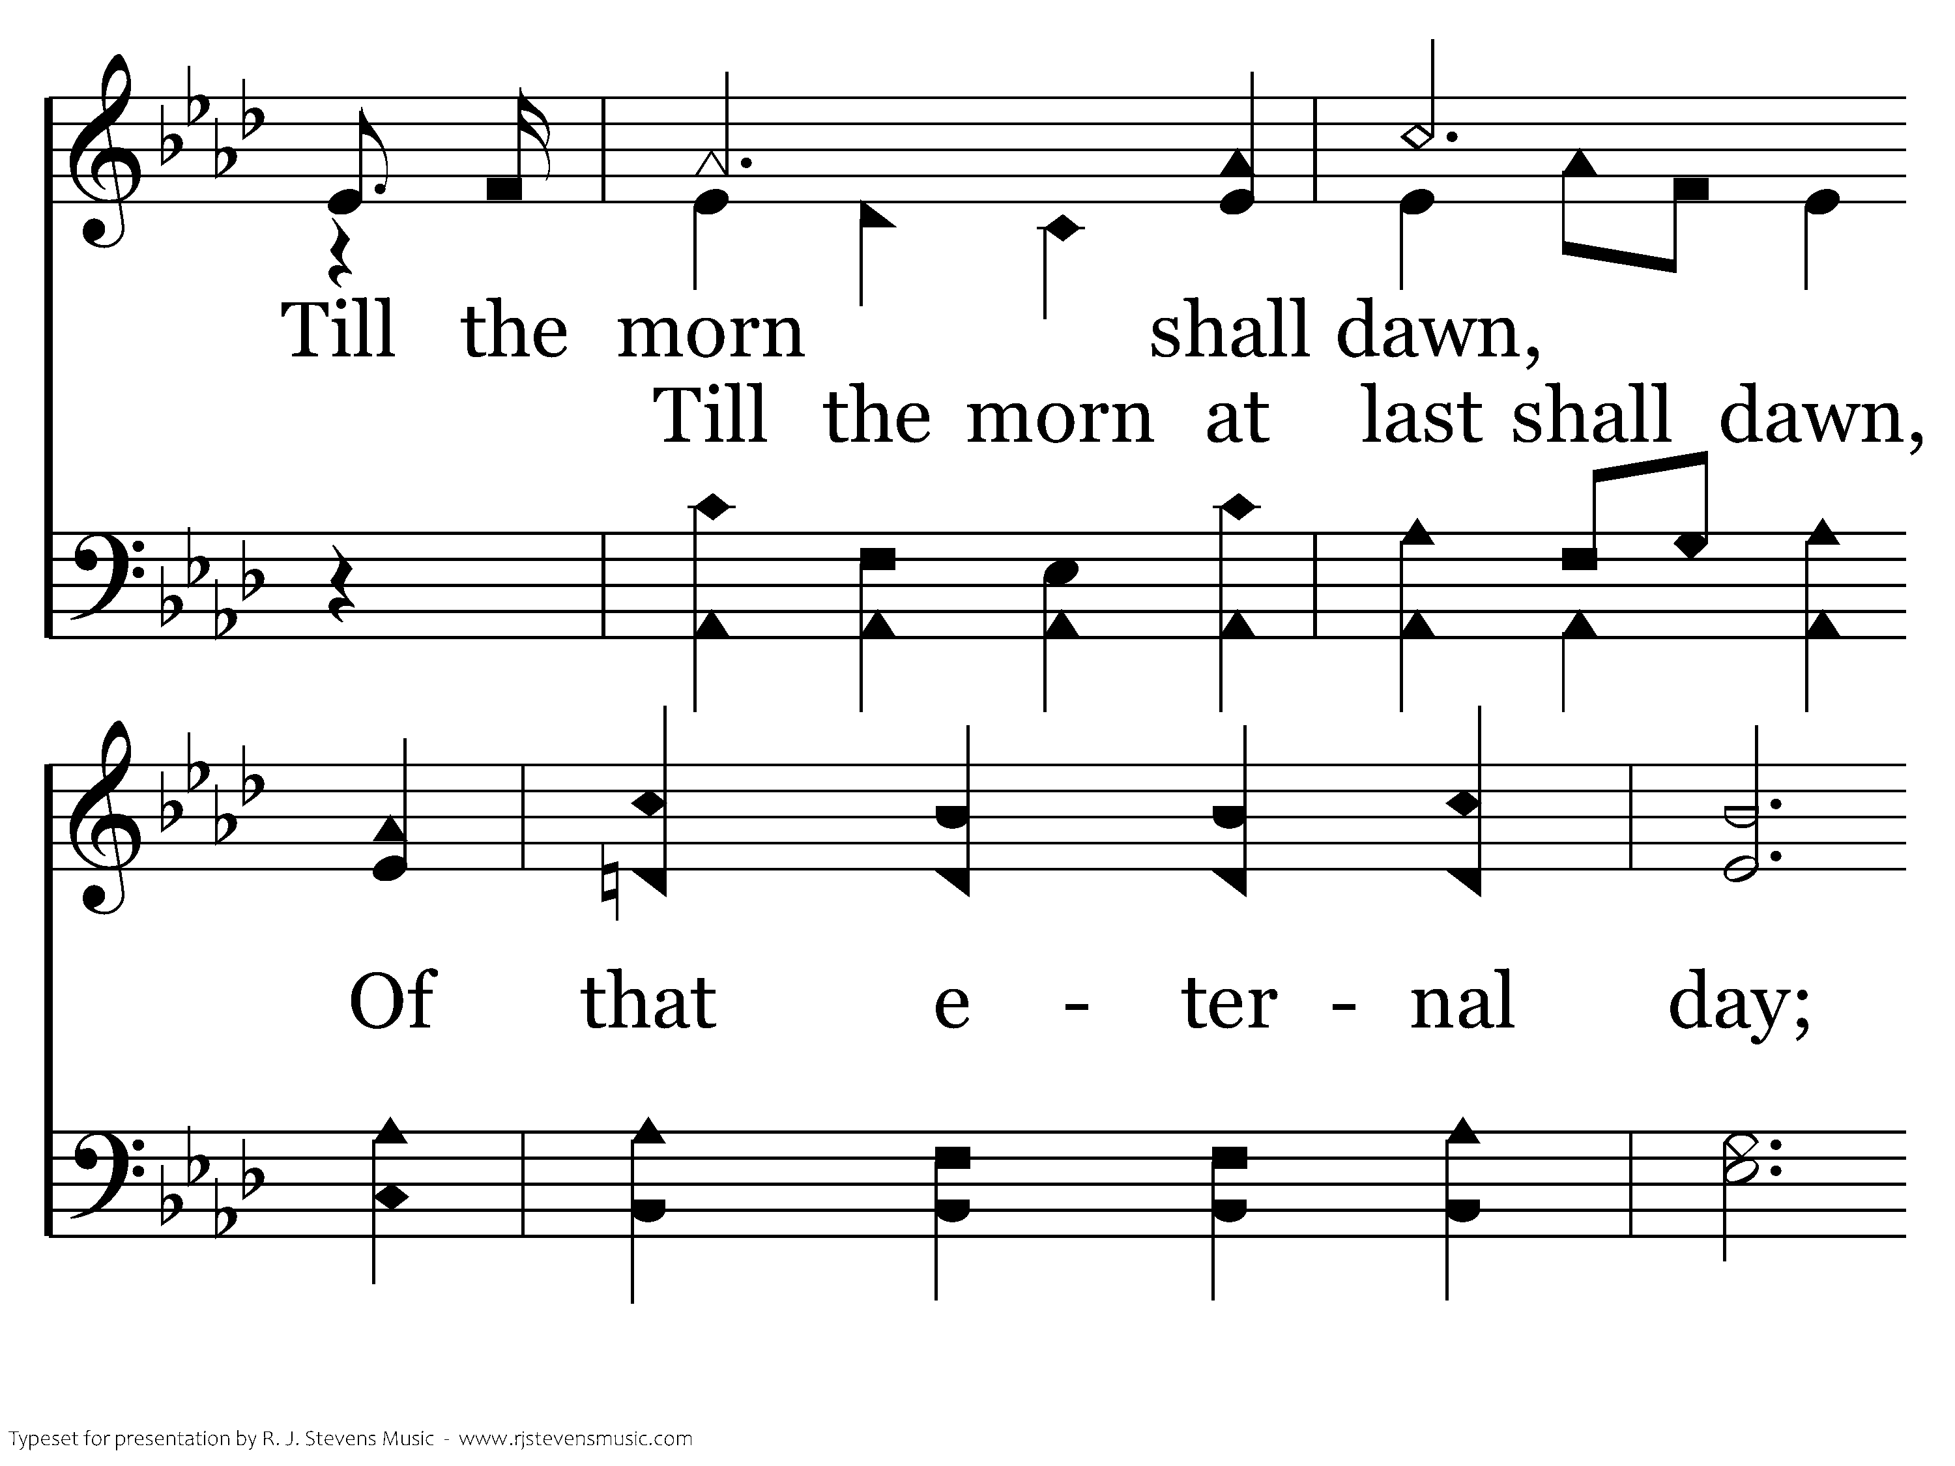
680 - Anywhere Is "Home" - 3.2

Slide 48
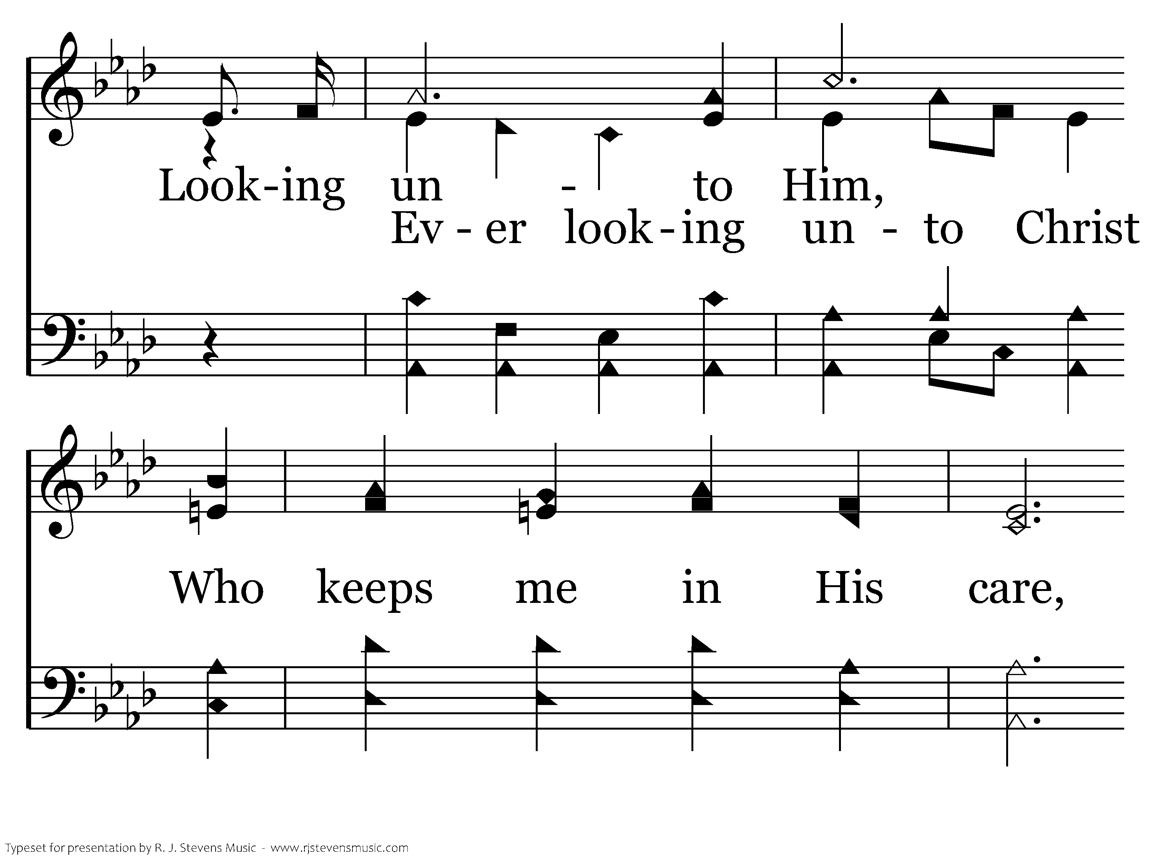
680 - Anywhere Is "Home" - 3.3

Slide 49
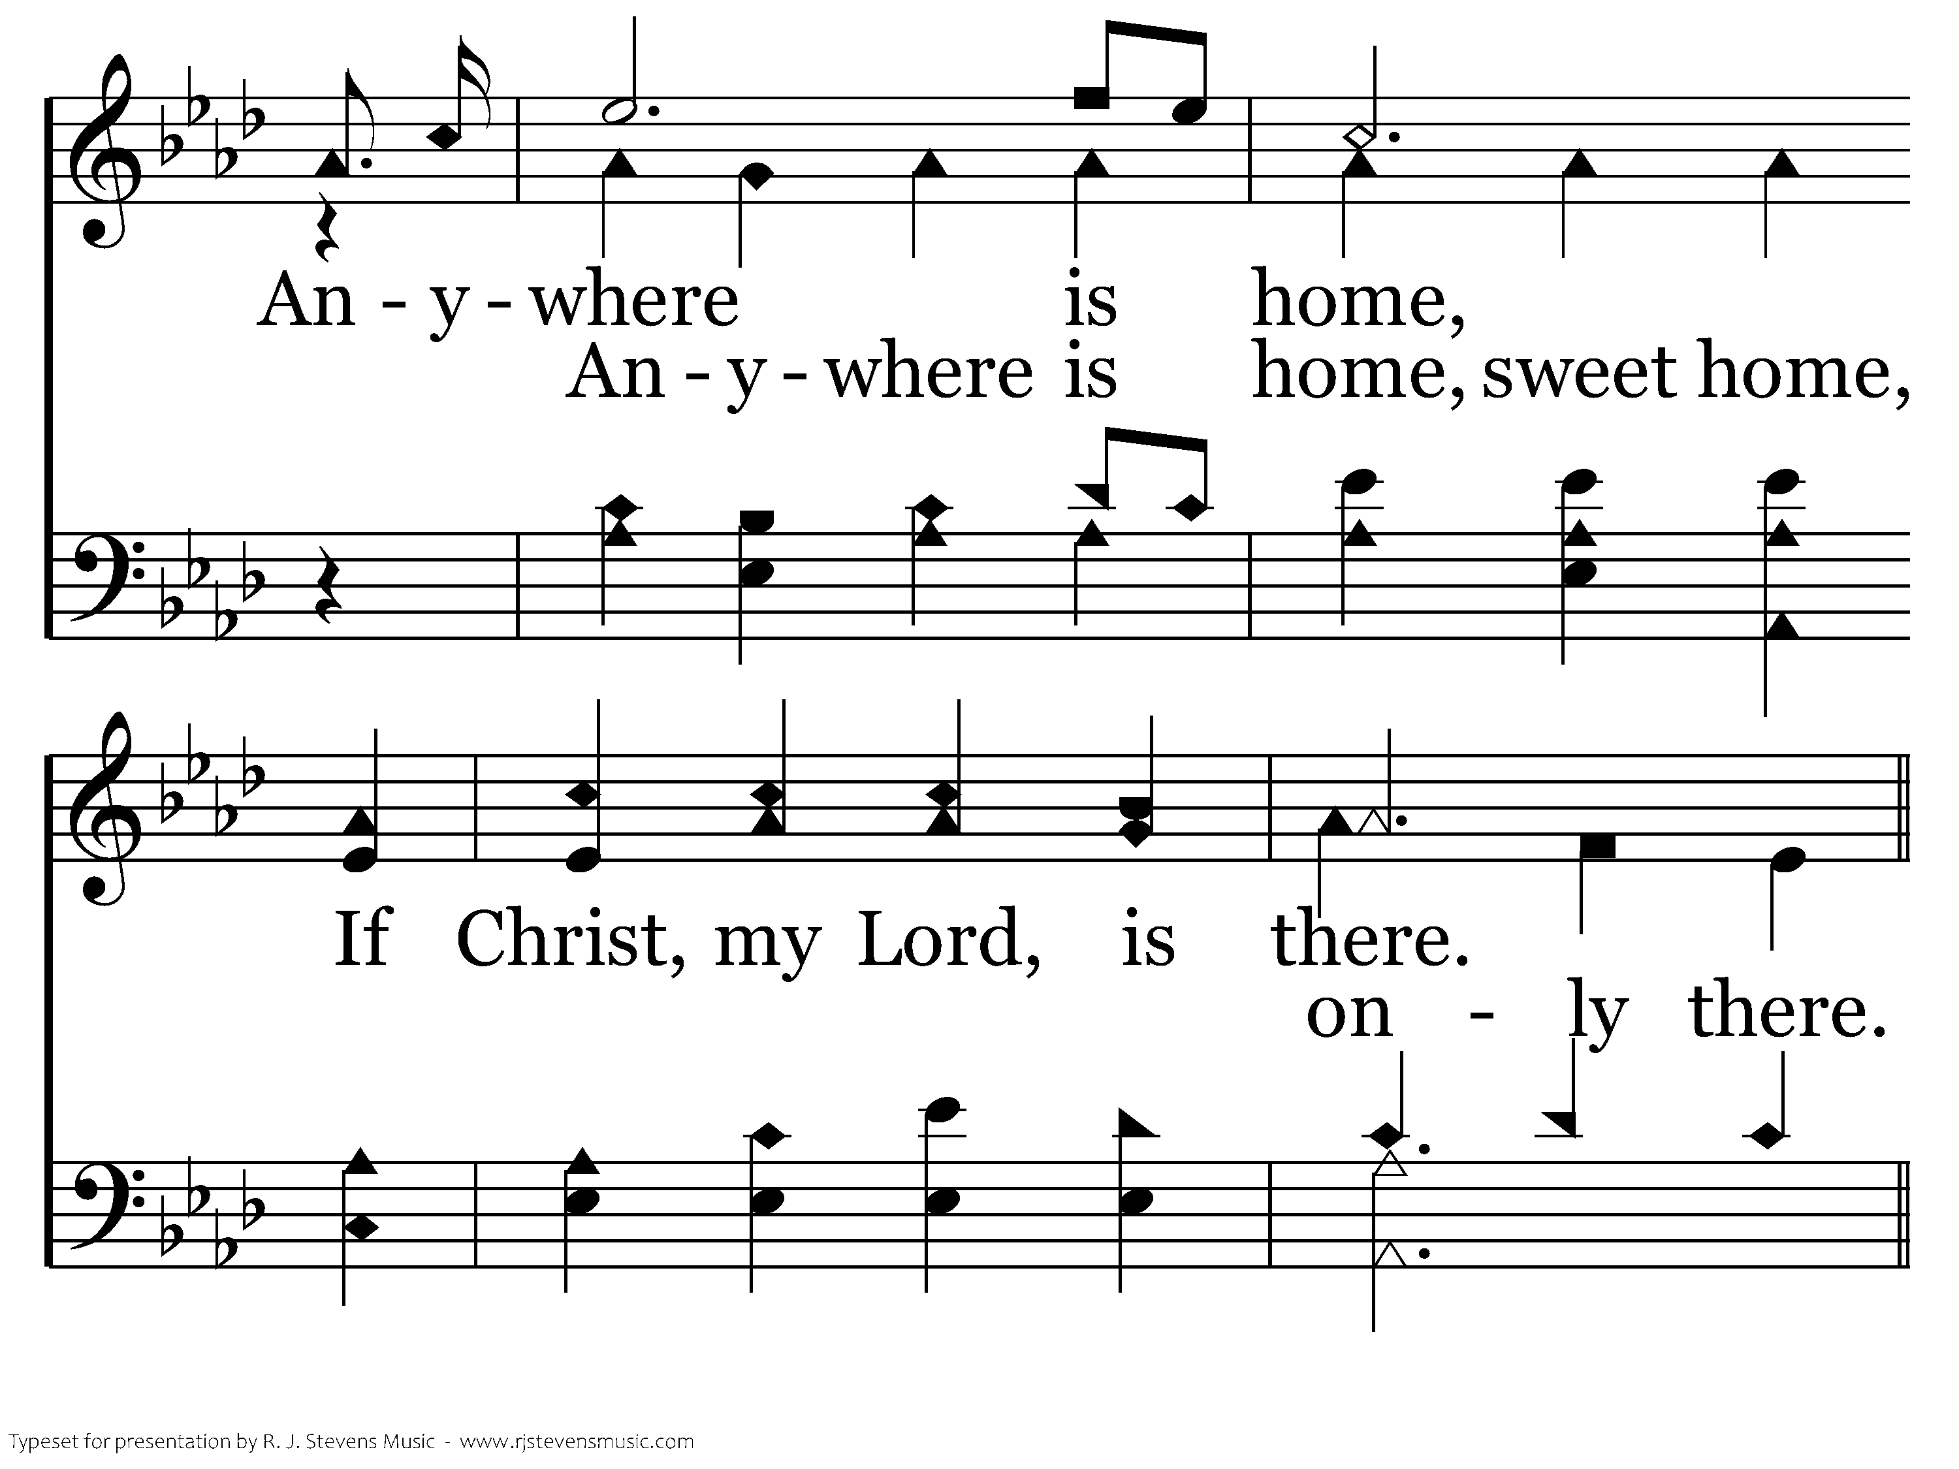
680 - Anywhere Is "Home" - 3.4

Slide 50
680 - Anywhere Is "Home" - C.1

Slide 51
680 - Anywhere Is "Home" - C.2

Slide 52
680 - Anywhere Is "Home" - C.3

Slide 53
680 - Anywhere Is "Home" - C.4
End of Song

