Slide 1

20634 - JESUS, DRAW ME EVER NEARER - Title

Slide 2
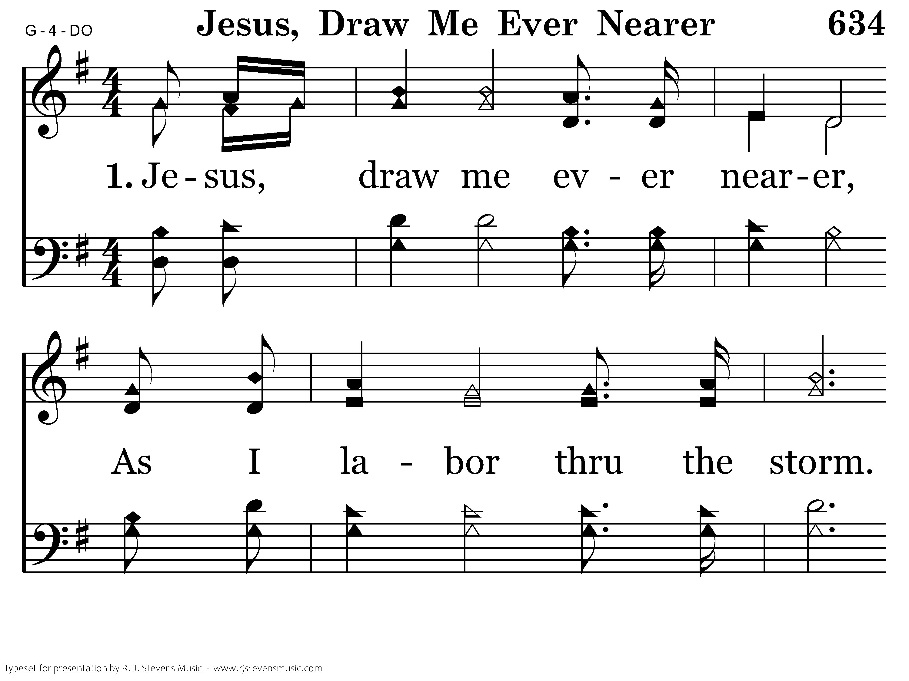
20634 - JESUS, DRAW ME EVER NEARER - 1.1

Slide 3
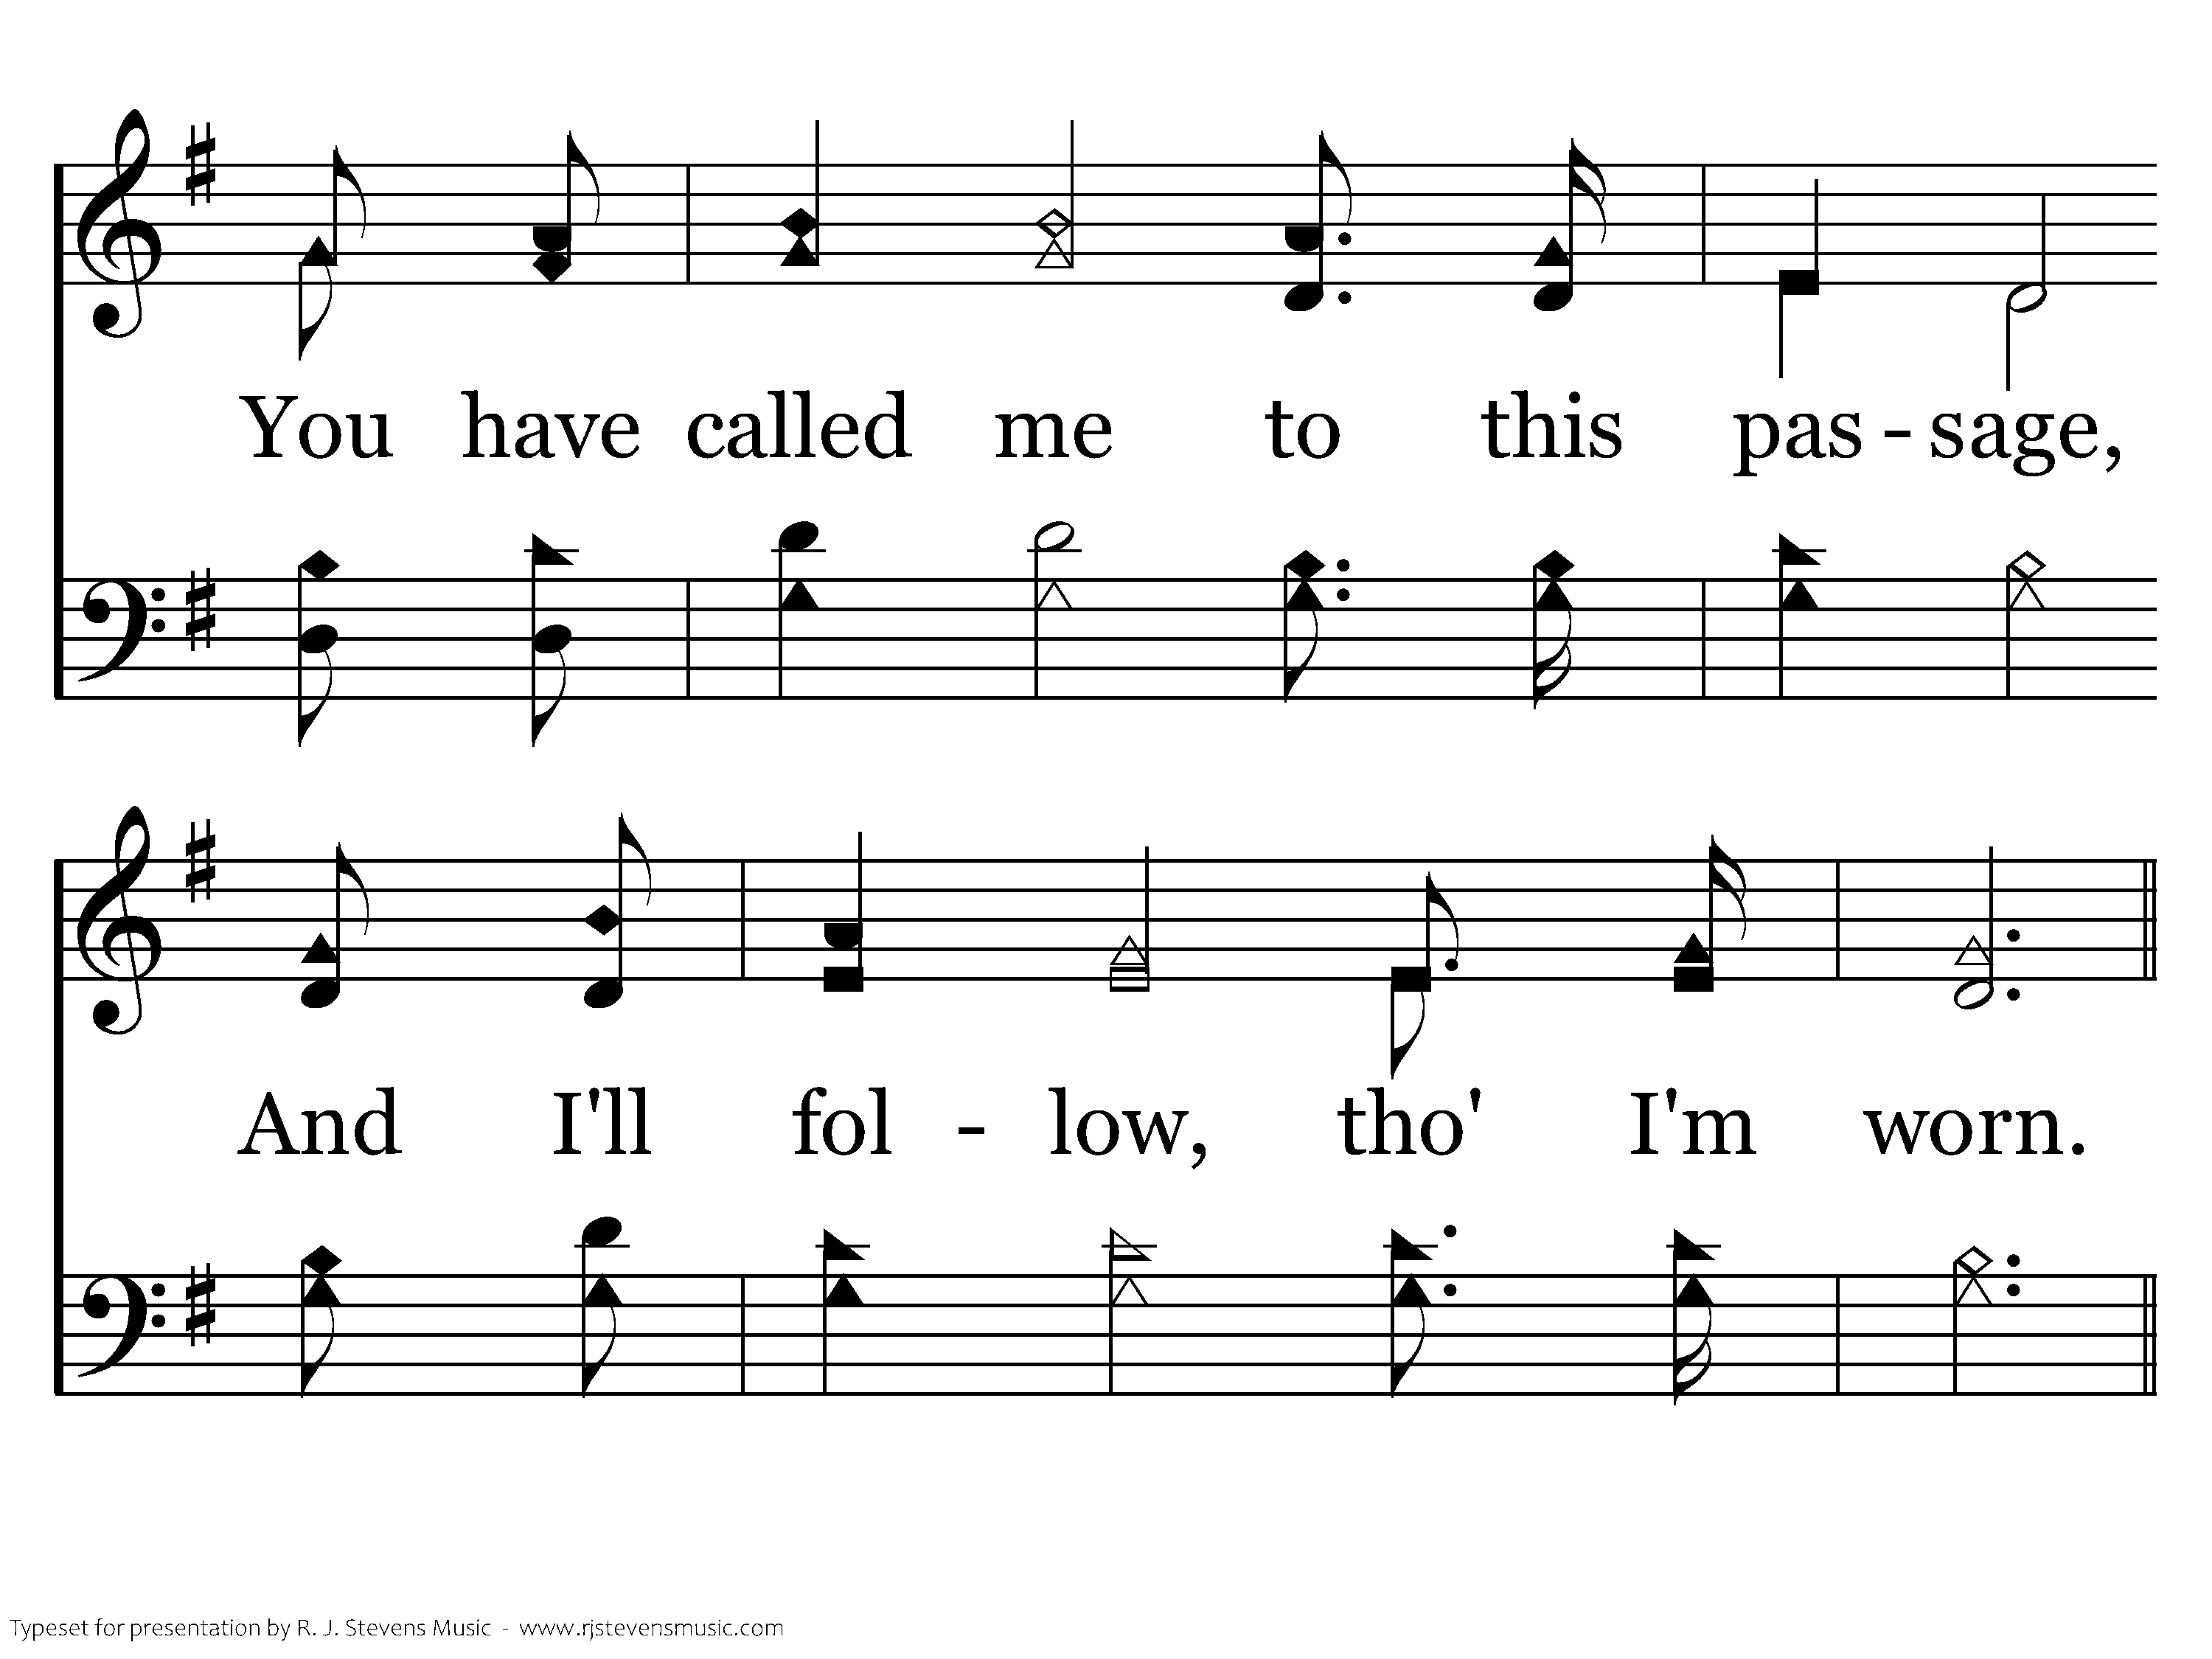
20634 - JESUS, DRAW ME EVER NEARER - 1.2

Slide 4
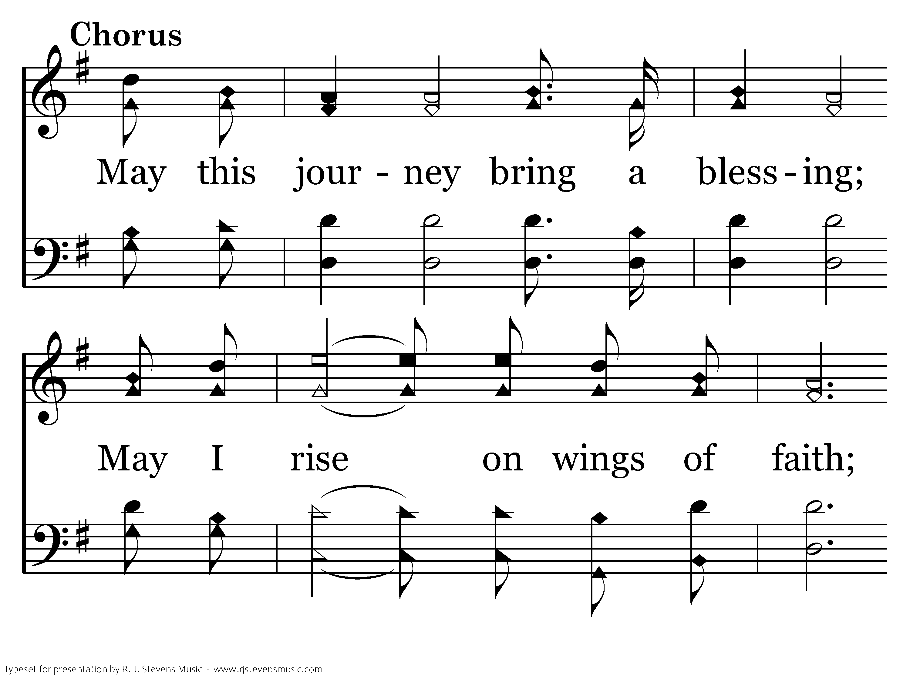
20634 - JESUS, DRAW ME EVER NEARER - C.1

Slide 5
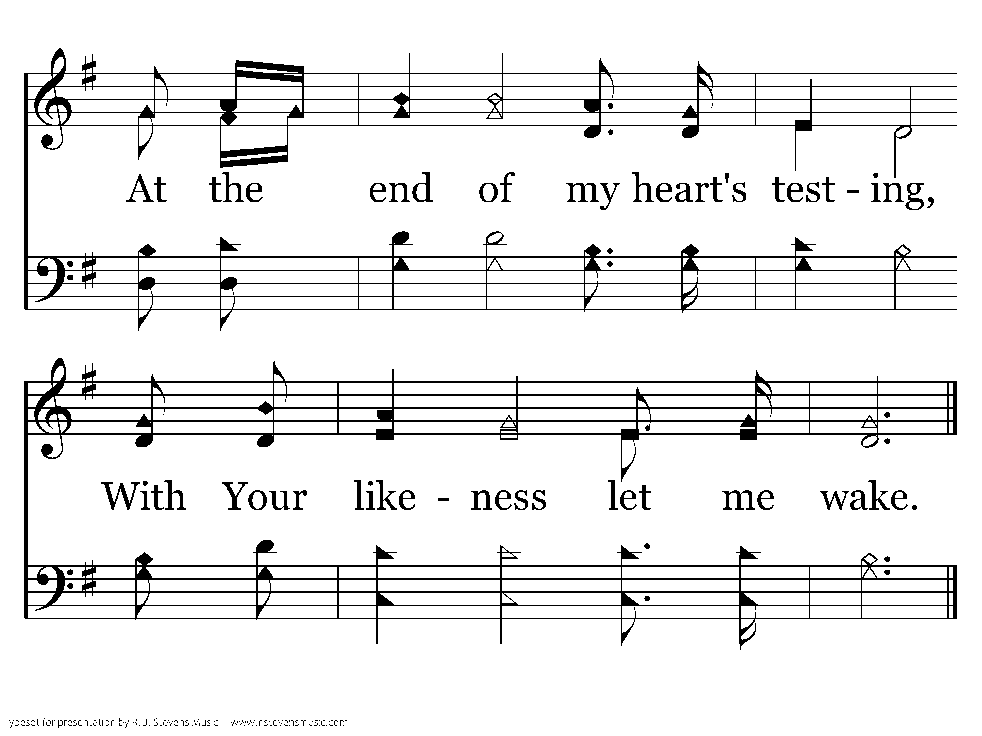
20634 - JESUS, DRAW ME EVER NEARER - C.2
End of Verse 1

Slide 6
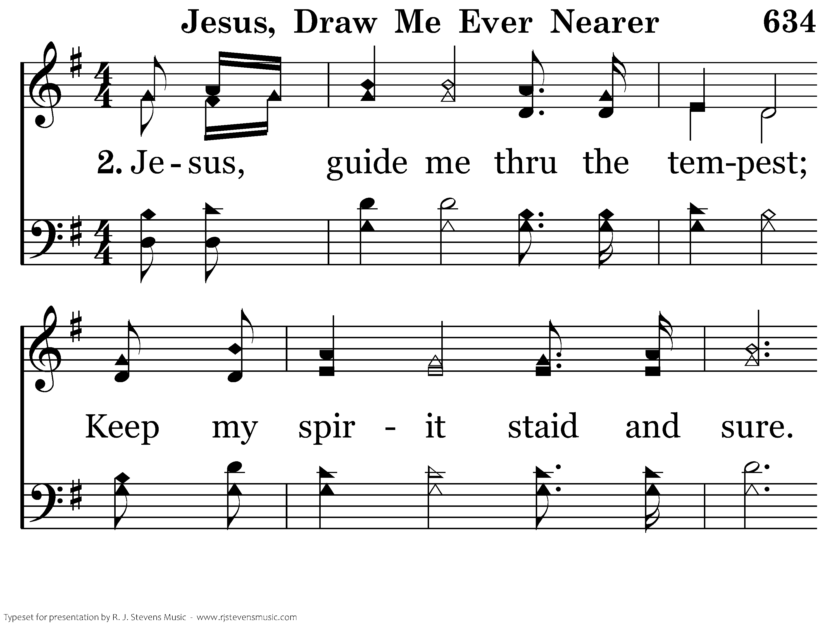
20634 - JESUS, DRAW ME EVER NEARER - 2.1

Slide 7
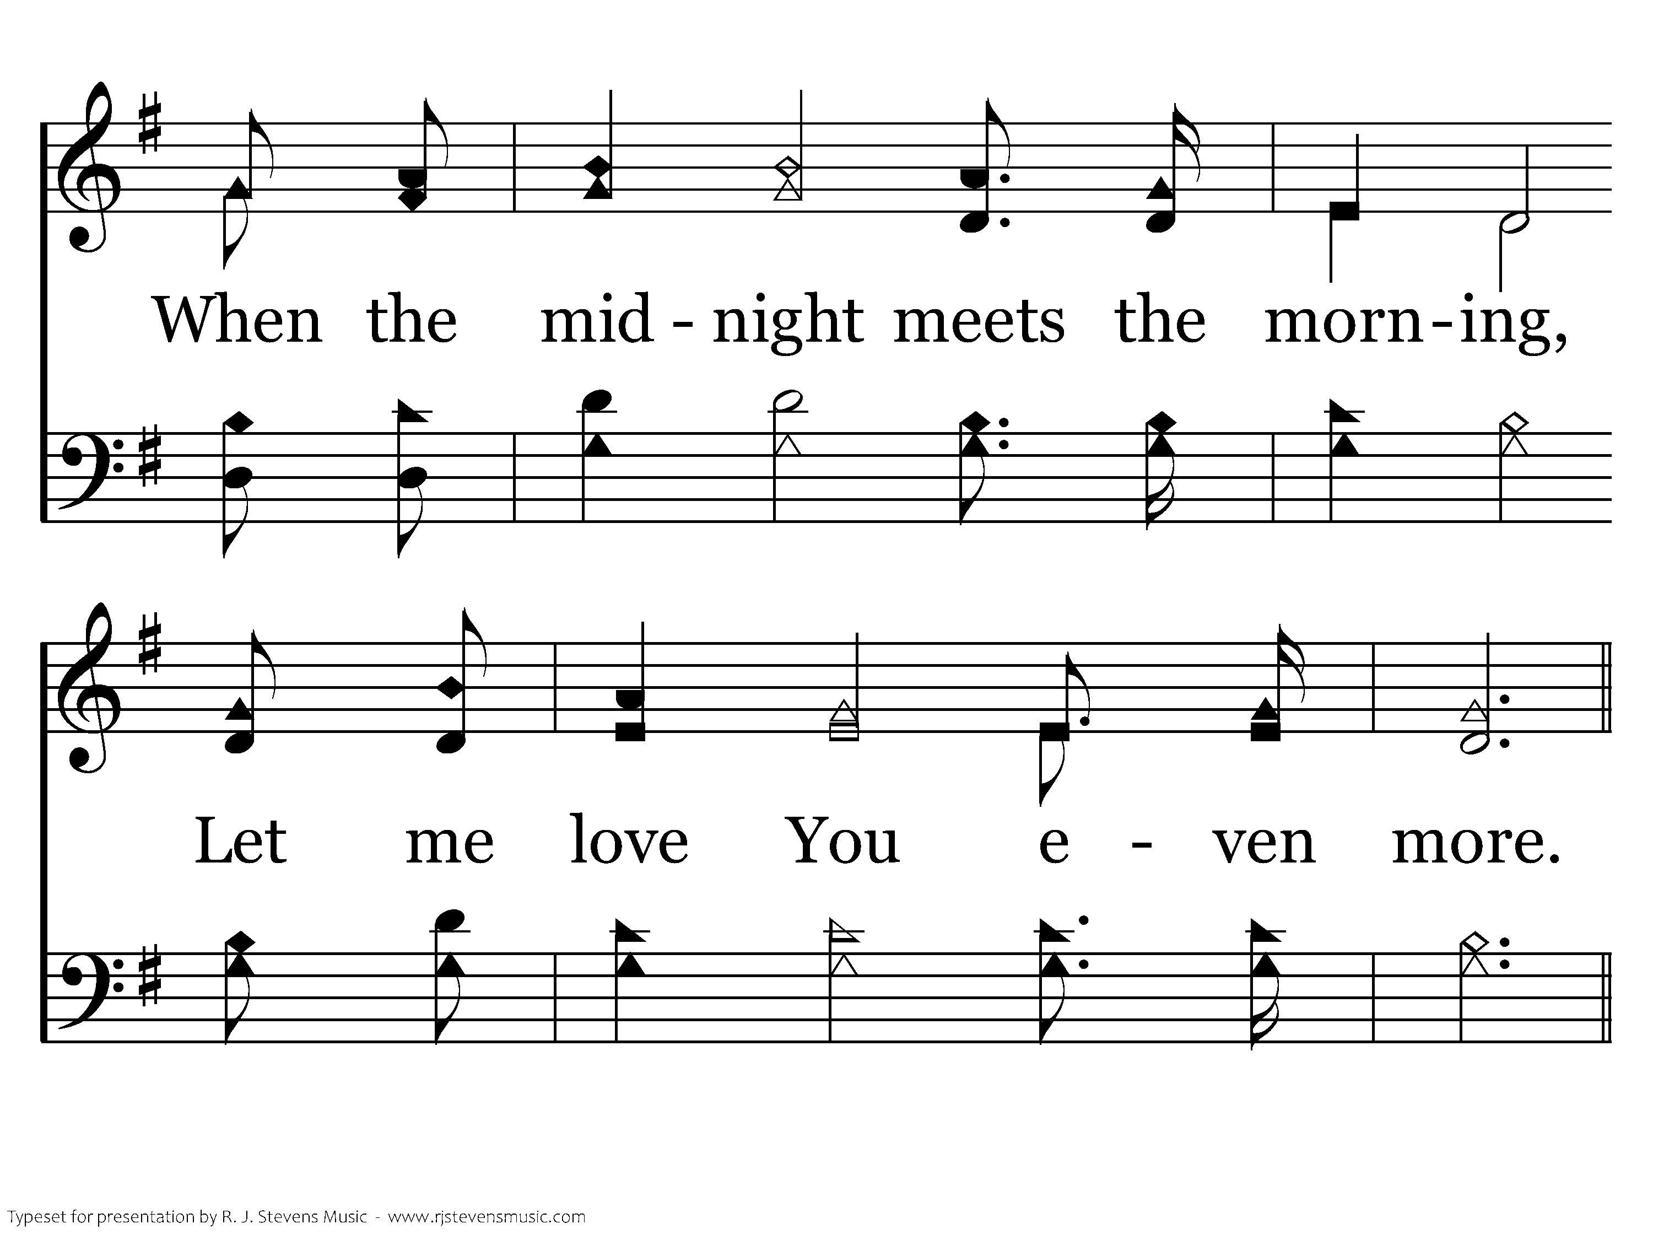
20634 - JESUS, DRAW ME EVER NEARER - 2.2

Slide 8
20634 - JESUS, DRAW ME EVER NEARER - C.1

Slide 9
20634 - JESUS, DRAW ME EVER NEARER - C.2
End of Verse 2

Slide 10
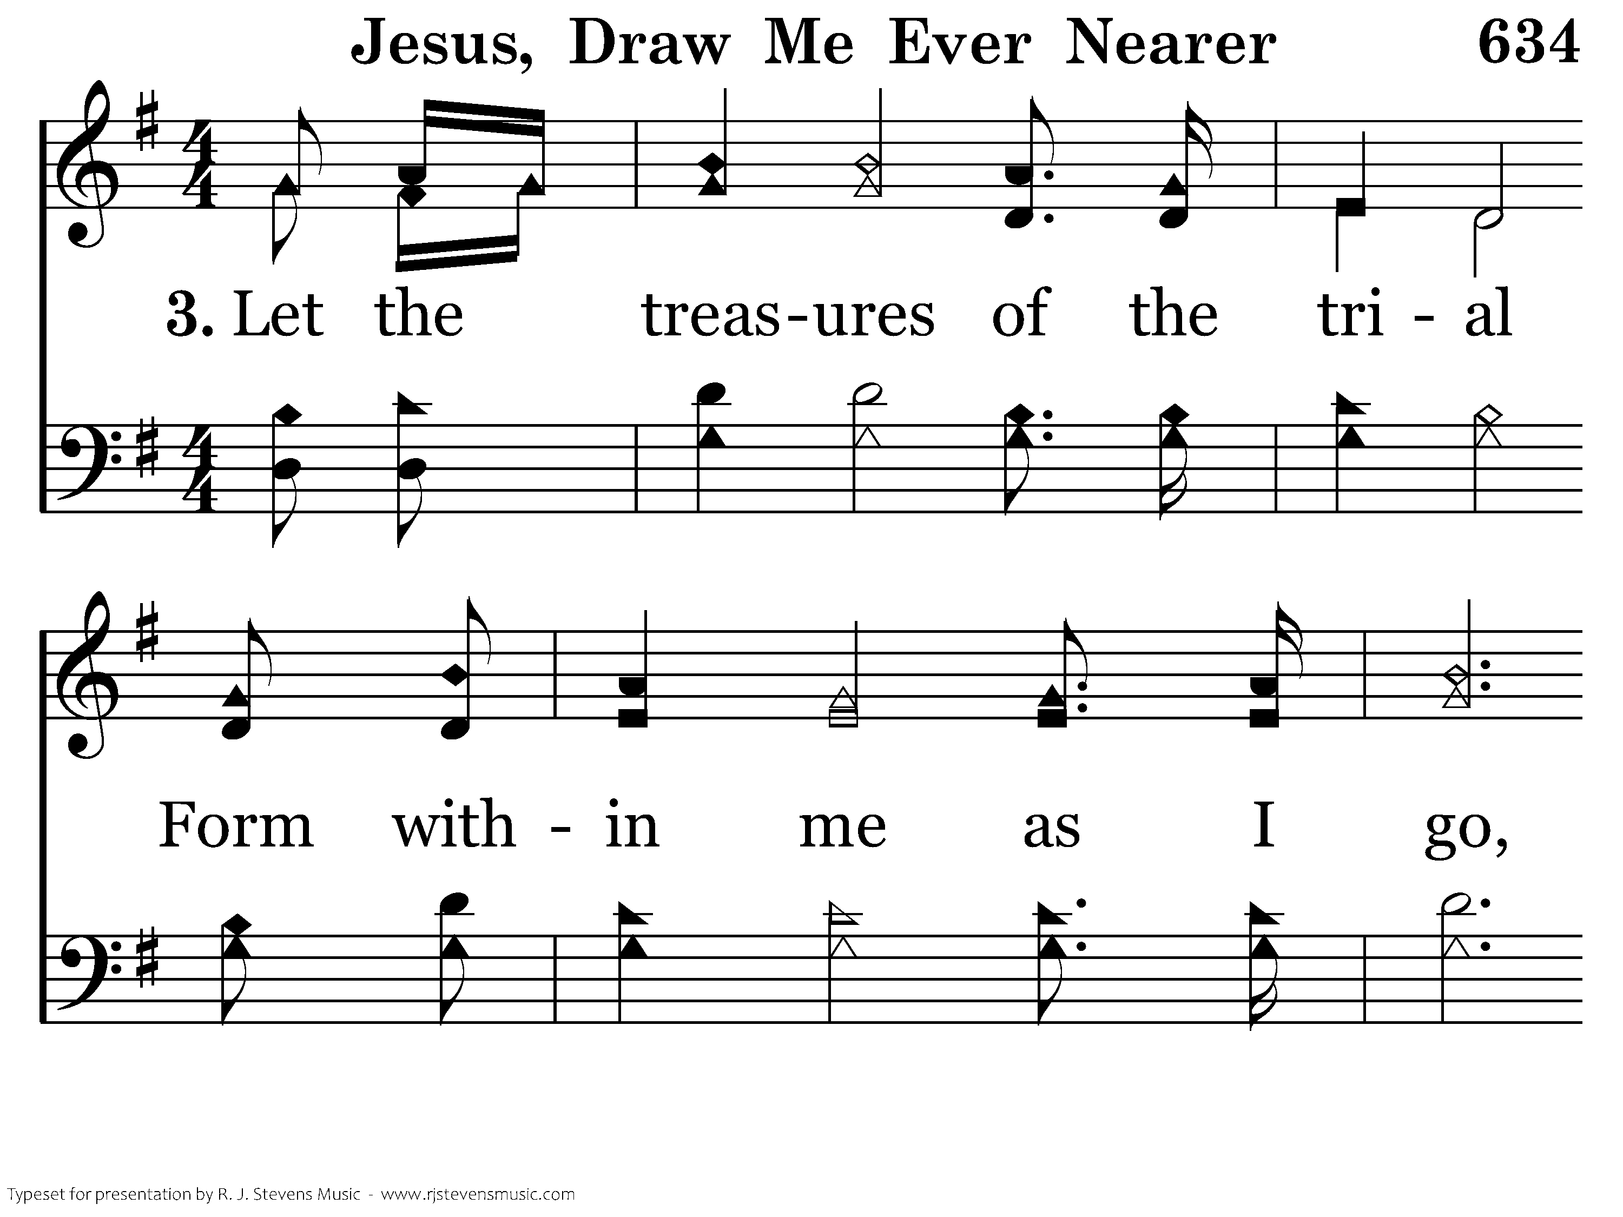
20634 - JESUS, DRAW ME EVER NEARER - 3.1

Slide 11
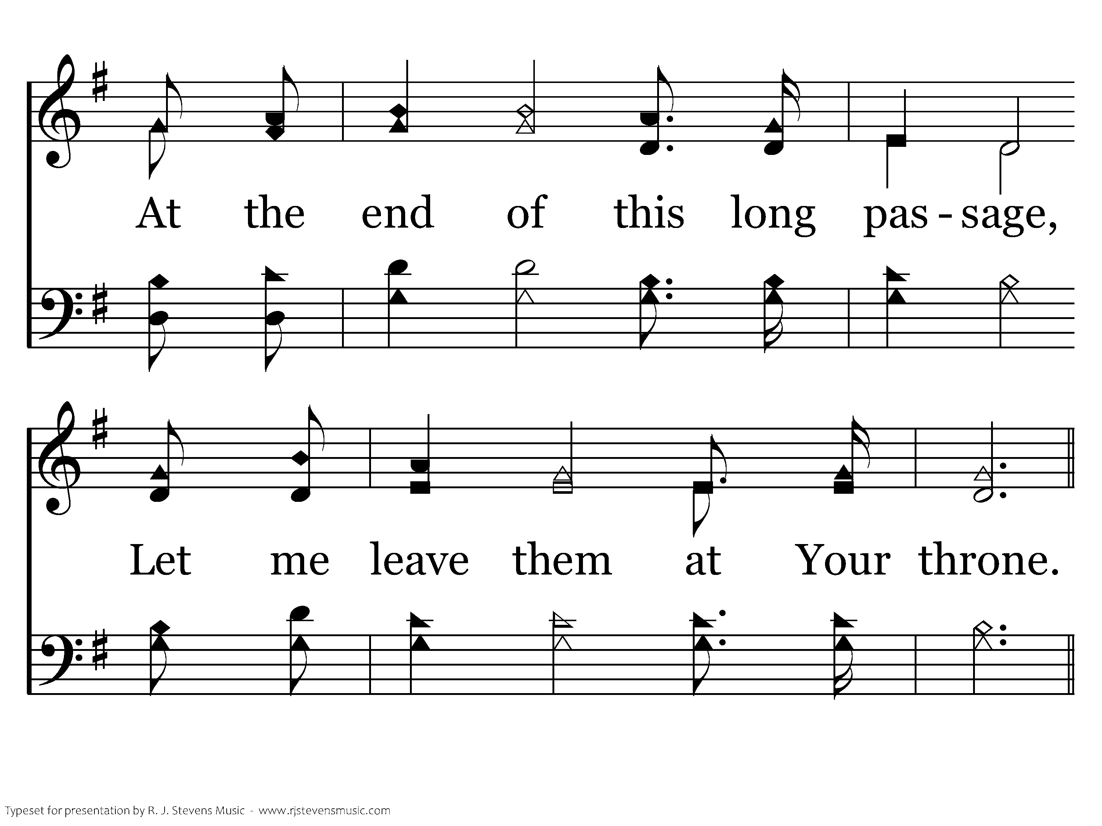
20634 - JESUS, DRAW ME EVER NEARER - 3.2

Slide 12
20634 - JESUS, DRAW ME EVER NEARER - C.1

Slide 13
20634 - JESUS, DRAW ME EVER NEARER - C.2
End of Song

Slide 14

20687 - HOW DEEP THE FATHER'S LOVE - Title

Slide 15
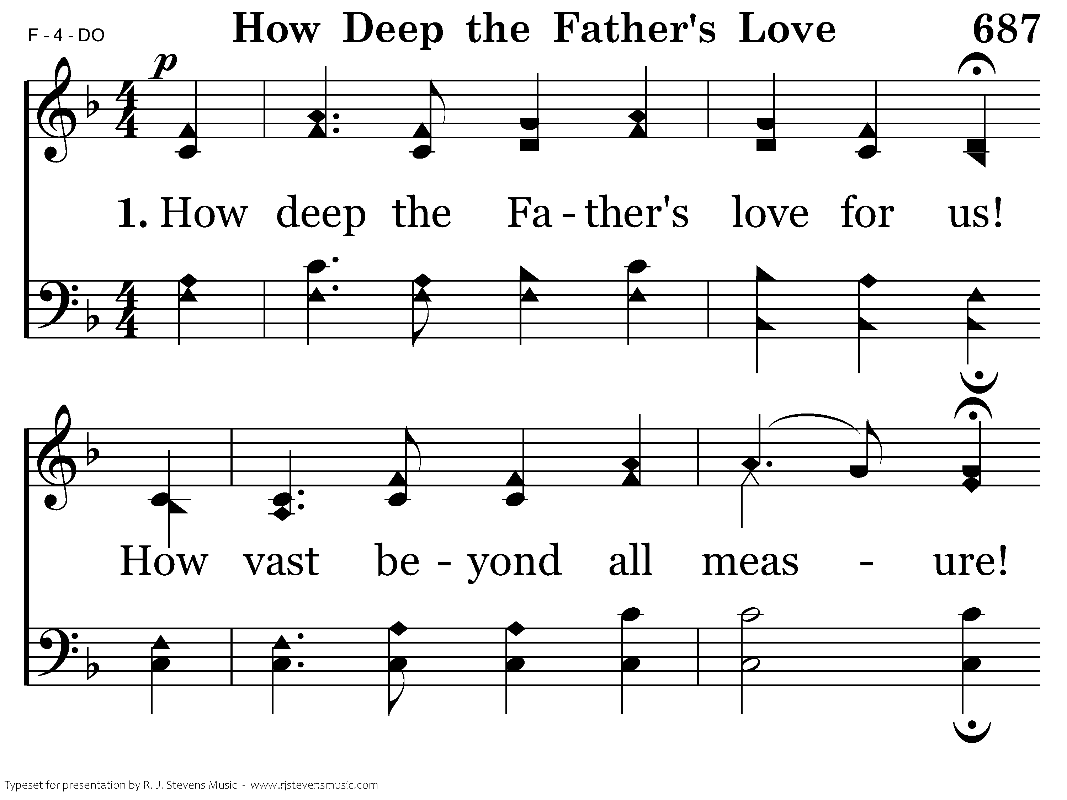
20687 - HOW DEEP THE FATHER'S LOVE - 1.1

Slide 16
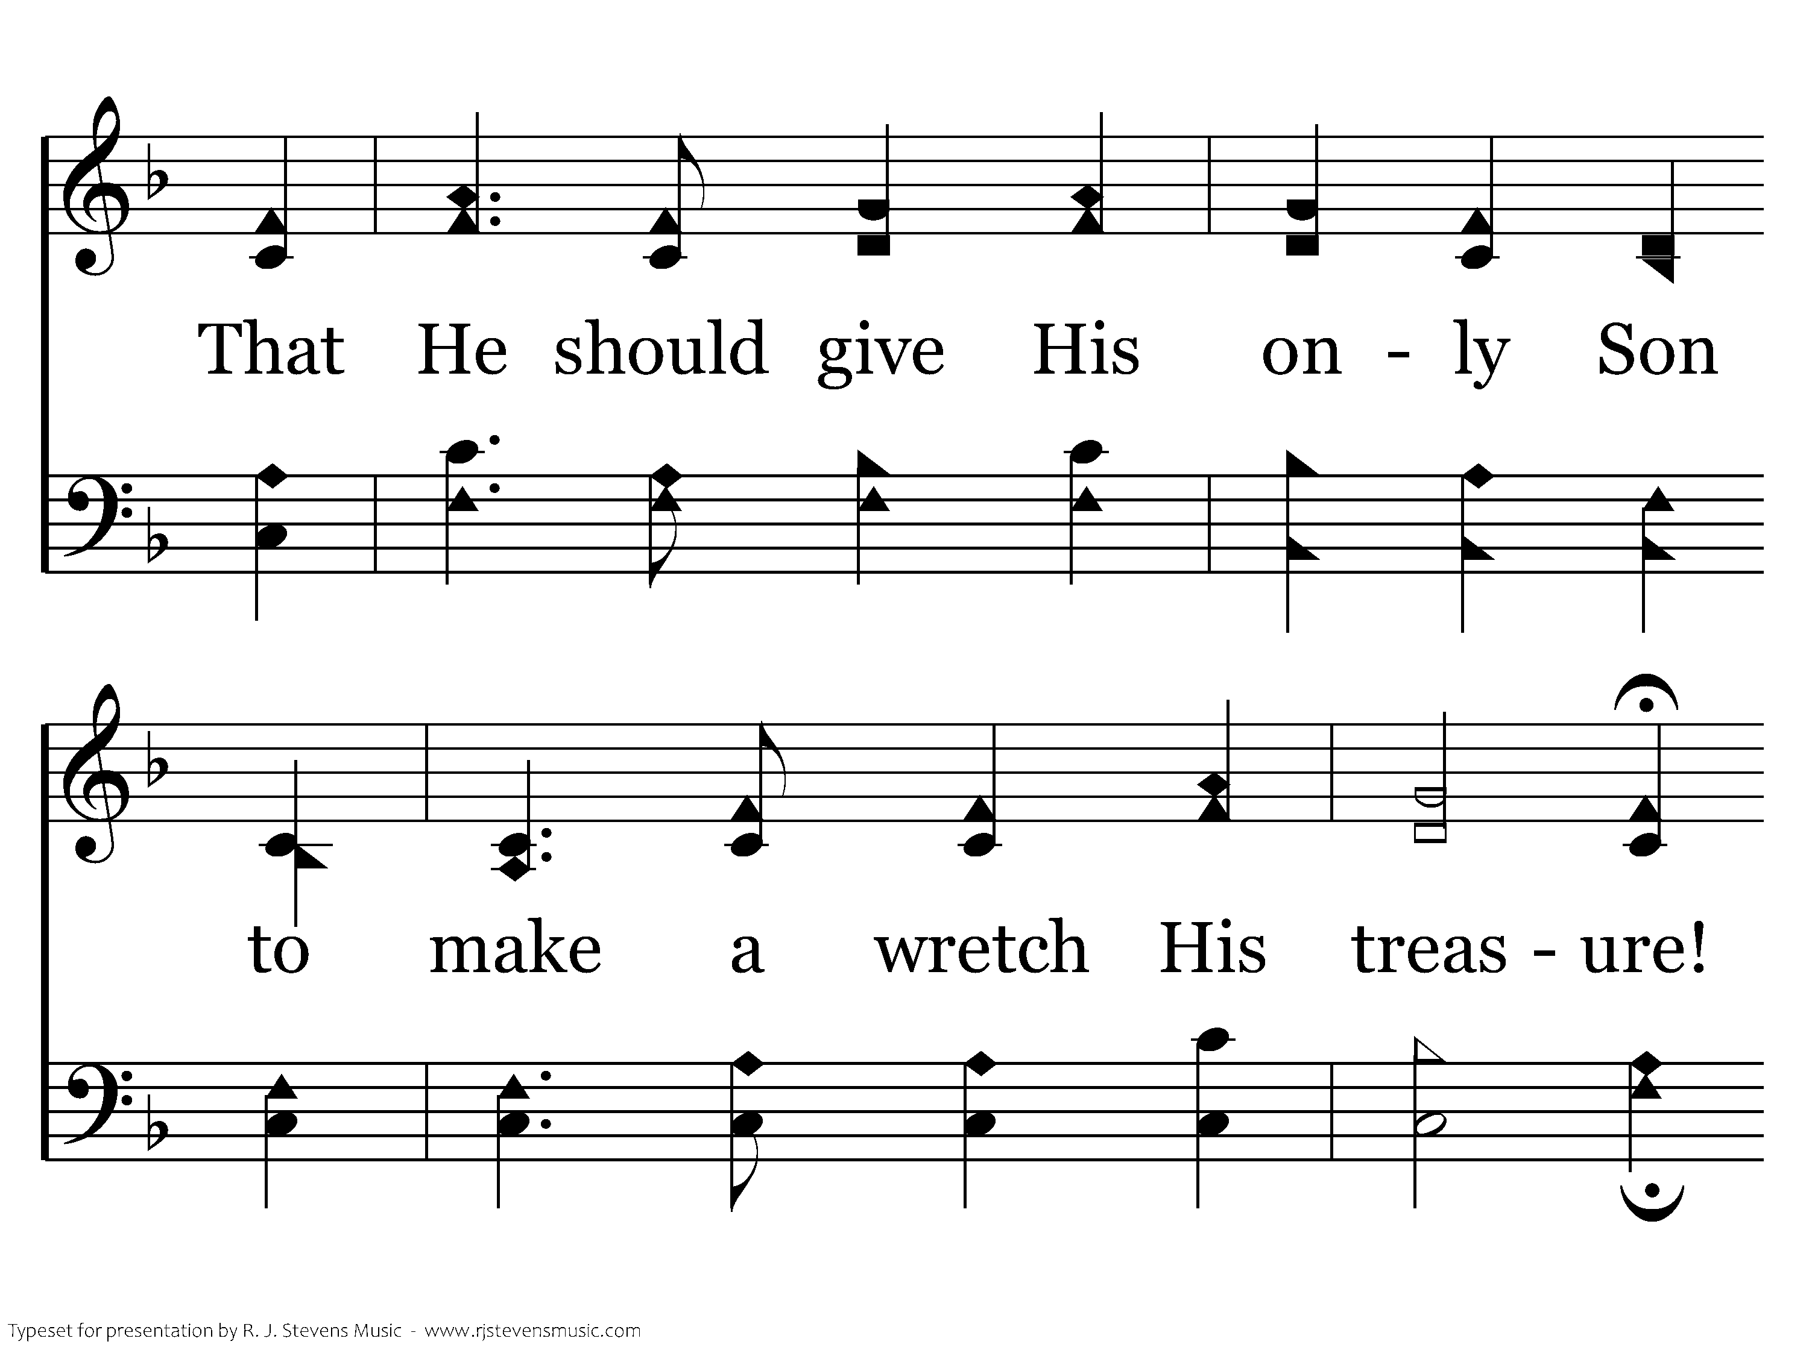
20687 - HOW DEEP THE FATHER'S LOVE - 1.2

Slide 17
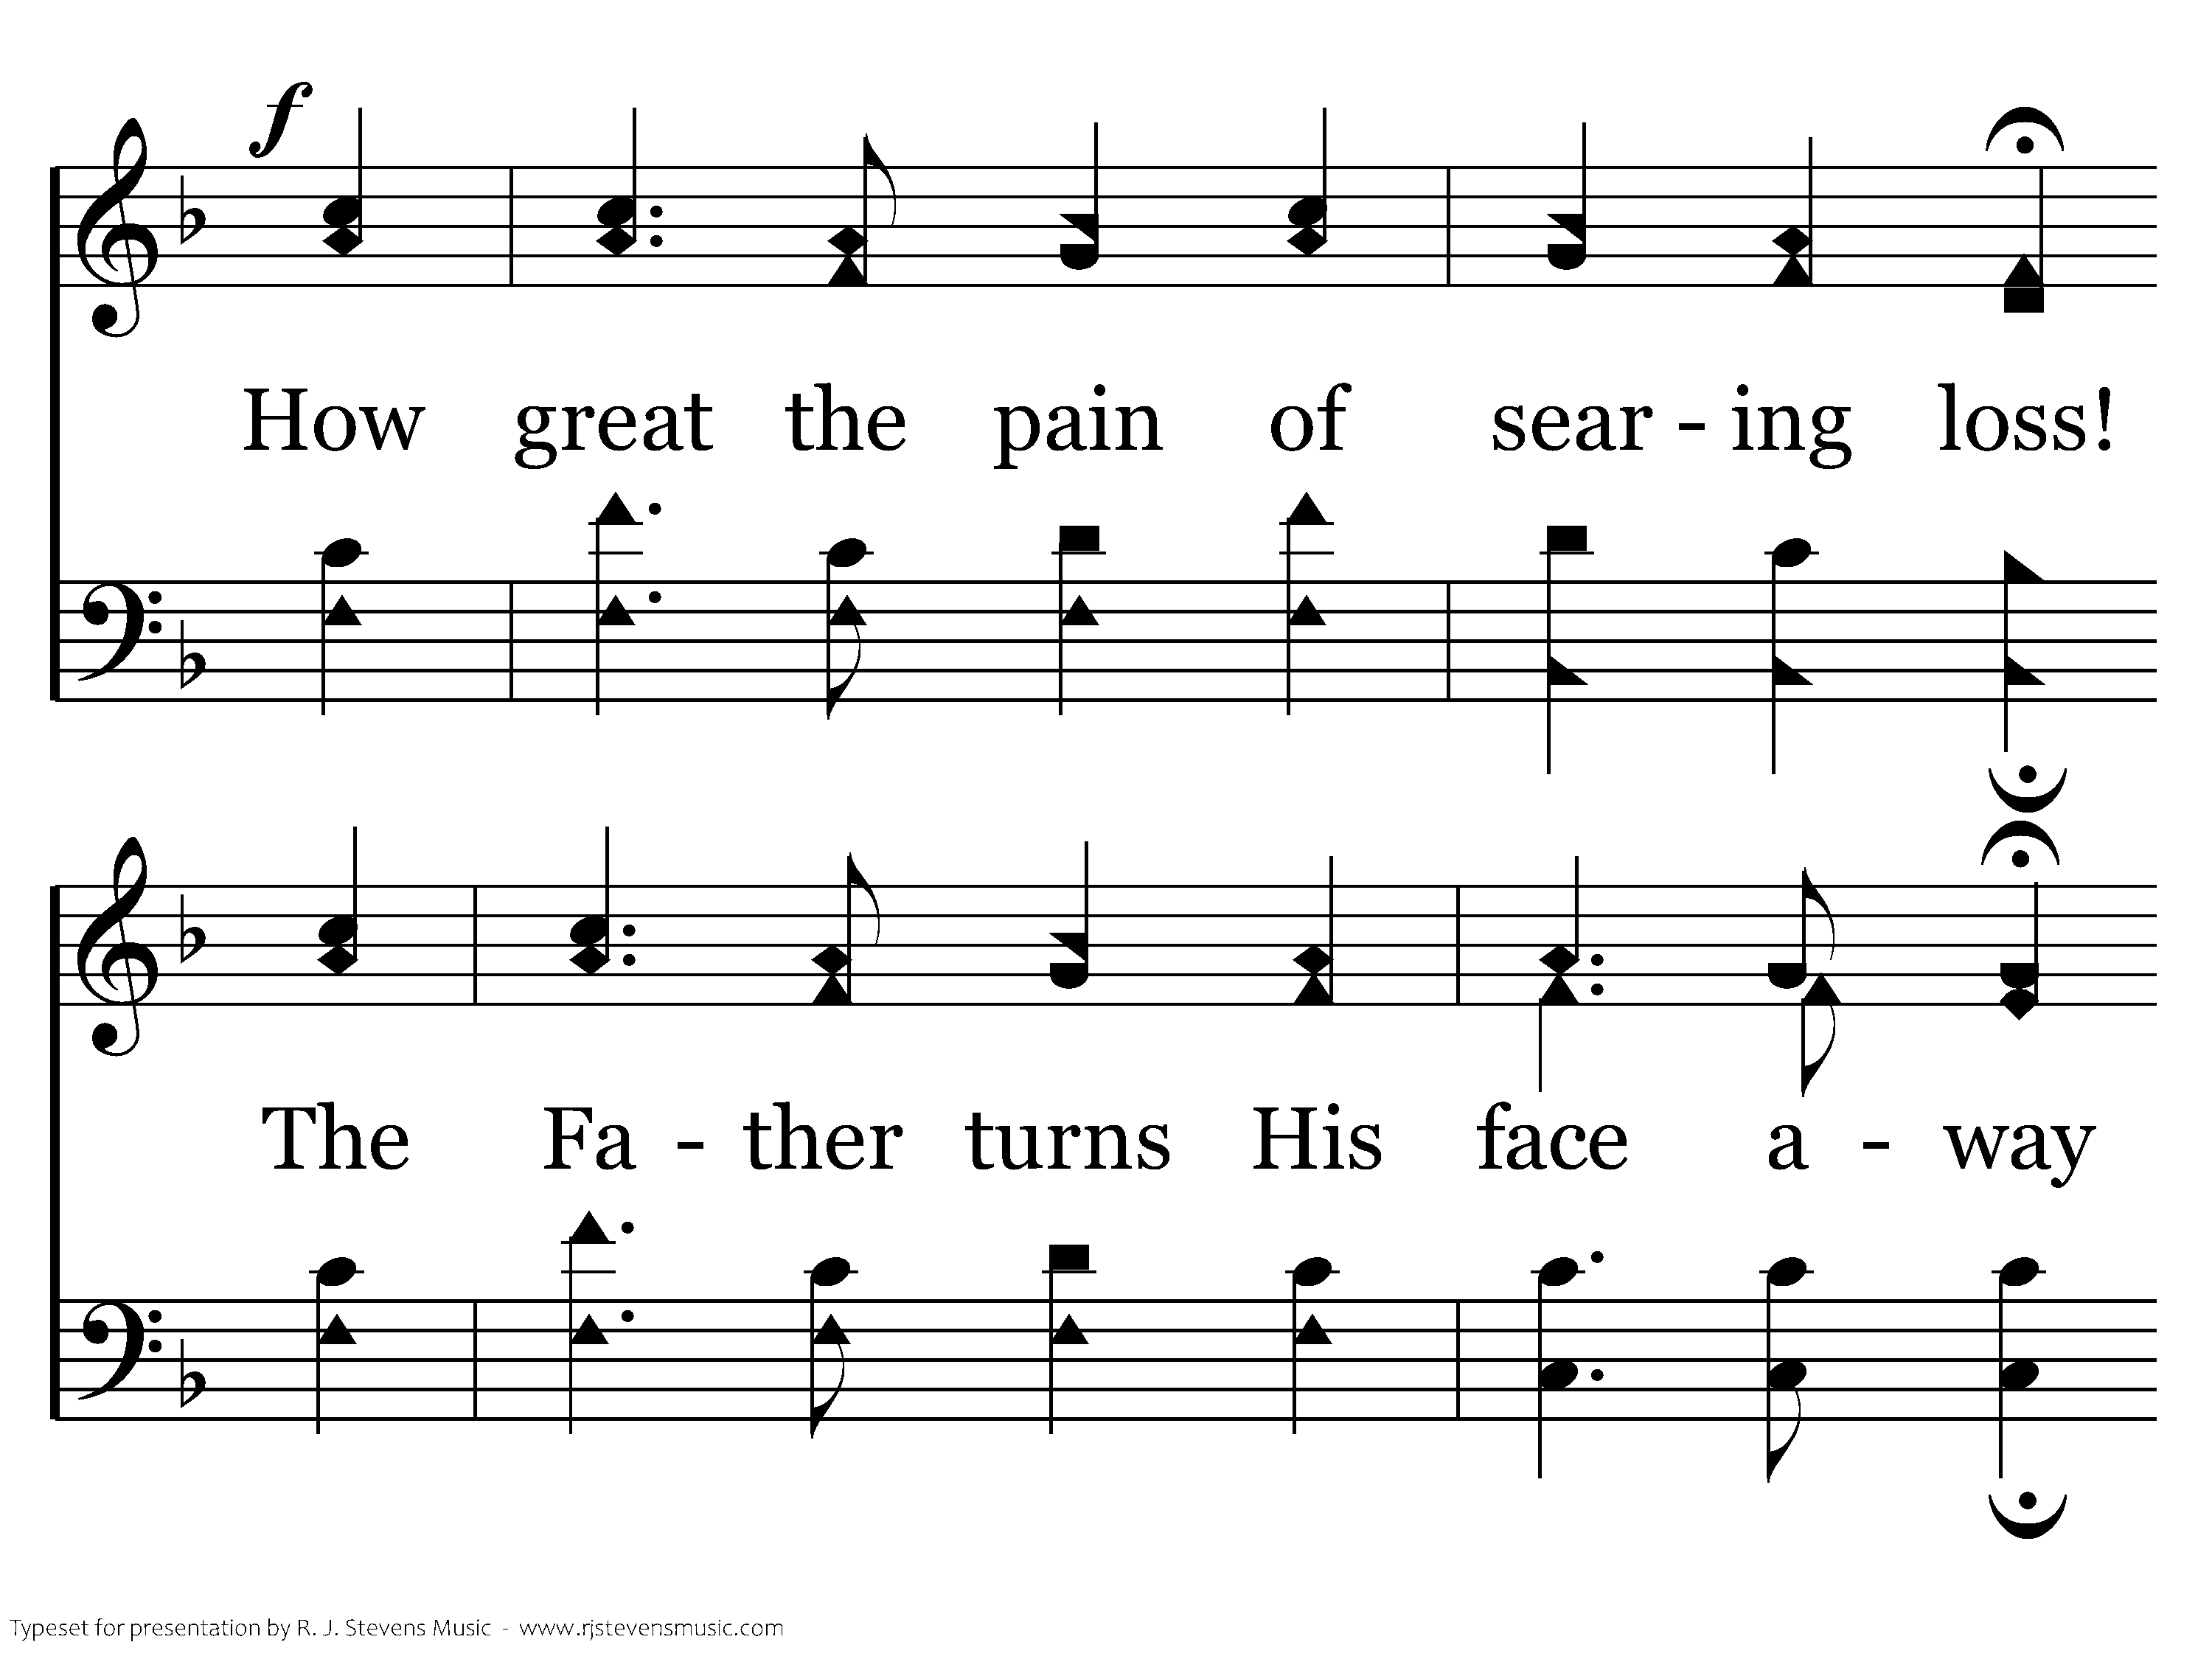
20687 - HOW DEEP THE FATHER'S LOVE - 1.3

Slide 18
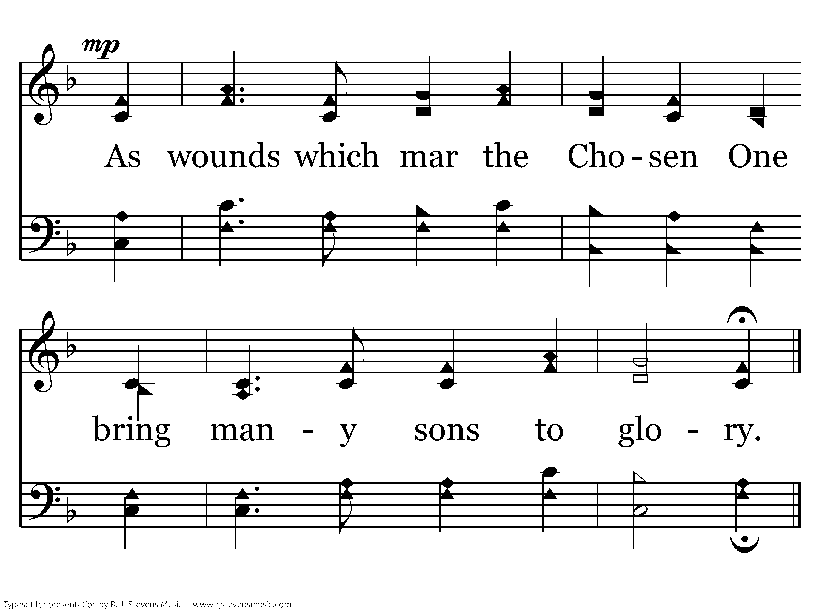
20687 - HOW DEEP THE FATHER'S LOVE - 1.4
End of Verse 1

Slide 19
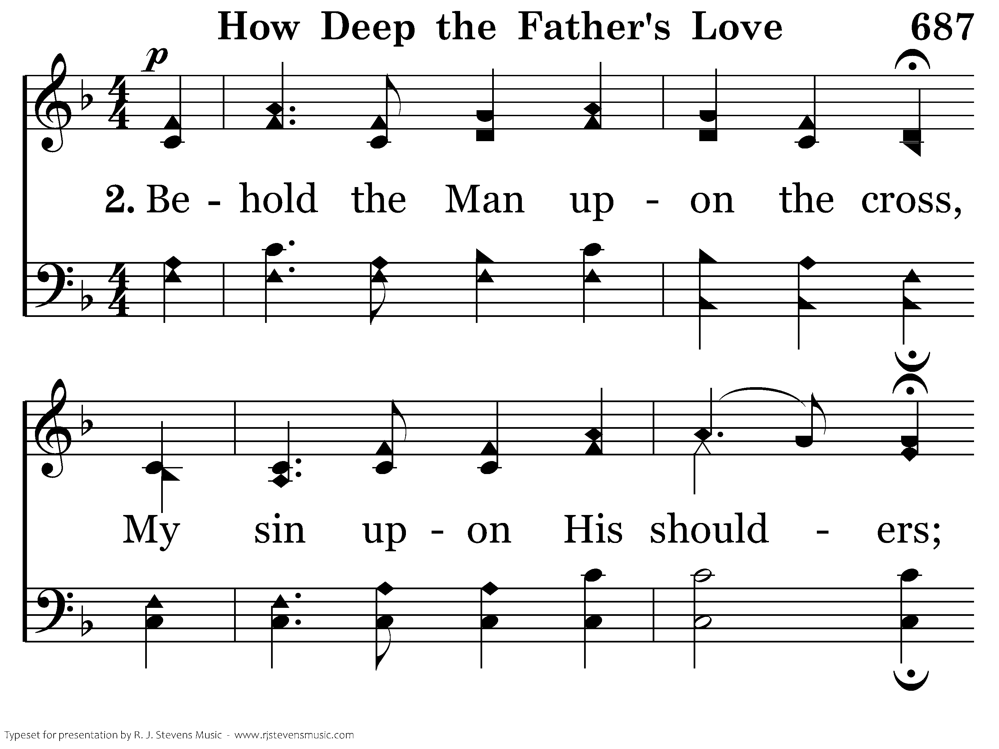
20687 - HOW DEEP THE FATHER'S LOVE - 2.1

Slide 20
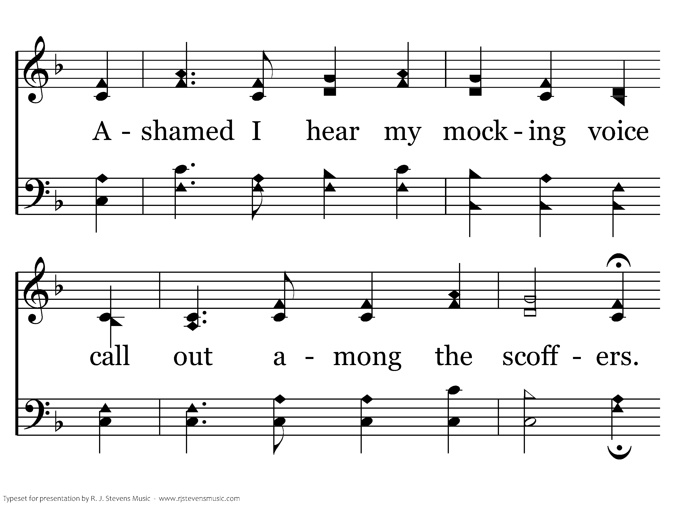
20687 - HOW DEEP THE FATHER'S LOVE - 2.2

Slide 21
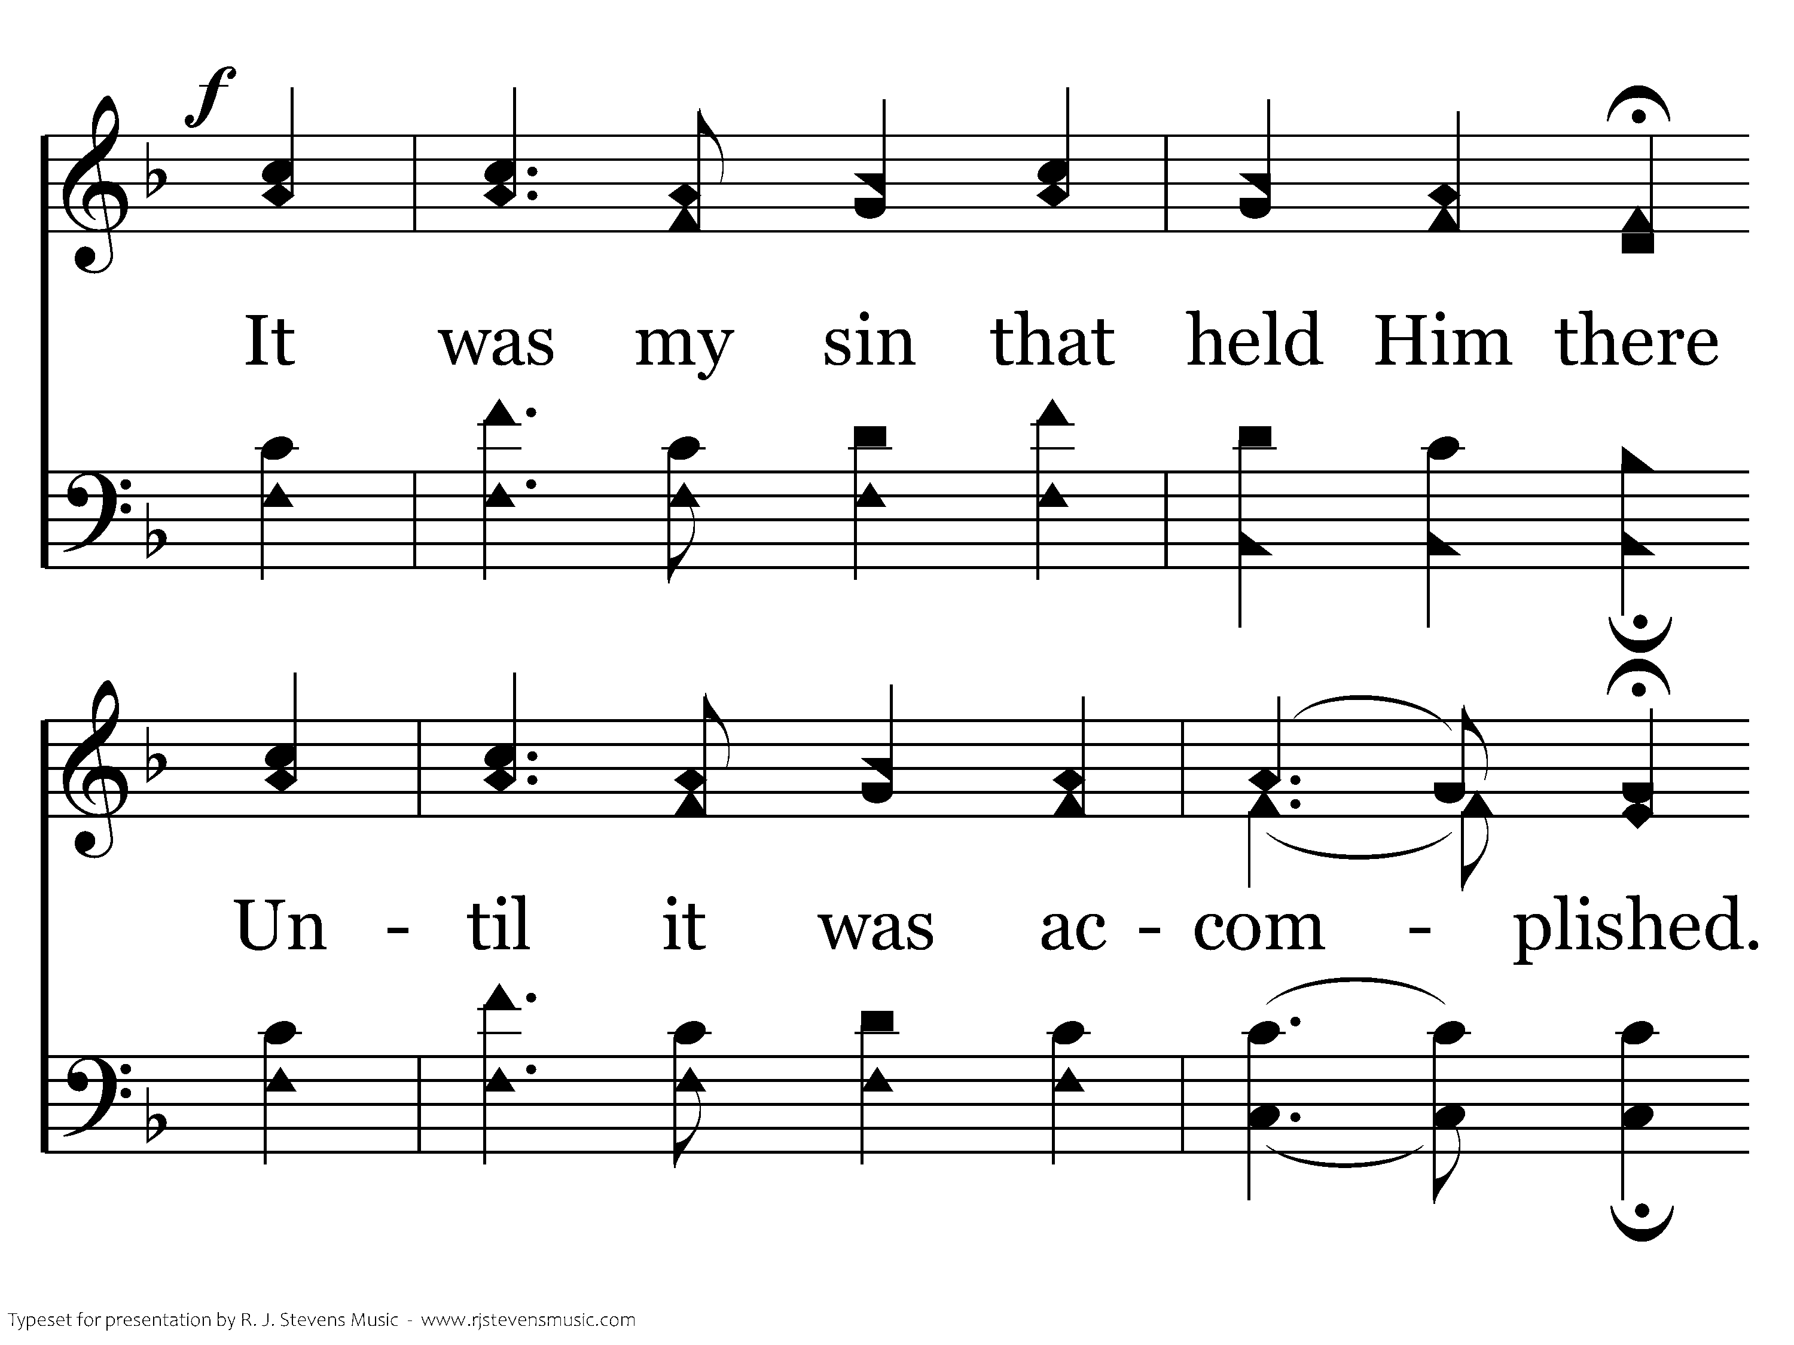
20687 - HOW DEEP THE FATHER'S LOVE - 2.3

Slide 22
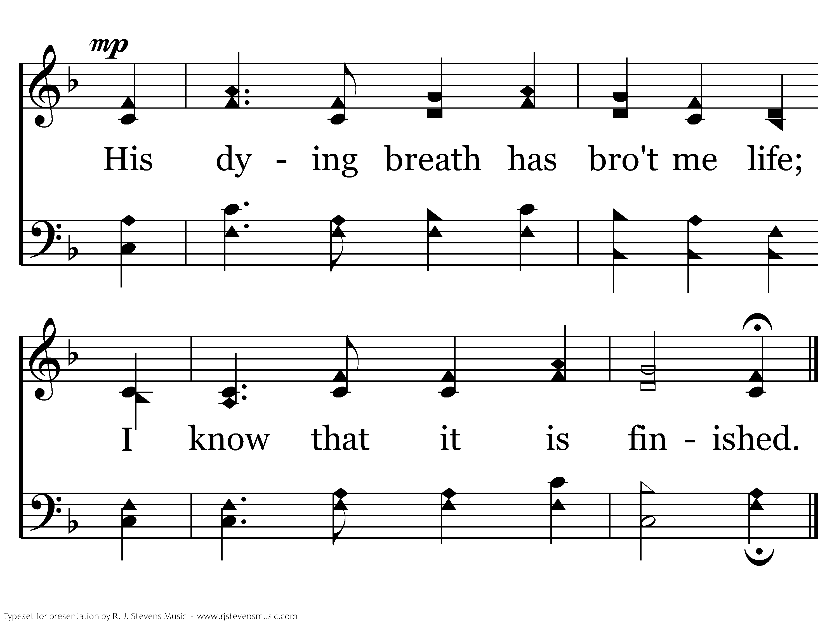
20687 - HOW DEEP THE FATHER'S LOVE - 2.4
End of Verse 2

Slide 23
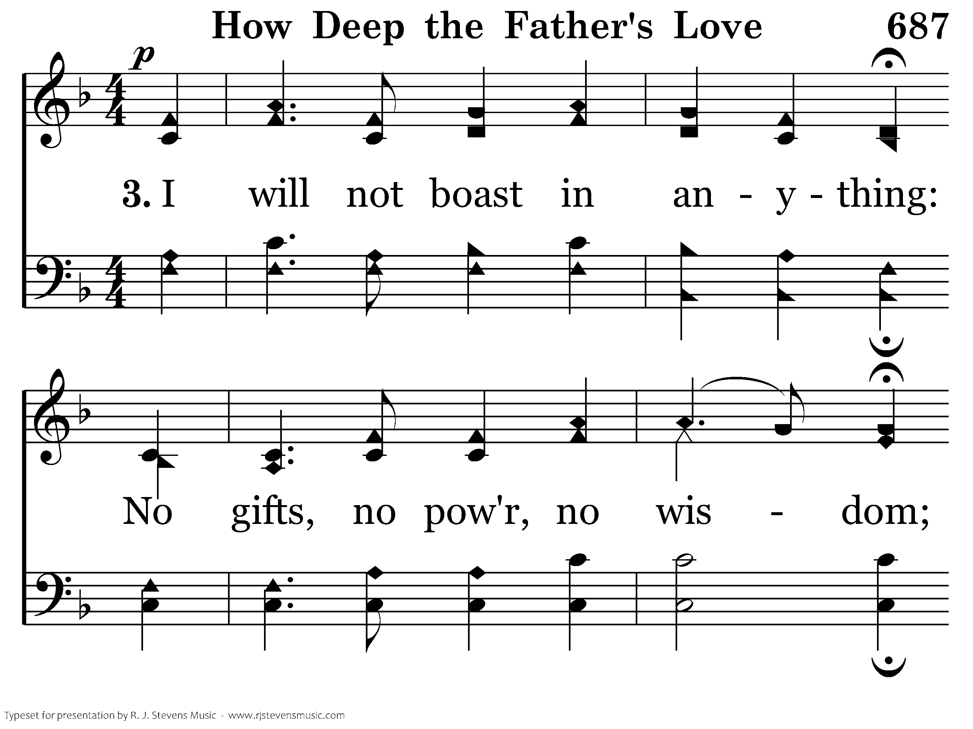
20687 - HOW DEEP THE FATHER'S LOVE - 3.1

Slide 24
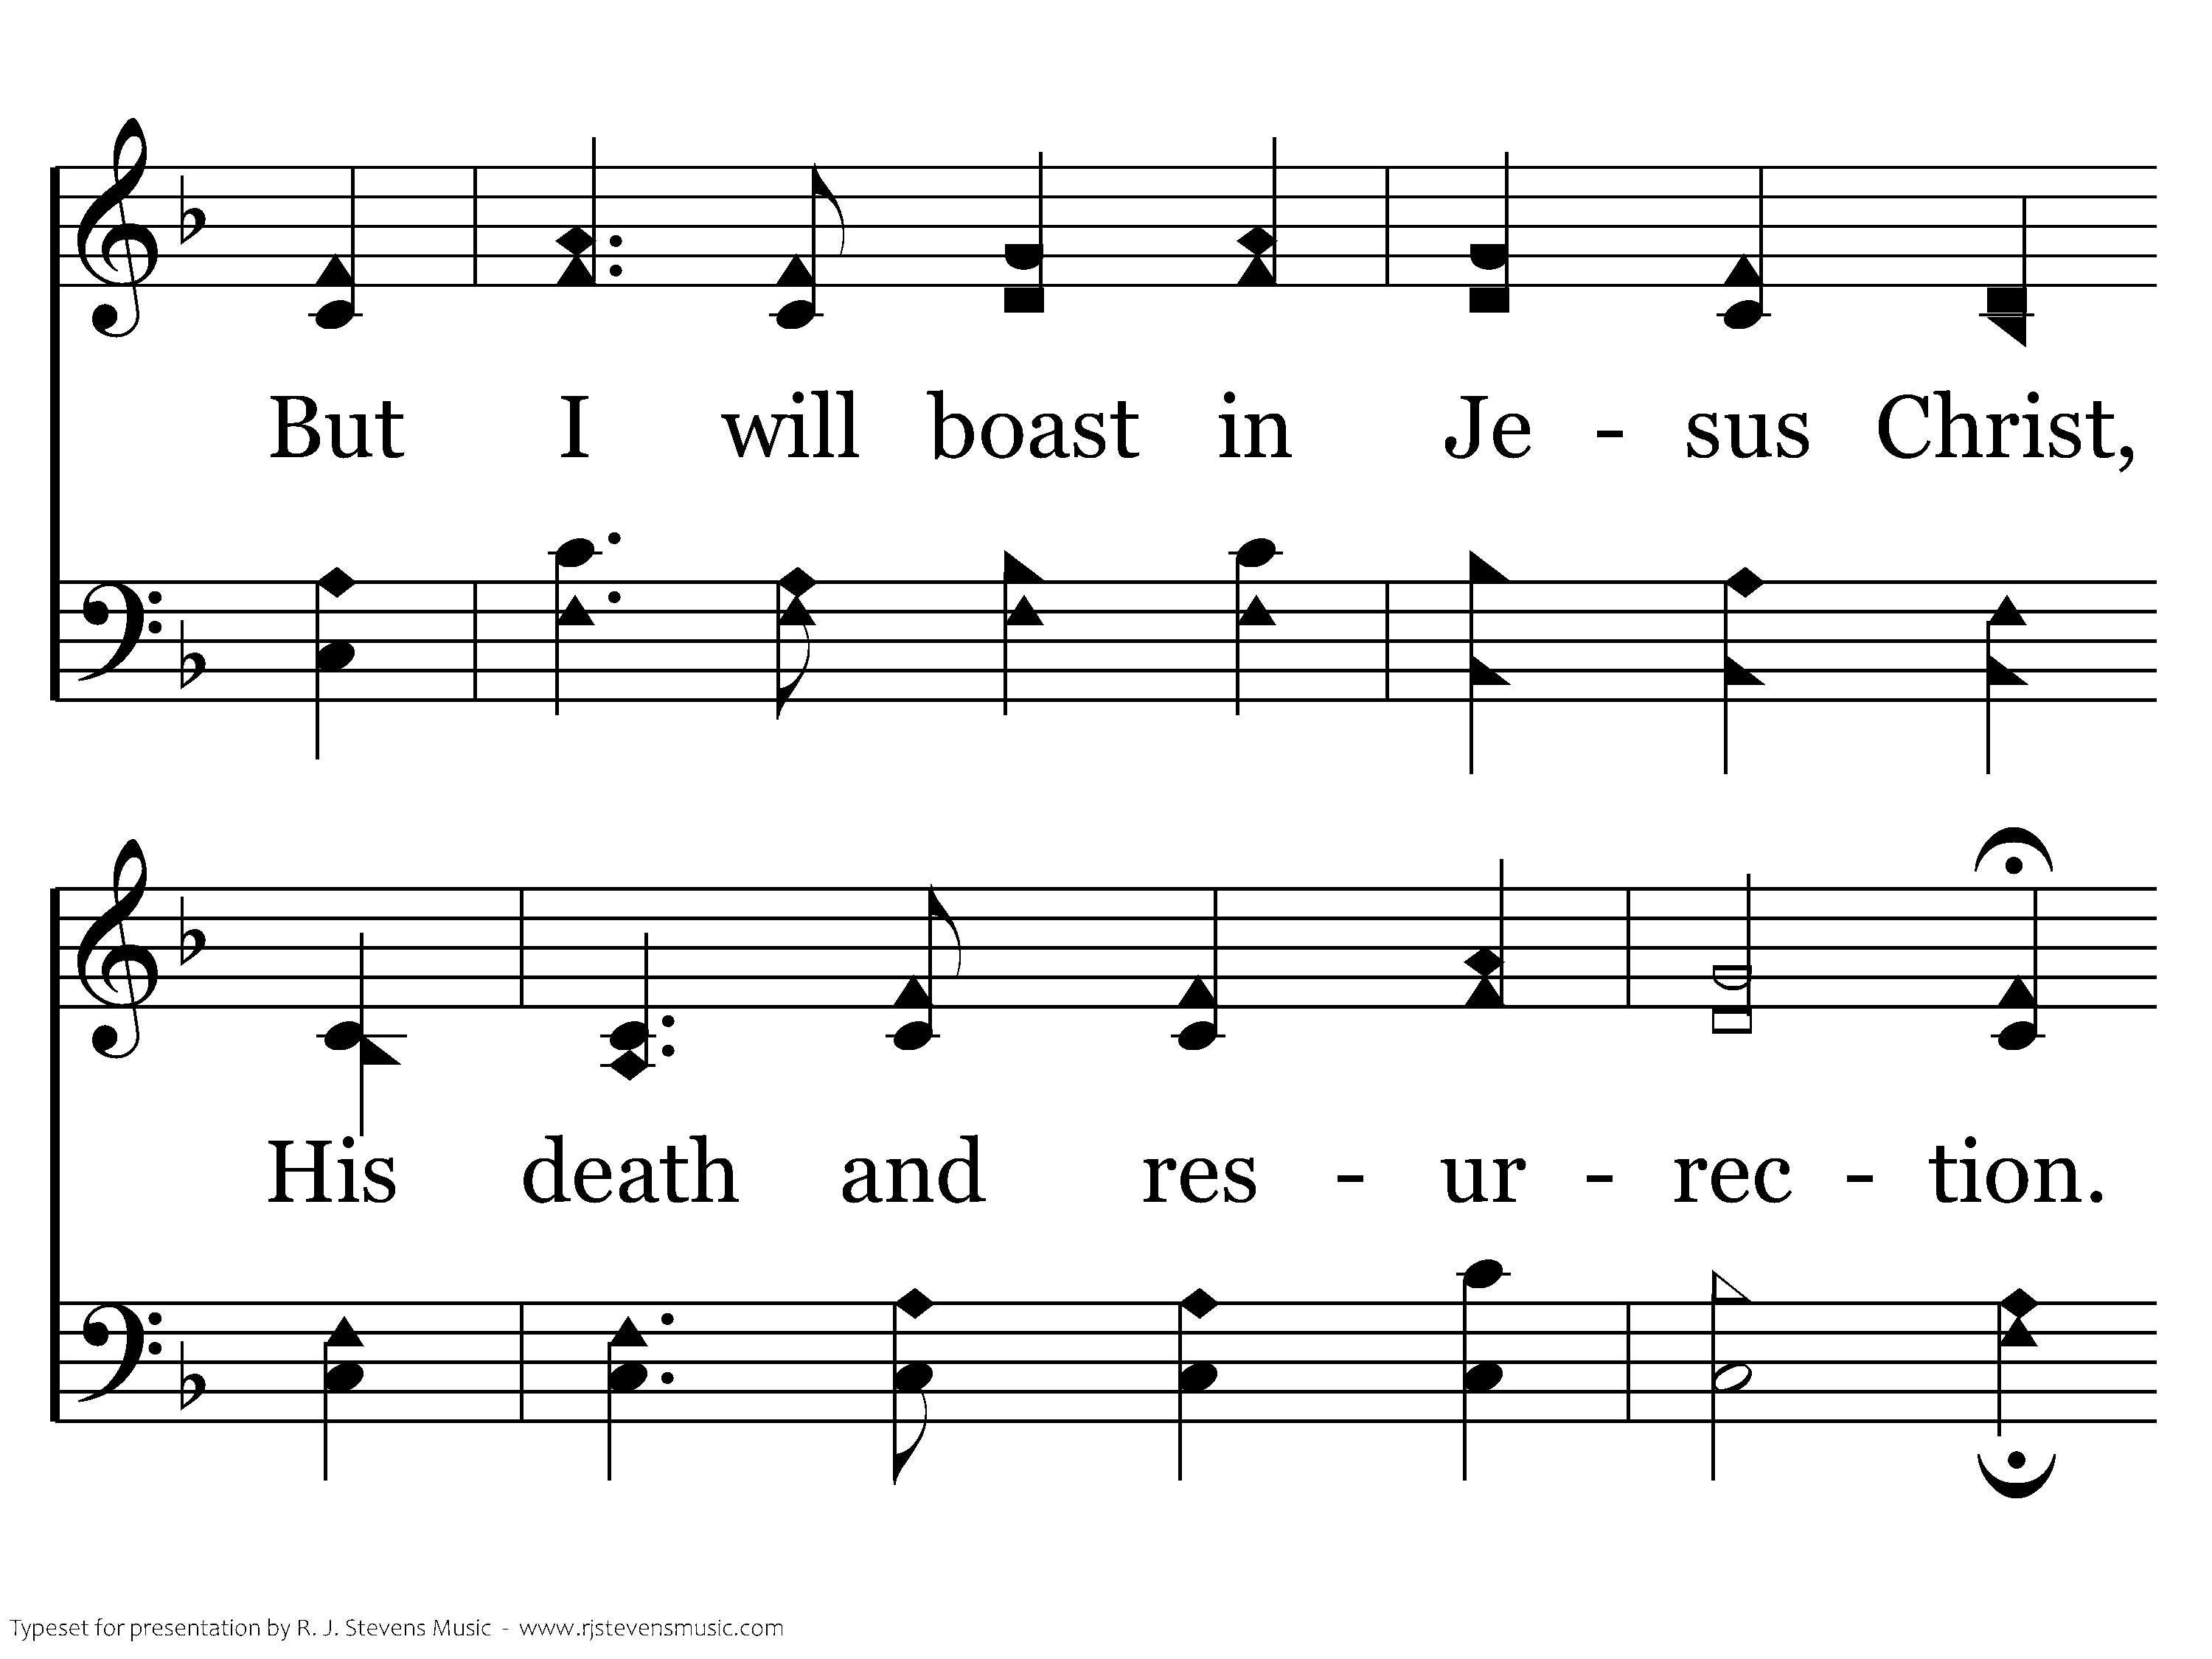
20687 - HOW DEEP THE FATHER'S LOVE - 3.2

Slide 25
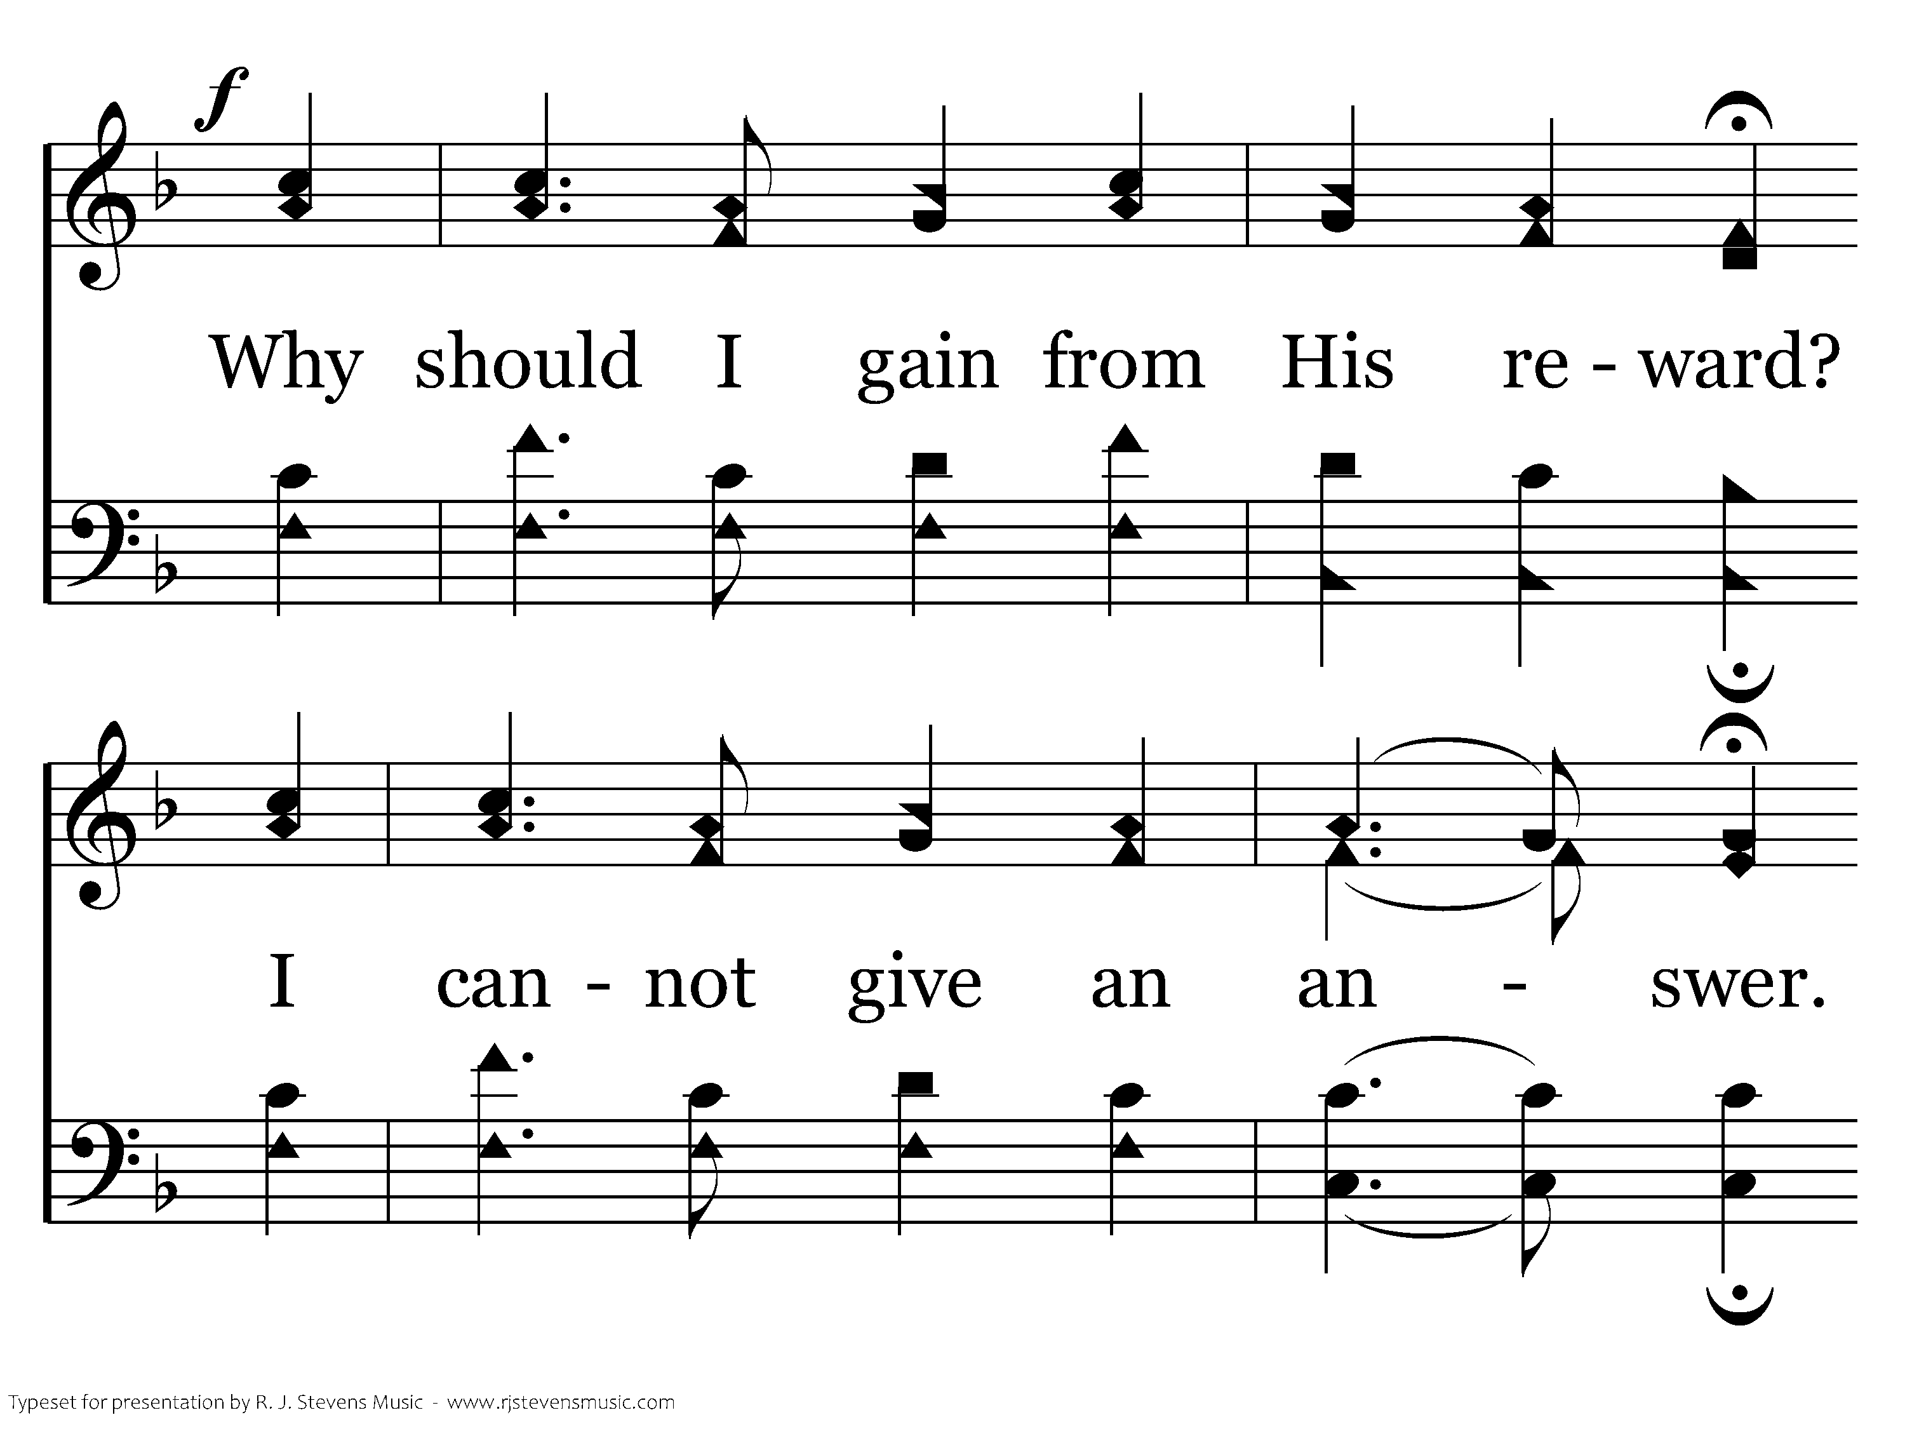
20687 - HOW DEEP THE FATHER'S LOVE - 3.3

Slide 26
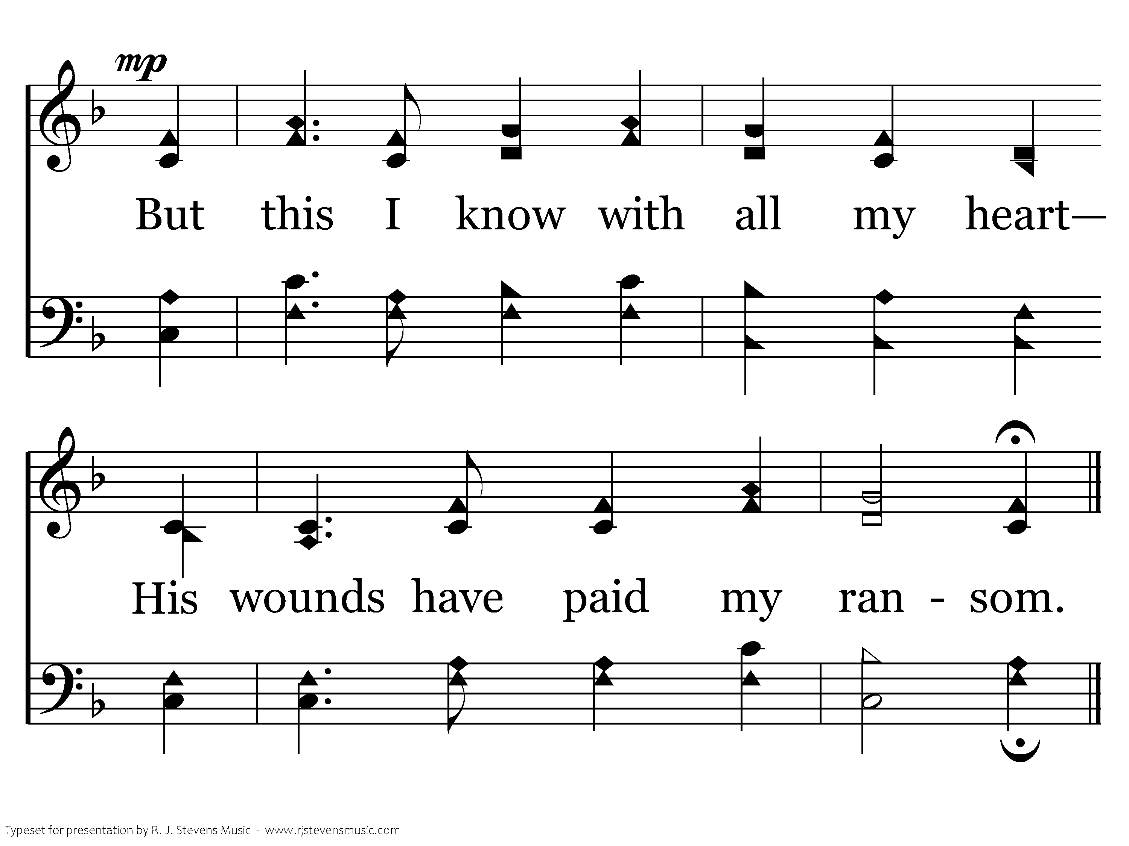
20687 - HOW DEEP THE FATHER'S LOVE - 3.4
End of Song

Slide 28
Periods of bible history
(The 3 Cycle Approach)
A Method For Organizing Bible Knowledge
adapted from Bob Waldron

Slide 29
The 3 Cycle Approach
First Cycle: Periods of Bible History
  The objective in this cycle is primarily to learn the list of periods of Bible history and how they link together.
Second Cycle: Contents of the Periods of History
  The objective of this cycle is to reinforce the first cycle, but are also adding the content of these periods, so that you will have a grasp of what is in each period.
Third Cycle: Scriptural Limits of the Bible Periods
  The objective in this third cycle is to reinforce yet again the list of Bible periods, to reinforce the links between the periods, to reinforce what is in each of these periods, and to show where each Bible period is set forth in Scripture.

Slide 30
Periods of bible history
Before the Flood
The Flood
The Scattering of the People
The Patriarchs
The Exodus
Wandering in the Wilderness
Invasion and Conquering
The Judges
The United Kingdom
The Divided Kingdom
Judah Alone
The Captivity
Return from Captivity
Years of Silence
Life of Christ
Early Church
Letters to Christians

Slide 31
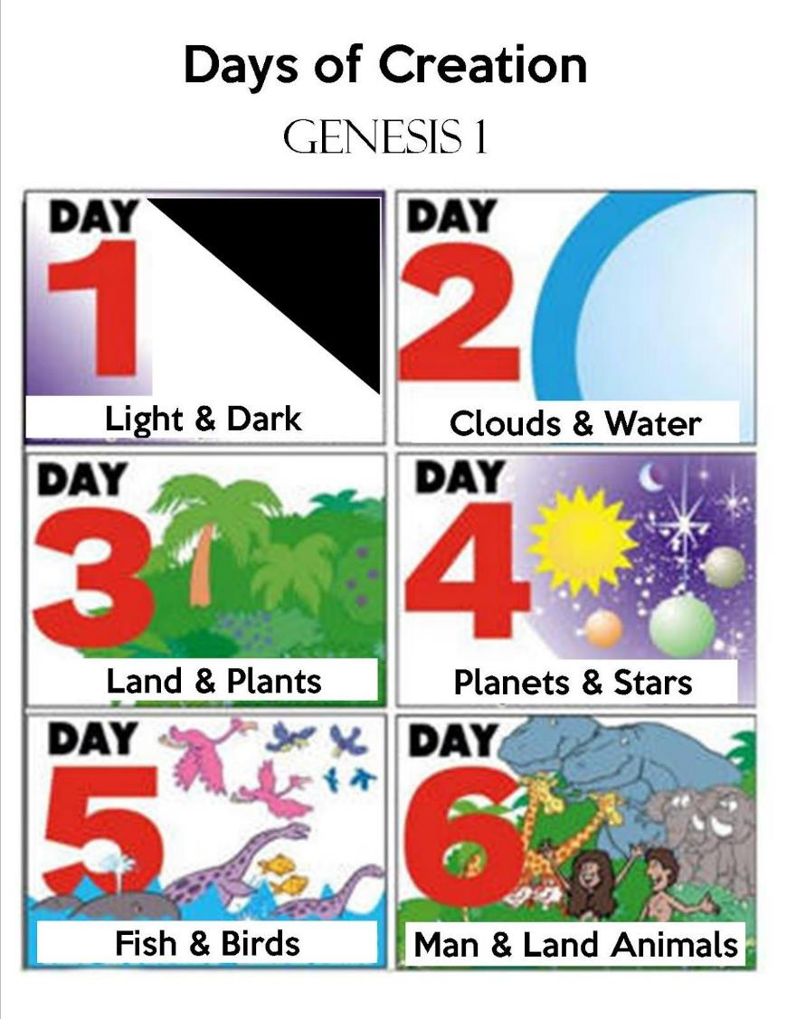

1. Before The Flood
Genesis 1-5
Chapter 1: Creation of the world.
Chapter 2: Adam and Eve in the Garden of Eden.
Chapter 3: First Sin.
Chapter 4: Cain and Abel.
Chapter 5: Generations of Adam.

Slide 32
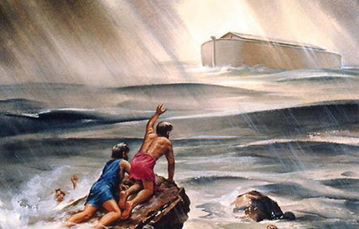
2. The Flood
Genesis 6-10
Chapter 6: the warning of the flood.
Chapter 7: the beginning of the flood.
Chapter 8: The end of the flood.
Chapter 9:
Meat for food.
Capital punishment
Rainbow covenant.
Noah’s drunkenness
Chapter 10: Generations of Noah’s sons.
Fast-forwards us to time of tower of Babel.

Slide 33
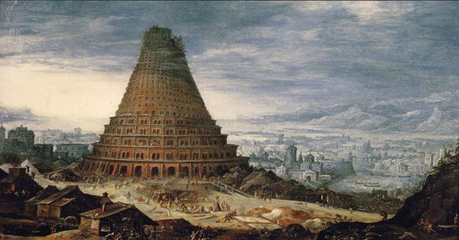
3. The Scattering of the People
Genesis 11
Tower of Babel built.
Languages divided.
Generations of Shem
Fast forwards us to the time of the Patriarchs

Slide 34
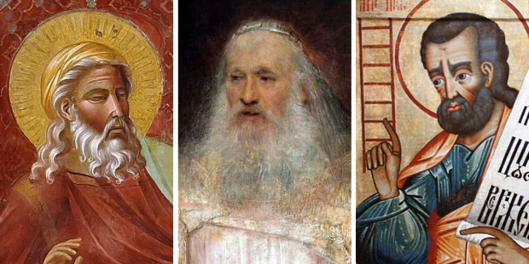
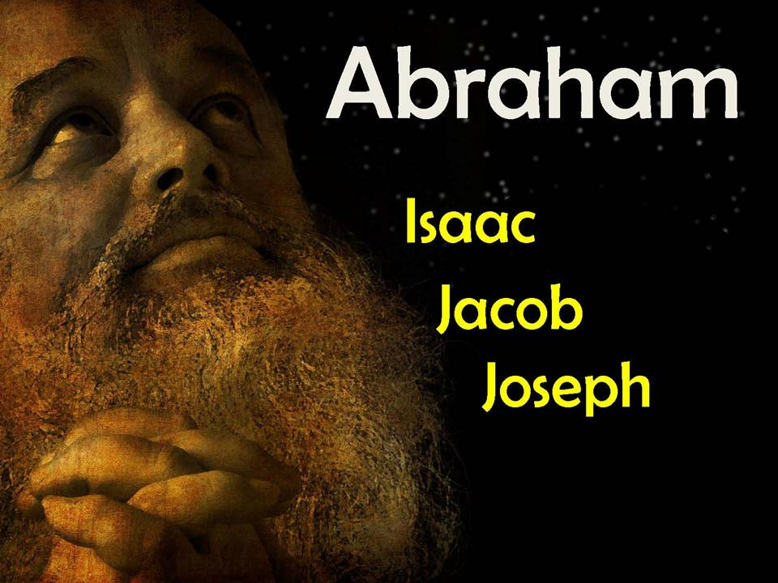
4. The Patriarchs
Genesis 12-50
Chapters 12-25: Abraham
Chapters 25-28: Isaac
Chapters 28-35: Jacob
Chapters 36: Esau
Chapters 37-50: Joseph
The children of Israel go to Egypt during the time of Joseph, but they did not stay in Egypt forever.

Slide 35
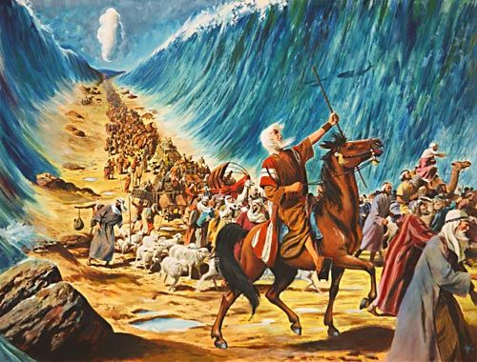
5. The Exodus
Exodus, Leviticus, Numbers 1-13
Numbers 1-9:
Census taken of people
Gifts of princes
Passover observed
One year since left Egypt
Numbers 10-12: Trip from Sinai to Kadesh-barnea
Numbers 13: Spies bring back a fearful report.
Exodus 1-15: Escape from Egypt
Exodus 16-18: Journey to Mount Sinai
Exodus 19-24: God makes a covenant with Israel
Exodus 25-30: Instructions for making the tabernacle and its furniture
Exodus 31: Two special craftsmen who will direct the work
Exodus 32-34: Israel breaks their covenant; God renews it.
Exodus 35-40: Building of the tabernacle and setting it up.
Book of Leviticus:
Laws given for the Priests and Levites.
Teaches concept of holiness.

Slide 36
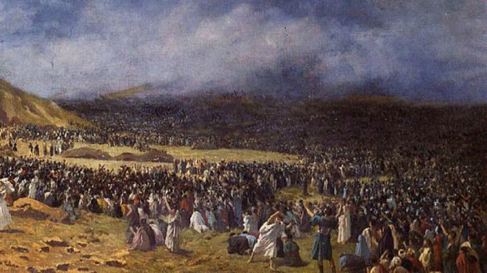
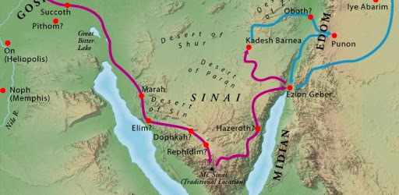
6. The Wandering in the Wilderness
Numbers 14-36; Deuteronomy, Joshua 1-5
Israel sentenced to wander in the wilderness
Korah, Dathan, Abiram
Aaron’s rod that budded
Miriam dies
Sin of Moses and Aaron
Passing by Edom
Aaron’s death
Fiery serpents
Conquer Sihon (Amorites)
Conquer Og (Bashan)
Balaam
Fornication with Midianites
Second Census
Slaughter of Midianites
Speeches of Moses in Deuteronomy
Moses’ death
Crossing of the Jordan
Observing the Passover

Slide 37
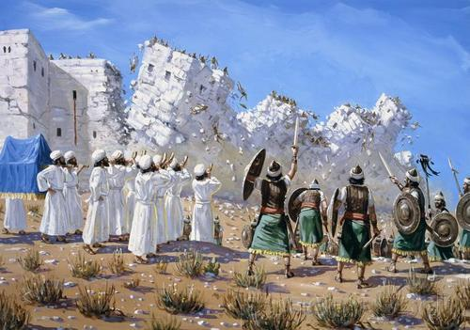
7. Invasion and Conquest of the Land
Joshua 4-24
Central campaign:
They take Jericho, Bethel, and Ai
They stake their claim on the land at Shechem
Southern campaign:
They make a treaty with the Gibeonites
Then fight the kings of the south
Northern campaign:
They fight the kings of the north, led by Jabin king of Hazor
Land distributed among the tribes
Trans-jordanic tribes return home
Joshua challenges Israel to keep from the idols and to be faithful to God.
Joshua challenges Israel to choose whom they will serve.
They renew their covenant with Jehovah.
The Israelites do not act the way they should and they fall into servitude to the nations around them!

Slide 38

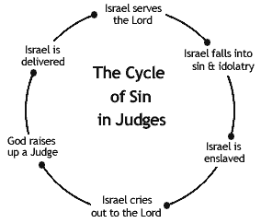
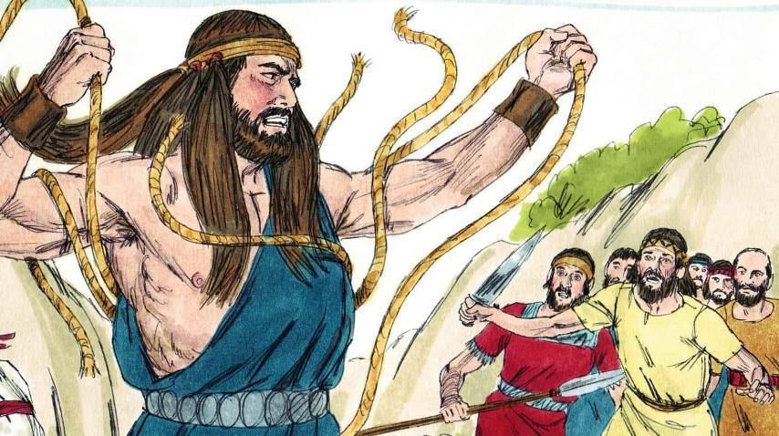
8. The Judges
God sent judges over Israel, one great woman fourteen men. They helped Israel fight their battles led them back to God from sin. Othniel, Ehud, Shamgar, Deborah, Gideon, Abimelech, Tola, Jair, Jephthah, Ibzan, Elon, Abdon, Samson, Eli, Samuel.

Slide 39
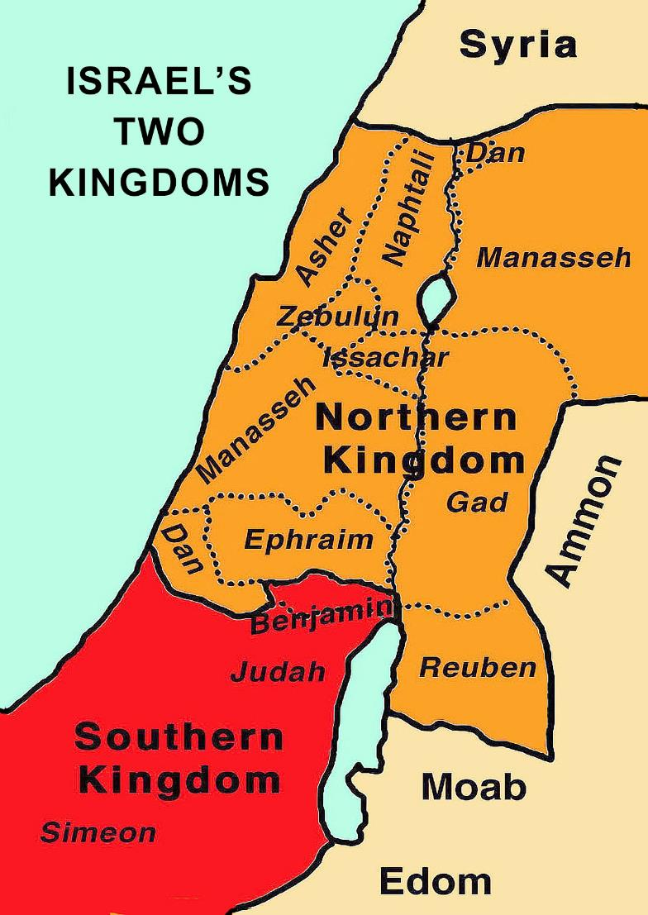
9. The United Kingdom
1 Samuel 10 – 1 Kings 11
Parallel: 1 Chronicles 10 – 2 Chronicles 9
Israel’s Three Great Kings
Saul
David
Solomon
David lived approximately 1,000 years before Christ was born.

Slide 40
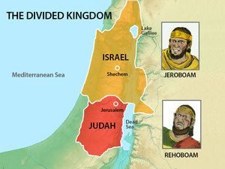
10. The Divided Kingdom
1 Kings 12 – 2 Kings 17
Parallel: 2 Chronicles 10-29
Israel in the North
Judah in the South
Period lasts 200 years until Israel in the North is taken away into Assyrian captivity
Obadiah, Joel, Amos, Hosea, Isaiah, and Micah prophesy
Isaiah continues into the time of Judah alone.

Slide 41
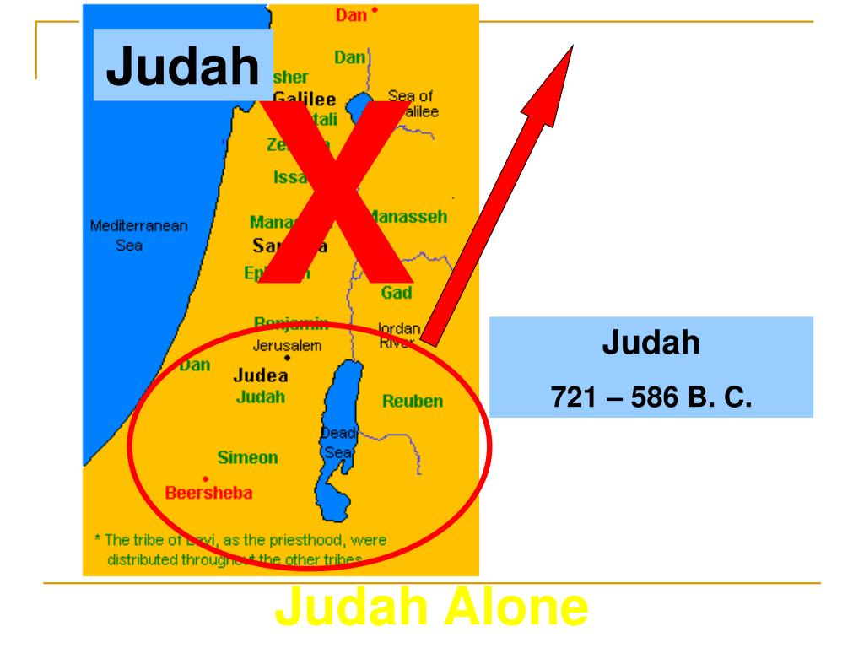
11. Judah Alone
2 Kings 18-25
Parallel: 2 Chronicles 29-36
Kings: Hezekiah, Manasseh, Josiah
Prophets: Zephaniah, Jeremiah, Habakkuk, Nahum

Slide 42
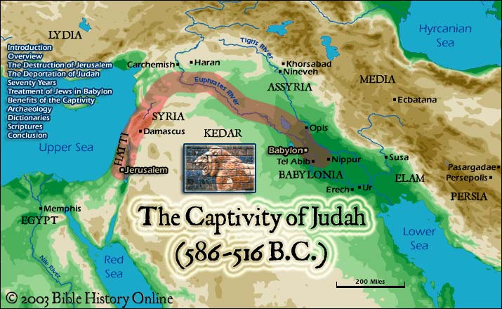
12. The Captivity
2 Kings 24
Parallel: 2 Chronicles 36
Lasted 70 years.
Prophets
Daniel
Ezekiel

Slide 43
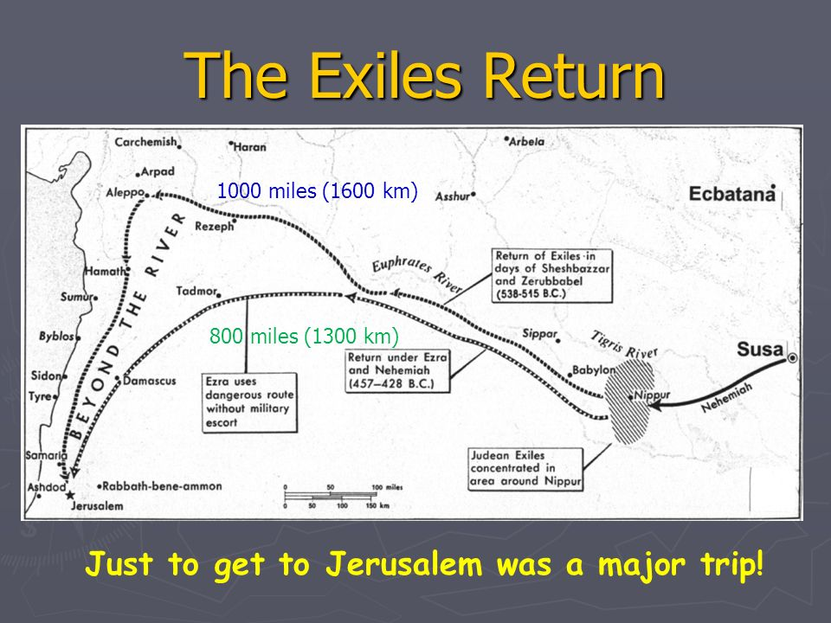
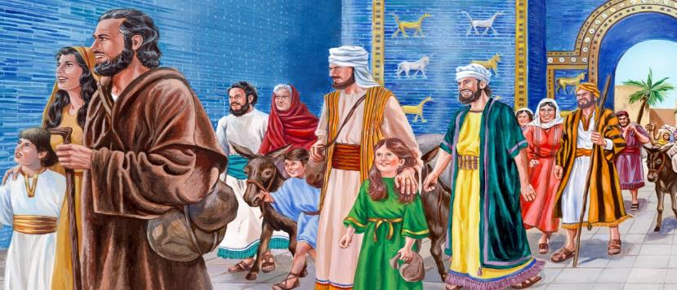
13. Return From Captivity
1st Return
Ezra 1-6 – 536 BC
Under Zerubbabel and Jeshua (High Priest)
They rebuild the temple.
Haggai and Zechariah: Prophecy at the same time.
Esther – Story of Esther comes between Ezra 6 & 7
2nd Return
Ezra 7-10 – 458 BC
Nehemiah: 445 BC – Rebuild the walls of Jerusalem
Malachi : The period ends with this book!

Slide 44
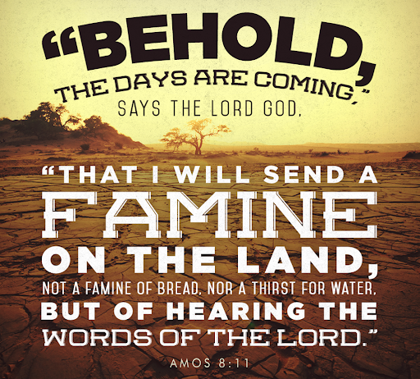
14. Years of Silence
400 years of silence
(No scriptures)
Period between the OT and NT.

Slide 45
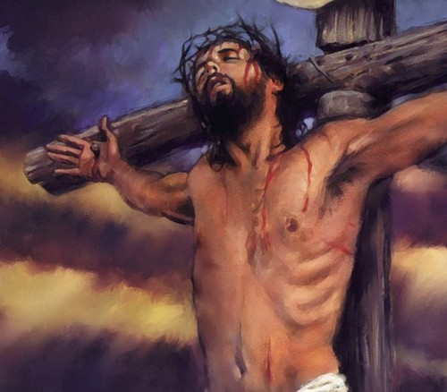

15. Life of Christ
Years of Preparation
Beginning of His ministry
Great Galilean Ministry
Periods of Retirement
Close of His ministry
Last Week
Resurrection Days
The Gospels
Matthew – Mark – Luke - John

Slide 46
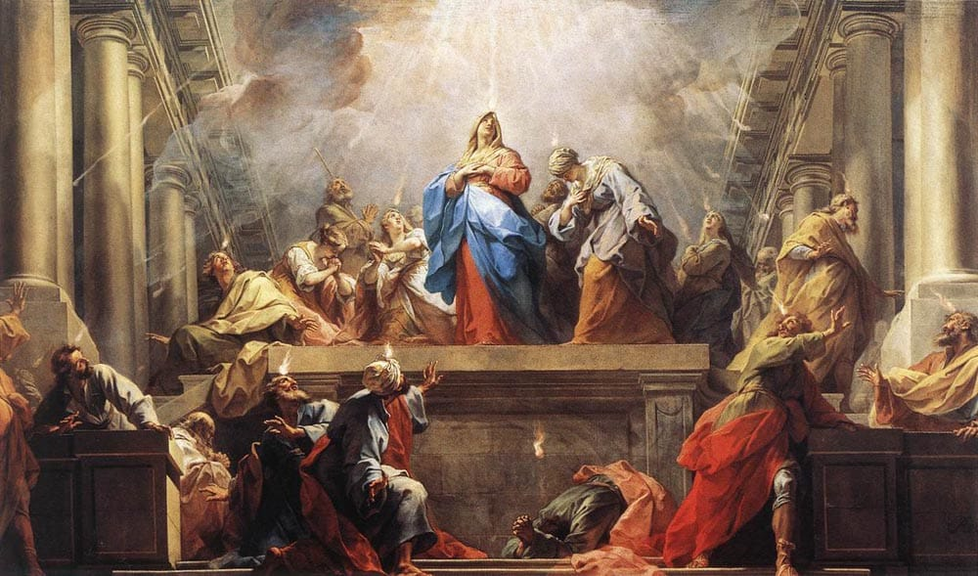
16. Early Church
Acts 1-12
Primarily the work in Jerusalem, Palestine, and the eastern end of the Mediterranean.
Covers about 15 years
Acts 13-28
Primarily the work of Paul
The spread of the Gospel into all of the Roman Empire.
Covers about 15 years.

Slide 47
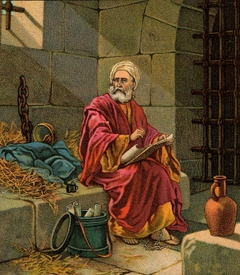
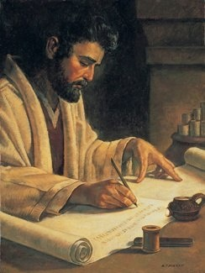
17. Letters to Christians
Includes all of the Epistles and Revelation because all of these were written to Christians.
Six of these were written during the time period of Acts:
1 and 2 Thessalonians
Galatians
1 and 2 Corinthians
Romans

Slide 48
Periods of bible history
Before the Flood
The Flood
The Scattering of the People
The Patriarchs
The Exodus
Wandering in the Wilderness
Invasion and Conquering
The Judges
The United Kingdom
The Divided Kingdom
Judah Alone
The Captivity
Return from Captivity
Years of Silence
Life of Christ
Early Church
Letters to Christians

Slide 49
Fourth Cycle –
A Lifetime of study
“Thanks be to God for His indescribable gift.”
(2 Corinthians 9:15)

Slide 50
Periods of bible history
Before the Flood
The Flood
The Scattering of the People
The Patriarchs
The Exodus
Wandering in the Wilderness
Invasion and Conquering
The Judges
The United Kingdom
The Divided Kingdom
Judah Alone
The Captivity
Return from Captivity
Years of Silence
Life of Christ
Early Church
Letters to Christians

Slide 51
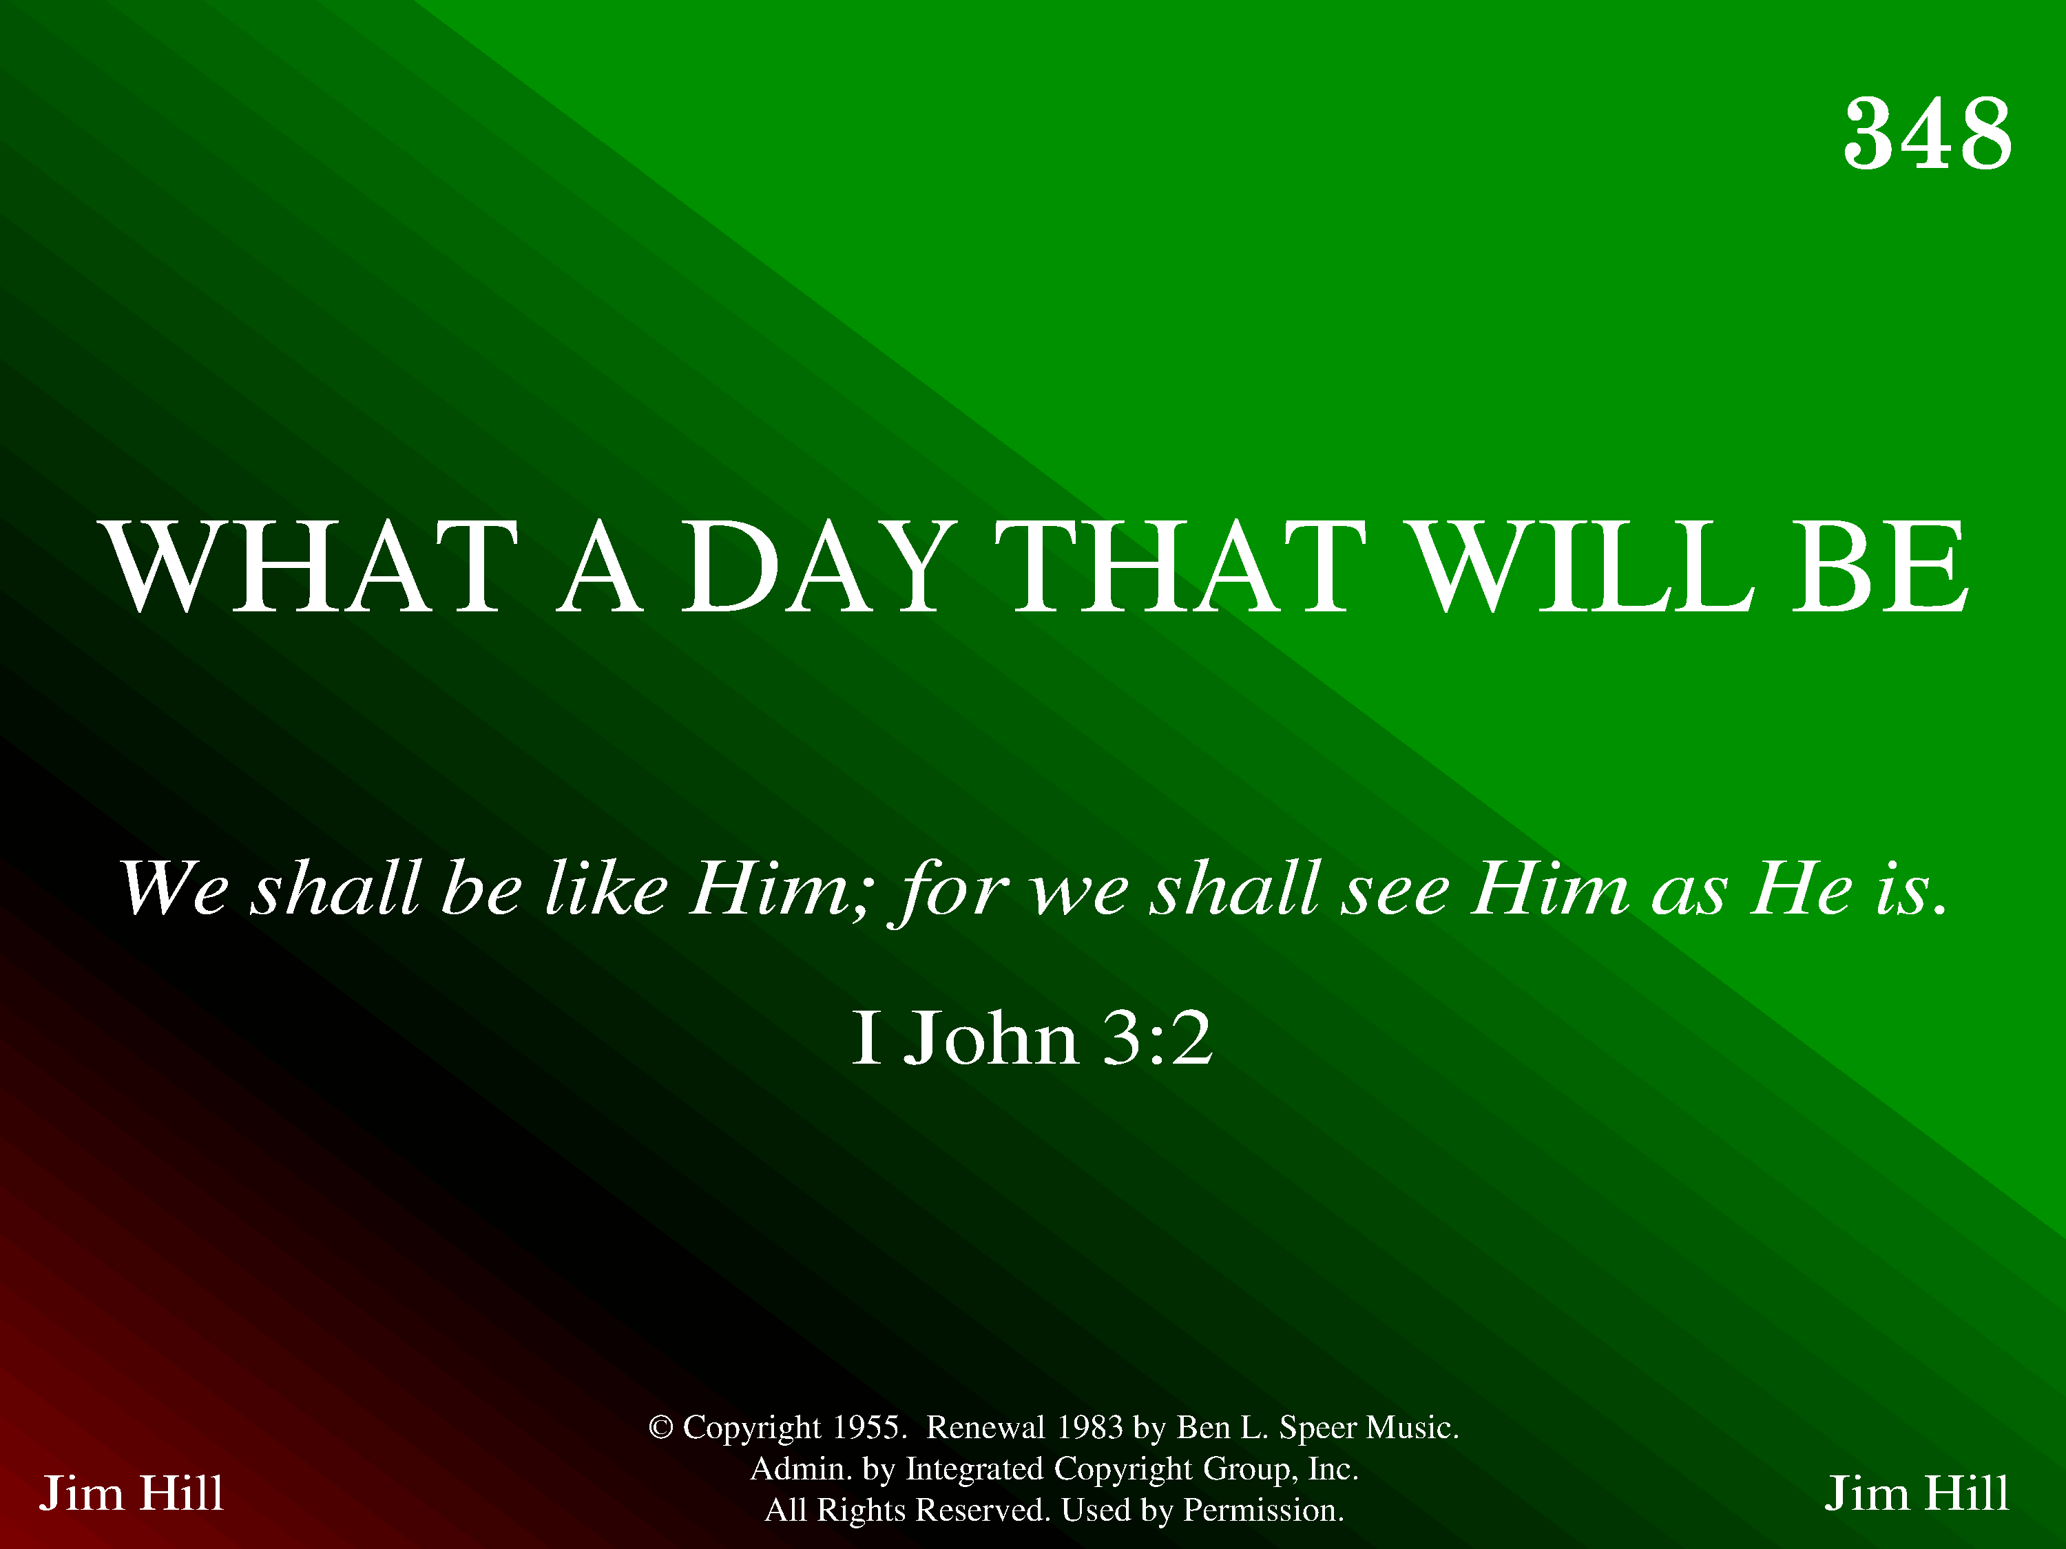
20348 - WHAT A DAY THAT WILL BE - Title

Slide 52
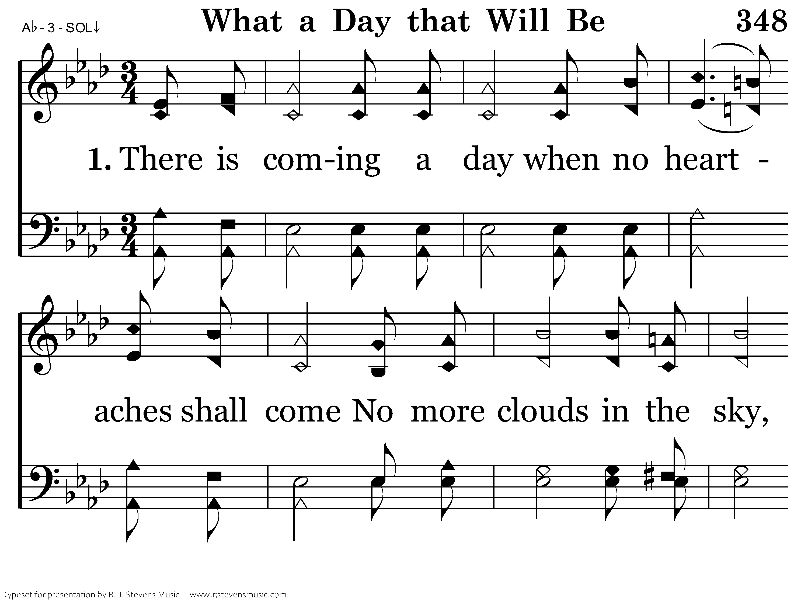
20348 - WHAT A DAY THAT WILL BE - 1.1

Slide 53
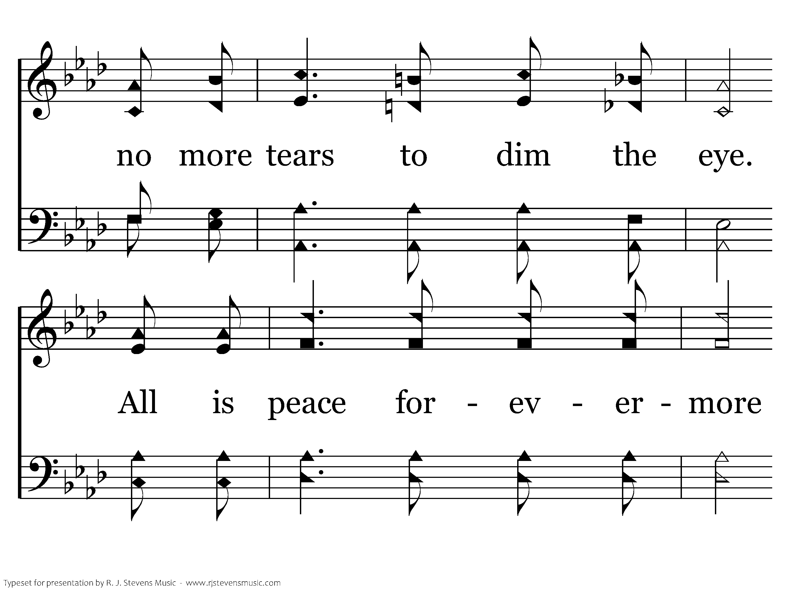
20348 - WHAT A DAY THAT WILL BE - 1.2

Slide 54
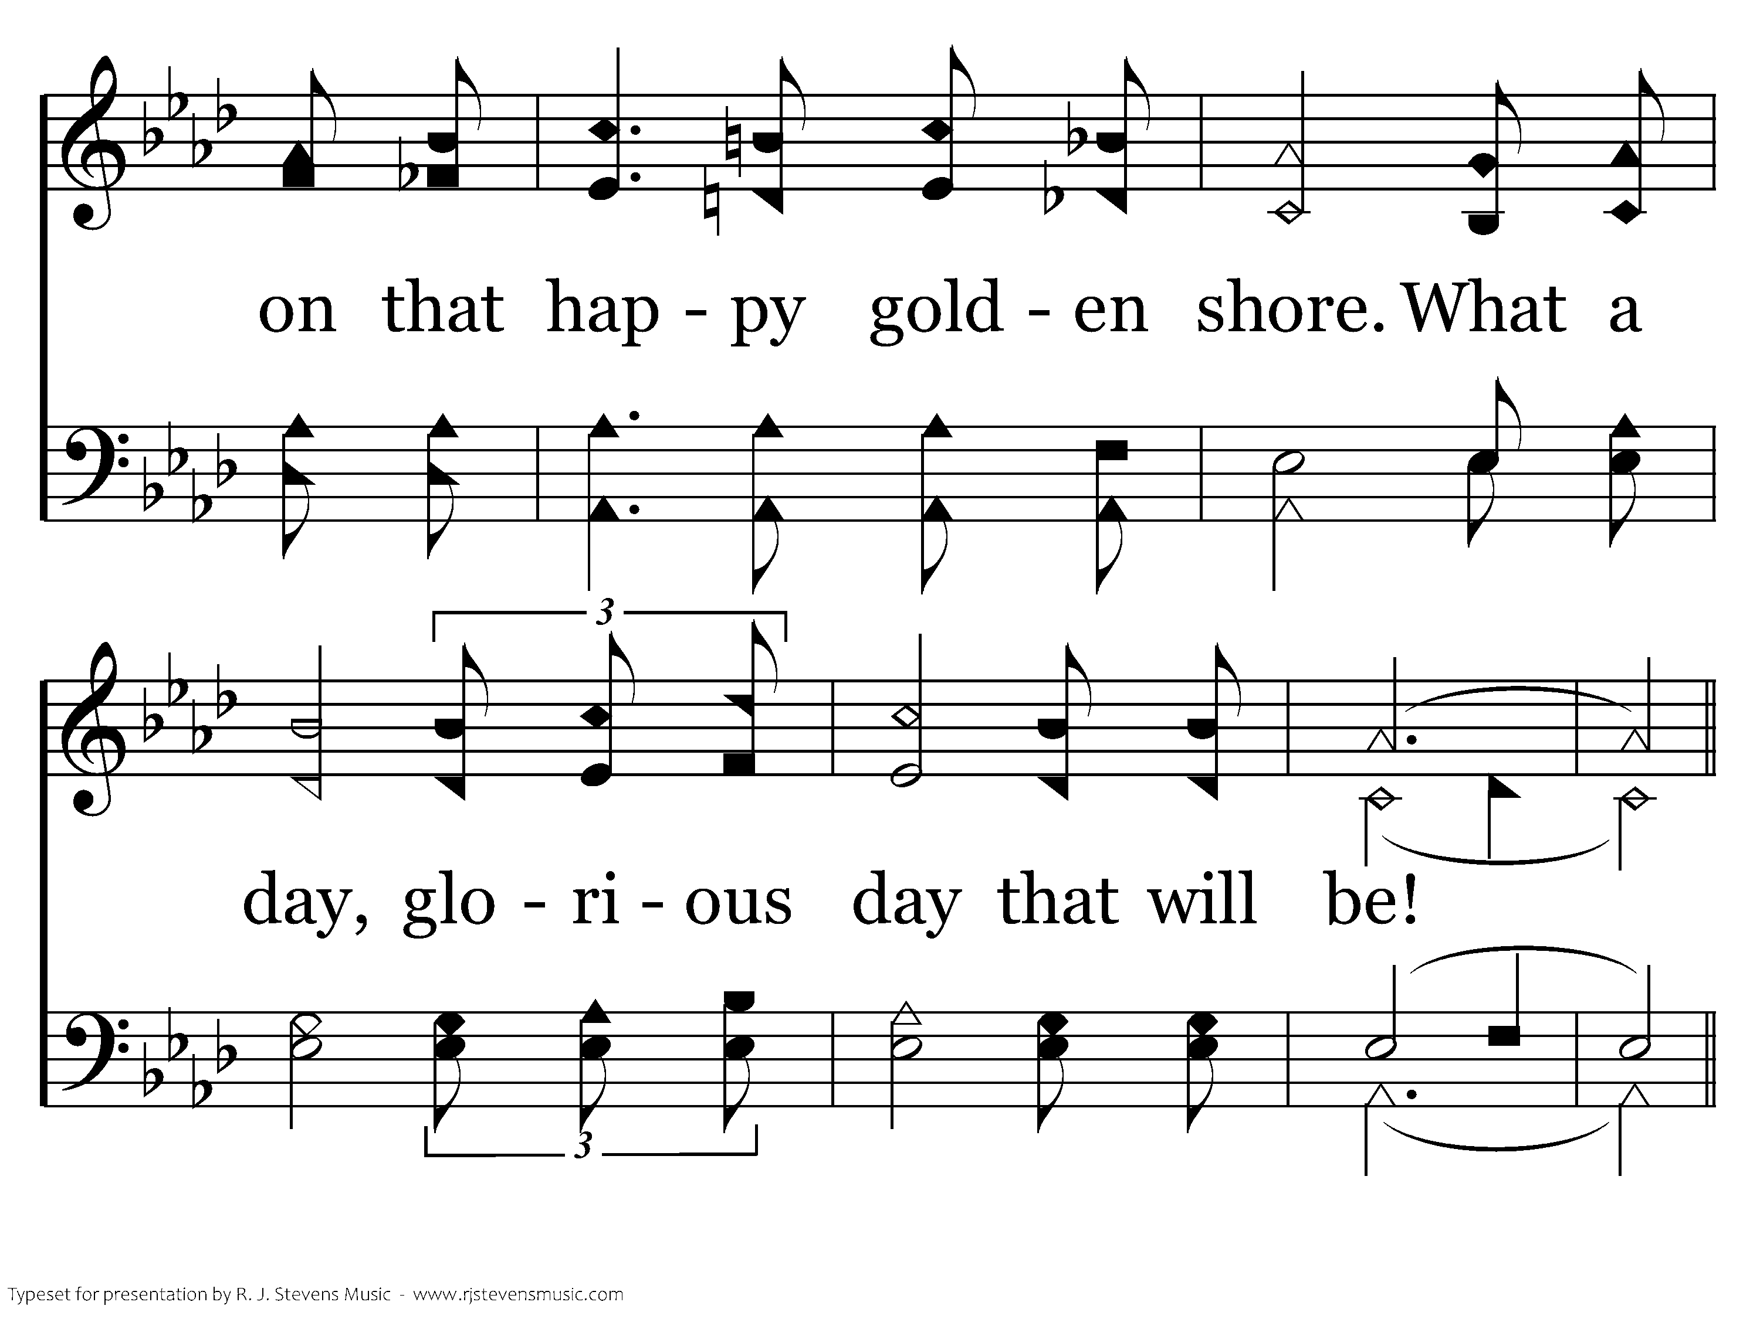
20348 - WHAT A DAY THAT WILL BE - 1.3

Slide 55
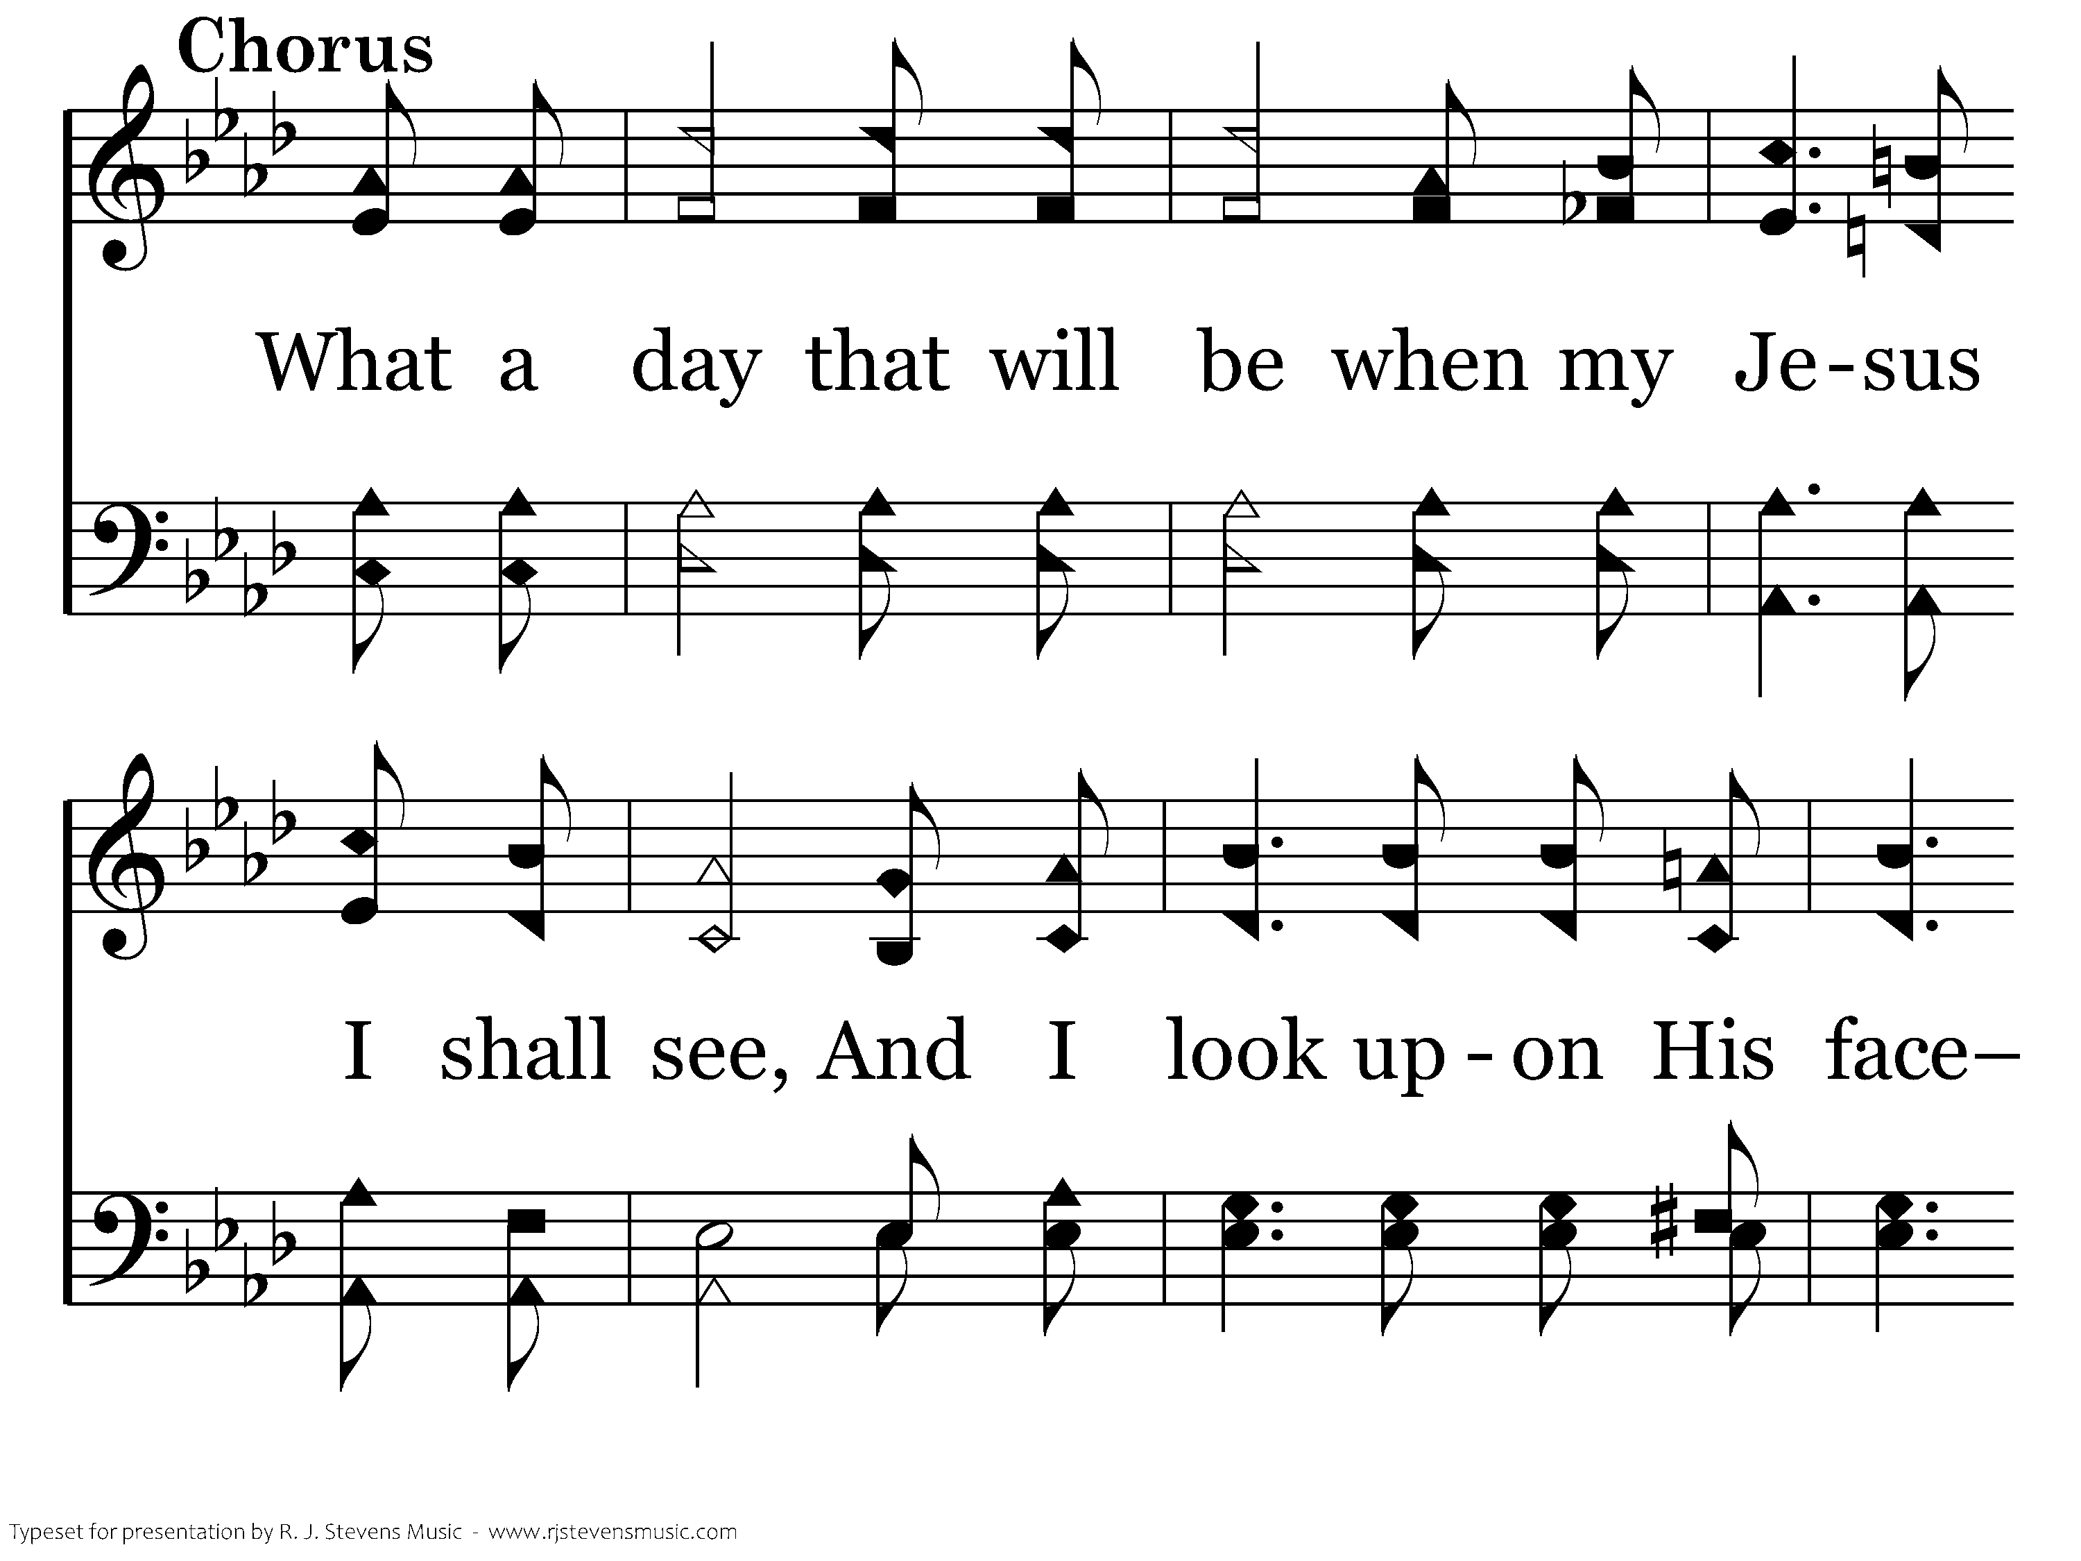
20348 - WHAT A DAY THAT WILL BE - C.1

Slide 56
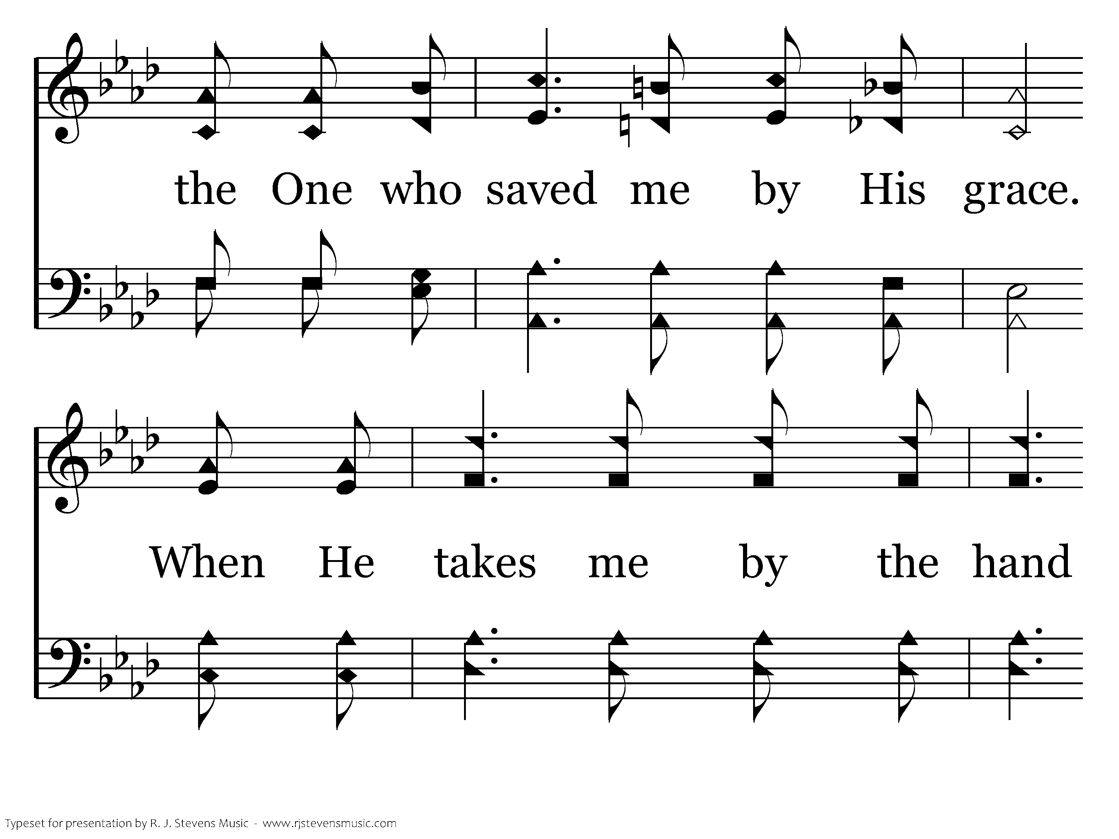
20348 - WHAT A DAY THAT WILL BE - C.2

Slide 57
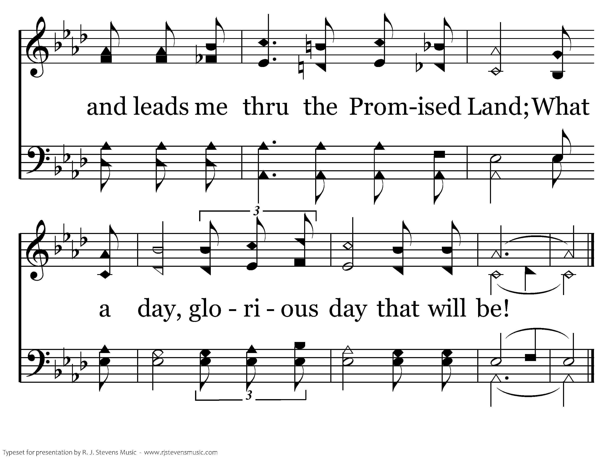
20348 - WHAT A DAY THAT WILL BE - C.3
End of Verse 1

Slide 58
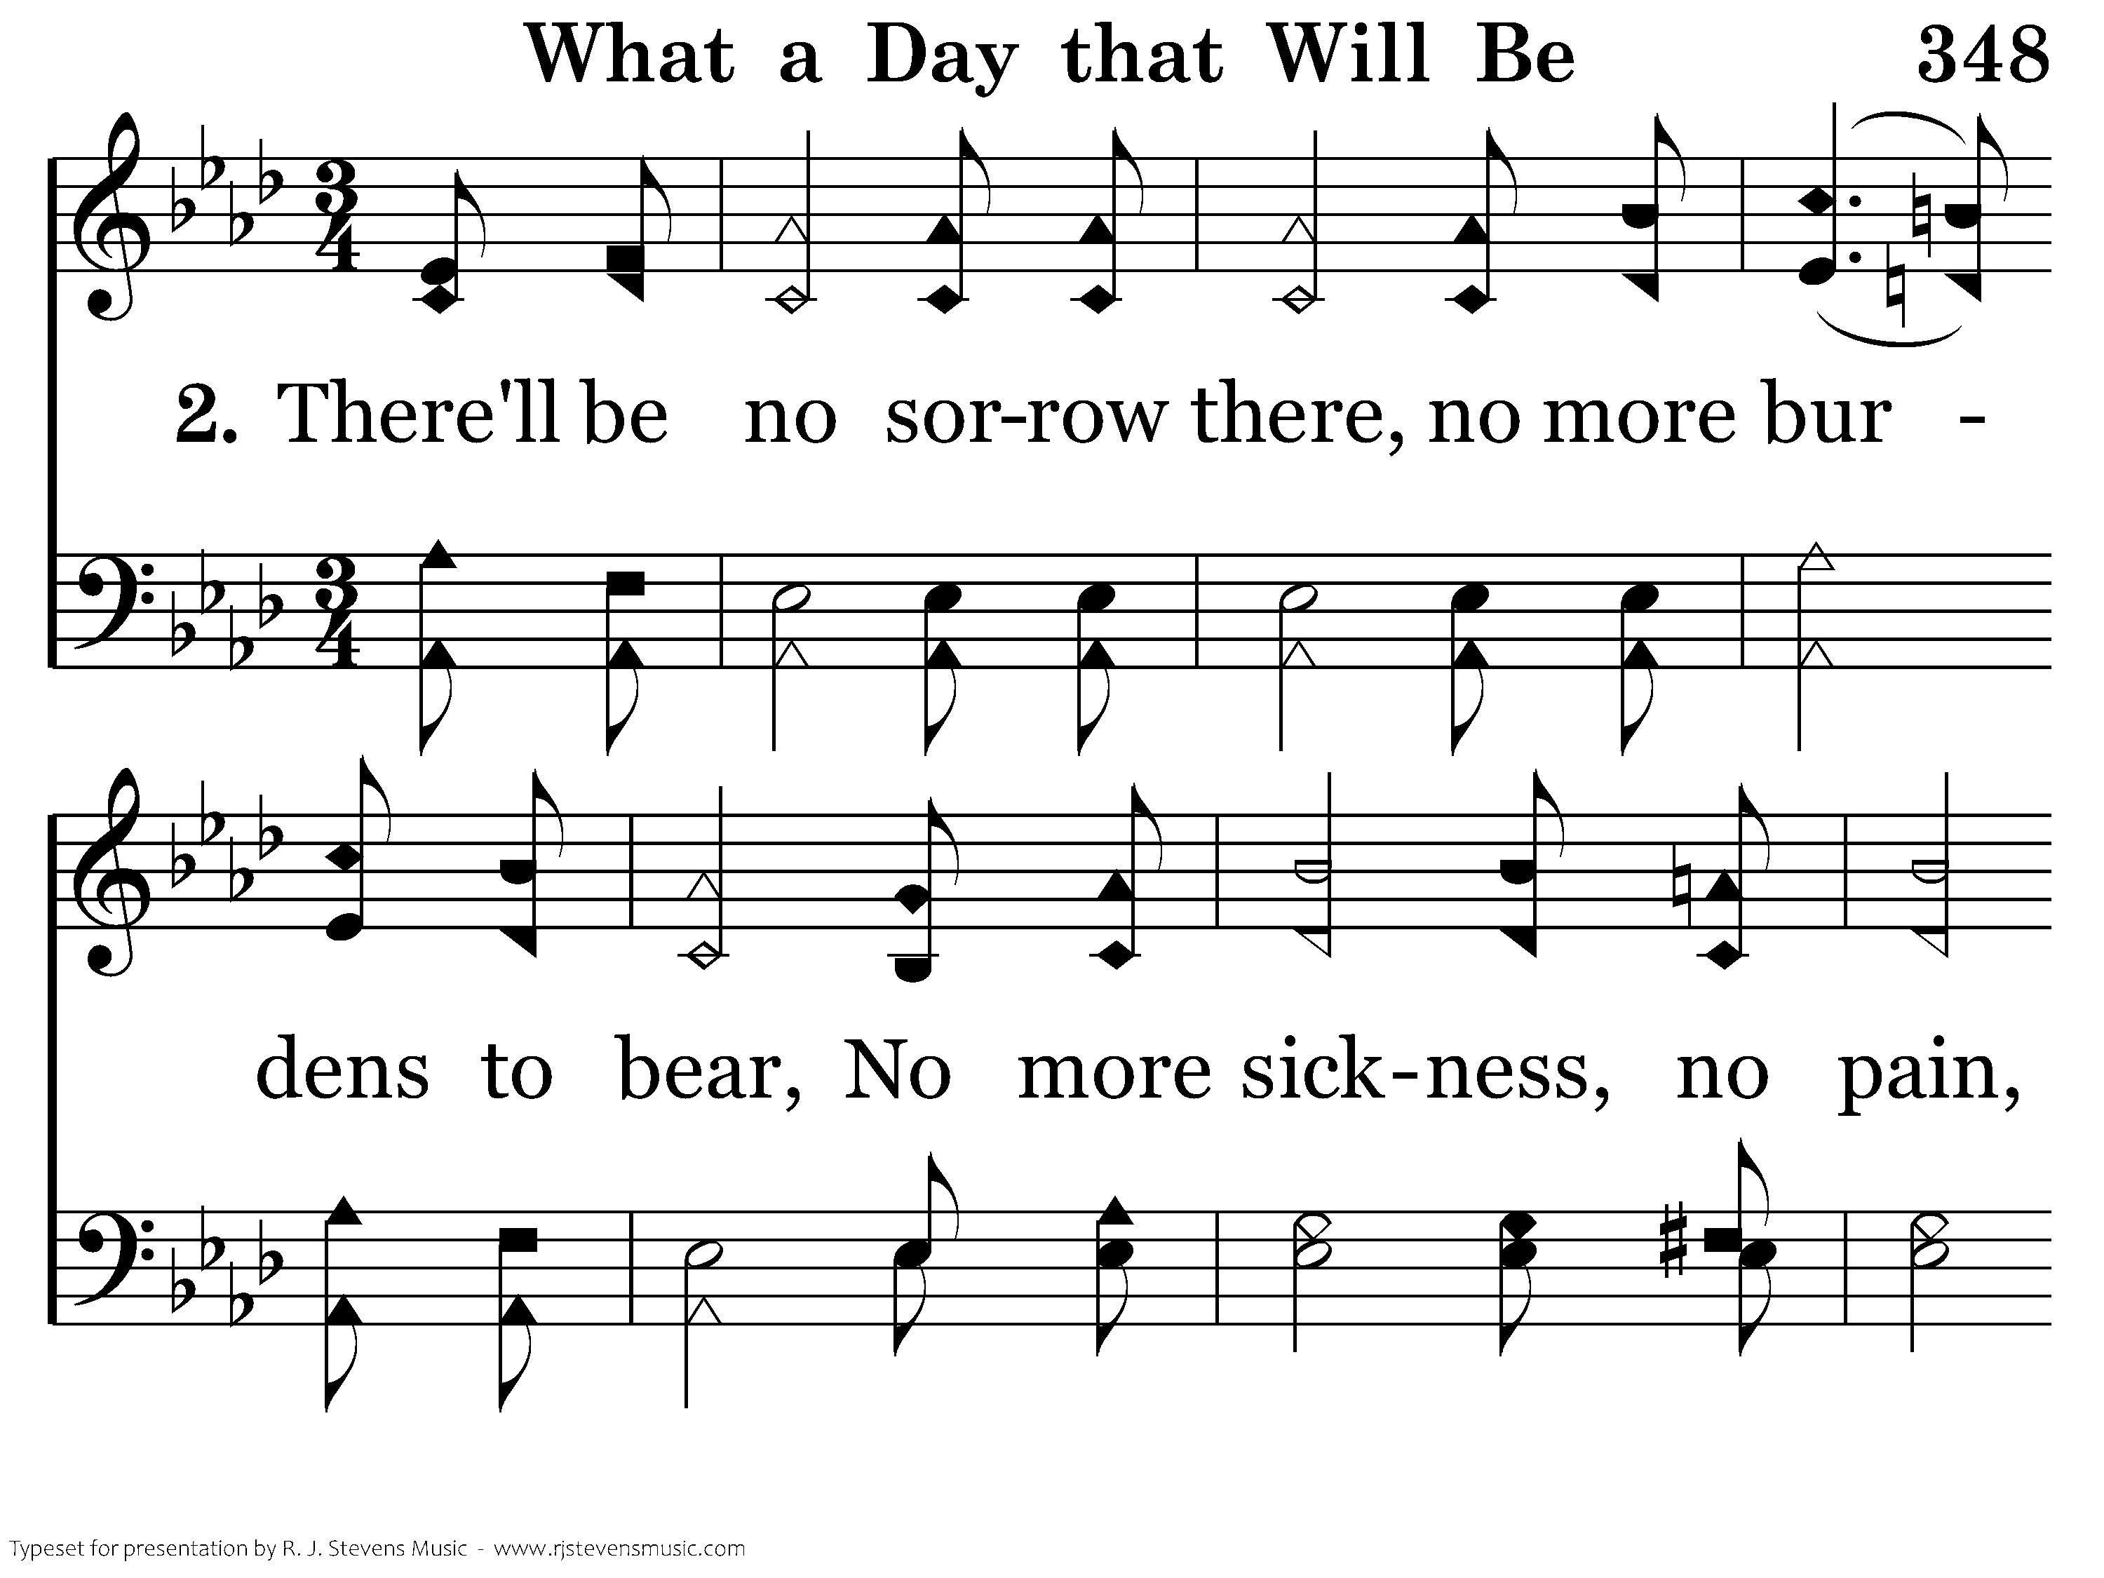
20348 - WHAT A DAY THAT WILL BE - 2.1

Slide 59

20348 - WHAT A DAY THAT WILL BE - 2.2

Slide 60

20348 - WHAT A DAY THAT WILL BE - 2.3

Slide 61
20348 - WHAT A DAY THAT WILL BE - C.1

Slide 62
20348 - WHAT A DAY THAT WILL BE - C.2

Slide 63
20348 - WHAT A DAY THAT WILL BE - C.3
End of Song

